Slide 1
MongoDB CRUD operations

Slide 2
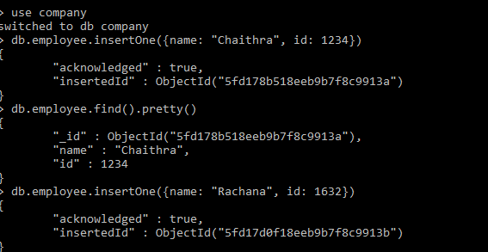
Create database → use databasename (use company) Create collection and insertion of data → db.employee.insertOne({name: "Chaithra", id: 1234}) To fetch the data →find().. & pretty().. db.employee.find().pretty()

Slide 3
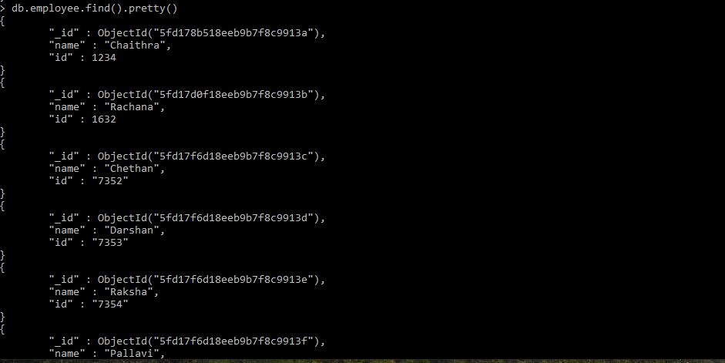
To print all data-> db.employee.find().pretty()

Slide 4
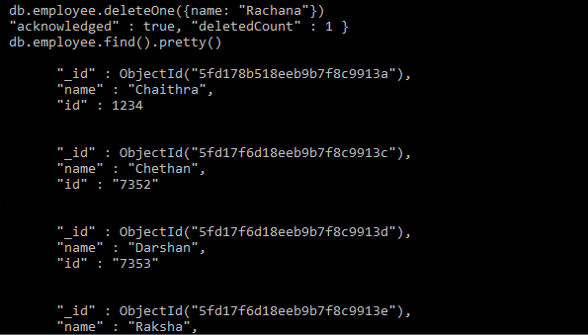
To delete one set of data based on condition: db.employee.deleteOne({name: "Rachana"})

Slide 5

To delete all data: db.employee.deleteMany({})

Slide 6
To update one set of data based on condition: db.employee.updateOne({name: "Pallavi"}, {$set: {salary: 30000}})

Slide 7
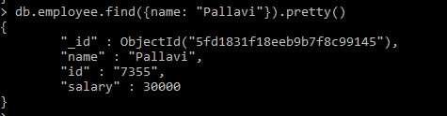
To print particular data based on condition.

Slide 8
Update operation: adding data to particular element: db.employee.updateOne({name: "Chethan"},{$set: {skills:["JAVA","SQL"]}})

Slide 9
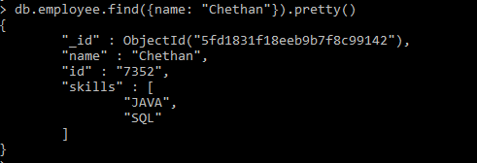
Fetching the data : db.employee.find({name: "Chethan"}).pretty()

Slide 10
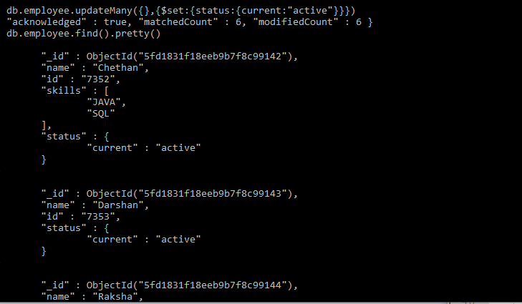
Update operation: To update all data: db.employee.updateMany({},{$set:{status:{current:"active"}}}) db.employee.find().pretty()

Slide 11
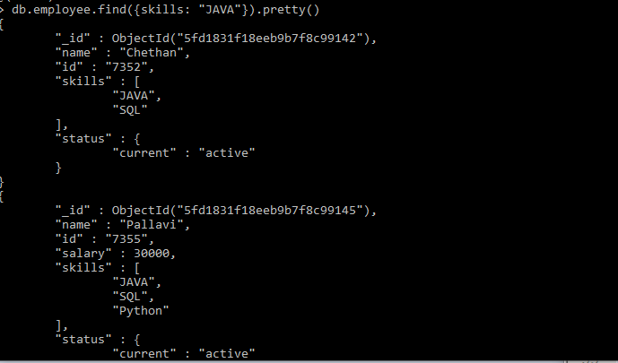
To fetch data: db.employee.find({skills: "JAVA"}).pretty()

