Slide 1
Mongo db relations

Slide 2
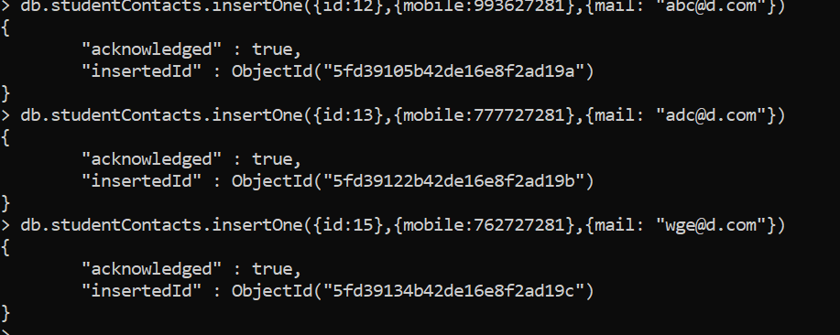
Student – Contact Details
1:1 relation

Slide 3
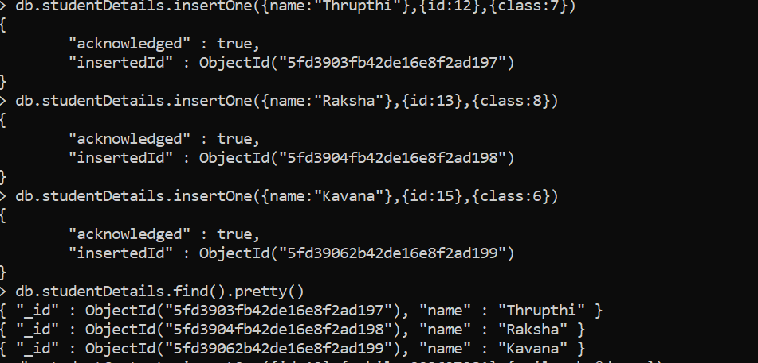

Slide 4
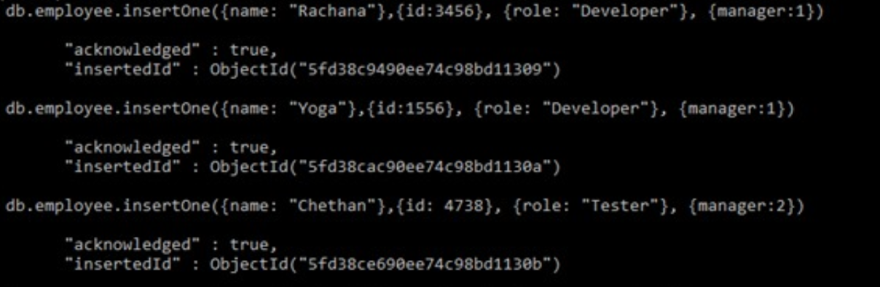
Employee – manager one – many relation

Slide 5
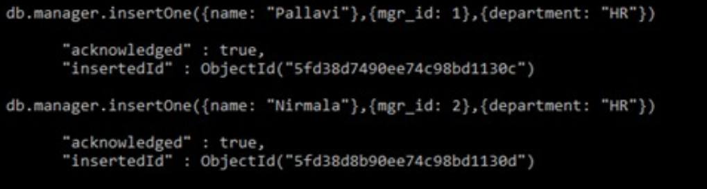

Slide 6
Student - course many : many relation

Slide 7
