Slide 1
Health Care Data Analysis Based On Heart Stroke Using Hadoop and Hive
Developed By : Chaithra Sai Gudimalla

Slide 2
Features Of Dataset:
This main aim of this project is to analyze the data of patients who are facing problems with Hypertension , Heart Disease and Stroke.
As we all know that now-a-days small children are also having heart diseases right from their birth.
There can be many reasons when a person is affected with heart problems like:
Work Tensions
The place they live rural or urban (Air pollution, Sound pollution)
The Sugar Levels
Their Body Mass Index
Their smoking status

Slide 3
Requirements for Analysis:
In this project I took Health Care dataset of various patients based on features like bmi , workType , age , glucose levels , smoking status.
Using the GUI of Ambari I have uploaded the file into hdfs.
Then I loaded the file into a table which was created in hive.
After importing file into the table in hive, I performed some queries to analyze the data.
I took the output of the queries and exported them into HDFS.

Slide 4
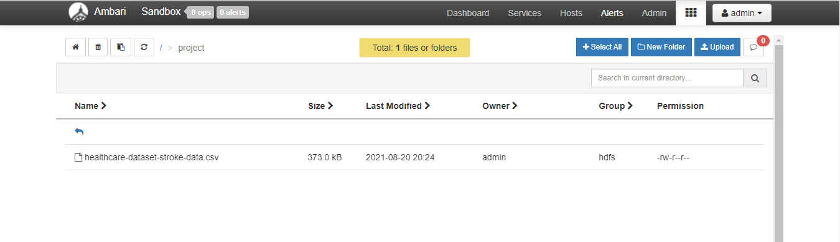
Used Ambari GUI to uplaod the file into HDFS

Slide 5
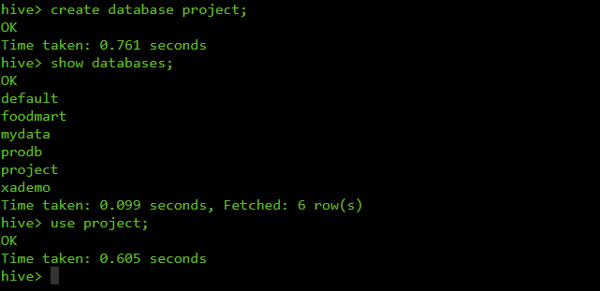
Creating Database in hive Command : create database databasename;

Slide 6
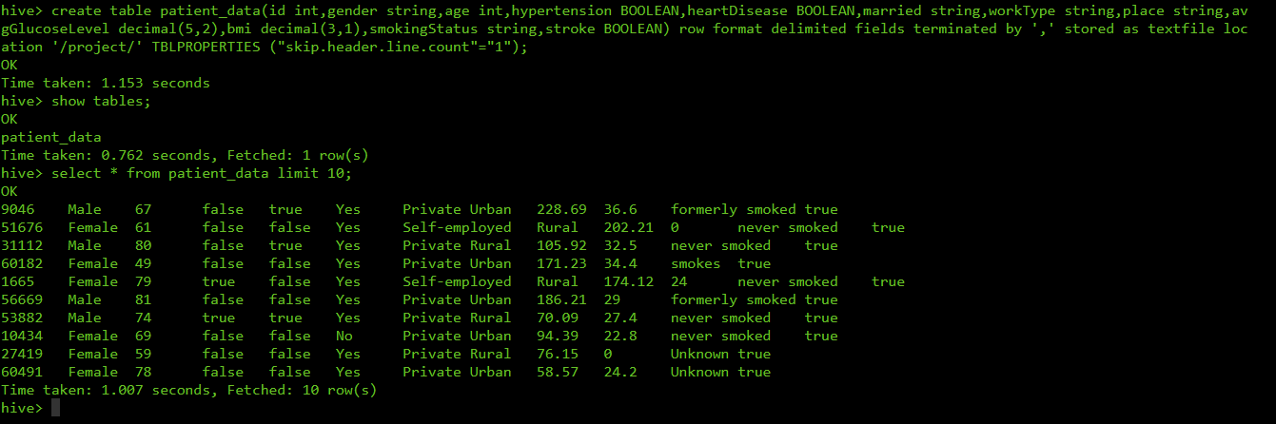
Creating table in database ‘project’ in hive command : create table patient_data( id int,gender string,age int,hypertension BOOLEAN,heartDisease BOOLEAN,married string,workType string,place string,avgGlucoseLevel decimal(5,2),bmi decimal(3,1),smokingStatus string, stroke BOOLEAN) row format delimited fields terminated by ‘,’ stored as textfile location ‘/project/’ TBLPROPERTIES (“skip.header.line.count”=“1”); To Verify : select * from patient_data limit 10;

Slide 7
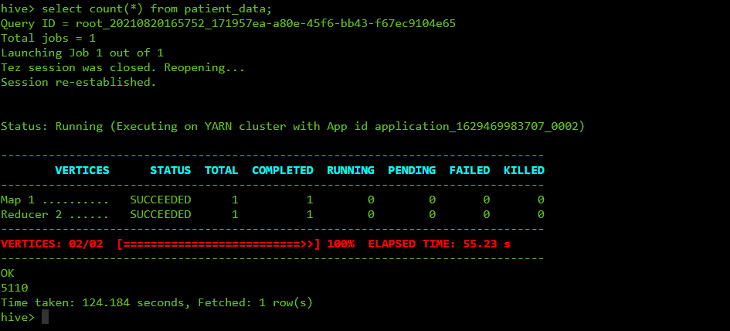
To get the total number of records in the dataset Command : select count(*) from patient_data;

Slide 8
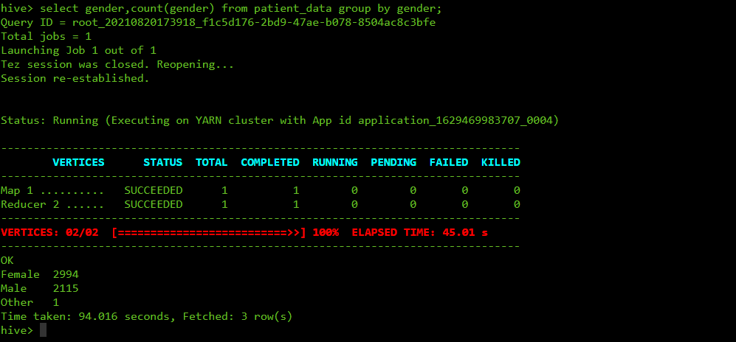
To get the count of female,male and other records in the dataset

Slide 9
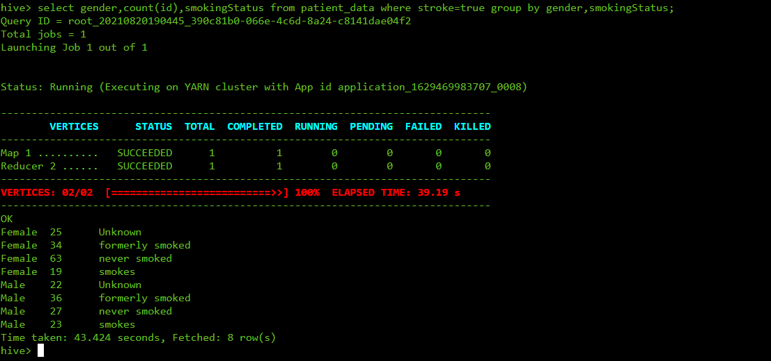
To get the count of patients based on gender and their smoking status who got stroke

Slide 10
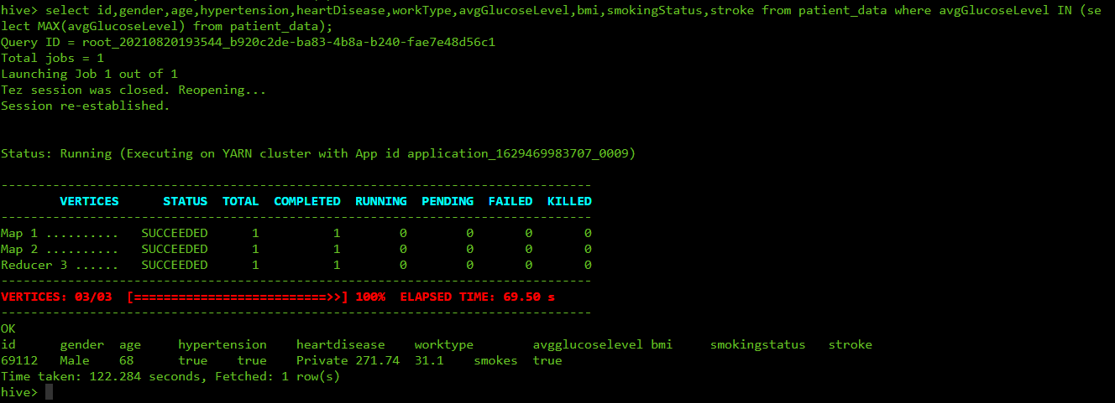
To get the details of patient who is having high average glucose levels

Slide 11
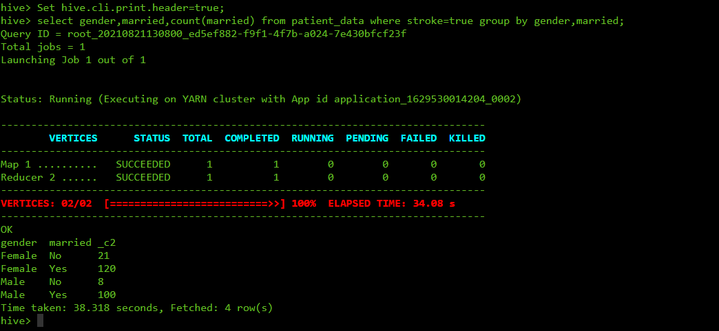
To get the count of patients who got stroke based on their gender and their marrital status

Slide 12
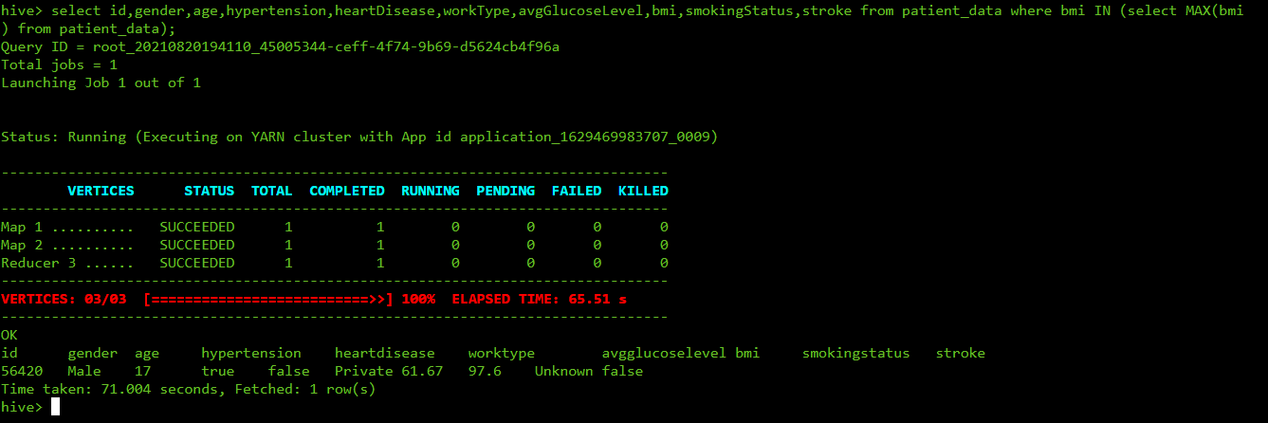
To get the patient data who is having high body mass index

Slide 13
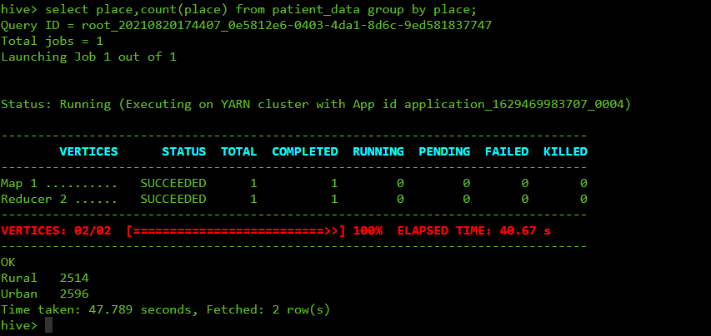
To get the count of patients based on place

Slide 14
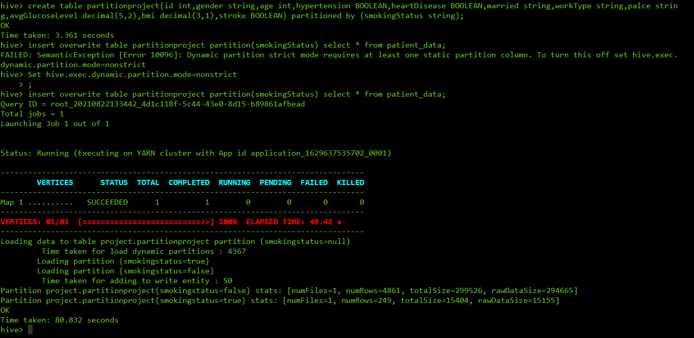
Partitioning table on the basis of smoking status

Slide 15
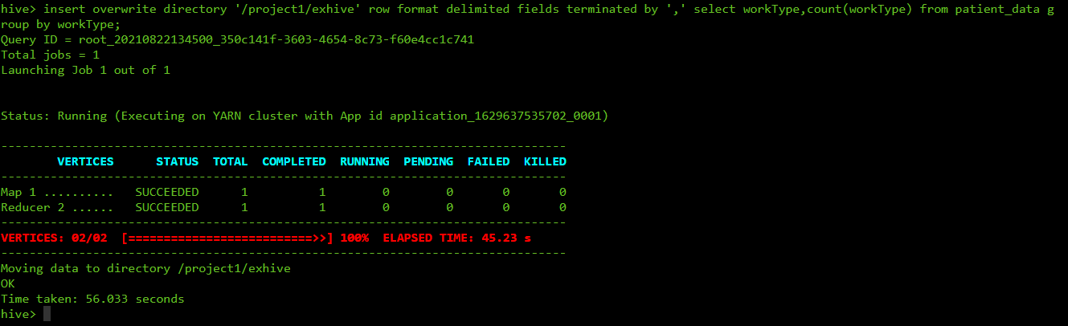
Copying output of the query into hdfs

Slide 16
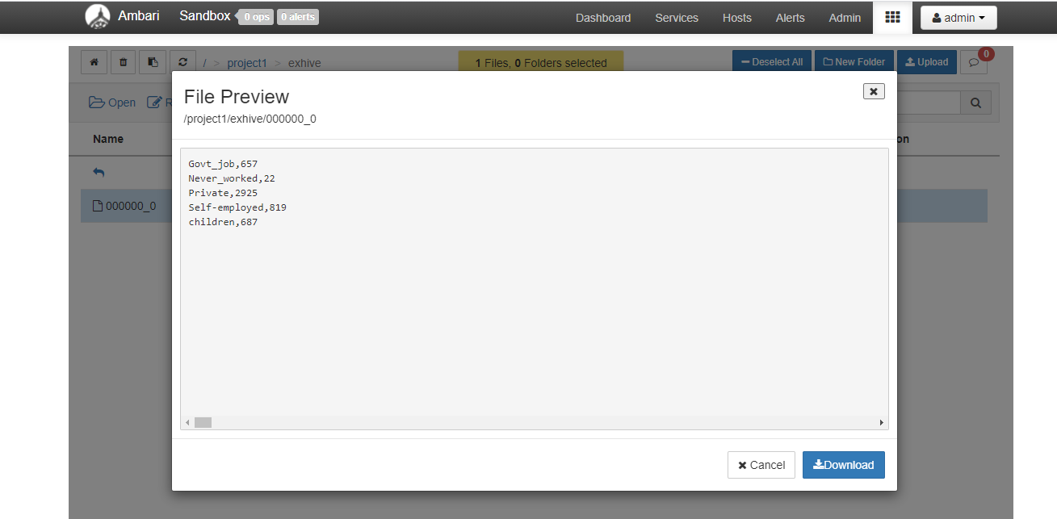
Loaded data into ambari

