Slide 1


Hotel Booking Cancellation
Chaitanya Kanupareddi
Ruchak Vira
Shourya Goel
Vinit Horakeri
Chaithra Kopparam Cheluvaiah

Slide 2
GOAL
Exploring all parameters of hotel data
Derive relationship and correlation between columns
Interpret actionable insight for improving hotel booking – reduce cancellations

Slide 3
APPROACH
Exploring data statistically
Exploratory Data Analysis
Creating model to predict reasons for hotel booking failure by
Building model with best parameters
Understanding significant predictors
Threshold for error acceptance
Visualizing data to identify most important features
Exploring categorical data using Bar charts, Histograms, Box Plot

Slide 4
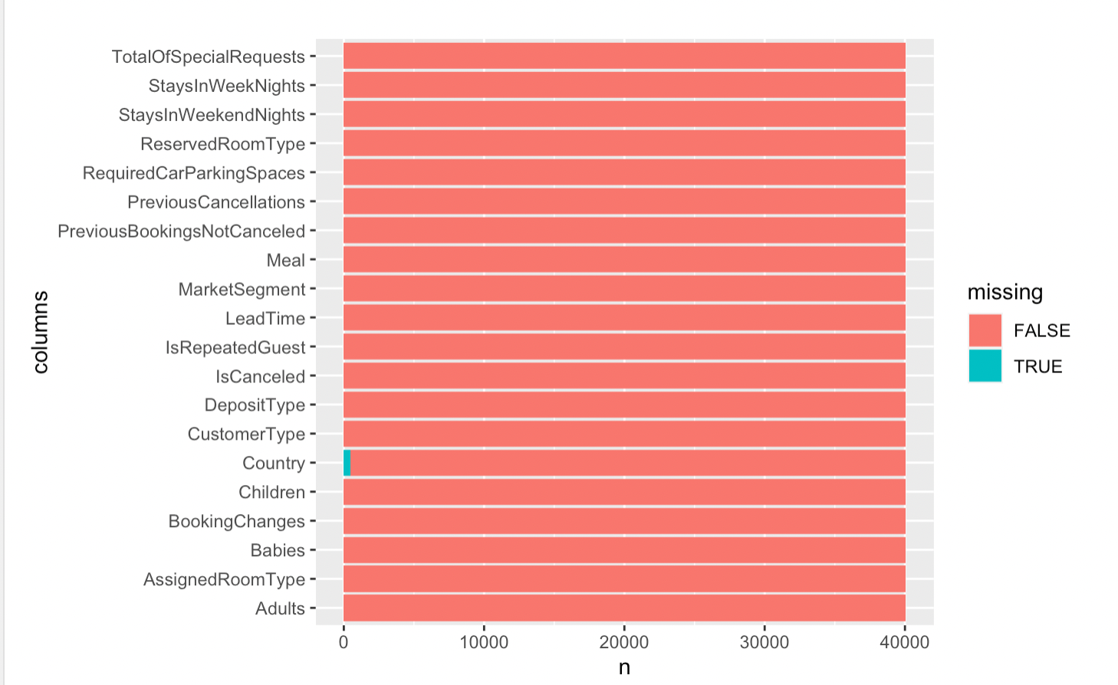
EXPLORATORY DATA ANALYSIS(EDA)
Country unknown for 464 bookings

Slide 5
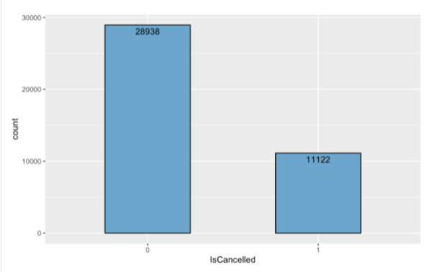
EDA (Insight 1)
Total count of canceled(1) and not cancelled(0) bookings

Slide 6
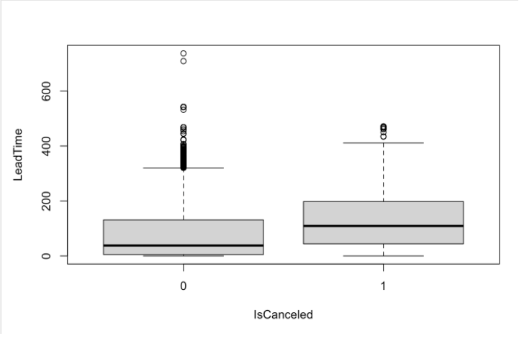
EDA (Insight 2)
The earlier the booking made, higher the chances of cancellation

Slide 7
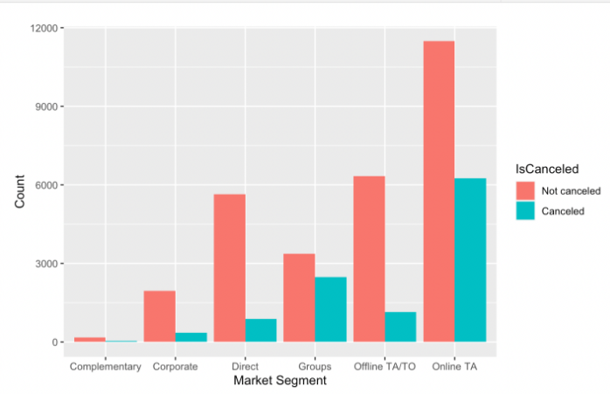
EDA (Insight 3)
Bookings made through online travel agents have more cancellation

Slide 8
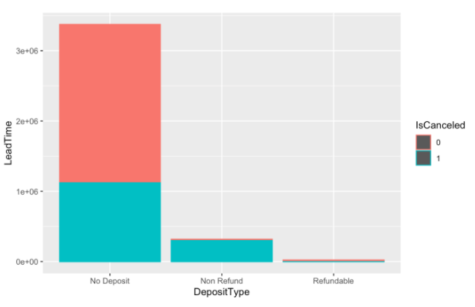
EDA (Insight 4)
When people are being offered no deposits for their booking there is an increase in bookings where in the other cases there is a higher rate of cancellations.

Slide 9
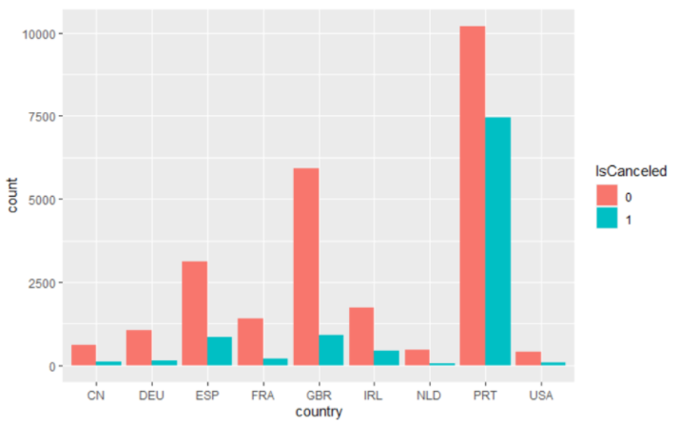
EDA (Insight 5)
Portugal has highest booking cancellation

Slide 10
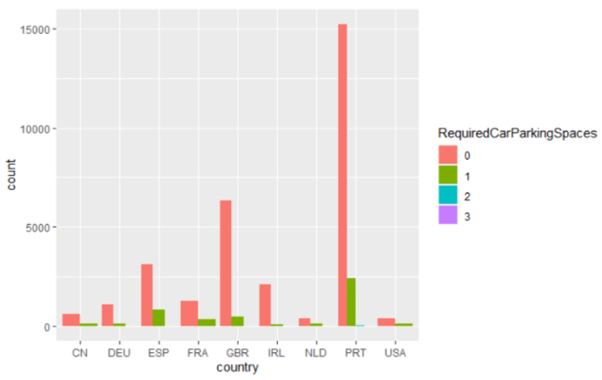
EDA (Insight 6)
There is no car parking required spaces as well in Portugal.

Slide 11
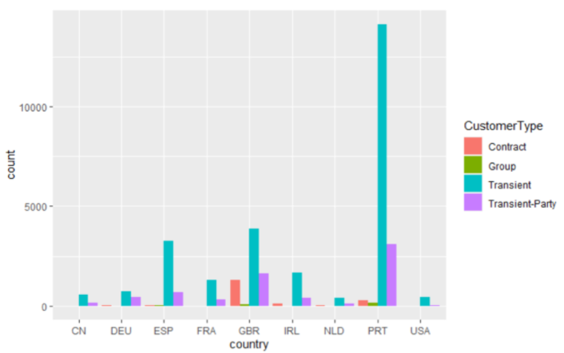
EDA (CONTINUED)
Most of the bookings are transient, that is booked for a brief period or booked just before arrival. This may be the reason there are no car parking spaces.

Slide 12
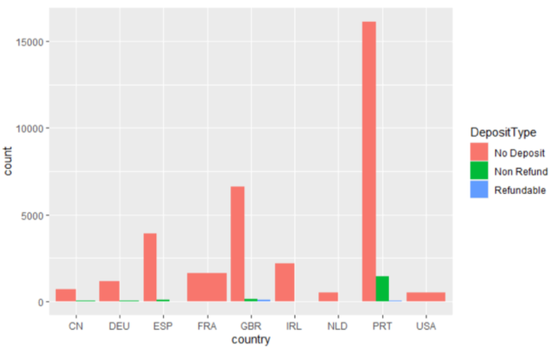
EDA (CONTINUED)
There are no deposits being collected in Portugal, this could lead to random booking and cancelling as there is no loss for customers

Slide 13
TOP 5 FEATURES CONTRIBUTING TO BOOKING CANCELLATION
Sooner the reservation is made compared to arrival time, the more likely it will be cancelled
Number of car parking space requested by the customer
How was the booking made? Through travel agents, travel operators, directly by customer Groups.
Home country of the customer
Deposit Type (Refundable, Non – Refundable, No deposit) for reserving the room

Slide 14
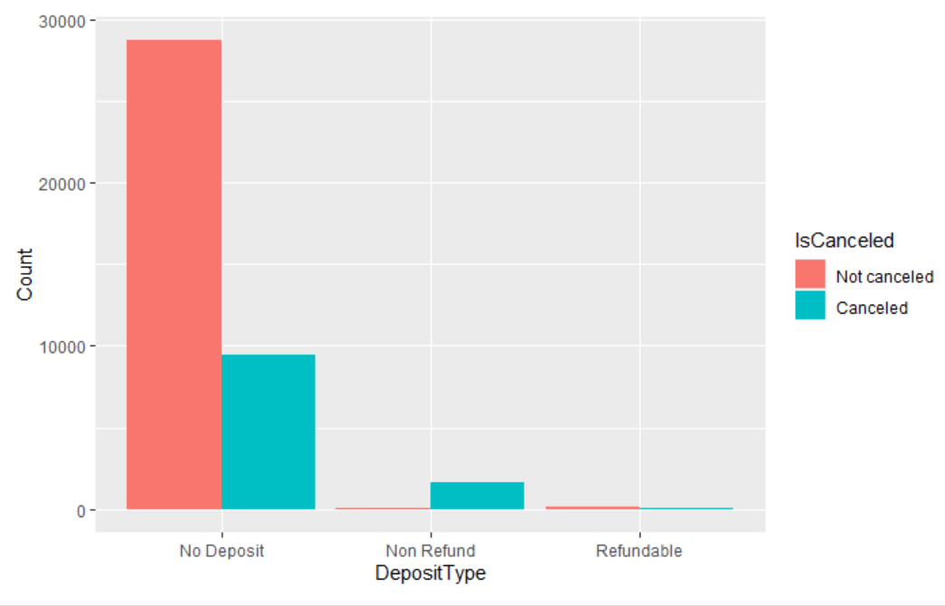
ACTIONABLE INSIGHT 1

Slide 15
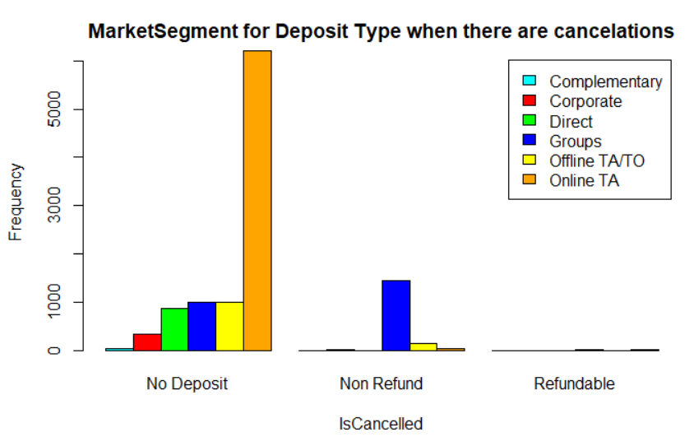

ACTIONABLE INSIGHT 1

Slide 16
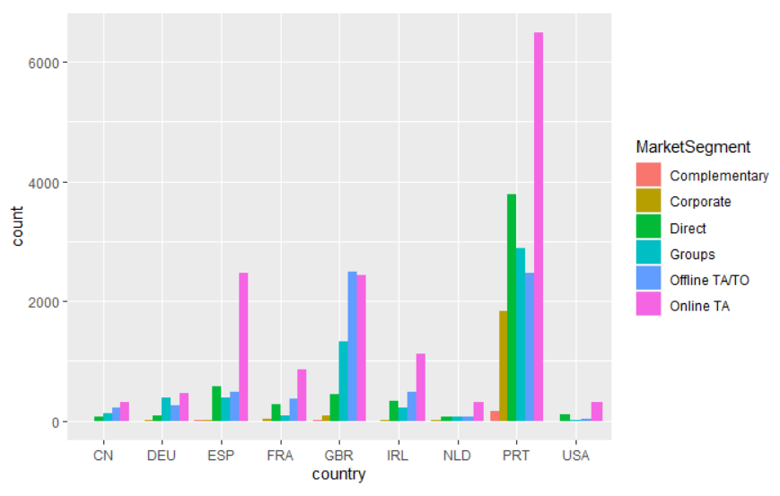
ACTIONABLE INSIGHT 1

Slide 17
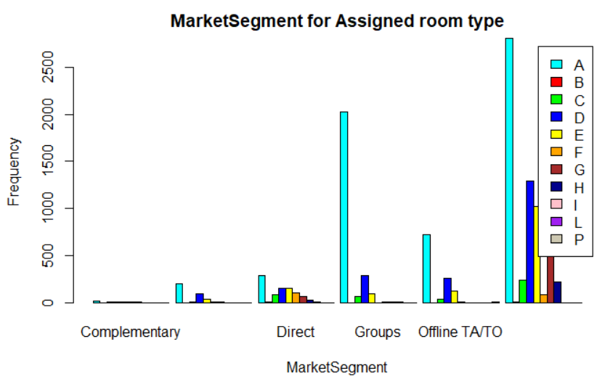
ACTIONABLE INSIGHTS 2

