Slide 1
News Summarization
Generating short length description of news articles
By Chaithra, Megha, Prateek, Reetodeep

Slide 2
Contents Table
Data Pre-processing
Exploratory Data Analysis
Word Embedding
Model and Evaluation
Difficulties and Future Explorations

Slide 3
Data Pre-processing
Handling null values
Lowercase Transformation
Removing HTML tags
Stop words and punctuations removal

Slide 4
Data Preprocessing Outcome
Dataset has 118 null values: Without having news article, we cannot summarize the news. Documents with null values are dropped.
Gone through the common lowercase transformation process to maintain consistency
Removed all the HTML code or URL links
Stop words and punctuations are also removed
Would check spell checker function

Slide 5
Exploratory Data Analysis
Type token ratio (TTR)
Wordcloud
Top 20 bigrams
Top 20 trigrams
Top 20 frequent words

Slide 6
Type Token Ratio (TTR)
Refers to the is the total number of unique words divided by the total number of words in a given segment of text
Higher TTR means High degree of lexical variation
In our case, we got 0.04 TTR score! As expected for news articles.

Slide 7
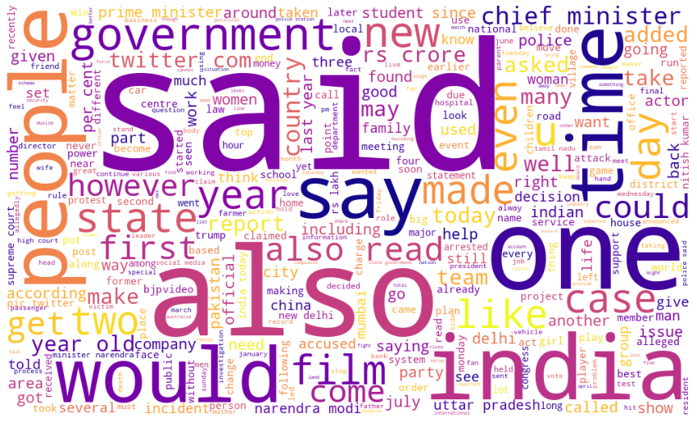
Word Cloud
Said
Would
India
Also
People
One
Time

Slide 8
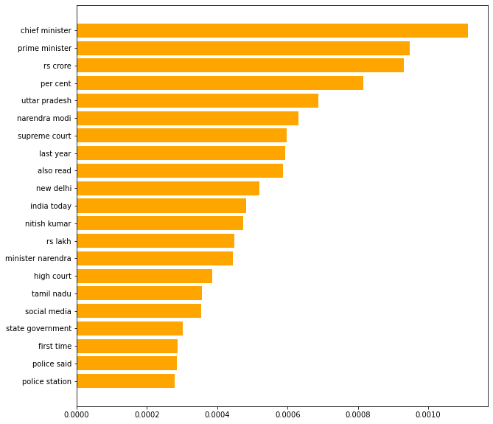
Top 20 bigrams

Slide 9
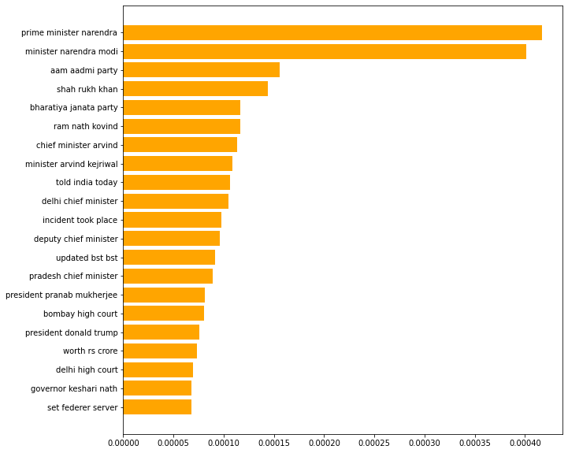
Top 20 trigrams

Slide 10
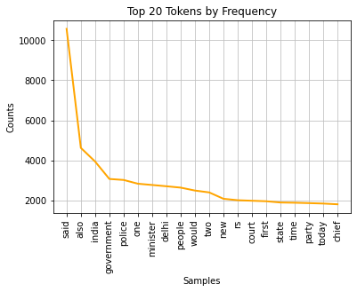
Top 20 frequent words
The word ‘said’ came as the most frequent word found for 10570 instances
Other frequent words found were ‘one’, ‘would’, ‘people’, ‘also’, ‘new’.
Also looked at the hapaxes. Some results are ‘notables’, dupe’, ‘patronize’ and others.

Slide 11
Word Embedding
Keras Embedding Layer -
The Embedding layer is initialized with random weights and will learn an embedding for all of the words in the training dataset

Slide 12
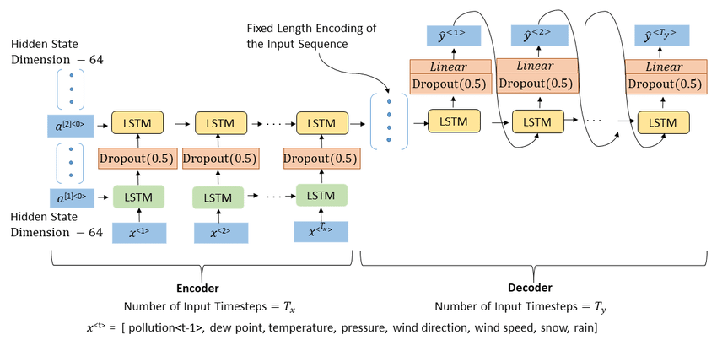
Encoder and Decoder

Slide 13
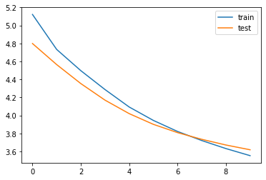
Model Evaluation
Accuracy of the Model - 46%

Slide 14
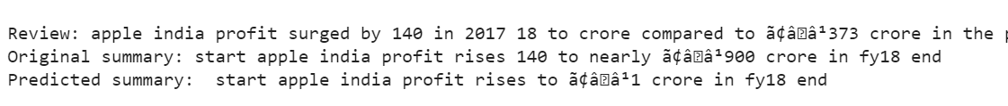
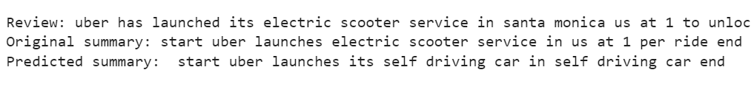
Predicted Summaries

Slide 15

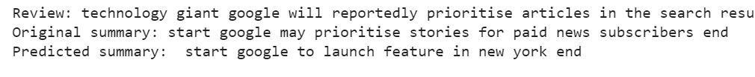
Predicted Summaries

Slide 16
Difficulties and Future Explorations
Generate More Meaningful Summaries
Pre-trained Word Embeddings
BiLSTM , Attention Model and Transformers
Improve Accuracy
Hyperparameter Tuning

Slide 17
Thank you! Any questions ?

