Slide 1
IST718 Big Data Analytics How to Access Lynda.com
Willard Williamson
Adjunct Professor
iSchool, Syracuse University
linkedin.com/in/ncc-1701-d

Slide 2
Resources
If you are new to git, python, Anaconda, etc, you can learn about these technologies using free training materials available on LinkedIn.
As a Syracuse University Student, you get a free subscription to the lynda.com learning web site which is part of LinkedIn.
If you do not have a LinkedIn account, create one

Slide 3
How to access Lynda.com for free: Step 1
Step 1: Log in at https://lynda.syr.edu using your SU login credentials.
If you have a LinkedIn account, you should now have access to Lynda training tutorials through LinkedIn Learning.

Slide 4
How to access Lynda.com for free: Step 2
Step 2: Log into LinkedIn
On the following slide, if you successfully logged into https://lynda.syr.edu using your Syracuse University credentials, you should see the orange Syracuse University symbol on the top right of your LinkedIn window.
The following 2 slides show sample git and python tutorials of interest
It is recommended to go through chapter 1 of the Learning git and github tutorial.
You do not need advanced git skills, you only need to understand the basics.

Slide 5
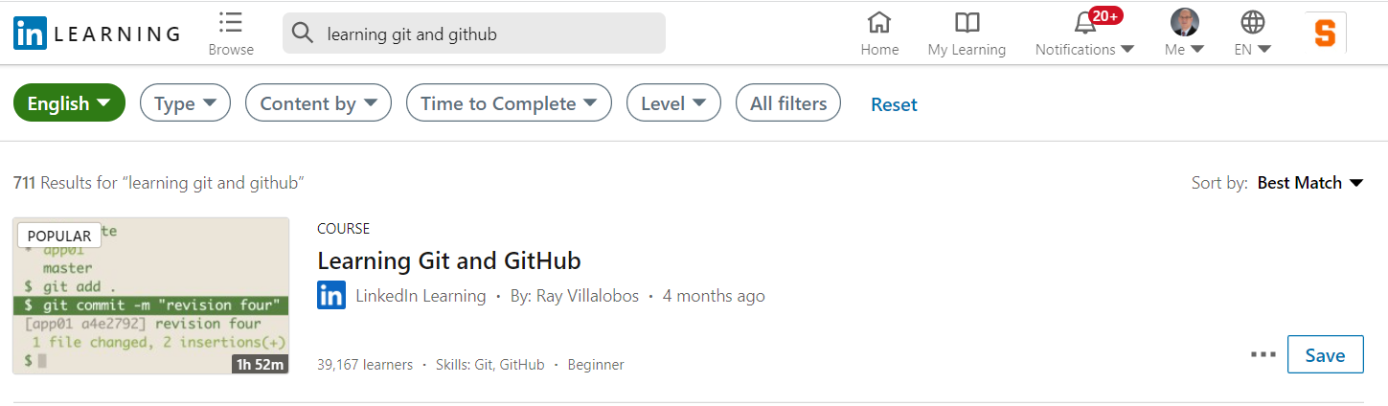
Resources: Github
You should see the orange Syracuse icon in the top right of your screen

Slide 6
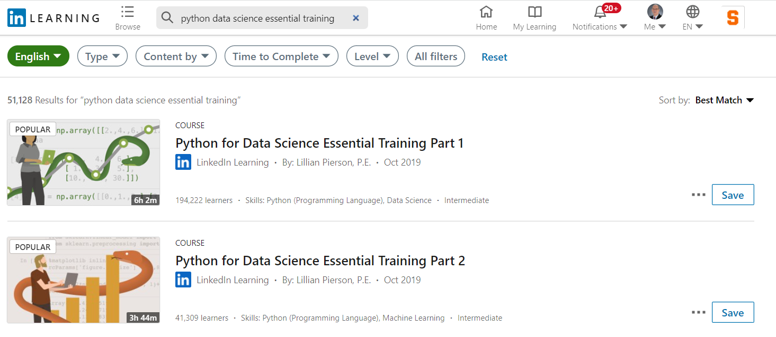
Resources: Python for Data Science Essentials

