Slide 1
IST718 Big Data Analytics Github Classroom
Willard Williamson
Adjunct Professor
iSchool, Syracuse University
linkedin.com/in/ncc-1701-d

Slide 2
Resources: Github
The Lynda.com lecture slides have recommended git training if you are completely new to git.
You definitely do not need advanced git skills for IST-718, you only need to understand the basics.
All homework will be distributed and collected via github classroom

Slide 3
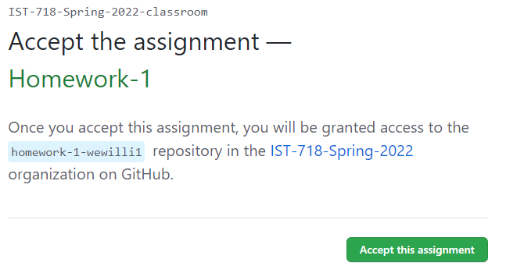
Download the student homework repo
Click the homework repo link in the blackboard homework announcement
Enter your username and password – you will be directed to the screen at the right
Click the “Accept this assignment” button

Slide 4
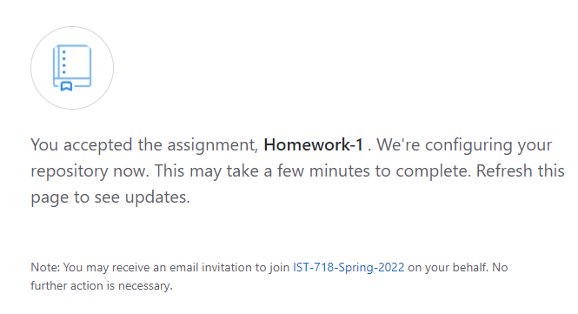
Download the student homework repo
After accepting the assignment, github will import the assignment repo into your personal github account.
The “importing starter code” box shows the import progress
It could take anywhere from a few seconds to a few hours to import the starter code depending on how busy github is

Slide 5
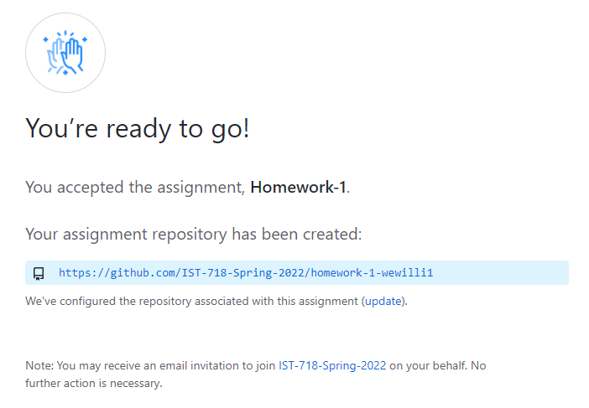
Download the student homework repo
Click the browser refresh button until the page indicates the assignment is ready to go
Click the resulting link to navigate to the assignment.

Slide 6
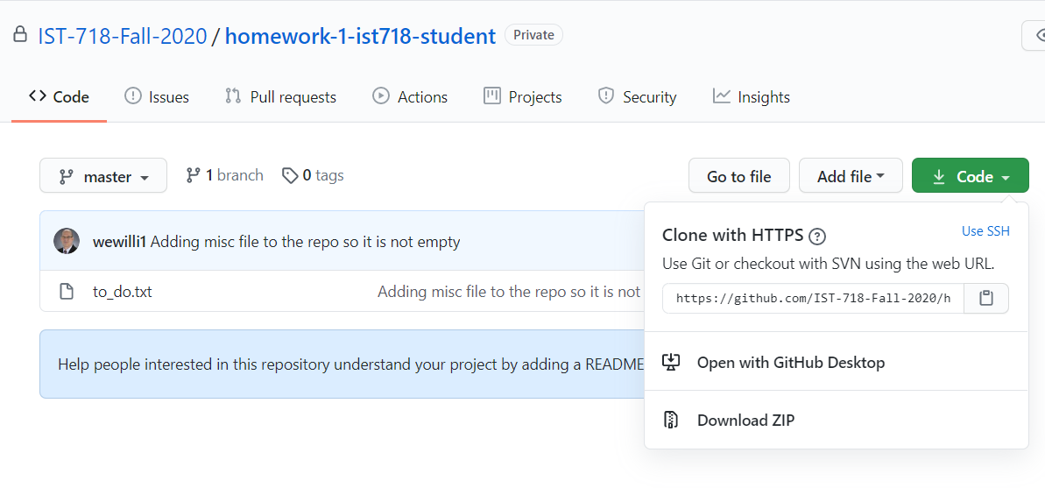
Download the student homework repo
Click the “Code” button
Select download zip
Save the zip file to a known location on your computer – preferably the area replicated by Google Drive Software (See later slides)

Slide 7
Unzip the repo zip file
After you download the repo zip file, explode the zip file on your computer into a known location.
Copy the files to your Google Drive for use in Colab

Slide 8
Google Drive for Mac and Windows
It is very convenient to install Google drive for Mac or Windows on your PC
Google drive software running on your personal Mac or Windows computer synchronizes your cloud Google drive with a directory on your personal computer.
The following is a link to download and install Google drive software: https://sites.google.com/view/software-gdrive/google-drive-download

Slide 9
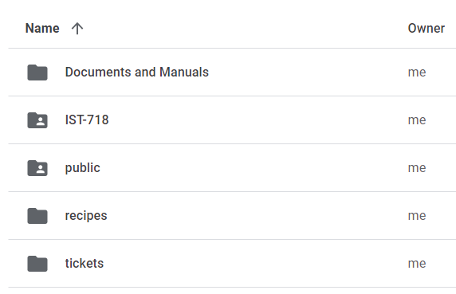
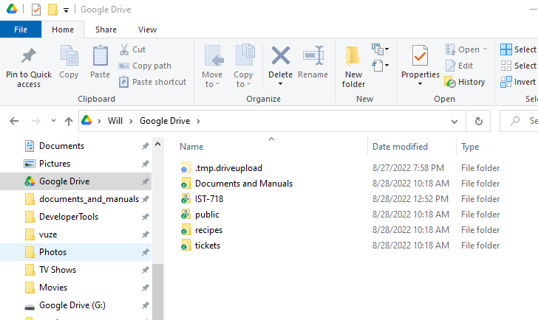
Google Drive Software In Action
Images Below:
Left hand side is a view of my Google drive from a web browser
Right hand side is a view of the exact same information from Windows Explorer on a Windows computer running Google Drive Software.

Slide 10
Why is Google Drive Software Useful?
If you have Google Drive running on your computer, simply unzip your downloaded homework repo in the directory which is shared with Google Drive.
Your homework assignment will automatically replicate to Google cloud.
Now all you have to do is open a web browser and double click your assignment to open it.

Slide 11
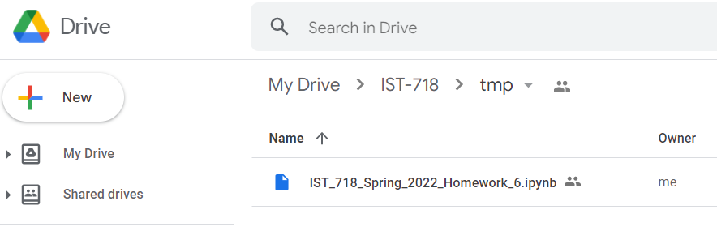
Opening Your Assignment In Colab Example
In this example, I saved a file named IST_718_Spring_2022_Homework_6.ipynb to a directory on my computer which is shared with Google drive.
The file was automatically replicated to the cloud and now all I have to do to open the file is double click the file from a Google Chrome web browser.

Slide 12
Advantages of Using Google Drive Software
The main advantage of using Google drive software is that as you work in colab, the changes you make are automatically replicated to Google drive and your local computer.
When you want to submit your assignment (covered in the following slides), your homework is already on your PC and ready to upload to github.
If you don’t install Google Drive software, you will have to go to colab and download your ipynb to your computer before you submit.

Slide 13
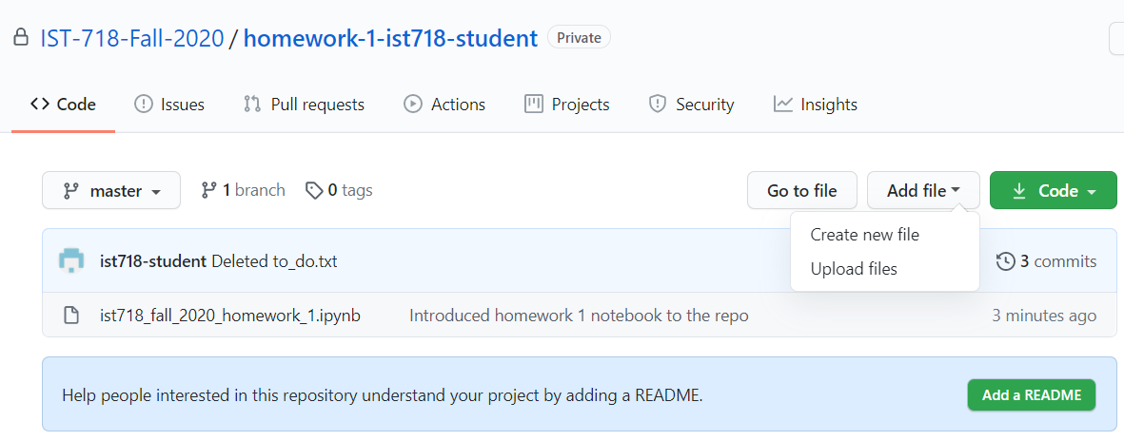
Submitting the Assignment
Select the “Add file” drop down list, then select “Upload Files”
Verify that the file name of the file you are uploading is exactly the same as the file name in github (in this example the file being uploaded should be named exactly “ist718_fall_2020_homework_1.ipynb”

Slide 14
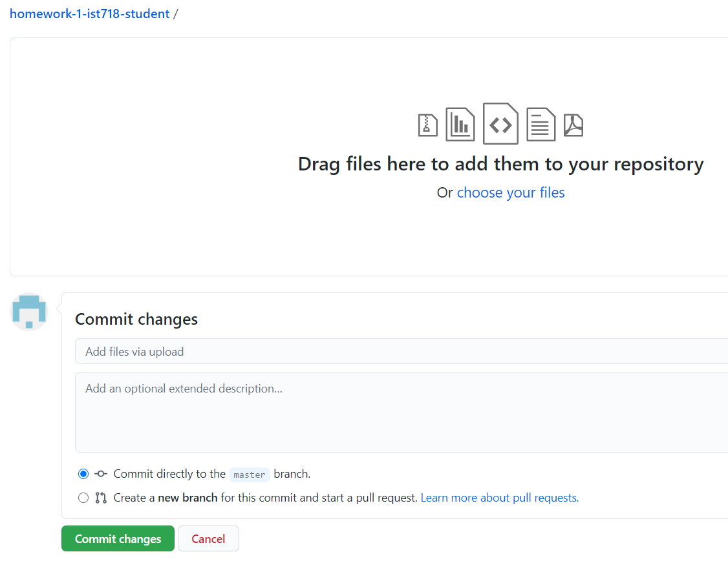
Submitting the assignment
Click the “choose your files” hyper link and select the file to upload.

Slide 15
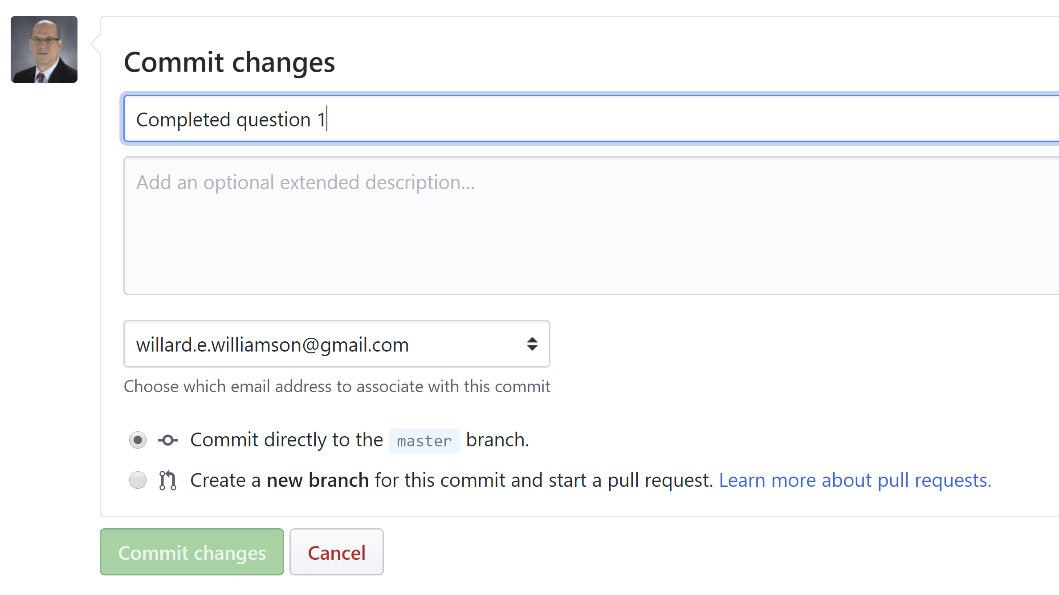
Submitting the assignment
Type a commit message like “Completed question 1”
Select the green “Commit Changes button”

Slide 16
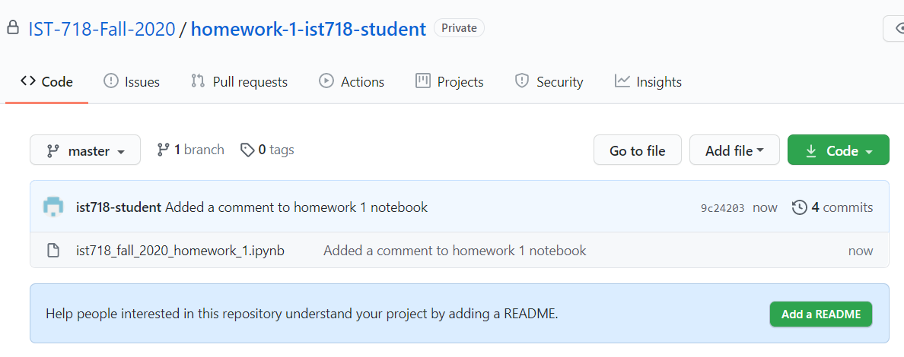
Verify the commit was successful
After clicking the commit button on the previous slide, you should see your commit message.
The commit example below was made with the message “Added a comment to homework 1 notebook”.
Note that the commit time is “now”
Verify that you did not add a new file to the repo
You can click the python notebook to view it and verify the changes you expect are in the repo

Slide 17
Commit Periodically
It is highly recommended to commit your assignment frequently using descriptive commit messages like “completed question 1”, etc.
You can easily recover your assignment from github if your computer has a problem, is lost, or stolen.

Slide 18
In Class Exercise
If you don’t have a github account, create one now
Add your github username to the class attendance sheet: https://docs.google.com/spreadsheets/d/1G5tiqXQn9mwyubWdINtPI_QONXH1_2U8oYikksgWlss/edit?usp=sharing
Clone homework 1 to your github account by clicking through on the link included in the homework 1 announcement in blackboard
Open your assignment in colab and complete question 0
Commit your assignment to github using a descriptive commit message
Verify your commit was successful as outlined in previous slides.

