Slide 1
IST718 Assessing Model Accuracy
Willard Williamson
Adjunct Professor
iSchool, Syracuse University
linkedin.com/in/ncc-1701-d

Slide 2
Attendance
Please fill out the attendance sheet: https://docs.google.com/spreadsheets/d/1_wlasAC8pjlVRyJABrLu2-o30yytu4xOtDMJp8OAGEc?authuser=willard.e.williamson%40gmail.com&usp=drive_fs
Write in a ‘1’ if you are present

Slide 3
From The Previous Class
We took a statistical approach to learning which acknowledges our uncertainty and noise in the data science process
We defined a model of the data
We estimated the parameters using training data
We used the model to predict or interpret the results
We could use supervised or unsupervised learning to find relationships between variables
If variables are not quantitative, we used classification models.

Slide 4
Generalization performance
Generalization is the performance of a learning method on independent test data
Generalization performance guides the choice of learning method or model
Why don’t we teach the best method?
David Wolpert: American Computer Scientist and Mathemetician
Because there is no free lunch in statistics: David Wolpert, “The Lack of A Priori Distinctions Between Learning Algorithms“, 1996
A Priori: Reasoning or knowledge which proceeds from theoretical deduction rather than from observation or experience.

Slide 5
Generalization performance (2)
The no free lunch theorem implies that we need to
Learn about the particular dataset we are working on (data science!)
Select the best method using generalization performance (data science!)
Essentially, there is no rule that maps the best model to each situation

Slide 6
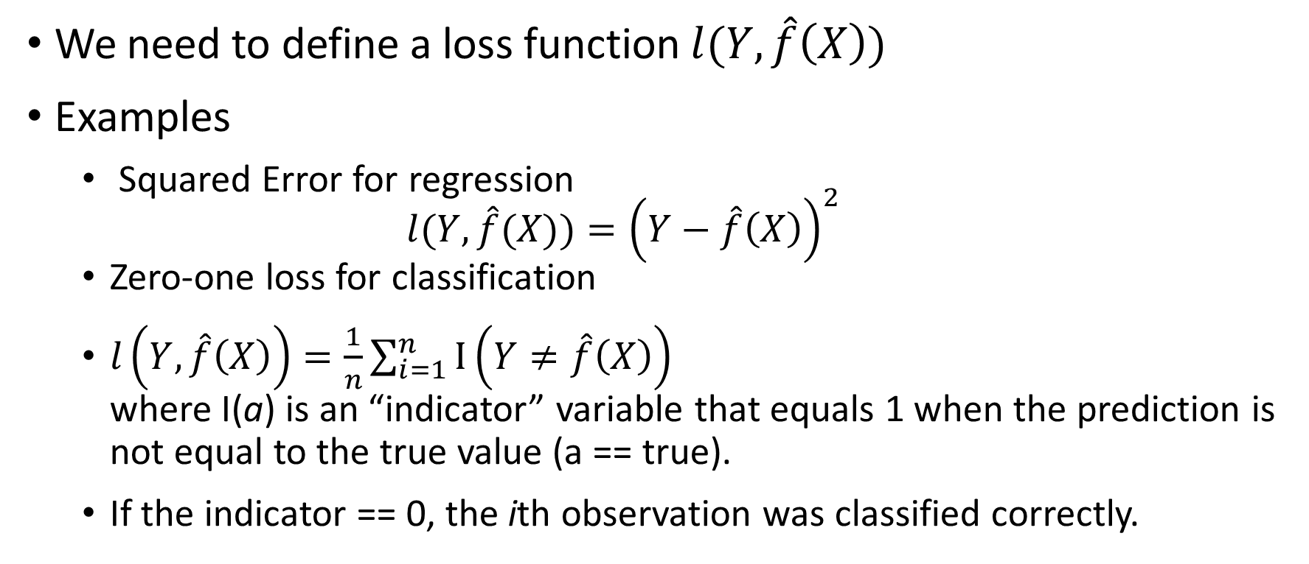
Measuring Generalization Performance: Theory
We need to define a loss function $l(Y,\hat{f}\left(X\right))$
Examples
Squared Error for regression $l(Y,\hat{f}(X))={\left(Y−\hat{f}\left(X\right)\right)}^{2}$
Zero-one loss for classification
$l\left(Y,\hat{f}\left(X\right)\right)=\frac{1}{n}\sum_{i=1}^{n}{I\left(Y≠\hat{f}\left(X\right)\right)}$ where I(a) is an “indicator” variable that equals 1 when the prediction is not equal to the true value (a == true).
If the indicator == 0, the ith observation was classified correctly.

Slide 7
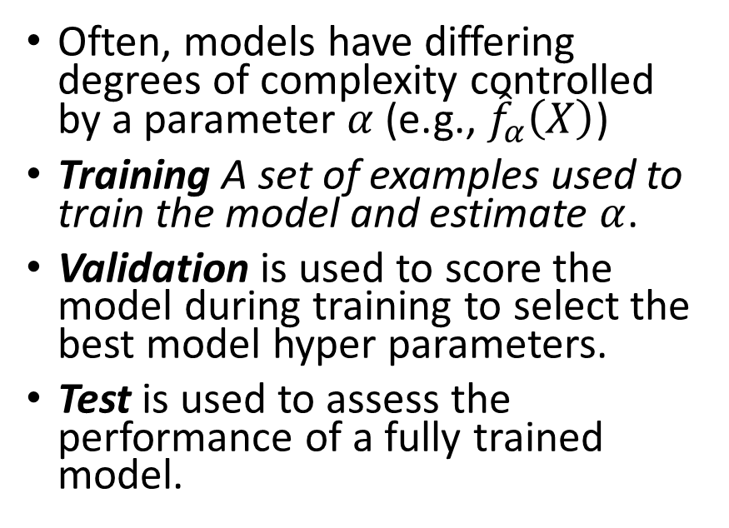
Train / Validation / Test Splits
Model select and assessment
Splits to estimate the expected test error
Often, models have differing degrees of complexity controlled by a parameter $α$ (e.g., ${\hat{f}}_{α}\left(X\right)$)
Training A set of examples used to train the model and estimate $α$.
Validation is used to score the model during training to select the best model hyper parameters.
Test is used to assess the performance of a fully trained model.
Train
Validation
Test
Training data
Model fitting
Model selection
Model assessment

Slide 8
Train / Validation / Test Splits Example
Example: Train and test 3 linear regression models using the diabetes data set. The linear regression model uses L1 regularization and therefore there is a regularization hyper parameter. The goal is to train 3 models where each model uses a different L1 regularization hyper parameter. Then compare performance between all the models so we can select the model that uses the best hyper parameter.
Train and test 3 separate models using the training data where the only difference between the 3 models is the L1 regularization hyper parameter.
Score each of the 3 models from step 1 above using the validation data. Pick the model with the best score (like the lowest mean squared error).
To evaluate the performance of the best model selected in step 2 above, use the test data.
Note: It is never correct to score the model with training data.

Slide 9
Estimating the expected test error: k-fold cross validation
The problem with the previous procedure is that we don’t use the test split during training
k-fold cross validation (partially) fixes this by running cross validation multiple times.

Slide 10
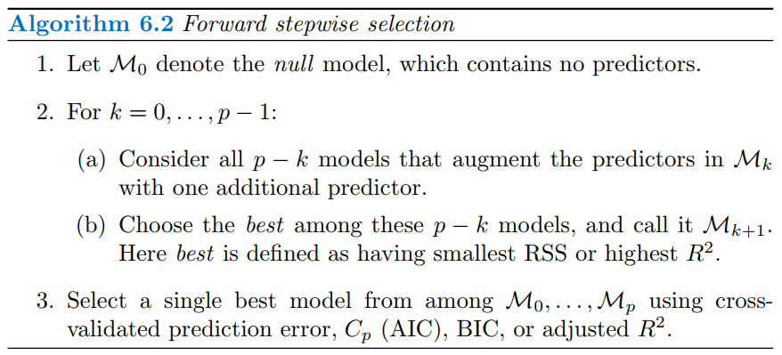
Linear model selection
Answers the question:
Which variables should be included in the model?
One of the simplest such procedures is the forward stepwise selection algorithm (See ISLR 6.1.2):
For diabetes data set, this procedure selects age, bmi, map, tc, ltg, and glu as the most important variable with estimated test error of 3324

Slide 11
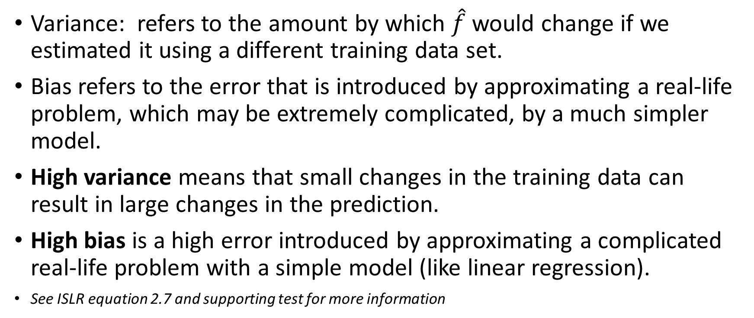
What is Model Bias and Variance
Variance: refers to the amount by which $\hat{f}$ would change if we estimated it using a different training data set.
Bias refers to the error that is introduced by approximating a real-life problem, which may be extremely complicated, by a much simpler model.
High variance means that small changes in the training data can result in large changes in the prediction.
High bias is a high error introduced by approximating a complicated real-life problem with a simple model (like linear regression).
See ISLR equation 2.7 and supporting test for more information

Slide 12
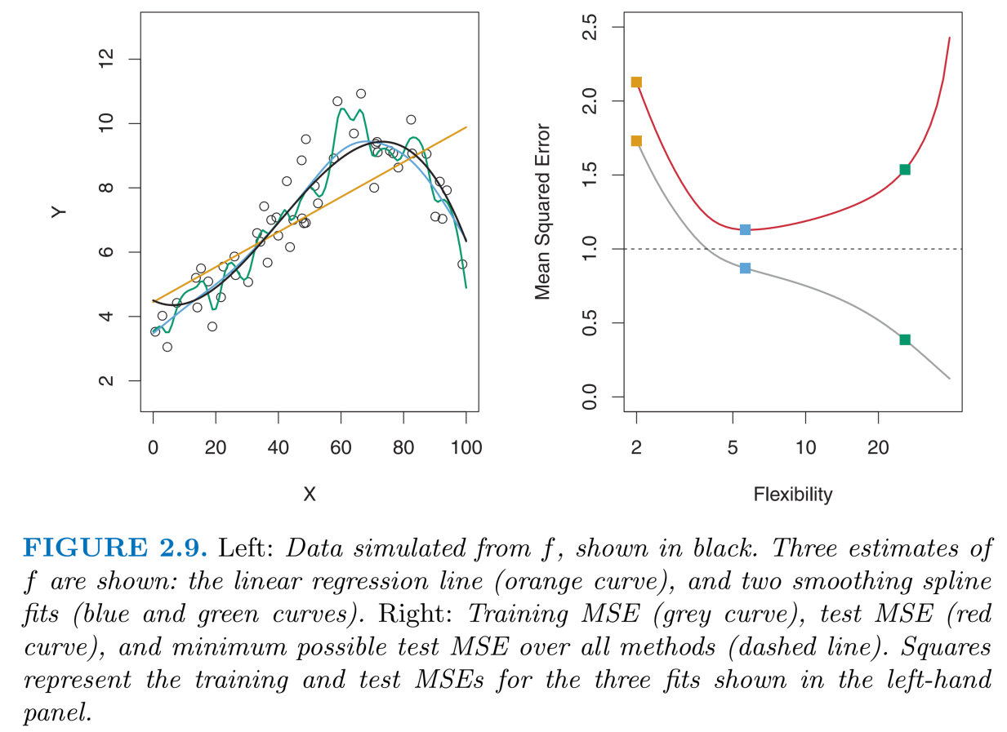
Bias / Variance Tradeoff
High bias: Straight orange line in the left hand plot.
High variance: Green line in left hand plot.
Right hand plot: Gray line shows that as we continue training, training data MSE continues to decrease.
Right hand plot: Red line shows that as we continue training, validation MSE decreases to a minimum and then starts increasing.
Overfitting happens as the gray line decreases while the red line increases in the right hand plot.

Slide 13
The Bias-Variance decomposition
In general, more complex models have low bias and high variance
Vice versa, simple models have high bias and low variance
This is a fundamental tradeoff

Slide 14
The Bias-Variance decomposition (2)
An example with the diabetes dataset
By adding a polynomial expansion to the variables:
bmi, age, bmi*age, bmi^2, age^2, etc.
We will have a new X_{new} matrix with p_{new} = 2p + p(p-1)/2 dimensions and run the following procedure:
Repeat many times
Randomly split the data into training and validation
For k=1 to p_{new}
Fitting model with k randomly selected features
Compute validation MSE

Slide 15
The Bias-Variance decomposition (3)
Overfitting
Low variance
High bias
High variance
Low bias

Slide 16
Bias-Variance decomposition: the learning curve
Simple model doesn’t learn much after 50 examples
Complex model keeps learning
Simple model has better performance with small datasets
Complex model has better performance with big dataset
Simple model (solid lines) Compared to Complex Model (dashed lines)

Slide 17
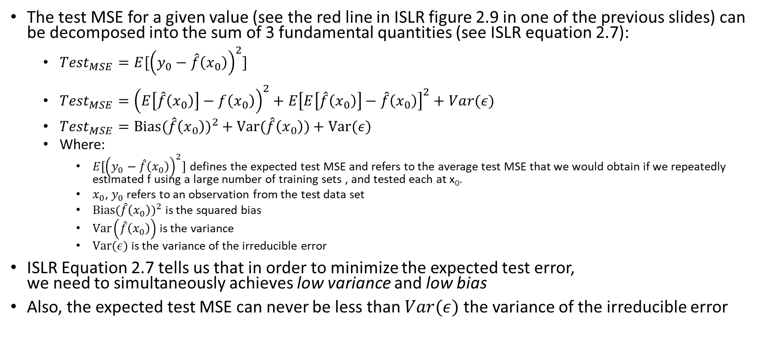
The Bias-Variance Trade Off Equation
The test MSE for a given value (see the red line in ISLR figure 2.9 in one of the previous slides) can be decomposed into the sum of 3 fundamental quantities (see ISLR equation 2.7):
${Test}_{MSE}=E[{\left(y_{0}−\hat{f}\left(x_{0}\right)\right)}^{2}]$
${Test}_{MSE}={\left(E\left[\hat{f}\left(x_{0}\right)\right]−f\left(x_{0}\right)\right)}^{2}+E{\left[E\left[\hat{f}\left(x_{0}\right)\right]−\hat{f}\left(x_{0}\right)\right]}^{2}+Var(ε)$
${Test}_{MSE}={Bias(\hat{f}\left(x_{0}\right))}^{2}+Var(\hat{f}\left(x_{0}\right))+Var(ε)$
Where:
$E[{\left(y_{0}−\hat{f}\left(x_{0}\right)\right)}^{2}]$ defines the expected test MSE and refers to the average test MSE that we would obtain if we repeatedly estimated f using a large number of training sets , and tested each at x₀.
$x_{0}$, $y_{0}$ refers to an observation from the test data set
${Bias(\hat{f}\left(x_{0}\right))}^{2}$ is the squared bias
$Var\left(\hat{f}\left(x_{0}\right)\right)$ is the variance
$Var(ε)$ is the variance of the irreducible error
ISLR Equation 2.7 tells us that in order to minimize the expected test error, we need to simultaneously achieves low variance and low bias
Also, the expected test MSE can never be less than $Var(ε)$ the variance of the irreducible error

Slide 18
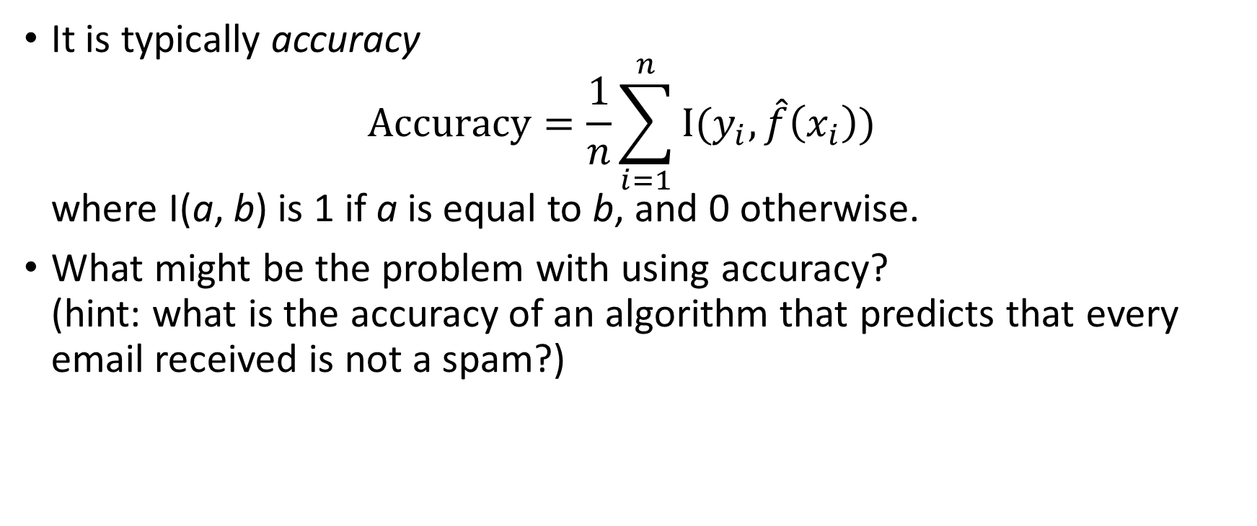
Measuring generalization performance: classification
It is typically accuracy $Accuracy=\frac{1}{n}\sum_{i=1}^{n}{I(y_{i},\hat{f}\left(x_{i}\right))}$ where I(a, b) is 1 if a is equal to b, and 0 otherwise.
What might be the problem with using accuracy? (hint: what is the accuracy of an algorithm that predicts that every email received is not a spam?)
Notes:
Answer: If 1 in 10 emails is a spam, then the model could show 90% accuracy even though it will never predict spam

Slide 19
Confusion Matrix
Accuracy is misleading for unbalanced datasets
Activity: Given one normal email and one spam email, GMAIL can perform a non-spam classification (NS) and spam classification (S). Where would you put all these cases in a confusion matrix?
Assume positive = spam, and negative = not spam
 |  | Predicted condition
 |  | Condition positive (spam) | Condition negative (Not Spam)
True condition | Condition positive (spam) | S/S | ?/?
 | Condition negative (not spam) | ?/? | ?/?
Notes:
There are four cases:
Spam email classified as spam (already in confusion matrix)
Normal email classified as spam (where?)
Spam email classified as normal email (where?)
Normal email classified as normal (where?)

Slide 20
Confusion matrix
Accuracy is misleading for unbalanced datasets
Activity: Given one normal email and one spam email, GMAIL can perform a non-spam classification (NS) and spam classification (S). Where would you put all these cases in a confusion matrix?
Assume positive = spam, and negative = not spam
 |  | Predicted condition
 |  | Condition positive (spam) | Condition negative (not spam)
True condition | Condition positive (spam) | S/S | S/NS
 | Condition negative (not spam) | NS/S | NS/NS
Notes:
There are four cases:
Spam email classified as spam (already in confusion matrix)
Normal email classified as spam (where?)
Spam email classified as normal email (where?)
Normal email classified as normal (where?)

Slide 21
Confusion Matrix
Assume positive = spam, and negative = not spam
 |  | Predicted condition
 |  | Condition positive (spam) | Condition negative (not spam)
True condition | Condition positive (Spam) | True positive (TP) | False negative (FN)
 | Condition negative (not spam) | False positive (FP) | True negative (TN)

Slide 22
Common statistics from confusion matrix
True positive rate (TPR), recall, sensitivity: TP / (TP + FN)
True negative rate (TNR), specificity: TN / (TN + FP)
False Positive Rate (FPR): FP / (FP + TN) = 1 -TNR
False Negative Rate: FN / (FN + TP) = 1 - TPR
Precision: TP / (TP + FP)
Accuracy: (TP + TN) / (P + N)
See: https://en.wikipedia.org/wiki/Confusion_matrix
 |  | Predicted condition
 |  | Condition positive | Condition negative
True condition | Condition positive | True positive (TP) | False negative (FN)
 | Condition negative | False positive (FP) | True negative (TN)
Notes:
Some examples:
High TPR: TSA (dragnet). They really want to catch every terrorist.
High TNR: pre-operative exam procedures. If we detect a heart problem, we really need to perform open heart surgery.
High precision: Don’t want to shut down a production line unless you are very sure about the test that indicates there is a problem with the production line

Slide 23
Performance Measurement Interpretation
Assume a machine learning test was developed to predict diabetes.
A group of study subjects is collected where some subjects are known to have diabetes and some do not have diabetes.
A true prediction means that a subject is predicted to have diabetes
A false prediction means that the subject is predicted to not have diabetes

Slide 24
Performance Measurement Interpretation
Confusion matrix metrics answer the following questions:
TPR / Recall / Sensitivity: Out of all the subjects that were truly diabetic, how many did we predict to be diabetic. Probability of detection.
FPR: Out of all the subjects that were truly not diabetic, how many did we predict to be diabetic. Probability of false alarm.
TNR / Specificity / Selectivity: Out of all the subjects that truly did not have diabetes, how many did we predict to not have diabetes. Probability of negative test given one does not have diabetes.
Precision: How many subjects labeled as being diabetic were actually diabetic.
Accuracy: How many subjects were correctly predicted out of all subjects in the study

Slide 25
Performance Measurement Interpretation
Confusion matrix metric interpretation
TPR / Recall: Use when false positives are better than false negatives. Example, it’s better to label a healthy subject diabetic rather than a diabetic subject healthy.
TNR / Specificity: Use when false negatives are better than false positives. Example: You are running a test to determine if you need to shut down a production line. Shutting down the line is expensive so you don’t want to shut it down due to a false positive test result.
Precision: Use in cases where high confidence in true positives is desirable. Example: See the production line example above.
Accuracy: Only works well for balanced data sets. The test is best used in combination with another metric (see ROC which follows).

Slide 26
Receiver Operating Characteristic (ROC) Curve
ROC was originally developed during world war 2 to measure the ability of radar receiver operators to distinguish between real aircraft targets and “false alarms” on the radar screens.
ROC is typically used for models that predict the probability of 2 class outcomes
The key to understanding ROC
TPR and FPR values are calculated across a range of thresholds where the threshold is compared to the model probability prediction to determine the class
The resulting data is plotted as TPR vs. FPR

Slide 27
Receiver Operating Characteristic (ROC) Curve
The ROC curve uses TP and FP cells in the confusion matrix (shown in red).
A threshold is used to determine spam vs. not spam (see threshold col in table below)
Remember that classification predictors predict the class with a probability
The resulting plot is called a ROC curve
 |  | Predicted condition
 |  | Condition positive (spam) | Condition negative (normal)
True condition | Condition positive (spam) | TP | FN
 | Condition negative (normal) | FP | TN
Email | P(spam) | Threshold Spam if P(spam) > 0.5
Normal | 0.1 | F
Spam | 0.4 | F
Normal | 0.2 | F
Spam | 0.6 | T
Normal | 0.7 | T

Slide 28
ROC Curve
We will classify as spam if classifier predicts with more than 50% spam
TPR: TP / (TP + FN)
TNR: TN / (TN + FP)
FPR: FP / (FP + TN) = 1 -TNR
Populate the confusion matrix from the prediction results
 |  | Predicted condition
 |  | Condition positive (spam) | Condition negative (normal)
True condition | Condition positive (spam) | 1 (TP) | 1 (FN)
 | Condition negative (normal) | 1 (FP) | 2 (TN)
True Condition | P(spam) | Predicted Condition Spam if P(spam) > 0.5
Normal | 0.1 | Normal
Spam | 0.4 | Normal
Normal | 0.2 | Normal
Spam | 0.6 | Spam
Normal | 0.7 | Spam
TPR = 1 / 2
FPR = 1 – (2 / 3) = 1/3

Slide 29
ROC Curve
We will classify as spam if classifier predicts with more than 10% spam
TPR: TP / (TP + FN)
TNR: TN / (TN + FP)
FPR: FP / (FP + TN) = 1 -TNR
Populate the confusion matrix from the prediction results
 |  | Predicted condition
 |  | Condition positive (spam) | Condition negative (normal)
True condition | Condition positive (spam) | 2 (TP) | 0 (FN)
 | Condition negative (normal) | 2 (FP) | 1 (TN)
True Condition | P(spam) | Predicted Condition Spam if P(spam) > 0.1
Normal | 0.1 | Normal
Spam | 0.4 | Spam
Normal | 0.2 | Spam
Spam | 0.6 | Spam
Normal | 0.7 | Spam
TPR = 1
FPR = 1 – (1 / 3) = 2/3

Slide 30
Measuring generalization performance: ROC curve
In the previous 2 slides, we calculated the TPR and FPR for thresholds 0.1 and 0.5
In practice, we would calculate TPR and FPF for many more thresholds than just 2
In this example, we show the two thresholds in the plot below
P(spam) > 0.1
1
P(spam) > 0.5
TPR
0
FPR (1 – TNR)
1
Notes:
Compute the points for a classifier that predicts spam 50% probability

Slide 31
Measuring generalization performance: ROC curve
If we connect a smooth line between the 2 points in this example, we can visualize what the ROC curve might look like if we calculated TPR and FPR for more than just 2 thresholds.
A real ROC curve would be calculated using hundreds or thousands of thresholds to create the smooth curve
Using the ROC Curve, we can pick threshold values that optimize a desired outcome.
Example: It might be better for a medical test to allow more false positives so the test doesn’t miss a true positive
1
TPR
0
FPR (1 – TNR)
1
Activity: Which point in the plot above is better for the medical test?

Slide 32
Measuring generalization performance: ROC curve (2)
Plot TPR vs. FPF for every threshold value
The Area Under the Curve (AUC) represents the performance
AUC ROC can be interpreted as the probability that the scores given by a classifier will rank a randomly chosen positive instance higher than a randomly chosen negative one
Higher AUC means better performance
The AUC for the red diagonal line represents the “random guess” performance.
1
TPR
Random classifier
0
FPR (1 – TNR)
1
Notes:
Compute the points for a classifier that predicts spam 50% probability

Slide 33
Classification in diabetes example
Let’s assume that disease progression greater than 250 is really bad
We want to predict really bad progressions
Unbalanced because 10% of people have bad levels of progression
Area under the curve = 0.9
Using all predictor variables

Slide 34

Feature Engineering for Homework 3
Useful information for homework 3

Slide 35
Ordinal Data Feature Engineering
T-Shirt Size | Xformed T-Shirt Size
Extra Small | 0
Small | 1
Medium | 2
Large | 3
Extra Large | 4
T-Shirt Size is Ordinal Categorical Data
In ordinal data there is a relationship between the categories. Example, small is larger than extra small.
It is often best to transform ordinal data such that the order is maintained in the transformation
Some models like random forest don’t need the order to be maintained
Best to maintain order for models like linear regression

Slide 36
Categorical Data Feature Engineering
Gender | Xformed Gender
Male | 0
Female | 1
There is no relationship between categories in plain categorical variables.
If there are only 2 categories, can simply encode as 0 / 1

Slide 37
One hot encoding
Target | Dog | Cat | Bird
Dog | 1 | 0 | 0
Cat | 0 | 1 | 0
Bird | 0 | 0 | 1
One hot encoding does not maintain relationships between categories so is best used on plain categorical data
New columns created for each outcome
Only the column matching the category is loaded with a 1, all other columns are 0

Slide 38
Inference Example with Standardization
When data columns are in different units, standardizing the data is similar to putting all of the data columns in the same units.
For example, we start with columns containing horsepower and weight in KG (car dataset)
If we standardize these 2 columns and build a linear regression model (or logistic regression model), we can directly compare the absolute value of the resulting model coefficients against each other to see which coefficient is more important (makes a bigger impact) on the outcome.
Can also include the coefficient sign for other forms of inference

Slide 39
Standardization
To Standardize columns of data:
Subtract the mean of the entire column from each column element
Divide each element in the column by the standard deviation of the entire column
Some algorithms require standardization. For example, deep learning might not show any training performance improvement unless you standardize or normalize the data
Some algorithms may train faster if the data is standardized
Linear / logistic regression does not require standardization for training but it does allow you to compare the resulting coefficients to each other.

Slide 40
Standard Scaling
In spark, see the StandardScaler object
The correct way to apply the standard scaler is to scale the training split, then apply the training mean and training standard deviation to scale the test and validation splits.
See https://sebastianraschka.com/faq/docs/scale-training-test.html for a concise example.
We expect you to apply the standard scaler correctly on the homework

Slide 41
Standardization in linear regression inference
Example: In linear regression, instead of thinking about one unit increase in horsepower, think about one standard deviation increase in horsepower
What about categorical variables?
If it makes sense to talk about one standard deviation increase in a categorical variable, then it makes sense to include the categorical variable in inference
Ordinal data is more likely to make sense. For example, it might make sense to include number of cylinders in car data but exclude a male / female column.
Inference: We are comparing coefficient (slope) standard deviation changes between variables

Slide 42
Attendance
Please fill out the attendance sheet: https://docs.google.com/spreadsheets/d/1_wlasAC8pjlVRyJABrLu2-o30yytu4xOtDMJp8OAGEc?authuser=willard.e.williamson%40gmail.com&usp=drive_fs
Write in a ‘1’ if you are present

