Slide 1
IST718 Big Data Analytics Spark MapReduce, Hadoop and Yarn
Willard Williamson
Adjunct Professor
iSchool, Syracuse University
linkedin.com/in/ncc-1701-d

Slide 2
Attendance
Please fill out the attendance sheet:
https://docs.google.com/spreadsheets/d/1G5tiqXQn9mwyubWdINtPI_QONXH1_2U8oYikksgWlss/edit?usp=sharing
Write in a ‘1’ if you are present or a 0 if you are absent.

Slide 3
Objectives of this unit
Introduction to distributed systems
The CAP theorem
Hadoop
Yarn
MapReduce

Slide 4
Distributed systems
A distributed system is a collection of independent computers that appear to the users as a single coherent system
Distributed System Advantages (compare to single system):
It could be cheaper: building a supercomputer is expensive
Faster processing: parallel processing
Reliability: if one node fails, then we can process in a different node
Incremental growth: add more computers as needed
Distributed System Disadvantage:
Software must be customized
Network: often this is the bottleneck
More components to fail
Complex security

Slide 5
Distributed systems
A distributed system is a collection of independent computers that appear to the users as a single coherent system
Distributed System Advantages (compare to single system):
It could be cheaper: building a supercomputer is expensive
Faster processing: parallel processing
Reliability: if one node fails, then we can process in a different node
Incremental growth: add more computers as needed
Distributed System Disadvantage:
Software must be customized
Network: often this is the bottleneck
More components to fail
Complex security
More complexity in general

Slide 6



Scaling Services: How do you address growth?
Vertical “Scale Up”
Add more resources to an existing system running the service.
Easier, but limited scale.
Single point of failure

Slide 7
Scaling Services: How do you address growth?
Vertical “Scale Up”
Horizontal “Scale Out”
Add more resources to an existing system running the service.
Easier, but limited scale.
Single point of failure
Run the service over multiple systems, and orchestrate communication between them.
Harder, but capable of massive scale.
Overhead to manage nodes.

Slide 8
CAP Theorem of Distributed Systems
Also called “Brewer’s Theorem” after computer scientist Eric Brewer.
There are many goals for a distributed system.
Almost all goals of distributed systems can be fit into one of these categories
Data Consistency: all nodes see the same data at the same time.
Data Availability: assurances that every request can be processed.
Partition Tolerance: network failures are tolerated, the system continues to operate

Slide 9
CAP Theorem of Distributed Systems
However, there is a fundamental constraint: only two of the goals can be fulfilled at the same time all the time
Data Consistency: all nodes see the same data at the same time.
Data Availability: assurances that every request can be processed.
Partition Tolerance: network failures are tolerated, the system continues to operate

Slide 10
CAP Theorem of Distributed Systems
However, there is a fundamental constraint: only two of the goals can be fulfilled at the same time all of the time
Data Consistency: all nodes see the same data at the same time.
Data Availability: assurances that every request can be processed.
Partition Tolerance: network failures are tolerated, the system continues to operate
Consistency
Partition
Tolerance
Availability
CA
CP
X
AP

Slide 11
Why Can’t You Have All Three? *
Node 1
Node 2
A Counterexample:
Suppose we lose communication between nodes, but a user can still communicate with both nodes. Now Partition Tolerance affects Availability and Consistency
If we guarantee Availability of requests, despite the failure:
We gain Partition Tolerance (the system still works), but we lose Consistency (nodes can get out of sync if writes are allowed).
If we guarantee Consistency of data, despite the failure:
We gain Partition Tolerance (again, system works) but Availability is degraded. In this case you can read from both nodes but can’t write to either node.
Can have all three some of the time
Can not have all three persistently all the time at the same time.
Notes:
http://www.infoq.com/articles/cap-twelve-years-later-how-the-rules-have-changed

Slide 12
A Banking Counter Example
Node 1
Node 2
Suppose node 1 and node 2 implement bank account functionality and partition tolerance is compromised as shown above.
If a user is allowed to make a deposit or withdrawal, consistency is compromised.
If consistency is compromised, the bank could lose money.
Example: User goes to multiple ATM machines to withdraw money. ATM 1 -> Node 1, ATM 2 -> Node 2.
It might be ok for a user to check account balances if deposits are not allowed.
Notes:
http://www.infoq.com/articles/cap-twelve-years-later-how-the-rules-have-changed

Slide 13
CAP Theorem of Distributed Systems
System | Consistency | Availability | Partition Tolerance
Email system
Bank account (debit, credit)
Databases
Distributed system for ML
Distributed system for log dumping
Consistency
Partition
Tolerance
Availability
CA
CP
X
AP
Data Consistency: all nodes see the same data at the same time.
Data Availability: assurances that every request can be processed.
Partition Tolerance: network failures are tolerated, the system continues to operate

Slide 14
CAP Theorem of Distributed Systems
System | Consistency | Availability | Partition Tolerance
Email system |  | ✅ | ✅
Bank account (debit, credit) | ✅ | ✅
Databases | ✅ | ✅
Distributed system for ML | ✅ |  | ?
Distributed system for log dumping |  | ✅ | ?
Consistency
Partition
Tolerance
Availability
CA
CP
X
AP
Data Consistency: all nodes see the same data at the same time.
Data Availability: assurances that every request can be processed.
Partition Tolerance: network failures are tolerated, the system continues to operate

Slide 15
CAP Theorem Database Examples
RDBMS: MSSQL, Oracle, MySQL
Consistency
Partition
Tolerance
Availability
Single-Master: Hbase, MongoDB, Accumulo, HDFS
CA
CP
X
AP
Eventual Consistency: Dynamo, Cassandra, CouchDb

Slide 16
Hadoop / MapReduce / YARN

Slide 17
What is Hadoop?
Apache Hadoop includes a storage system called the Hadoop Distributed File System (HDFS), and a computing system called MapReduce
HDFS and MapReduce are closely integrated
HDFS is designed for low-cost storage over clusters of commodity servers
Difficult to run MapReduce without Hadoop. MapReduce depends on Hadoop.

Slide 18
What is MapReduce?
MapReduce is a programming model and an associated implementation for processing and generating large data sets
MapReduce algorithm can run in parallel across machines in a cluster.
MapReduce is a distributed programming model

Slide 19
What is YARN
YARN stands for Yet Another Resource Negotiator
Is a large-scale distributed operating system for big data applications
Responsible for managing distributed applications on the Hadoop cluster (example: Spark)
Provides RAM and CPU resources to applications

Slide 20
Birthplace of Hadoop:
Google, Facebook, Yahoo!
These companies had so much data, that enterprise DBMSs could not meet their reporting requirements.
Time to process
1 day of data
Number of
Hours in a day.

Slide 21
Hadoop Handles Big Data By Scaling Out
Problem: File Too Large to fit on a single storage platform?
Solution: Distribute the file over several computers.
Problem: Server not “fast” enough to process your data.
Solution: Distribute data processing over several computers.
Data
Processing

Slide 22

Hadoop is Designed to Use Commodity Hardware
Hadoop Hardware
Modular
Easy to add and remove nodes.
Failure is not only acceptable, but expected.
This is contrary to enterprise hardware
High-redundancy / Fault-tolerant
Vertical Scaling
Storage arrays
* Google Hardware spec for server source: C|NET

Slide 23
HDFS Summary
Based on Google’s GFS (Google File System)
Data Distributed over Physical Nodes
Designed for Failover
Data Split into Blocks
Default Replication factor is 3

Slide 24
HDFS At Work
Client:
1) Issues command to write data.csv file to HDFS
File: data.csv
$ hdfs dfs –put data.csv
Namenode – responsible for managing file data on the cluster:
2) Splits the file into 128MB blocks (size can be changed).
3) Writes each block to a separate Datanode.
4) Replicates each block a number of times (default is 3).
5) Keeps track of which nodes contain each block in the file.
Namenode /users/deacuna/data.csv
1
2
3
4
1
3
2
4
3
2
1
2
3
4
Datanodes
4
3
1
4
2
1

Slide 25















The Hadoop Ecosystem: Open Source Tools
Hadoop
HDFS
Notes:
Feel free to spend a lot of time on this slide. Many of these frameworks are not discussed later in the course, so now is likely your only chance to explain them. Let the students ask questions and make the discussion interactive.

Slide 26
How Does Hadoop Store, Process and Manage Big Data?

Slide 27
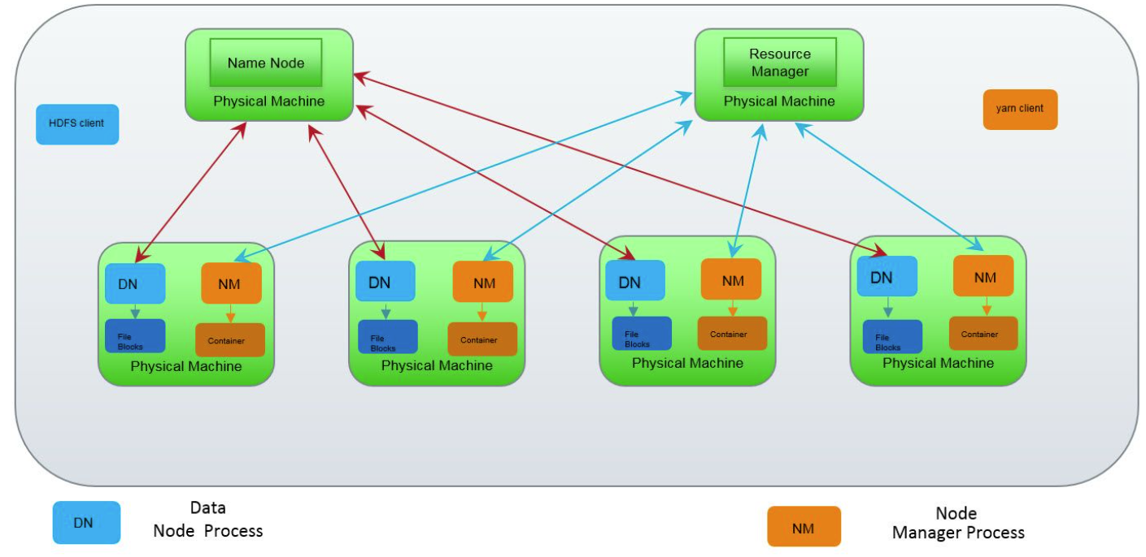
Hadoop Clusters – HDFS & YARN
3 HDFS Node Types:
Name Node:
Data Node
HDFS Client
3 YARN Node Types
Resource Manager
Node Manager
YARN Client

Slide 28
HDFS: Hadoop Distributed File System
Name Node: Maintains metadata for files stored on the data nodes. Data Node: Implements distributed file services – file is distributed across machines in the cluster
HDFS Client: Provides file services to applications by interfacing with Name Node and Data Nodes
Name, data, and client nodes are processes – not hardware.
Interestingly data nodes store data using native OS file system
This section uses information from here: https://community.cloudera.com/t5/Community-Articles/Understanding-basics-of-HDFS-and-YARN/ta-p/248860

Slide 29
HDFS Continued
HDFS file access is performed as follows:
Applications query an HDFS client for file access.
HDFS client queries the name node to determine where data is located on data nodes.
HDFS client retrieves data from data nodes and sends data to application
Data is never routed through the name node

Slide 30
YARN: Yet Another Resource Negotiator
A system for managing distributed applications.
Consists of:
Central Resource Manager (RM)
Distributed Node Managers (NM)
A client that provides services to applications

Slide 31
YARN Continued
RM maintains meta info:
What jobs are running on what node manager.
How much RAM / CPU per job
Responsibility for scheduling jobs on the nodes
Applications interact with YARN through the YARN client
NM manages application resources on the node using “containers”

Slide 32
YARN / HDFS Working Together
Best practice is to run Hadoop Name Node & YARN Resource Manager on different physical machines
Application RAM / CPU managed by NM
YARN container is an abstraction of RAM and CPU
Application data files managed by DN
Overall orchestration handled through HDFS and YARN clients

Slide 33
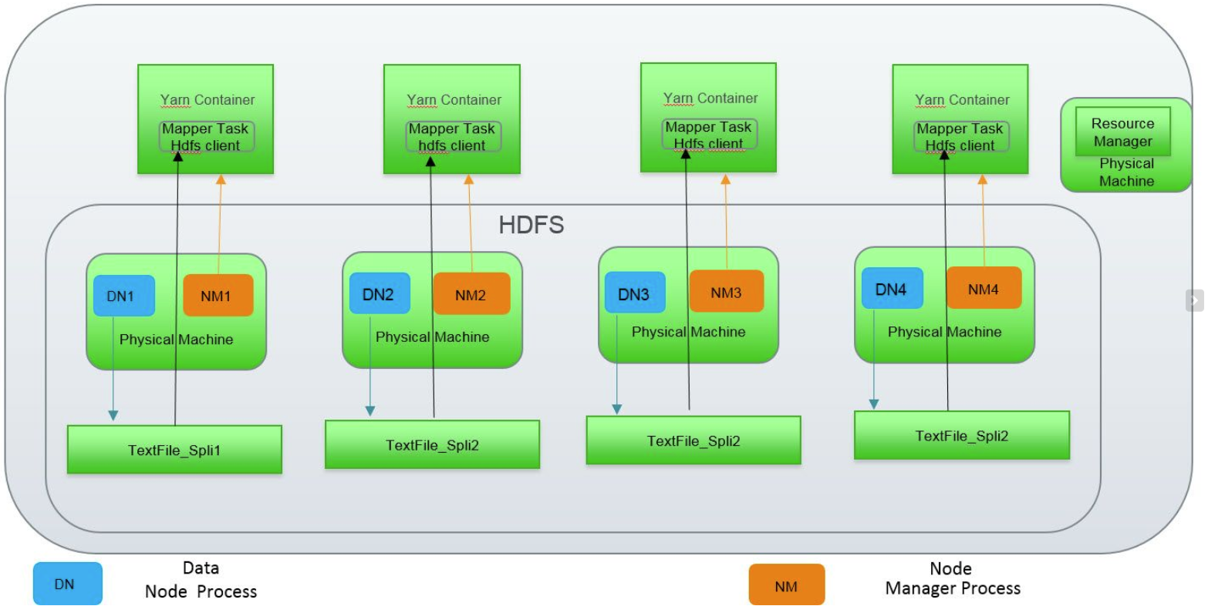
YARN / HDFS Working Together Continued
Image to the right is an expansion of yarn containers
YARN Containers contain distributed app (mapper task in this example)
HDFS client is used by the app in the YARN containers to access data files
Resource manager orchestrates / coordinates splitting the app between node managers.
Errata: Note that the graphic taken from the cloudera web site to the right incorrectly lists file splits as split 1, followed by 3 split 2’s. Should be split 1, 2, 3, 4.

Slide 34
MapReduce

Slide 35
The problem
We want to use our distributed system to process arbitrarily large amounts of data
We can develop custom code for communicating among computers and solving a problem
The problem is that this code can be different for each task
“MapReduce is a programming model and an associated implementation for processing and generating large data sets” J. Dean, S. Ghemawat, “MapReduce: Simplified Data Processing on Large Clusters”, OSDI 2004

Slide 36

The solution
Create a simple programming model where there is no communication between tasks, enhancing fault tolerance and lowering complexity
An example application:
Very large and distributed dataset of orders per month and state
We want to compute total number of orders per month
JAN, CT, 4
FEB, PA, 1
FEB, NJ, 1
JAN, NY, 3
JAN, PA, 1
JAN, NJ, 2
MAR, NY, 1
MAR, VT, 2
MAR, PA, 3
FEB, NY, 2
FEB, VT, 1
MAR, NJ, 2

Slide 37
MapReduce (programming model)
Computation takes a set of input key/value pairs and produces a set of output key/value pairs
The user implements two functions: Map and Reduce
Map: takes an input element and produces a set of intermediate key/value pairs
Reduce: accepts an intermediate key and a pair of values for the same key and combines them into zero or one value.
The program stops when no more key-value pairs can be reduced
Map
Reduce

Slide 38
MapReduce: example
Map: takes an input element and produces a set of intermediate key/value pairs
input
1
2
3
4
5
6
7
8
9
10
input element

Slide 39
MapReduce: example
Map: takes an input element and produces a set of intermediate key/value pairs
input
Map
1
2
3
4
5
6
7
8
9
10
input element
lambda e: (1, e)

Slide 40
MapReduce: example
Map: takes an input element and produces a set of intermediate key/value pairs
input
Intermediate pairs
Map
1
2
3
4
5
6
7
8
9
10
input element
lambda e: (1, e)
(1, 1)

Slide 41
MapReduce: example
Map: takes an input element and produces a set of intermediate key/value pairs
input
Intermediate pairs
Map
1
2
3
4
5
6
7
8
9
10
lambda e: (1, e)
(1, 1)
input element

Slide 42
MapReduce: example
Map: takes an input element and produces a set of intermediate key/value pairs
input
Intermediate pairs
Map
1
2
3
4
5
6
7
8
9
10
lambda e: (1, e)
(1, 1)
(1, 2)
input element

Slide 43
MapReduce: example
Map: takes an input element and produces a set of intermediate key/value pairs
input
Intermediate pairs
Map
1
2
3
4
5
6
7
8
9
10
lambda e: (1, e)
(1, 1)
(1, 2)
(1, 3)
(1, 4)
(1, 5)
(1, 6)
(1, 7)
(1, 8)
(1, 9)
(1, 10)
input element

Slide 44
MapReduce: example
Map: takes an input element and produces a set of intermediate key/value pairs
input
Intermediate pairs
Map
1
2
3
4
5
6
7
8
9
10
lambda e: (1, e)
(1, 1)
(1, 2)
(1, 3)
(1, 4)
(1, 5)
(1, 6)
(1, 7)
(1, 8)
(1, 9)
(1, 10)
input element
Identify 1) input, 2) input element, 3) map function (3.1 rule for key, 3.2 rule for value), 6) intermediate key / value

Slide 45
MapReduce: example
Reduce: accepts an intermediate key and a pair of values for the same key and combines them into zero or one value.
Intermediate pairs
(1, 1)
(1, 2)
(1, 3)
(1, 4)
(1, 5)
(1, 6)
(1, 7)
(1, 8)
(1, 9)
(1, 10)
pair values (same key)

Slide 46
MapReduce: example
Reduce: accepts an intermediate key and a pair of values for the same key and combines them into zero or one value.
Intermediate pairs
(1, 1)
(1, 2)
(1, 3)
(1, 4)
(1, 5)
(1, 6)
(1, 7)
(1, 8)
(1, 9)
(1, 10)
reduce by key
pair values (same key)
lambda v1, v2: v1 + v2

Slide 47
MapReduce: example
Reduce: accepts an intermediate key and a pair of values for the same key and combines them into zero or one value.
Intermediate pairs
Intermediate pairs
(1, 1)
(1, 2)
(1, 3)
(1, 4)
(1, 5)
(1, 6)
(1, 7)
(1, 8)
(1, 9)
(1, 10)
reduce by key
(1, 4)
pair values (same key)
lambda v1, v2: v1 + v2

Slide 48
MapReduce: example
Reduce: accepts an intermediate key and a pair of values for the same key and combines them into zero or one value.
Intermediate pairs
Intermediate pairs
(1, 1)
(1, 2)
(1, 3)
(1, 4)
(1, 5)
(1, 6)
(1, 7)
(1, 8)
(1, 9)
(1, 10)
reduce by key
(1, 4)
(1, 2)
(1, 4)
(1, 5)
(1, 6)
(1, 7)
(1, 8)
(1, 9)
(1, 10)
pair values (same key)
lambda v1, v2: v1 + v2

Slide 49
MapReduce: example
(Repeat) Reduce: accepts an intermediate key and a pair of values for the same key and combines them into zero or one value.
Intermediate pairs (t+1)
Intermediate pairs (t)
(1, 4)
(1, 2)
(1, 4)
(1, 5)
(1, 6)
(1, 7)
(1, 8)
(1, 9)
(1, 10)
(1, 4)
(1, 2)
(1, 4)
(1, 5)
(1, 6)
(1, 7)
(1, 8)
(1, 9)
(1, 10)
Next iteration

Slide 50
MapReduce: example
(Repeat) Reduce: accepts an intermediate key and a pair of values for the same key and combines them into zero or one values.
Intermediate pairs
Intermediate pairs
(1, 4)
(1, 2)
(1, 4)
(1, 5)
(1, 6)
(1, 7)
(1, 8)
(1, 9)
(1, 10)
reduce by key
pair values (same key)
lambda v1, v2: v1 + v2

Slide 51
MapReduce: example
(Repeat) Reduce: accepts an intermediate key and a pair of values for the same key and combines them into zero or one value.
Intermediate pairs
Intermediate pairs
(1, 4)
(1, 2)
(1, 4)
(1, 5)
(1, 6)
(1, 7)
(1, 8)
(1, 9)
(1, 10)
reduce by key
(1, 8)
(1, 2)
(1, 5)
(1, 6)
(1, 7)
(1, 8)
(1, 9)
(1, 10)
pair values (same key)
lambda v1, v2: v1 + v2

Slide 52
MapReduce: example
(Repeat) Reduce: accepts an intermediate key and a pair of values for the same key and combines them into zero or one value.
Intermediate pairs
Intermediate pairs
(1, 8)
(1, 2)
(1, 5)
(1, 6)
(1, 7)
(1, 8)
(1, 9)
(1, 10)
reduce by key
(1, 13)
(1, 2)
(1, 6)
(1, 7)
(1, 8)
(1, 9)
(1, 10)
pair values (same key)
lambda v1, v2: v1 + v2
Identify 1) intermediate key, 2) pairs of values, 3) reduce function, 4) output value

Slide 53
MapReduce: example
(Repeat) Reduce: accepts an intermediate key and a pair of values for the same key and combines them into zero or one value.
Intermediate pairs
No more reduce possible
(1, 45)
(1, 10)
reduce by key
(1, 55)
pair values (same key)
lambda v1, v2: v1 + v2
Identify 1) intermediate key, 2) pairs of values, 3) reduce function, 4) output value

Slide 54
Example Mapreduce Code
Examples in the following slides can be found at the end of the Introduction to Spark and DataFrames notebook

Slide 55
MapReduce: example
Map: takes an input element and produces a set of intermediate key/value pairs
Reduce: accepts an intermediate key and a pair of values for the same key and combines them into zero or one value.
input
Intermediate pairs
Output
1
2
3
4
5
6
7
8
9
10
(1, 1)
(1, 2)
(1, 3)
(1, 4)
(1, 5)
(1, 6)
(1, 7)
(1, 8)
(1, 9)
(1, 10)
map
reduce
(1, 55)
lambda e: (1, e)
lambda v1, v2: v1 + v2
What is the goal of this MR job?

Slide 56
MapReduce: example
Map: takes an input element and produces a set of intermediate key/value pairs
Reduce: accepts an intermediate key and a pair of values for the same key and combines them into zero or one value.
input
1
2
3
4
5
6
7
8
9
10
map
reduce
lambda e: (1, e)
lambda v1, v2: max(v1, v2)
What is the goal of this MR job?

Slide 57
MapReduce: example
Map: takes an input element and produces a set of intermediate key/value pairs
Reduce: accepts an intermediate key and a pair of values for the same key and combines them into zero or one value.
input
1
2
3
4
5
6
7
8
9
10
map
reduce
lambda e: (1, e)
lambda v1, v2: min(v1, v2)
What is the goal of this MR job?

Slide 58
MapReduce: example
Map can generate several keys
Input (text)
map
reduce
“Document one”
“Another document”
“A document”
def f(e):
results = []
for word in e.split():
results.append((word))
return results
lambda v1, v2: v1 + v2
What is the goal of this MR job?

Slide 59
MapReduce: Total number of orders
JAN, NY, 3
JAN, PA, 1
JAN, NJ, 2
JAN, CT, 4
FEB, PA, 1
FEB, NJ, 1
FEB, NY, 2
FEB, VT, 1
MAR, NJ, 2
MAR, NY, 1
MAR, VT, 2
MAR, PA, 3
Given the following set of records of Month, State, and orders
Compute the total number of orders per month using map reduce
def map_func(row): ??
def reduce_by_key_func(value1, value2): ??

Slide 60
MapReduce: Total number of orders
JAN, NY, 3
JAN, PA, 1
JAN, NJ, 2
JAN, CT, 4
FEB, PA, 1
FEB, NJ, 1
FEB, NY, 2
FEB, VT, 1
MAR, NJ, 2
MAR, NY, 1
MAR, VT, 2
MAR, PA, 3
Given the following set of records of Month, State, and orders
Compute the total number of orders per month using map reduce
def map_func(row): return [row[0], row[2]]
def reduce_by_key_func(value1, value2): return value1 + value2

Slide 61
MapReduce: theory
Uses the functional programming paradigm
Operations do not change data structures – data structures are immutable
Data flows are implicitly defined by program design
Order of operation does not matter
This means:
Easy to parallelize
Fault-tolerant: re-execute failed operation
Status and monitoring
Easy abstraction

Slide 62
MapReduce Shuffle and Combine
The actual implementation of the process relies on four steps
Shuffle and combine are largely transparent to the user
Shuffle → Transfer output from mapper to reducer nodes with similar keys
Combine → Output of reducer nodes into single output.
Map
Shuffle
Reduce
Combine

Slide 63
MapReduce: Total Orders by State
Source
File
HDFS Blocks Data Nodes
Mapping
Shuffle
Reduce
Combine
JAN, NY, 3
JAN, PA, 1
JAN, NJ, 2
JAN, CT, 4
FEB, PA, 1
FEB, NJ, 1
FEB, NY, 2
FEB, VT, 1
MAR, NJ, 2
MAR, NY, 1
MAR, VT, 2
MAR, PA, 3
JAN, NY, 3
JAN, PA, 1
JAN, NJ, 2
NY, 3
PA, 1
NJ, 2
CT, 4
CT, 4
NJ, 2 NJ, 1 NJ, 2
NJ, 5
CT, 4 NJ, 5
NY, 6
PA, 5
VT, 3
JAN, CT, 4
FEB, PA, 1
FEB, NJ, 1
CT, 4
PA, 1
NJ, 1
NY, 3
NY, 2
NY, 1
NY, 6
FEB, NY, 2
FEB, VT, 1
MAR, NJ, 2
NY, 2
VT, 1
NJ, 2
PA, 1 PA, 1 PA, 3
PA, 5
MAR, NY, 1
MAR, VT, 2
MAR, PA, 3
NY, 1
VT, 2
PA, 3
VT, 1 VT, 2
VT, 3

Slide 64
Attendance
Please fill out the attendance sheet: https://docs.google.com/spreadsheets/d/1G5tiqXQn9mwyubWdINtPI_QONXH1_2U8oYikksgWlss/edit?usp=sharing
Write in a ‘1’ if you are present or a 0 if you are absent

