Slide 1
IST718 Advanced Information Analytics Course Introduction
Willard Williamson
Adjunct Professor
iSchool, Syracuse University
linkedin.com/in/ncc-1701-d

Slide 2
Attendance
Don’t forget to fill out the attendance spreadsheet.
Add a “P” indicating you are present for the class.
Attendance spreadsheet can be found at the following link: https://docs.google.com/spreadsheets/d/1G5tiqXQn9mwyubWdINtPI_QONXH1_2U8oYikksgWlss/edit?usp=sharing

Slide 3
About me
Willard Williamson, Adjunct Professor, iSchool
Education:
Master of Liberal Arts (ALM), Software Engineering, Harvard Extension School
Advanced Graduate Certificate in Data Science, Harvard Extension School
Bachelor of Science, Computer Engineering Technology, Rochester institute of Technology
Professional
Software Engineer at Lockheed for 20 years
Retired from Lockheed
Currently working as a Software Engineering Contractor at Lockheed

Slide 4
About Me
Born and raised in Syracuse NY
Previously worked applied data science submarine electronic warfare at Lockheed
Extensive experience in Radar software: Signal processing, target detection, systems programming, distributed systems
Traveled all over the world working on Radar Systems

Slide 5
Faculty Assistant Introduction
Shubham Sharma
Office Hours: To Be Announced on blackboard
Shubham will send an email to the class if office hours will be cancelled or if there is a time change. Cancellation emails will be sent as far in advance as possible.

Slide 6
In class rules
Provide a high-quality learning environment
Laid back course atmosphere
It is okay to join late / leave early - though we prefer that you are here on time and for the whole class.
You are responsible for filling in the attendance sheet if you come late or leave early.
Eating / drinking during class is fine.
Always okay to ask questions.
This is an in-person class and you are expected to show up for class.

Slide 7
Course Overview
Syllabus Overview
Data science vs. big data
About the course

Slide 8
Syllabus Overview
Syllabus Review

Slide 9
About the course
1/4 of the course covers prerequisite skills required for big data analytics
Python programming, understanding machine learning
1/4 of the course covers Spark and Hadoop, providing skills required to perform big data analytics.
1/4 of the course consists of case studies, where you apply your skills and knowledge to real-world applications.
1/4 of the course consists of a project, where you work in groups in a real-world application
Blackboard final exam covering high level course concepts

Slide 10
Course roadmap
Dealing with big data: tools and algorithms
(Case 3) Ensemble models; wisdom of the crowd
(Case 1) Linear models; supervised learning
(Case 2) Dimensionality reduction; unsupervised learning
(Case 4) Deep learning; highly non-linear models
Foundations of Statistical Learning (probability, model validation)
Small/medium data
Low model complexity
High interpretability
Low computational power
Big data
High model complexity
Low interpretability
High computational power

Slide 11
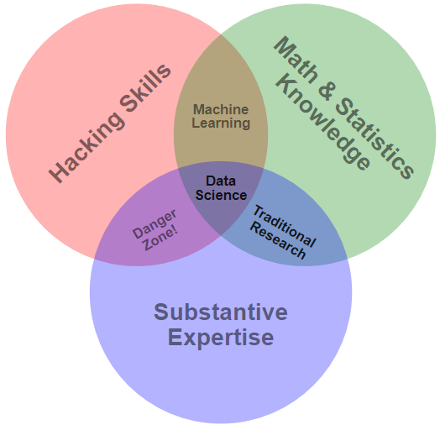
What is data science?
Data Science Venn Diagram*
*Drew Conway: https://s3.amazonaws.com/aws.drewconway.com/viz/venn_diagram/data_science.html
Notes:
Hacking skills represents programming, software expertise, and data manipulation abilities.
Danger zone represents creating analysis without knowledge of how you got there, common among people with subject expertise and the ability to generate their own results technically.

Slide 12
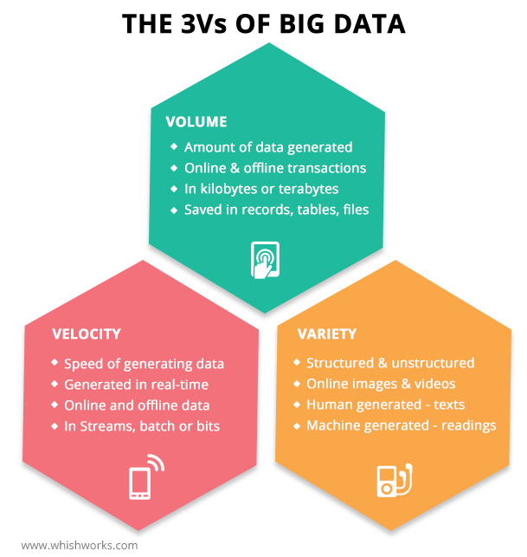
What is Big Data?
Data with the following characteristics:
Data Volume too large to store on a single system.
Data Velocity too fast for processing by a single computer.
Data Variety too complex for traditional processing techniques.
These are known as the “three V’s” of big data.

Slide 13
Classic Data Science vs. Big Data
Classic data science
Big-data data science
High level features available for use in models – for example maybe some features were synthesized through feature engineering
Small models
Models can run on a single computer and a single disk
Model used is very general or there is no model at all!
Features are often very low level (e.g., raw transactions vs credit scores)
Models are very large and cannot fit on a single computer or a single disk

