Slide 1
IST718 Object Recognition with Deep Learning
Willard Williamson
Adjunct Professor
iSchool, Syracuse University
linkedin.com/in/ncc-1701-d

Slide 2
Attendance
Please fill out the attendance sheet: https://docs.google.com/spreadsheets/d/1G5tiqXQn9mwyubWdINtPI_QONXH1_2U8oYikksgWlss/edit?usp=sharing
Write in a ‘1’ if you are present

Slide 3
Objectives
Object recognition case study
Relationship between the human brain and neural networks
From logistic regression (sigmoid) to neural networks
The perceptron
Spark Multi-layer perceptron
Training neural networks
Demo with multi-layer perceptron

Slide 4

The object recognition use case
Detect an object present in an image
Caltech101 dataset (year 2003)
101 categories of objects, each category has 40 to 800 images
Notes:
Some problems with analyzing this dataset?

Slide 5
A high dimensional problem
Each image is 300 x 200 x 3 pixels (width x height x channels)
180,000 “raw” features
Relationship between raw features and classes is highly non-linear

Slide 6
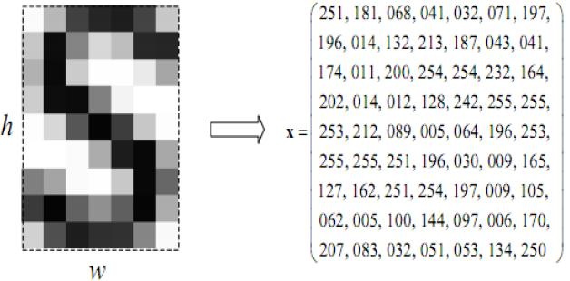
A high dimensional problem
Each pixel in the image correlates with a column in the training data
Color images have 3 layers of pixels (RGB)
Image resolution is constantly increasing as camera hardware improves

Slide 7
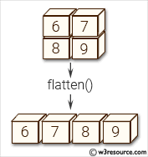
Image Flattening
To train on image data (for a feed forward network like we are studying in this class), flatten the pixel matrix into a vector
Each pixel is a column in the training data
Each row is an image

Slide 8
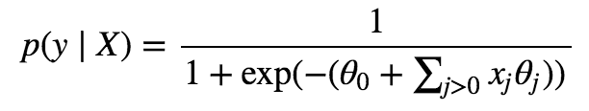
A problem with logistic regression
We are trying to learn
Logistic regression is a linear model
Works best when the classes are linearly separable
Image features are highly non linear

Slide 9
Introduction to Neural Networks
The gold standard for image classification is convolutional neural networks
Unfortunately, convolutional neural networks are not available in Spark
Spark ONLY provides a “Feed Forward” neural network algorithm called MultilayerPerceptronClassifier

Slide 10
Introduction to Neural Networks
Development of neural networks dates back to the early 1940s.
Emerged as one of the key machine learning techniques.
Gained in popularity due to advancements in computer hardware and software which have made algorithms run more efficient.
Example: Introduction of graphics processing units like Nvidia video cards has greatly improved the performance of computing GPU algorithms.

Slide 11
Introduction to Neural Networks
Can do everything a normal digital computer can do
Can compute any computable function
Especially useful for
Classification
Regression
Function Approximation

Slide 12
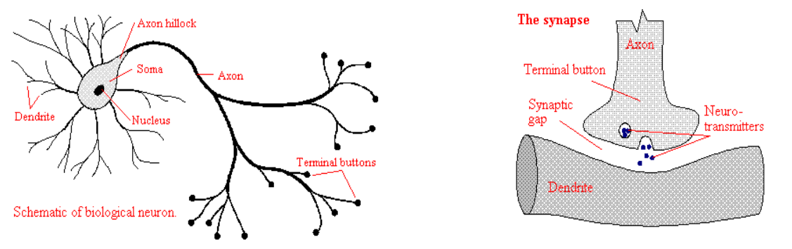
The Biological Neuron
Artificial Neural Network perceptrons are loosely inspired by their biological neuron counter parts
A neuron is a cell that uses biochemical reactions to process information
A neuron’s dendritic tree is connected to thousands of neighboring neurons
Information is transmitted through the axon / dendrite synaptic gap (also called a synapse)
The received signals are summed and processed through the non-linear neuron characteristics
The neuron output “fires” based on non-linear processing characteristics

Slide 13
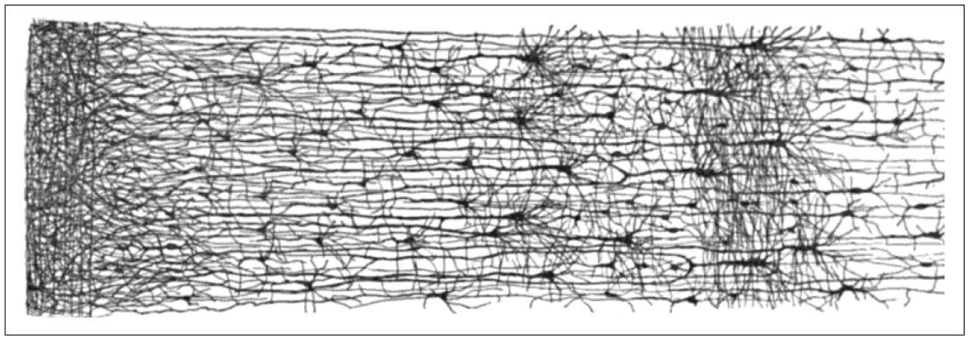
One Learning Algorithm & Layers Hypothesis
The smallest structural unit in the human brain is the neuron.
This image shows many neurons connected together
This is an image by the famous scientist Santiago Ramón y Caja showing interconnected neurons
https://www.nytimes.com/2017/02/17/science/santiago-ramon-y-cajal-beautiful-brain.html

Slide 14
From Biological to Artificial Neurons
Artificial neurons were inspired by biological neurons.
In reality, biological neurons and the human brain are much more complex than their artificial counterparts

Slide 15
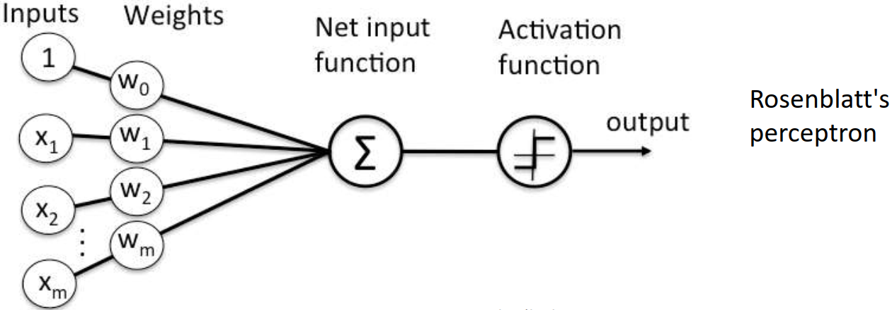
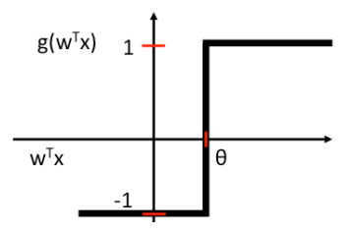
Perceptron
Perceptron Block Diagram
Artificial neurons are sometimes called perceptrons
One of the early mathematical models of a human neuron was made by Frank Rosenblatt and called Rosenblatt’s Perceptron with learning rules.
Rosenblatt “threshold” perceptron mimics a single brain neuron: It either fires or not
A perceptron receives multiple input signals, and if the sum of the signals exceed a threshold, it either fires or remains silent
In the plot to the right, theta is the decision threshold.`
Perceptron Step Function

Slide 16
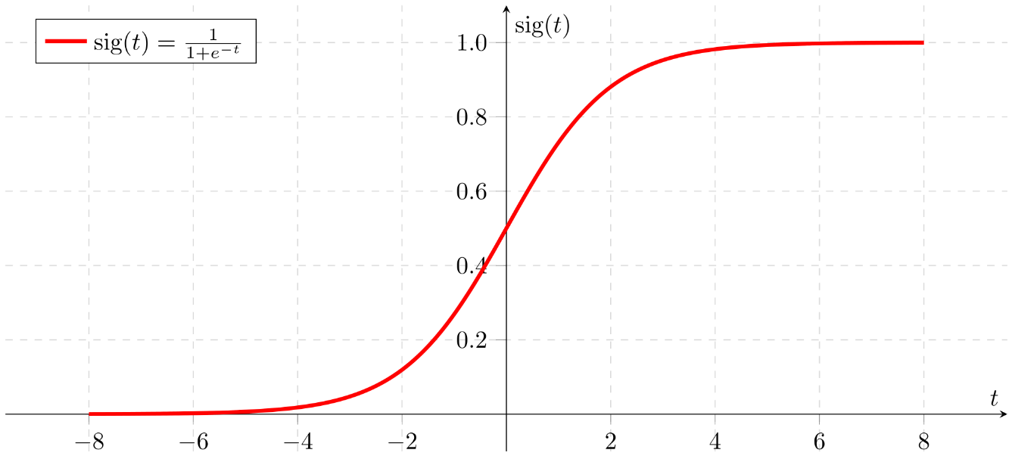
Spark MultiLayerPerceptron Class
The sigmoid is similar to the perceptron but provides a smooth transition between no activation and activation
According to the spark documentation, the MultiLayerPerceptron class uses the sigmoid as the activation function
Sigmoid Function

Slide 17
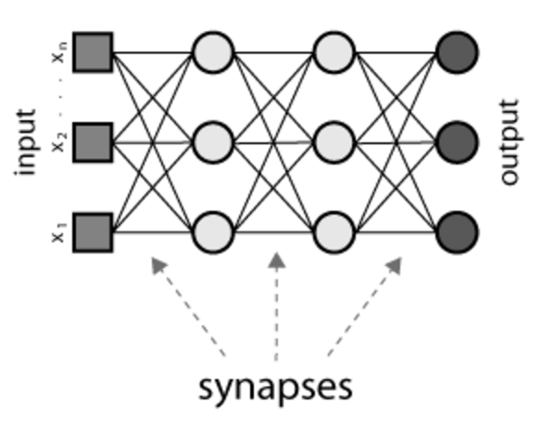
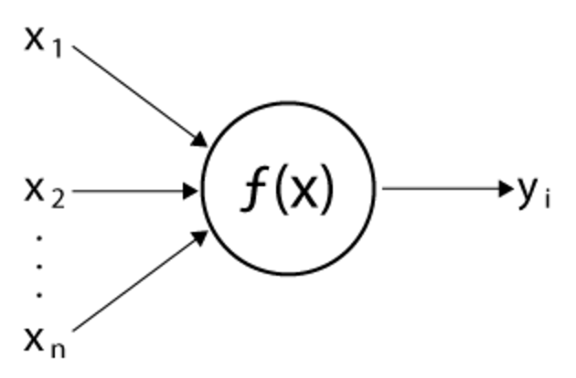
The general idea of artificial neural networks
Multiple units belong to layers and those layers are interconnected to other layers
Sigmoid

Slide 18
Advantages and disadvantages of ANN
Pros:
Can fit complex non-linear relationships
Easy to try different types of layers
Inspired by a very effective machine (the brain!)
Cons:
Hard to interpret the model, not good for inference
Many parameters
Easy to overfit
Needs lots of training data
Long training time

Slide 19
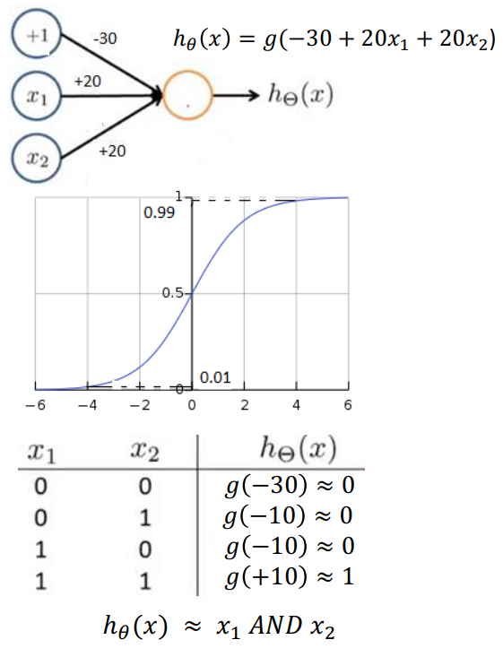
Neural Network Logical AND Function
The model to the right implements a logical AND function
The sigmoid value at +4 is close to 1
The sigmoid value at -4 is close to 0

Slide 20
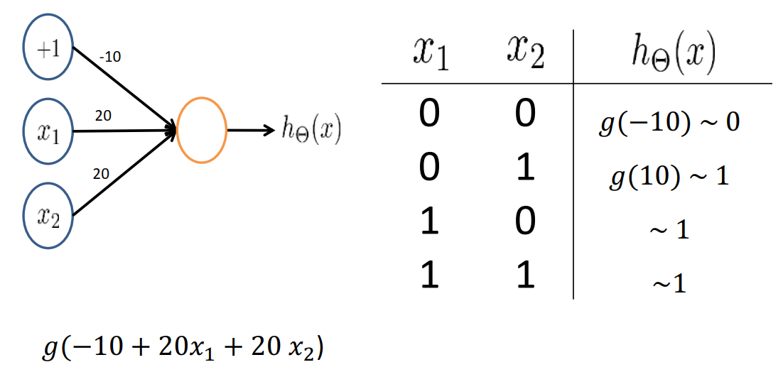
Neural Network OR Function

Slide 21
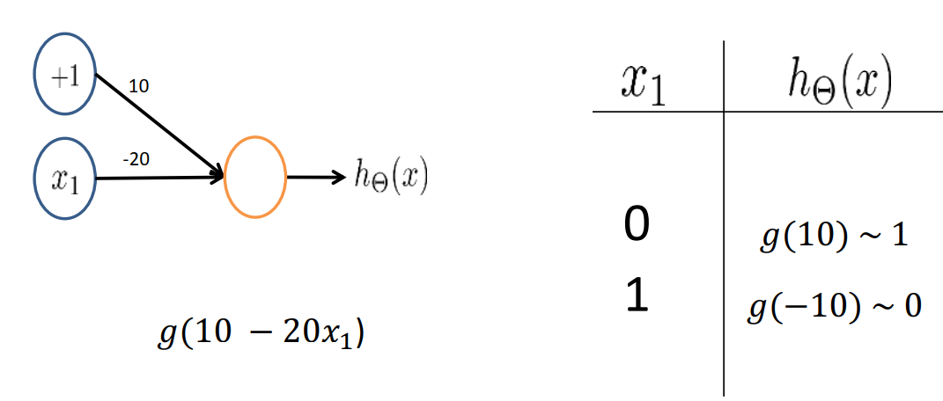
Neural Network NOT Function
AND, OR, and NOT functions can be used to build any logical function
At a conceptual level, our computers are just collections of AND, OR, and NOT gates
This evidence supports the claim that NN’s can compute any computable function

Slide 22
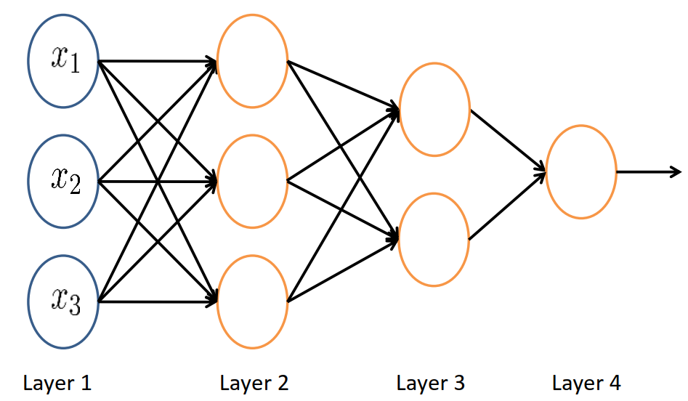
Network Example
3 Inputs, 1 output
2 Hidden layers
The network to the right produces a single output
Example: Classify cat / dog
Example: Predict a single real value like car fuel milage

Slide 23
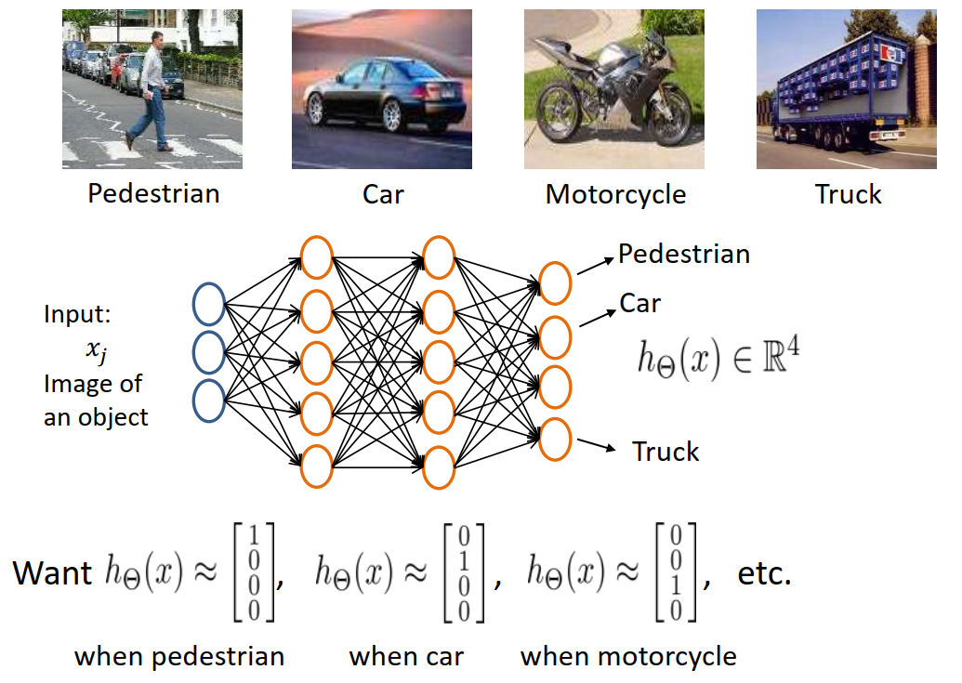
Multiclass Network Example

Slide 24
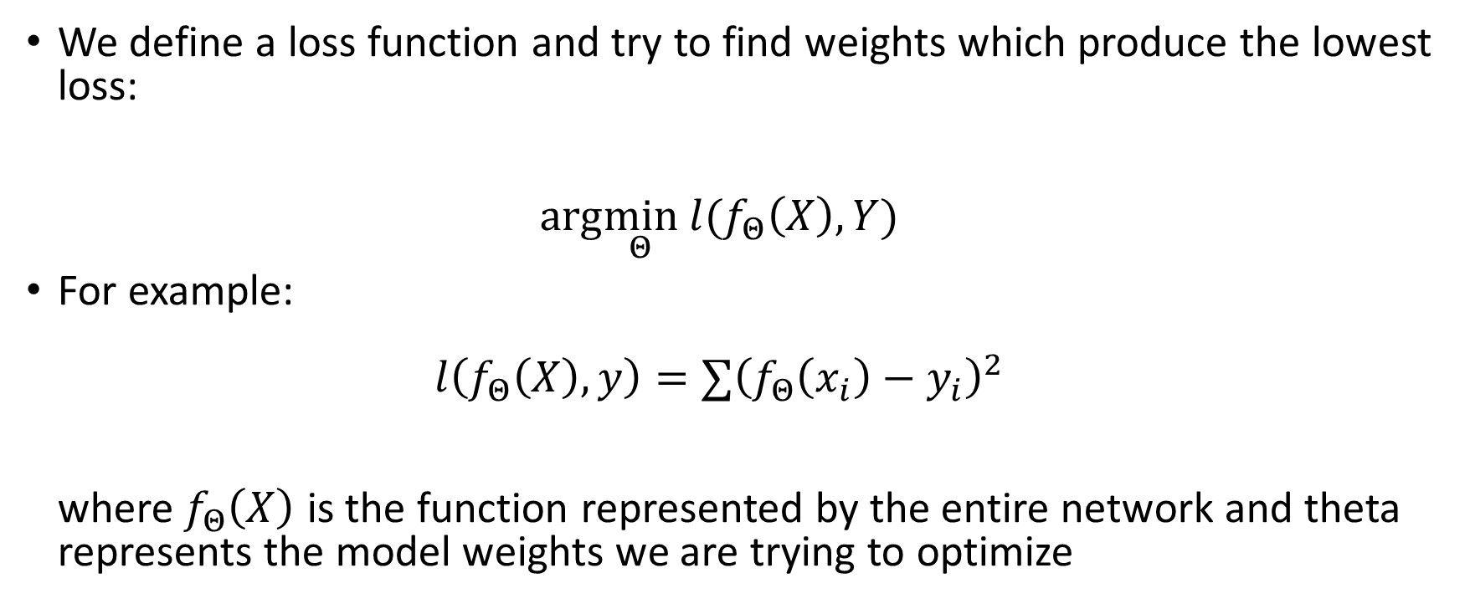
How to train a neural network?
We define a loss function and try to find weights which produce the lowest loss: $arg\min_{Θ} l(f_{Θ}\left(X\right),Y)$
For example: $l\left(f_{Θ}\left(X\right),y\right)=∑{\left(f_{Θ}\left(x_{i}\right)−y_{i}\right)}^{2}$ where $f_{Θ}\left(X\right)$ is the function represented by the entire network and theta represents the model weights we are trying to optimize

Slide 25
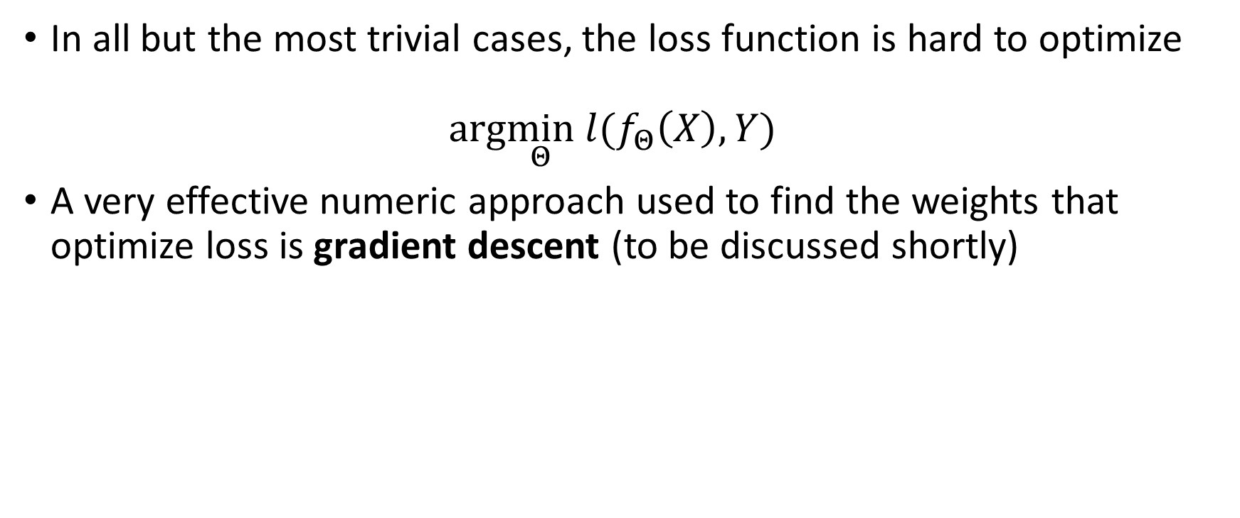
Optimizing the loss function
In all but the most trivial cases, the loss function is hard to optimize $arg\min_{Θ} l(f_{Θ}\left(X\right),Y)$
A very effective numeric approach used to find the weights that optimize loss is gradient descent (to be discussed shortly)

Slide 26
Deep Learning Terminology
One epoch is equal to one forward pass and one back propagation of ALL the training examples in the training data set
A batch means all data in the data set. Forward and back propagation calculations are typically made in batches.
A mini batch is a subset of the data set.
Iterations are the number of batches processed with a forward and back propagation
Example: If the training data contains 1000 training examples and the mini batch size is 500, then it will take 2 iterations to complete 1 epoch

Slide 27
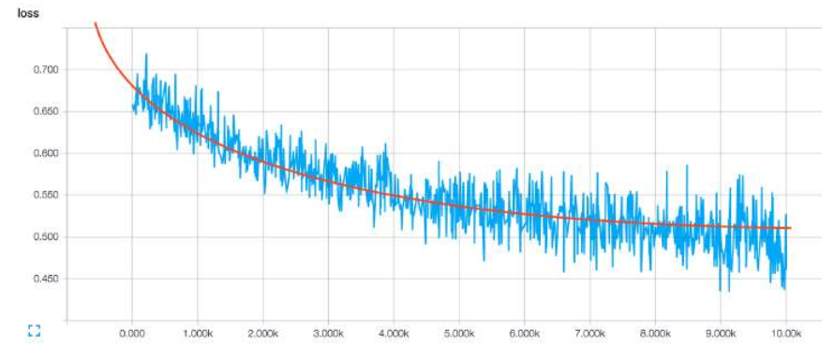
Example Loss vs. Epoch Plot
Weights are calculated iteratively through the “Gradient Descent” optimization algorithm
Weights are typically calculated per batch
Epochs

Slide 28
Gradient Descent High Level Overview
Gradient descent is an algorithm to find the points where a function achieves its minimum value.
We define learning as changing the model weights over time in order to minimize the loss
Weights are calculated by iteratively computing forward and back propagations.
Forward propagation computes model prediction and loss
Back propagation computes gradient or partial derivative of loss with respect to each input variable
New weights are calculated using the partial derivatives

Slide 29
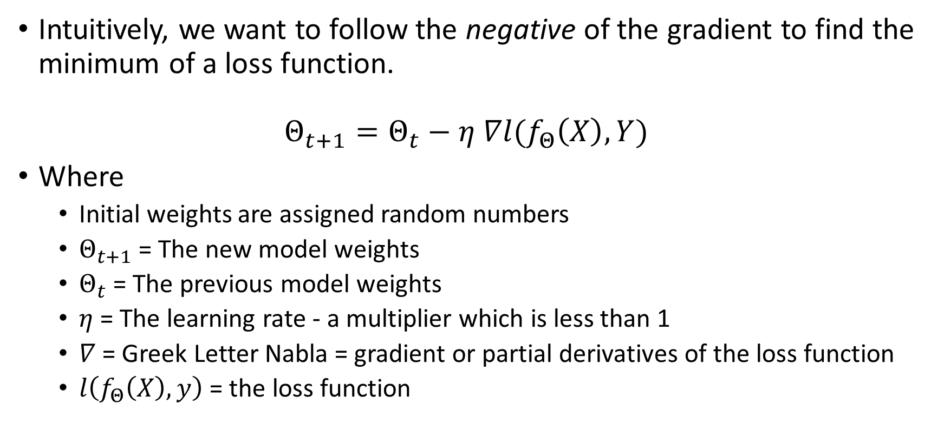
Gradient descent formalization
Intuitively, we want to follow the negative of the gradient to find the minimum of a loss function. $Θ_{t+1}=Θ_{t}−η ∇l(f_{Θ}\left(X\right),Y)$
Where
Initial weights are assigned random numbers
$Θ_{t+1}$ = The new model weights
$Θ_{t}$ = The previous model weights
$η$ = The learning rate - a multiplier which is less than 1
$∇$ = Greek Letter Nabla = gradient or partial derivatives of the loss function
$l\left(f_{Θ}\left(X\right),y\right)$ = the loss function

Slide 30
Gradient Descent Types
Batch gradient descent calculates the gradient across all training examples to compute 1 update of the weights
Stochastic gradient descent calculates the gradient using a single random sample (without replacement) to compute 1 update of the weights
Minibatch Stochastic Gradient Descent samples a batch of observations of size n where n is typically 32, 64, 128, 256, or 512

Slide 31
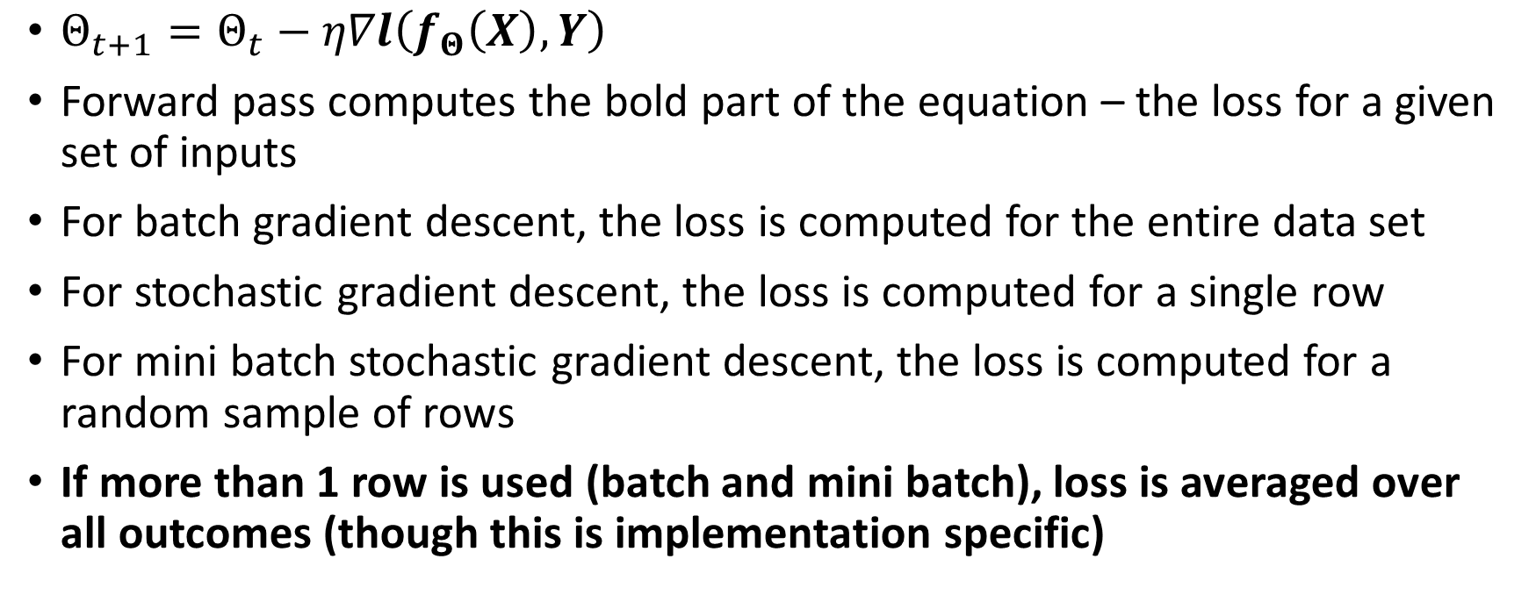
Gradient Descent Forward Propagation
$Θ_{t+1}=Θ_{t}−η∇l\left(f_{Θ}\left(X\right),Y\right)$
Forward pass computes the bold part of the equation – the loss for a given set of inputs
For batch gradient descent, the loss is computed for the entire data set
For stochastic gradient descent, the loss is computed for a single row
For mini batch stochastic gradient descent, the loss is computed for a random sample of rows
If more than 1 row is used (batch and mini batch), loss is averaged over all outcomes (though this is implementation specific)

Slide 32

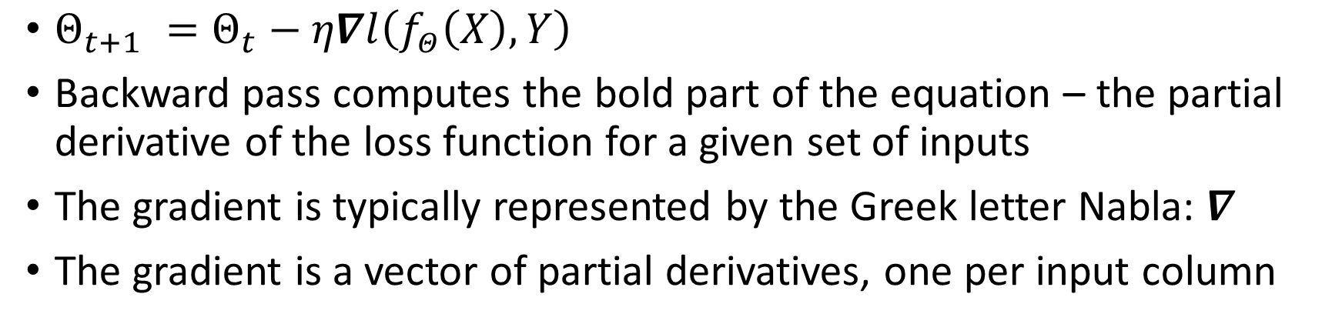
Gradient Descent Back Propagation
$Θ_{t+1} =Θ_{t}−η∇l\left(f_{Θ}\left(X\right),Y\right)$
Backward pass computes the bold part of the equation – the partial derivative of the loss function for a given set of inputs
The gradient is typically represented by the Greek letter Nabla: $∇$
The gradient is a vector of partial derivatives, one per input column

Slide 33

Weight Calculation
Forward pass calculates loss:${ Θ}_{t+1} =Θ_{t}−η∇l\left(f_{Θ}\left(X\right),Y\right)$
Backward pass calculates gradient:${ Θ}_{t+1} =Θ_{t}−η∇l\left(f_{Θ}\left(X\right),Y\right)$
The last step is to calculate and update the model weights:
$Θ_{t+1} =Θ_{t}−η∇l\left(f_{Θ}\left(X\right),Y\right)$

Slide 34
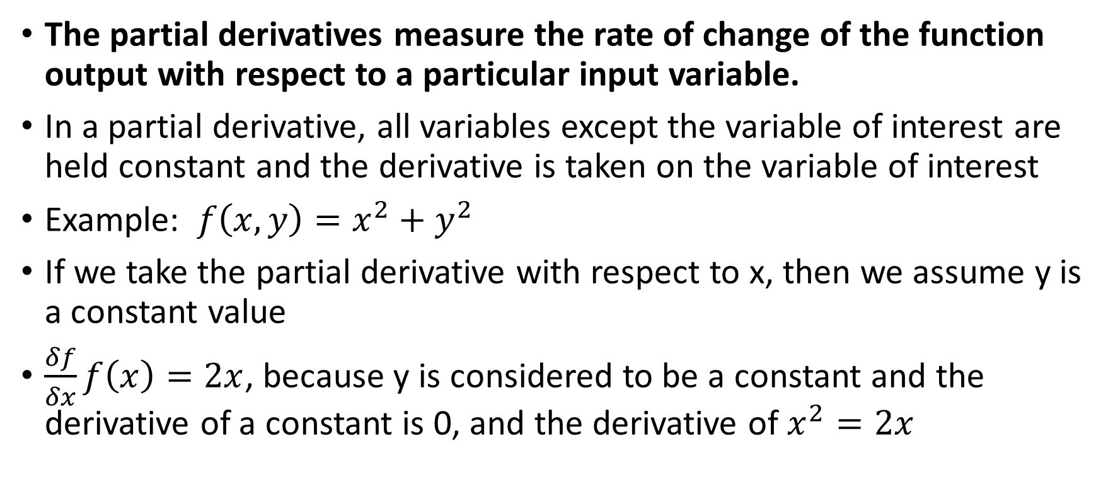
What is a Partial Derivative
The partial derivatives measure the rate of change of the function output with respect to a particular input variable.
In a partial derivative, all variables except the variable of interest are held constant and the derivative is taken on the variable of interest
Example: $f\left(x,y\right)=x^{2}+y^{2}$
If we take the partial derivative with respect to x, then we assume y is a constant value
$\frac{δf}{δx}f\left(x\right)=2x$, because y is considered to be a constant and the derivative of a constant is 0, and the derivative of $x^{2}=2x$

Slide 35
Partial derivative and learning rate
The partial derivative (or gradient) tells us the slope of the loss function for each predictor
The gradient points up the curve, therefore we subtract a fraction of the gradient to decrease the loss function
The gradient tells us the slope direction but says nothing about how far the step should be to find the minimum
The learning rate is one of the most important hyper parameters in the model

Slide 36
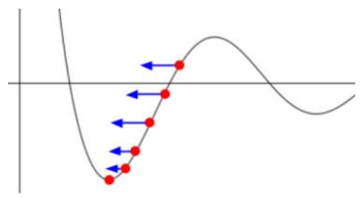
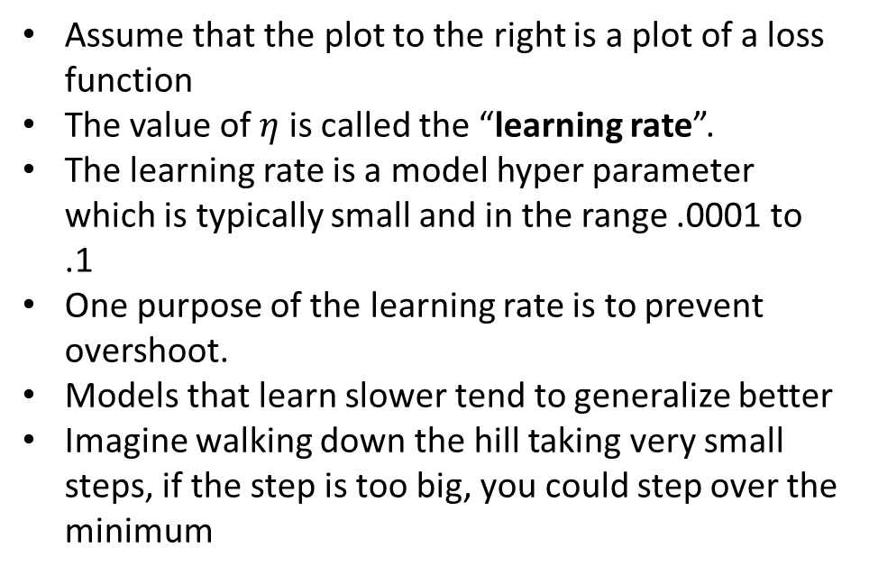
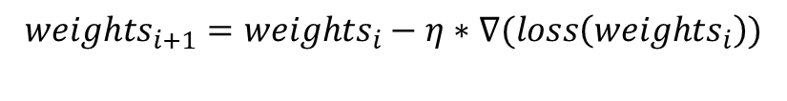
Gradient Descent Learning Rate
Assume that the plot to the right is a plot of a loss function
The value of $η$ is called the “learning rate”.
The learning rate is a model hyper parameter which is typically small and in the range .0001 to .1
One purpose of the learning rate is to prevent overshoot.
Models that learn slower tend to generalize better
Imagine walking down the hill taking very small steps, if the step is too big, you could step over the minimum
$${weights}_{i+1}={weights}_{i}−η∗∇(loss\left({weights}_{i}\right))$$

Slide 37
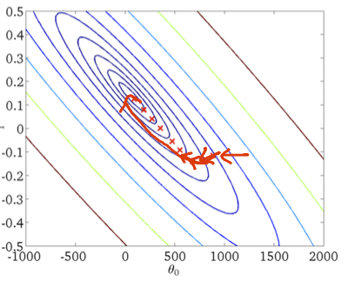
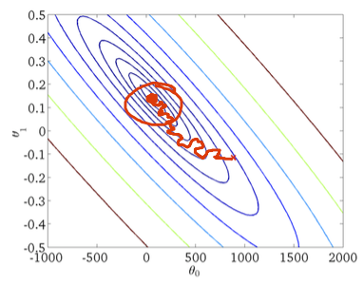
Stochastic vs. Batch
Gradient Descent
Stochastic Gradient Descent
Red lines indicate the path that gradient descent takes to the minimum
The plots are contour plots of the loss function.
The random sampling tends to produce a noisier path to the minimum
The noisy path also helps the algorithm jump out of local minimums
Plots:
Right top: Batch gradient descent takes a direct / smooth path to the minimum
Right bottom: Stochastic gradient descent takes a noisy path to the minimum
Stochastic Gradient Descent

Slide 38
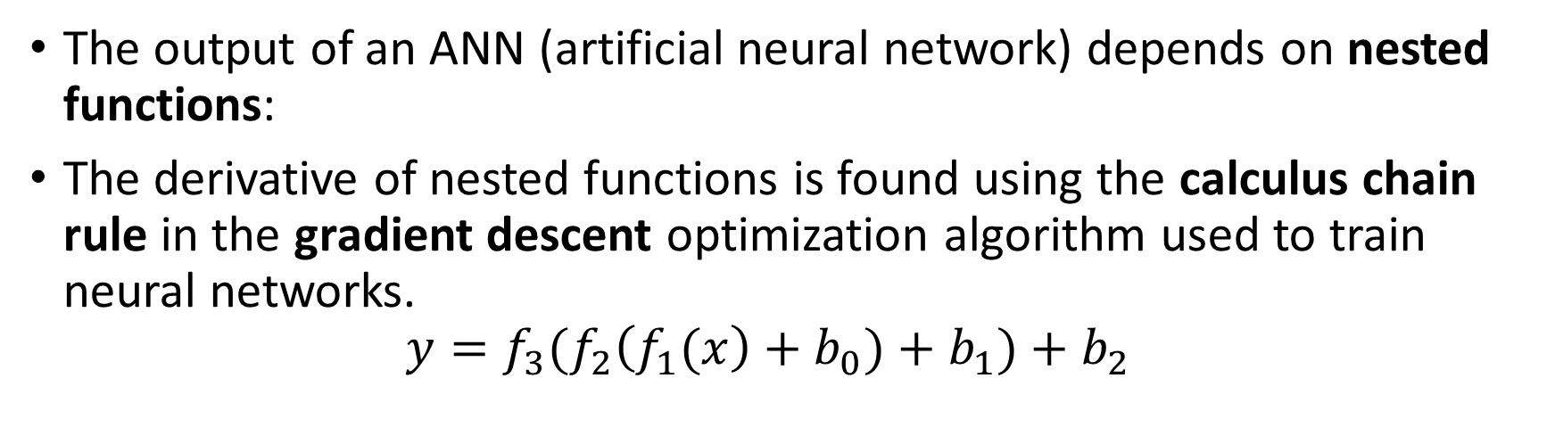
Neural Networks are made up of nested functions
The output of an ANN (artificial neural network) depends on nested functions:
The derivative of nested functions is found using the calculus chain rule in the gradient descent optimization algorithm used to train neural networks. $y=f_{3}(f_{2}\left(f_{1}(x\right)+b_{0})+b_{1})+b_{2}$
Nested nonlinearities
Using the chain rule, we can calculate the derivatives in the back propagation by multiplying together derivatives of individual functions

Slide 39
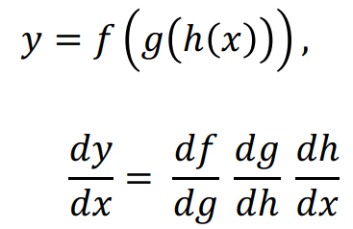
Chain Rule
Given the function
Then

Slide 40
How to calculate partial derivatives
Define simple derivative rules
Create a graph representing the model
Apply simple derivative rules to calculate the derivatives at each node in the graph
The chain rule is utilized to propagate the derivatives through the layers of the model

Slide 41
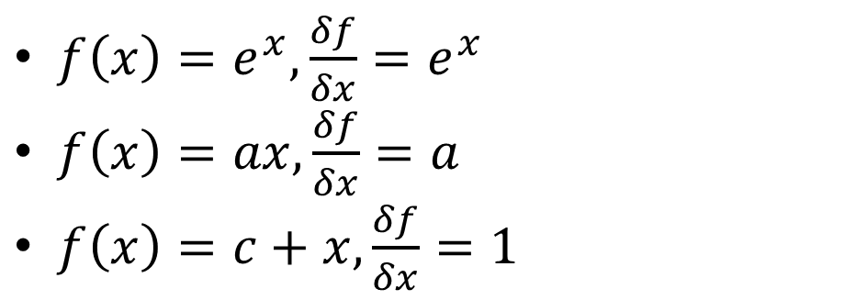
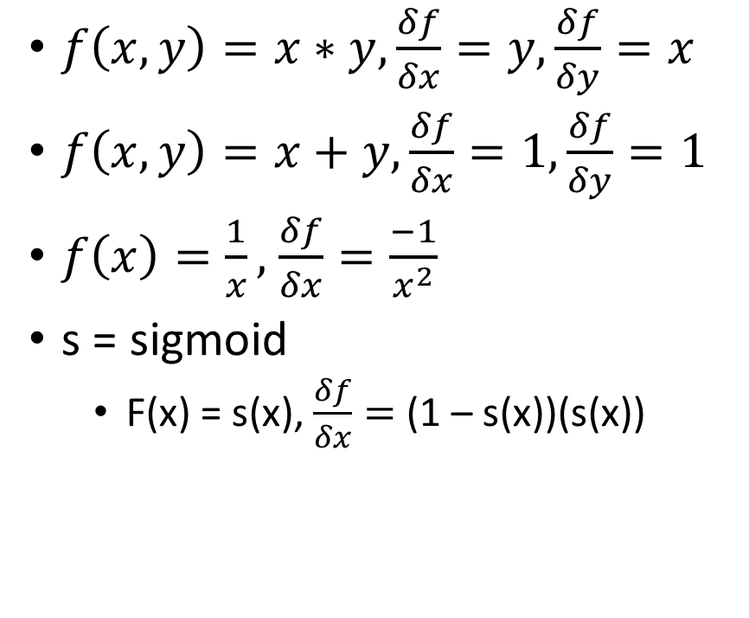
Back Propagation: Simple Derivative Rules
$f\left(x,y\right)=x∗y,\frac{δf}{δx}=y,\frac{δf}{δy}=x$
$f\left(x,y\right)=x+y,\frac{δf}{δx}=1,\frac{δf}{δy}=1$
$f\left(x\right)=\frac{1}{x},$ $\frac{δf}{δx}=\frac{−1}{x^{2}}$
s = sigmoid
F(x) = s(x), $\frac{δf}{δx}=$ (1 – s(x))(s(x))
$f\left(x\right)=e^{x},\frac{δf}{δx}=e^{x}$
$f\left(x\right)=ax, \frac{δf}{δx}=a$
$f\left(x\right)=c+x,\frac{δf}{δx}=1$

Slide 42
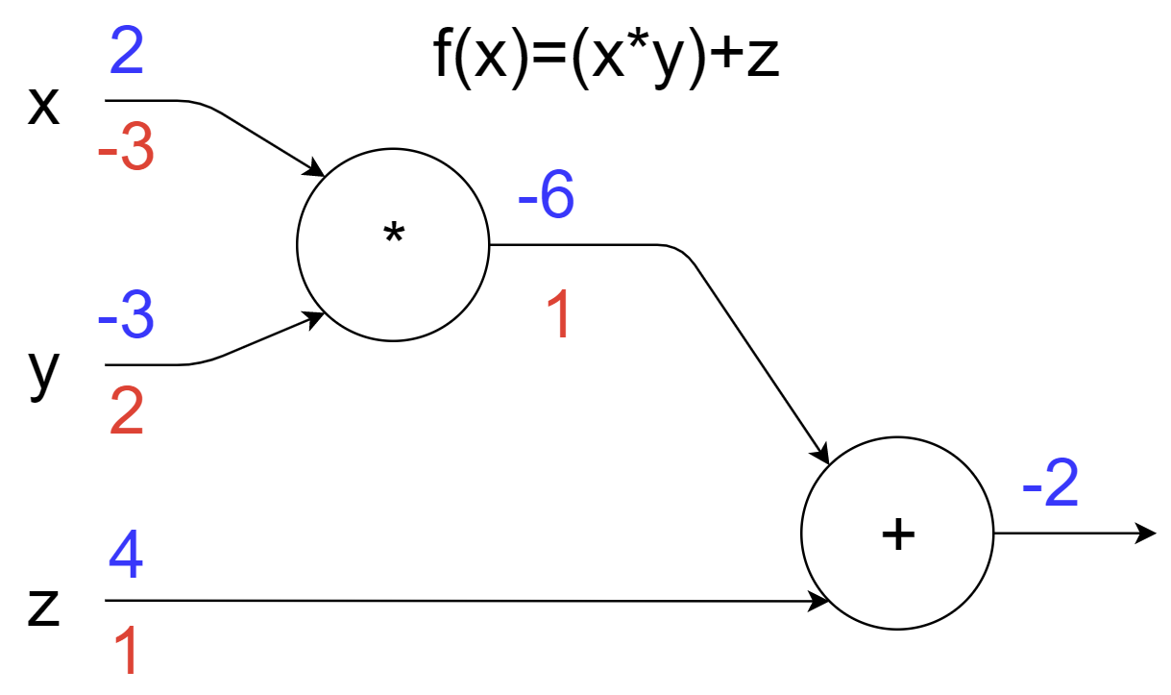
Forward and Back Propagation Example
Forward propagation shown in blue
Backward propagation shown in red
Back propagation values are calculated using simple derivative rules in slide above
The derivative of each node is the product of the derivatives of the following nodes and the output of the previous node

Slide 43
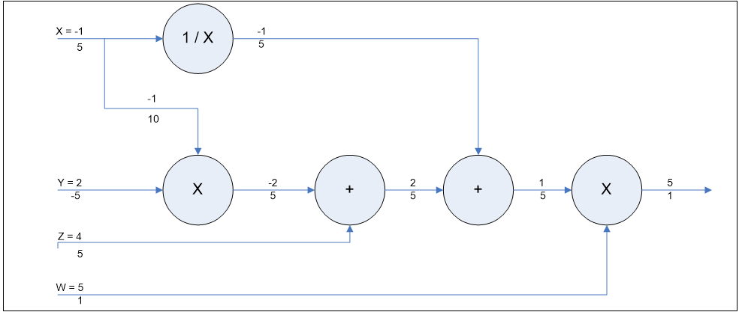
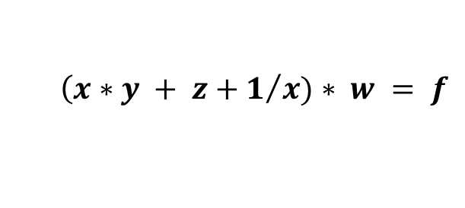
Another Forward and Back Propagation Example
$$\left(x∗y + z+1/x)∗ w = f\right.$$

Slide 44
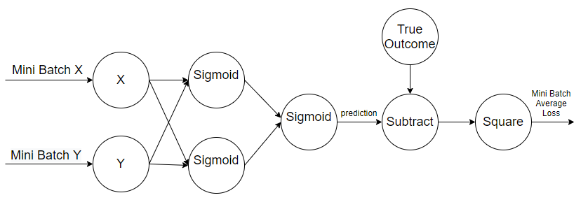
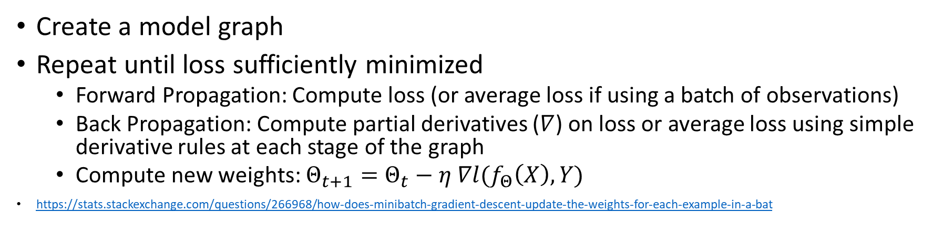
Putting it all together
Create a model graph
Repeat until loss sufficiently minimized
Forward Propagation: Compute loss (or average loss if using a batch of observations)
Back Propagation: Compute partial derivatives ($∇$) on loss or average loss using simple derivative rules at each stage of the graph
Compute new weights: $Θ_{t+1}=Θ_{t}−η ∇l(f_{Θ}\left(X\right),Y)$
https://stats.stackexchange.com/questions/266968/how-does-minibatch-gradient-descent-update-the-weights-for-each-example-in-a-bat

Slide 45
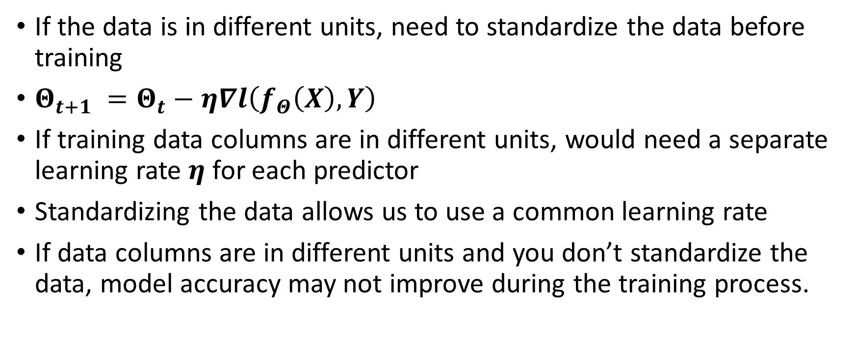
Practical NN training considerations
If the data is in different units, need to standardize the data before training
$Θ_{t+1} =Θ_{t}−η∇l\left(f_{Θ}\left(X\right),Y\right)$
If training data columns are in different units, would need a separate learning rate $η$ for each predictor
Standardizing the data allows us to use a common learning rate
If data columns are in different units and you don’t standardize the data, model accuracy may not improve during the training process.

Slide 46
Spark MultiLayerPerceptron Class
Uses sigmoids as the perceptron
Uses cross entropy as the loss function
Cross entropy calculates the difference between 2 probability distributions: True outcomes vs. predicted outcomes
See https://spark.apache.org/docs/latest/ml-classification-regression.html#multilayer-perceptron-classifier

Slide 47
Spark MultiLayerPerceptron API
class pyspark.ml.classification.MultilayerPerceptronClassifier(featuresCol='features', labelCol='label', predictionCol='prediction', maxIter=100, tol=1e-06, seed=None, layers=None, blockSize=128, stepSize=0.03, solver='l-bfgs', initialWeights=None, probabilityCol='probability', rawPredictionCol='rawPrediction’)
https://spark.apache.org/docs/latest/api/python/pyspark.ml.html#pyspark.ml.classification.MultilayerPerceptronClassifier

Slide 48
Spark MultiLayerPerceptron API
blockSize = Param(parent='undefined', name='blockSize', doc='Block size for stacking input data in matrices. Data is stacked within partitions. If block size is more than remaining data in a partition then it is adjusted to the size of this data. Recommended size is between 10 and 1000, default is 128.’)
stepSize = Param(parent='undefined', name='stepSize', doc='Step size to be used for each iteration of optimization (>= 0).’)
maxIter = Param(parent='undefined', name='maxIter', doc='max number of iterations (>= 0).’)
tol = Param(parent='undefined', name='tol', doc='the convergence tolerance for iterative algorithms (>= 0).')

Slide 49
Attendance
Please fill out the attendance sheet: https://docs.google.com/spreadsheets/d/1G5tiqXQn9mwyubWdINtPI_QONXH1_2U8oYikksgWlss/edit?usp=sharing
Write in a ‘1’ if you are present

