Slide 1
IST407/707 Applied Machine Learning
Clustering Techniques

Slide 2
Helpful textbook chapters
In Tan et al;
Chapter 2.4 Measures of similarity and dissimilarity
Chapter 8.1 cluster analysis overview
Chapter 8.2 kMeans clustering algorithm
Chapter 8.3 HAC algorithm

Slide 3
Cluster Analysis

Slide 4
What is Cluster Analysis?
Finding groups of objects such that the objects in a group will be similar (or related) to one another and different from (or unrelated to) the objects in other groups
Inter-cluster distances are maximized
Intra-cluster distances are minimized

Slide 5
Why is Cluster Analysis Used ?
When analyzing data, we may have millions of items. How can we understand the variance across items?
We might hypothesize that items may only belong to a few groups or classes: items are similar within each segment but different across segments.
Clustering is one way to induce (not deduce!) important groupings that inform subsequent analyses.
E.g. customer segmentation, event analysis, resource utilization, pathogen detection, etc.

Slide 6
What is Cluster Analysis?
Unsupervised learning: no predefined classes
Typical applications
Explore a large data set without prior knowledge about it.
Customer segmentation, document clustering, etc.
Classification without training data
Usually less accurate than supervised learning methods.
Outlier detection
E.g. Identify plagiarism cases
Notes:
Quick review of week 1 clustering applications, customer segmentation, document clustering for organizing searching results

Slide 7
When is Clustering Appropriate?
Automatic cluster detection is a tool for undirected data mining, because the automatic cluster detection techniques find patterns in the data with no target variable.
Automatic cluster detection is an undirected data mining technique that can be used to learn about the structure of complex data. Clustering does not answer any question directly, but studying clusters can lead to valuable insights.
One important application of clustering is customer segmentation. Clusters of customers form naturally occurring customer segments of people whose similarities may include similar needs and interests.
Automatic cluster detection is a form of modeling. Clusters are detected in training data and the rules governing the clusters are captured in a model, which can be used to score previously unclassified data.
After cluster labels have been assigned, they often become input to directed data mining models. They may also serve as reporting dimensions.
Linoff and Berry

Slide 8
Requirements of Clustering in Data Mining
Scalability
Ability to explore large data set
Ability to deal with different types of attributes
Nominal, ordinal, numeric
When we calculate dist. measure between variables, can algorithm handle all different variable types?
Discovery of clusters with arbitrary shape
Spherical vs. other shapes
Easy to cluster using distance-based methods
Difficult to cluster because the two clusters are overlapped

Slide 9
Requirements for effective cluster analysis
Some domain knowledge very helpful for determining input parameters and clustering technique
The number of desired clusters
Strategy for noise and outliers
Insensitive to order of input records
High dimensionality (though depends on technique!)
Sparse data
Interpretability and usability
Able to explain the patterns observed
These are the main aspects needed for effective clustering

Slide 10
Types of Clusterings
A clustering is a set of clusters
Important distinction between hierarchical and partitional sets of clusters
Partitional (flat) Clustering
A division data objects into non-overlapping subsets (clusters) such that each data object is in exactly one subset
Hierarchical clustering
A set of nested clusters organized as a hierarchical tree

Slide 11
Partitional Clustering
Original Points

Slide 12
Partitional Clustering
Original Points
A Partitional Clustering

Slide 13
Hierarchical Clustering
Traditional Hierarchical Clustering
Traditional Dendrogram
Steps
Start with two nearest data examples p2 and p3 and merge into cluster.
Merge with p4 to get larger cluster
Continue process until all data examples are included.

Slide 14
Hierarchical Clustering
Non-traditional Hierarchical Clustering
Non-traditional Dendrogram
We can also use parallel processing to allow examples to be clustered at the same time.
The Dendrogram shows the Process of Hierarchical Clustering .

Slide 15
Major Clustering Approaches
Partitioning approach:
Construct various partitions and then evaluate them by some criterion, e.g., minimizing the sum of square errors
Typical methods: k-means, k-medoids, CLARANS, EM
Hierarchical approach:
Create a hierarchical decomposition of the set of data (or objects) using some criterion
Typical methods: Diana, Agnes, BIRCH, ROCK, CAMELEON
There many Algorithms Available for Clustering

Slide 16
Where Can I Apply K-Means? Here is a list of nine interesting use cases for k-means.
Document Classification
Cluster documents in multiple categories based on tags, topics, and the content of the document. This is a very standard classification problem and k-means is a highly suitable algorithm for this purpose. The initial processing of the documents is needed to represent each document as a vector and uses term frequency to identify commonly used terms that help classify the document. The document vectors are then clustered to help identify similarity in document groups. Here is a sample implementation of the k-means for document clustering.
Delivery Store Optimization
Optimize the process of good delivery using truck drones by using a combination of k-means to find the optimal number of launch locations and a genetic algorithm to solve the truck route as a traveling salesman problem. Here is a whitepaper on the same topic.
Identifying Crime Localities
With data related to crimes available in specific localities in a city, the category of crime, the area of the crime, and the association between the two can give quality insight into crime-prone areas within a city or a locality. Here is an interesting paper based on crime data from Delhi FIRs.
https://dzone.com/articles/10-interesting-use-cases-for-the-k-means-algorithm

Slide 17
Where Can I Apply K-Means? Here is a list of nine interesting use cases for k-means.
Customer Segmentation
Clustering helps marketers improve their customer base, work on target areas, and segment customers based on purchase history, interests, or activity monitoring. Here is a white paper on how telecom providers can cluster pre-paid customers to identify patterns in terms of money spent in recharging, sending SMS, and browsing the internet. The classification would help the company target specific clusters of customers for specific campaigns.
Insurance Fraud Detection
Machine learning has a critical role to play in fraud detection and has numerous applications in automobile, healthcare, and insurance fraud detection. Utilizing past historical data on fraudulent claims, it is possible to isolate new claims based on its proximity to clusters that indicate fraudulent patterns. Since insurance fraud can potentially have a multi-million dollar impact on a company, the ability to detect frauds is crucial. Check out this white paper on using clustering in automobile insurance to detect frauds.
Automatic Clustering of IT Alerts
Large enterprise IT infrastructure technology components such as network, storage, or database generate large volumes of alert messages. Because alert messages potentially point to operational issues, they must be manually screened for prioritization for downstream processes. Clustering of data can provide insight into categories of alerts and mean time to repair, and help in failure predictions.
https://dzone.com/articles/10-interesting-use-cases-for-the-k-means-algorithm

Slide 18
Where Can I Apply K-Means? Here is a list of ten interesting use cases for k-means.
Rideshare Data Analysis
The publicly available Uber ride information dataset provides a large amount of valuable data around traffic, transit time, peak pickup localities, and more. Analyzing this data is useful not just in the context of Uber but also in providing insight into urban traffic patterns and helping us plan for the cities of the future. Here is an article with links to a sample dataset and a process for analyzing Uber data.
Cyber-Profiling Criminals
Cyber-profiling is the process of collecting data from individuals and groups to identify significant co-relations. The idea of cyber profiling is derived from criminal profiles, which provide information on the investigation division to classify the types of criminals who were at the crime scene. Here is an interesting white paper on how to cyber-profile users in an academic environment based on user data preferences.
Call Record Detail Analysis
A call detail record (CDR) is the information captured by telecom companies during the call, SMS, and internet activity of a customer. This information provides greater insights about the customer’s needs when used with customer demographics.
https://dzone.com/articles/10-interesting-use-cases-for-the-k-means-algorithm

Slide 19
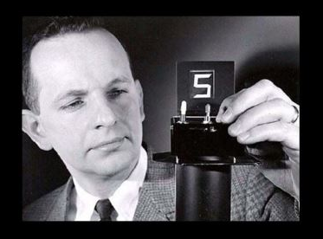
Aside: Heilmeier’s catechsim
George H. Heilmeier, a former DARPA director (1975-1977), crafted a set of questions known as the "Heilmeier Catechism" to help Agency officials think through and evaluate proposed research programs.
What are you trying to do? Articulate your objectives using absolutely no jargon.
How is it done today, and what are the limits of current practice?
What is new in your approach and why do you think it will be successful?
Who cares? If you are successful, what difference will it make?
What are the risks?
How much will it cost?
How long will it take?
What are the mid-term and final “exams” to check for success?

Slide 20
Class Discussion
Your management team wants to implement a Cluster based solution. They would like to understand the risks and benefits of such a solution, and how it could be incorporated into everyday workflows.
Identify a use case and develop the outline of a proposal. Please include:
Context and domain: Provide a sense of the domain and what stakeholders’ needs are.
Objectives (H1): What are the specific objectives you hope to address address?
State of the art (H2): How are these needs currently being met (or aren’t they)?
Method fit (H3): Why is clustering the right method?
Value added (H4): What is the benefit of applying this technique given stakeholder needs?
Data Needed (H5 & H6): What data is necessary and how will we collect it? Are there cost / benefit tradeoffs to consider?
Metrics (H8): How will we know if we’ve been successful?

Slide 21
Distance Measures
https://ensemble.syr.edu/Watch/Distance_Measure

Slide 22
Distance Measures (chapter 2.4)
Similarity and distance: two opposite concepts:
Similarity measures how close/similar two examples are.
Distance measures how far/different two examples are.
The definitions of distance functions are dependent on variable types: numeric, nominal. Many data sets contain mixed types of attributes.
Example: how similar are these two people? i = (Refund = No, Married, Income = 120K) j = (Refund = Yes, Married, Income = 90K)
Three variables in example: (One Numeric, Two Nominal)
How can we compare the similarities or distances between these two examples i and j ?
Notes:
First look at how to deal with numeric variables, then nominal, then how to combine them.

Slide 23
Numeric Attributes
If the data has all numeric attributes, distance measures can compare the numeric values of the attributes:
Some popular ones include: Minkowski distance:
where i = (x_{i1}, x_{i2}, …, x_{ip}) and j = (x_{j1}, x_{j2}, …, x_{jp}) are two p-dimensional data instances, and q is a positive integer
If q = 1, d is Manhattan distance
Taking the absolute value of the differences between attribute values
Notes:
Manhattan distance: how many street blocks to walk from point i to point j in Manhattan? Assume you can’t fly.

Slide 24
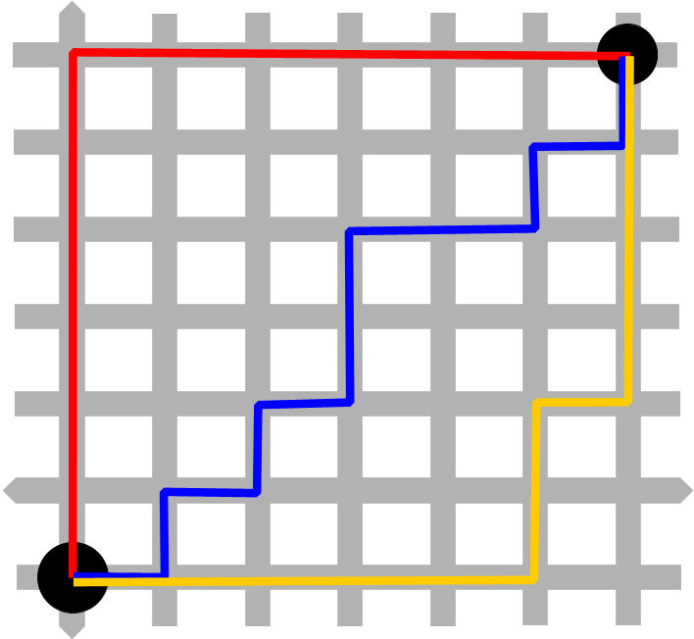
Manhattan Distance
https://upload.wikimedia.org/wikipedia/commons/d/de/Manhattan_distance_bgiu.png

Slide 25
Euclidean distance
When q = 2, d is Euclidean distance:
j
c
a
i
b
Notes:
Euclidean distance: draw a straight line from A to B. The length of the line is the Euclidean distance between A and B.

Slide 26
Properties of distance measure
A distance measure should satisfy the following requirements:
d(i,j) ≥ 0 (non-negative value)
d(i,i) = 0 (zero distance to itself)
d(i,j) = d(j,i) (symmetric measure)
d(i,j) ≤ d(i,k) + d(k,j) (shortest distance between two points) -> triangle inequality

Slide 27
Distance between nominal values
Example: how similar are these two people? i = (Refund = Yes, Married, Income = 120K) j = (Refund = No, Divorced, Income = 90K)
Taxpayer | Refund | Marital Status | Income in thousands
i | Yes | Married | 120
j | No | Divorced | 90

Slide 28
Method 1: simple matching
Taxpayer | Refund | Marital Status | Income in thousands
i | Yes | Married | 120
j | No | Divorced | 90
m: # of matches, p: total # of nominal variables

Slide 29
Method 2: convert nominal to binary variables
Taxpayer | Refund | Marital Status | Income in thousands
i | Yes | Married | 120
j | No | Divorced | 90
Convert a nominal attribute to multiple binary attributes, and treat binary attributes as numeric (0 or 1)
Taxpayer | Refund | Married? | Divorced? | Single? | Income
1 | 1 | 1 | 0 | 0 | 120
2 | 0 | 0 | 1 | 0 | 90

Slide 30
Binary variables: symmetric or asymmetric
All patients run through many tests.
How different are their test results?
Patient | Test1 | Test2 | Test3 | Test4 | Test5 | test6
Jack | 1 | 0 | 1 | 0 | 0 | 0
Mary | 1 | 0 | 1 | 0 | 1 | 0

Slide 31
Binary variables: symmetric or asymmetric
Mary
A contingency table for binary data
Gives the number of attributes of each pair of values
Jack
Patient | Test1 | Test2 | Test3 | Test4 | Test5 | test6
Jack | 1 | 0 | 1 | 0 | 0 | 0
Mary | 1 | 0 | 1 | 0 | 1 | 0
Notes:
A means the number of positive test results they share

Slide 32
Symmetric binary attributes
Object j
Distance measure for symmetric binary attributes:
Object i

Slide 33
Asymmetric binary attributes
Object j
If most test results are negative,
d will be much greater than a, b, and c . Sharing many negative test results is not that informative to doctors.
Distance measure for asymmetric binary attributes:
Object i

Slide 34
Distance between ordinal values
Method 1: treat as nominal
Method 2: treat as numeric

Slide 35
Attributes of Mixed Types
A database may contain different types of attributes
symmetric binary, asymmetric binary, nominal, ordinal, numerical
How to compute the distance between examples with heterogeneous attributes?
Calculate distance for each type of attribute and aggregate

Slide 36
Similarity measure
If defining a distance measure d in [0,1] range, similarity can be defined as 1-d.
Other similarity measures
Cosine similarity measure
Note – beware Euclidean distance in high dimensions!
https://stats.stackexchange.com/questions/99171/why-is-euclidean-distance-not-a-good-metric-in-high-dimensions

Slide 37
Vector space representation and Cosine similarity
Distance/similarity measures
Euclidean distance
Cosine similarity
X=(1,2)
Y=(4,2)
d
α

Slide 38
Cosine similarity
In the range of [0, 1]
“0” means two vectors are perpendicular to each other
“1” means same vector direction and length
Commonly used in information retrieval and text mining to compare document similarity
High-dimensional space
Each word in the vocabulary is a dimension

Slide 39
Importance of Normalization
Sometimes we need to normalize the distance measure so that we don’t cause problems
https://ensemble.syr.edu/Watch/Importance_of_Normalization

Slide 40
Potential Problem Type 1
Different variables might use different scales
Age: [0, 120]
Income: [0, 2M]
If averaging the difference on these two variables, income would weigh much more than age
Solution: normalize both variables to the same scale, e.g. [0, 1]
The dimensions with larger scales can dominate the distance measures while the dimension with smaller numbers will not be as impactful as they should be

Slide 41
Potential Problem Type 2
Lets say we have a collection of documents we want to analyze. Some documents are long, while others are short.
Different examples(documents)/vectors might differ greatly in length
E.g. for text documents, the vector lengths of long documents are much greater than the vector lengths short documents
The longer documents tend to be far away from the short documents bases on the raw Euclidian distance.

Slide 42
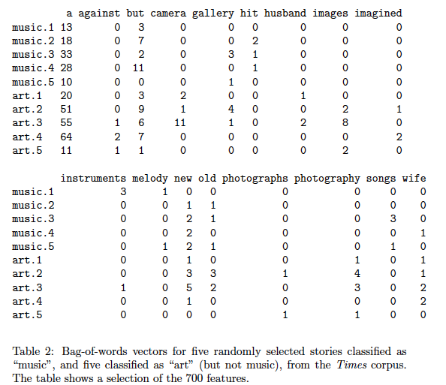
An example of normalization in Information Retrieval
http://www.stat.cmu.edu/~cshalizi/350/lectures/01/lecture-01.pdf

Slide 43
Longer docs tend to be far away from short ones based on raw Euclidean distance
http://www.stat.cmu.edu/~cshalizi/350/lectures/01/lecture-01.pdf

Slide 44
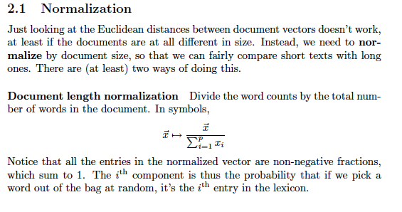
Normalization by doc length (L-1)

Slide 45
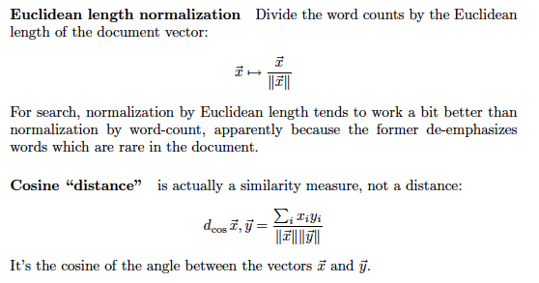
Normalization by Euclidean length (L-2)

Slide 46
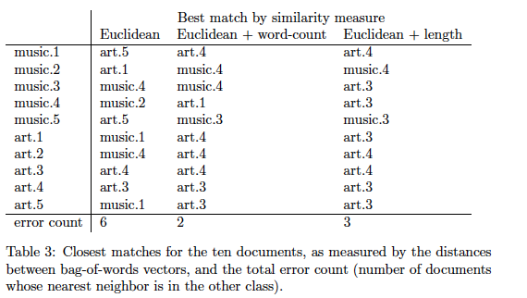
Compare results with/without normalization

Slide 47
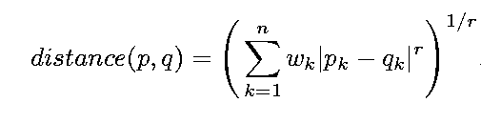

Weighted distance/similarity
For some data, some dimensions are more important than others, and thus their similarity/distance carries more weight. In these cases, we can assign different weights to individual dimensions/attributes.
e.g.

Slide 48
Similarity/Distance measure in R
# define a function that calculates the Euclidean distance between two vectors a and b
ED = function(a, b) sqrt(sum((a-b)^2))
# define a function that calculates the Cosine similarity between two vectors a and b
CS = function(a,b) a%*% b/sqrt(a%*%a * b%*%b)
# given two vectors a and b
a=c(1,2,3)
b=c(4,5,6)
# call functions to calculate distance
ED(a,b)=5.196
CS(a,b)=0.975

Slide 49
Summary of distance/similarity
Manhattan and Euclidean distance for numeric variables
Properties of distance measure
Distance for nominal variables: count matches or convert to binary
Symmetric vs. asymmetric binary variables
Convert ordinal to either numeric or nominal
Calculate distance/similarity on each attribute or attribute group and then average over all
Cosine similarity
Importance of normalization

Slide 50
K-MEANS ALGORITHM

Slide 51
Centroid / Medoid of a Cluster
Centroid: the “gravity center” of a cluster, which is calculated as the average of all data examples in a cluster
For numeric variable, use the mean as the average
For nominal data, use mode as the average
Medoid: the data item that is closest to the centroid (or whose sum of dissimilarities to other objects is minimized)

Slide 52
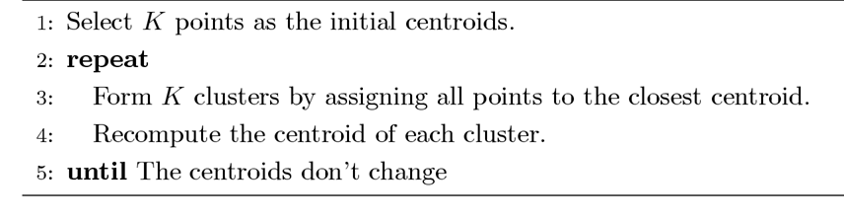
The K-Means Clustering Method

Slide 53
The K-Means Clustering Method
Example
10
10
9
9
8
8
7
7
6
6
5
5
4
Assign each objects to most similar center
Update the cluster means
4
3
3
2
2
1
1
0
0
0
1
2
3
4
5
6
7
8
9
10
0
1
2
3
4
5
6
7
8
9
10
reassign
reassign
K=2
Arbitrarily choose K points as initial cluster centers
Update the cluster means

Slide 54
Importance of Choosing Initial Centroids
A good clustering result

Slide 55
Importance of Choosing Initial Centroids

Slide 56
Importance of Choosing Initial Centroids …
A less meaningful result

Slide 57
Importance of Choosing Initial Centroids …

Slide 58
TUNING K-MEANS
https://ensemble.syr.edu/Watch/Tuning_kMeans

Slide 59
Solutions to Initial Centroids Problem
Choosing the initial Centroid is very important for k-means. If we choose initial bad centroid, we will not get meaningful results
Multiple runs, changing random seeds every time
Helps, but probability is not on your side, esp. for many dimensions
Sample and use hierarchical clustering to determine initial centroids
Select more than k initial centroids and then select among these initial centroids
Select most widely separated

Slide 60
Compare SSE of different initial centroids
Most common measure is Sum of Squared Error (SSE)
x is a data point in cluster C_{i} and m_{i} is the centroid/medoid for cluster C_{i}
For each point, the error is the distance to the centroid/medoid
To get SSE, we square these errors and sum them.
Given two clustering results with SAME number of clusters, we can choose the one with the smallest SSE

Slide 61
Be careful with SSE
Attention! One easy way to reduce SSE is to increase K, the number of clusters.
However, we must be careful. When K equals the data set size(# of clusters = # of data points in data set), each data point will end up as its own cluster, SSE=0.
Don’t simply use K to reduce SSE. K should have a reasonable range of value in real applications.

Slide 62
What if the iteration never stops?
It’s possible that the k-Means algorithm could reiterate endlessly. Want can we do to control?
Set max number of iterations
Set min value of SSE change
Set slightly above 0

Slide 63
Choosing K
Domain knowledge should provide a range
Several approaches to optimizing from there
The Elbow method (Scree plot of SSE)
The Silhouette Method

Slide 64
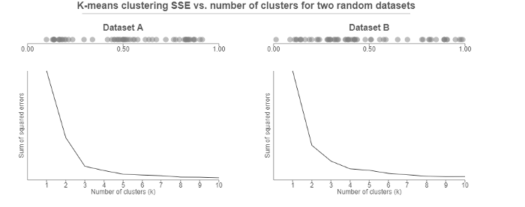
The Elbow Method
Calculate SSE across a range of reasonable Ks
Plot the results
Pick the “elbow”
Here, it’s pretty clear
Here, not so much

Slide 65
The Elbow Method: Limitations
Somewhat subjective
Comparing SSEs between different values of k is subject to some pitfalls
Usually a good idea to verify with another method

Slide 66
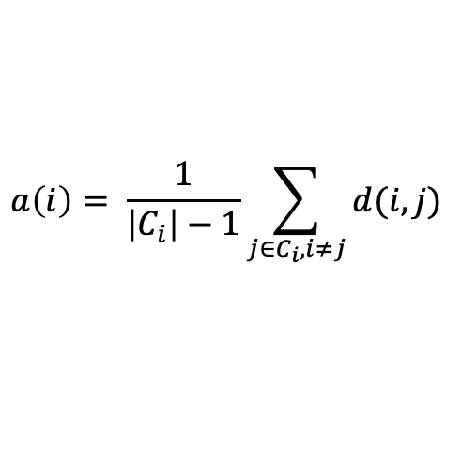
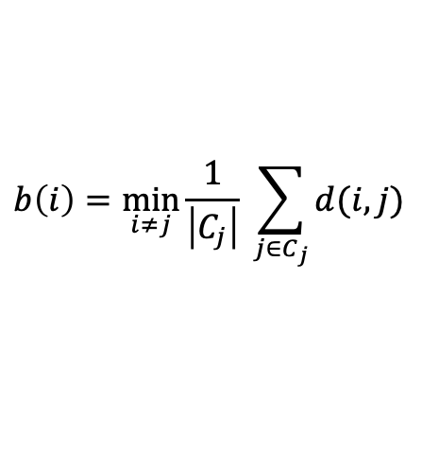
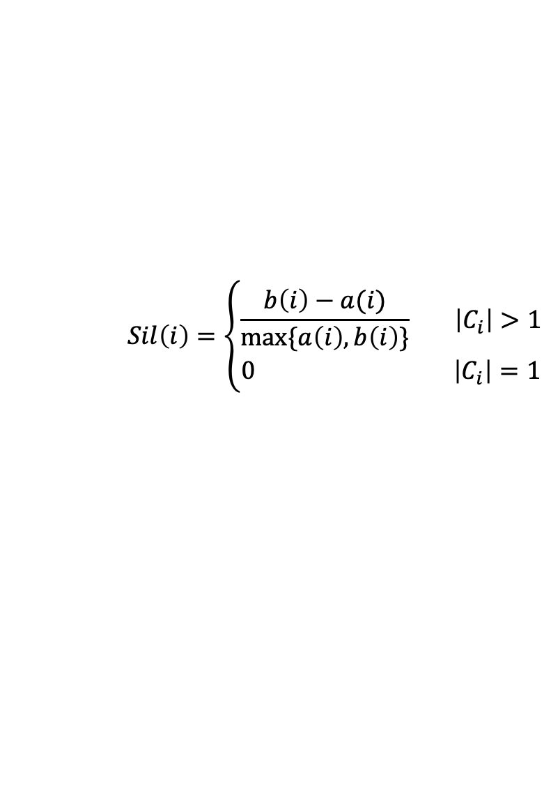
The Silhouette Method
The Silhouette value measures how similar a point is to its own cluster (cohesion) compared to other cluster (separation).
$$Sil\left(i\right)=\left\{\begin{aligned}\frac{b\left(i\right)−a(i)}{max⁡\{a\left(i\right),b\left(i\right)\}} \left|C_{i}\right|>1 \\ &0 \left|C_{i}\right|=1\end{aligned}\right.$$
Mean intra-cluster distance
Mean distance to closest cluster
$$a\left(i\right)= \frac{1}{\left|C_{i}\right|−1}\sum_{j∈C_{i}, i≠j}{d(i,j)}$$
$$b\left(i\right)=\min_{i≠j}{\frac{1}{\left|C_{j}\right|}} \sum_{j∈C_{j}}{d(i,j)}$$

Slide 67
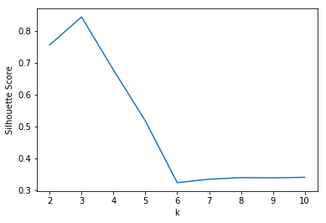
Using The Silhouette Method
Compute the average silhouette value for clusterings at each value of k.
Graph
Pick the peak

Slide 68
Choosing K - Summary
The Elbow method and Silhouette method are complementary.
Many other methods are available (e.g., statistical methods), and sometimes all can be applied at once using a simple clustering library.
Majority vote wins!
In general, you should apply at least a couple of methods.
As always, domain knowledge should be your guide!

Slide 69
Use Medoids to resist outliers in K-means
The k-means algorithm is sensitive to outliers !
Since an object with an extremely large value may substantially distort the distribution of the data.
K-Medoids: Instead of taking the mean value of the object in a cluster as a reference point, medoids can be used, which is the most centrally located object (data point) in a cluster.
10
10
9
9
8
8
7
7
6
6
5
5
4
4
3
3
2
2
1
1
0
0
1
2
3
4
5
6
7
8
9
10
0
0
1
2
3
4
5
6
7
8
9
10

Slide 70
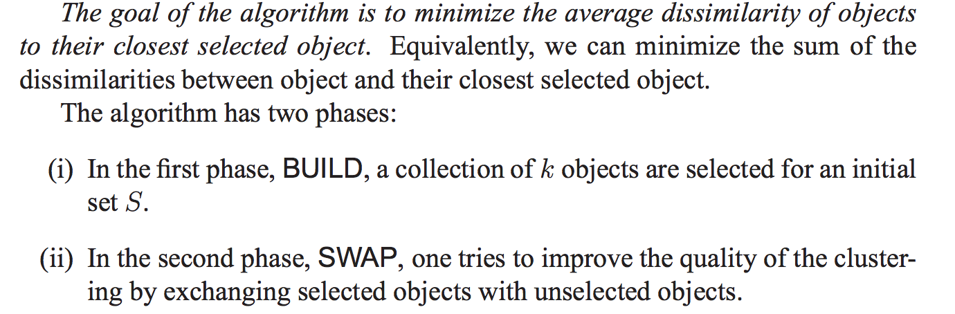
PAM: a k-Medoid algorithm
http://www.cs.umb.edu/cs738/pam1.pdf
PAM: Partition around medoids
K-Medoid is an alternative algorithm to handle outliers.

Slide 71
Variations of the K-Means Method
K-Means is called a hard cluster algorithm because data points can only belong to one cluster.
One variation are the mixture models (soft clustering)
Estimates clusters from probability distributions
Includes the Expectation Maximization (EM) algorithm

Slide 72
Cluster Validity
For classification we have training data, so we can evaluate how good the model is. In a cluster, w do not have training so we do not know how good the model is.
For supervised classification we have a variety of measures to evaluate how good our model is
Accuracy, precision, recall
For cluster analysis, the analogous question is how to evaluate the “goodness” of the resulting clusters?
Some say “clusters are in the eye of the beholder”! But is that our only option ?

Slide 73
Different Methods for Cluster Validation
Cluster Cohesion: Measures how closely related are objects in a cluster
high intra-class similarity
SSE as a cohesion measure
Cluster Separation: Measure how distinct or well-separated a cluster is from other clusters
low inter-class similarity
The Silhouette Method is one measure that combines these
Validating the Cluster results can be challenging.
Comparing the results of a cluster analysis to externally known results
Confirm with domain experts
cohesion
separation

Slide 74
Comments on the K-Means Method
Strength: Relatively efficient:
Weakness
Need to specify k, the number of clusters, in advance. Can be challenging.
Sensitive noisy data and outliers
Not suitable to discover clusters with non-convex shapes

Slide 75
Final Comment on Cluster Validity
“The validation of clustering structures is the most difficult and frustrating part of cluster analysis.
Without a strong effort in this direction, cluster analysis will remain a black art accessible only to those true believers who have experience and great courage.”
Algorithms for Clustering Data, Jain and Dubes
Make sure you spend enough time to inspect clusters. Experiment with different k values to see impact on results.
Not Easy But Important

Slide 76
HIERARCHICAL AGGLOMERATIVE CLUSTERING

Slide 77
Hierarchical Clustering
Produces a set of nested clusters organized as a hierarchical tree
Can be visualized as a dendrogram
A tree like diagram that records the sequences of merges or splits

Slide 78
Dendrogram: Shows How the Clusters are Merged
Decompose data objects into a several levels of nested partitioning (tree of clusters), called a dendrogram.
A clustering of the data objects is obtained by cutting the dendrogram at the desired level, then each connected component forms a cluster.

Slide 79
Strengths of Hierarchical Clustering
Do not have to assume any particular number of clusters
Any desired number of clusters can be obtained by ‘cutting’ the dendrogram at the proper level
They may correspond to meaningful taxonomies

Slide 80
Agglomerative Clustering Algorithm
More popular hierarchical clustering technique
Basic algorithm is straightforward
Let each data point be a cluster
Compute the distance matrix
Repeat
Merge the two closest clusters
Update the distance matrix
Until only a single cluster remains
Key operation is the computation of the distance of two clusters
Different approaches to defining the distance between clusters distinguish the different algorithms

Slide 81
Starting Situation
Start with clusters of individual points and a distance matrix
p1
p2
p3
p4
p5
. . .
p1
p2
p3
p4
p5
.
.
.
Distance Matrix

Slide 82
How to Define Inter-Cluster Distance
Similarity?
Single-linkage
Complete-linkage
Average-linkage
Centroid-linkage
Ward’s method
Notes:
Did you get to compute distance between clusters in k-Means?
No, because in k-Means we only compute new centroids and the distance between data points and the centroids

Slide 83
How to Define Inter-Cluster Distance
Single-linkage
Minimum distance between two clusters
The distance between a pair of closest members
Pros and cons
Depends only on the distance ordering
Sensitive to outliers
Clusters with large diameters

Slide 84
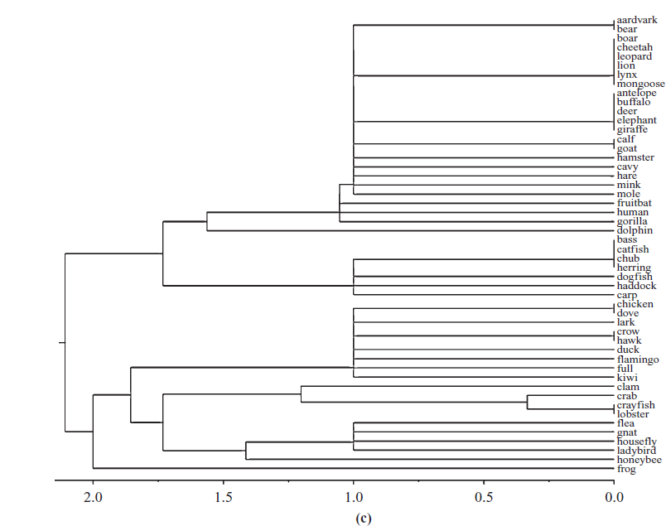
Single-linkage

Slide 85
How to Define Inter-Cluster Distance
Complete-linkage
Maximum distance between clusters
The distance between a pair of farthest members
Pros and cons
Depends only on the distance ordering
Sensitive to outliers
Clusters with small diameters
Distance Matrix

Slide 86
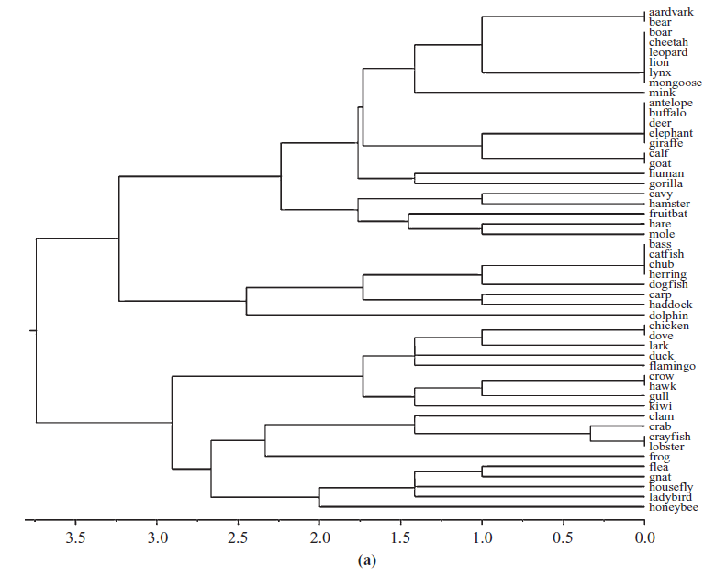
Complete-linkage

Slide 87
How to Define Inter-Cluster Distance
×
×
To overcome sensitivity to outliers:
Average-linkage: The average distance between each pair of members of the two clusters
Centroid-linkage: Distance between two centroids
Notes:
Does average-linkage require more computational cost than single linkage or complete linkage?
No, because all three methods require computing distance between all pairs

Slide 88
How to Define Inter-Cluster Distance
Ward’s method: minimize the increase in SSE for each cluster
Recall:
Pros and cons
Creates compact, evenly sized clusters
Presumes clusters of similar density

Slide 89
Hierarchical Clustering: Problems and Limitations
Once a decision is made to combine two clusters, it cannot be undone
No objective function is directly minimized–how to choose a cutoff?
Different linkage calculations have problems with one or more of the following:
Sensitivity to noise and outliers
Difficulty handling different sized clusters and convex shapes
Breaking large clusters
Note that Ward’s method and complete linkage are usually preferred

Slide 90
Exercise
In Orange the HierarchicalClusterer is a classic HAC algorithm.
Question 1: using the “classes to clusters evaluation”, run HierarchicalClusterer on the Iris data using single linkage and complete linkage. Which one led to better result? Can you explain why?
Question 2: compare k-Means and HAC performance in clustering animals in the zoo data set. Which algorithm gave better result (based on Orange’s class-to-cluster accuracy measure), in what parameter setting?

