Slide 1
Internship Review - 3
Name : Chaithra M
University No : 4MT23MC012
Department : Master of Computer Applications
College Name : Mangalore Institute of Technology and Engineering
Company : Accelerlab solutions pvt. Ltd
Duration : 10 weeks
Internal guide: Ms.Yogitha M
External guide: Mr. Krishnamurthy Bhat Kakunje

Slide 2
Company Overview – Accelerlab Solutions Pvt. Ltd.
Founded: 2017 (initially as a freelance group)
Location: Moodbidri, Karnataka
Focus: Full-stack web development & scalable tech solutions
Mission: Deliver innovative, functional, and user-centric web applications
Services: Frontend, backend, UI/UX, version control,
deployment, and API integration
Strengths: Agile development, client-centric solutions, collaborative work culture

Slide 3
Internship Scope & Learning Objectives
Scope: End-to-end full stack web development using
modern frameworks and tools.
Learning Objectives:
Apply theoretical knowledge to real-world projects.
Gain practical experience with HTML, CSS, JavaScript,
ReactJS, Node.js, MongoDB.
Build responsive, secure, and interactive web applications.
Implement RESTful APIs and integrate frontend-backend systems.

Slide 4
Technologies, Tools, and Frameworks
Frontend: HTML, CSS, Tailwind CSS, JavaScript, Bootstrap, ReactJS
Backend: Node.js, Express.js
Database: MongoDB Atlas
Tools: Git, GitHub, Postman, Visual Studio Code
Deployment & API: JWT for authentication, Axios for API integration

Slide 5
Frontend Development Approach
Used ReactJS for component-based architecture
Styled using Tailwind CSS for utility-first rapid UI development
Designed with responsive principles (Flexbox, Grid, media queries)
Created dynamic forms and layouts with React state and props
Integrated React Router for smooth single-page navigation

Slide 6
Backend Development Approach
Developed REST APIs using Express.js
Managed schemas and CRUD operations with MongoDB + Mongoose
Implemented authentication & authorization with JWT
Built secure endpoints for different user roles (Admin, Manager, Staff)
API Testing using Postman

Slide 7
Project Contributions
Food Delivery System (Main Project)
Multi-role system :(Admin, Delivery Boy, User)
Modules: user authentication and registration
restaurant, menu management
order placement and tracking

Slide 8
Tools & Technologies Used:
Frontend Development: JavaScript, HTML, CSS
Backend Development: Express, Node.js
Frameworks/Libraries: React.js, Tailwind CSS, Bootstrap,
IDEs: Visual Studio Code
Databases: MongoDB
Other Tools: GitHub
Postman as API

Slide 9
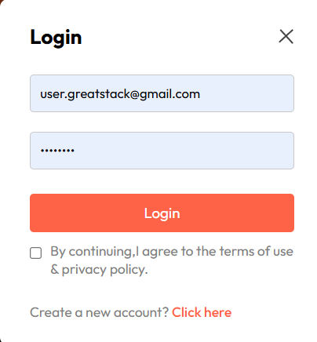
Implementation (Food delivery System)
Figure 1: Login Interface

Slide 10
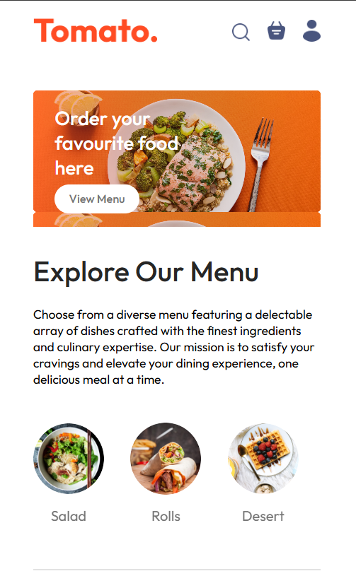
Implementation (FOOD DELIVERY SYSTEM)
Figure 2: Home Page

Slide 11
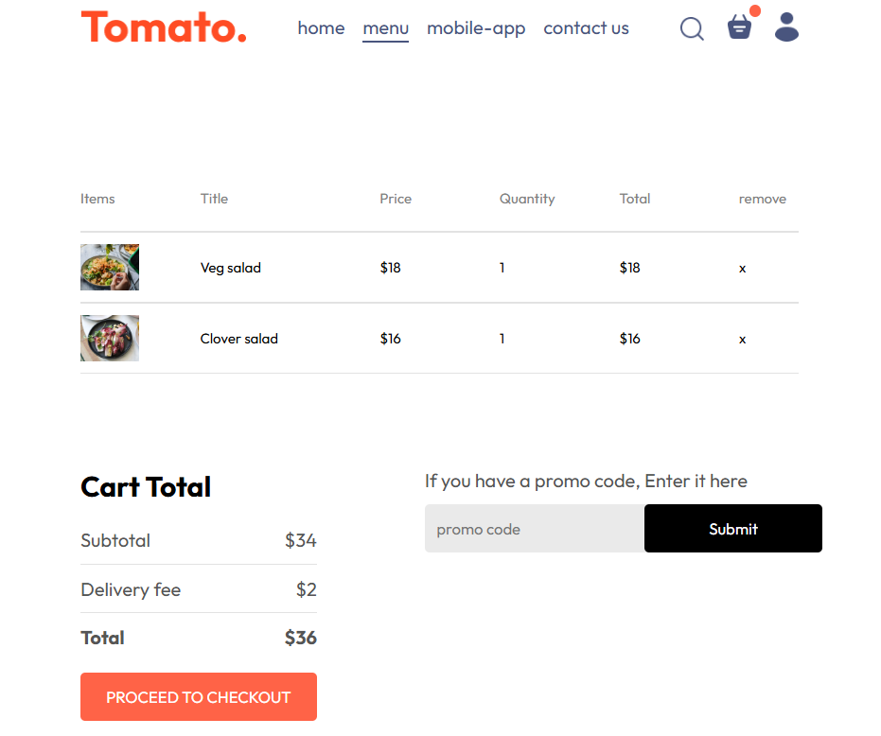
Implementation (FOOD DELIVERY SYSTEM)
Figure 3: Add to cart page

Slide 12
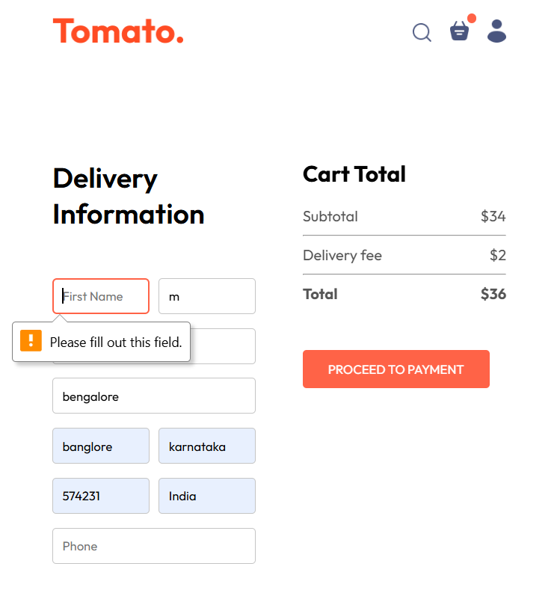
Implementation (FOOD DELIVERY SYSTEM)
Figure 4: Delivery Information page

Slide 13
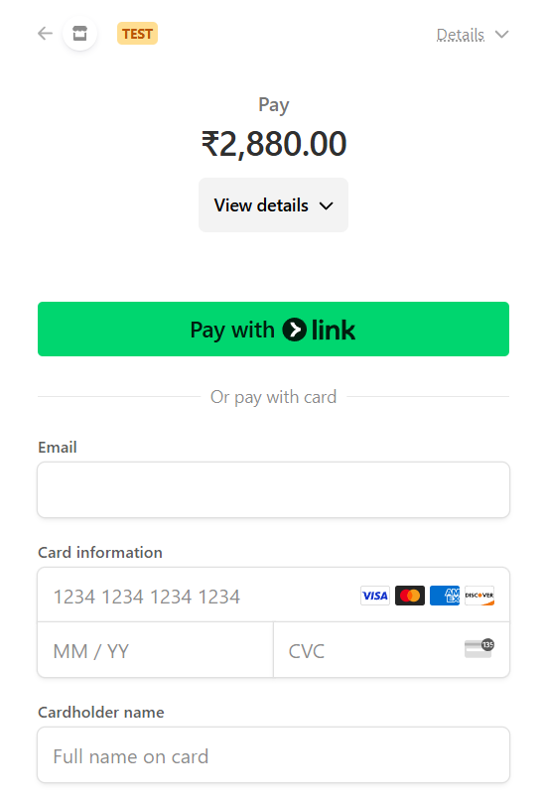
Implementation (FOOD DELIVERY SYSTEM)
Figure 5: Payment page

Slide 14
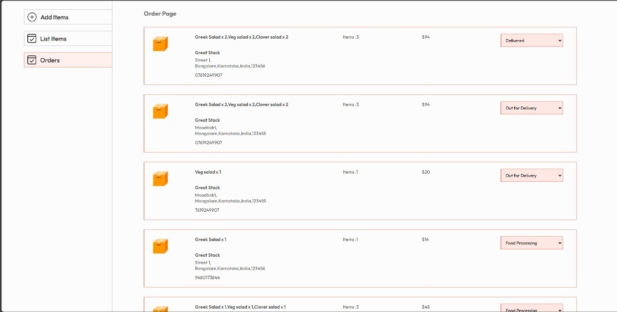
Implementation (Inventory Management System)
Figure 6: Delivery Status

Slide 15
Challenges and Problem-Solving
Learning Tailwind CSS: Overcame steep learning curve with
documentation and component practice
Authentication Flow: Secured backend routes using JWT; debugged using Postman
State Management: Managed complex UI states using React hooks
Frontend-Backend Sync: Used Axios & Express middleware for seamless integration

Slide 16
Results & Outcomes
Built fully responsive frontend pages
Developed complete backend APIs with authentication
Gained confidence in MERN stack development
Delivered modules for real-world usage

Slide 17
Conclusion
Successfully bridged the gap between academic theory and industrial practice
Gained full-stack development proficiency and professional confidence

