Slide 1
Welcome
1
MyServiceNeed
Social platform to post service needs and find service work
https://myserviceneed.com

Slide 2
What Services people can share?
2
1) Event Services
2) House/Construction Work
3) Repair Services
4) Vehicle Services
5) Health Services
6) Agriculture Services
7) Social Services
8) Sports Services
9) Business Services
10)Personal Services and more
List will get added with more services

Slide 3
Problem
3
Price is an important concern for customers to get their service done.
Current platforms leave you disconnected from the service providers near to you.
No easy way exists to get my service done for less cost by service providers near to me.

Slide 4



Solution
4
A web platform where users can post their service need and service providers near to user can respond :
SAVE
MONEY
while getting your service
need done
MAKE
MONEY
when providing services near to you
Service Requester
Service Provider

Slide 5
Establishing Network: Our First Priority
5
For LinkedIn, PayPal, and Google the key is the network.
Where the network is the key the first mover is critical to revenue.
PayPal waited until 4 million registered users before turning on revenue.

Slide 6
Market Size
6
10 Billion+
1Million
1Billion
SERVICES BOOKED (WORDLWIDE)
Total Available Market
BUDGET & ONLINE SERVICES
Serviceable Available Market
SERVICES
MyServiceNeed
Market Share

Slide 7

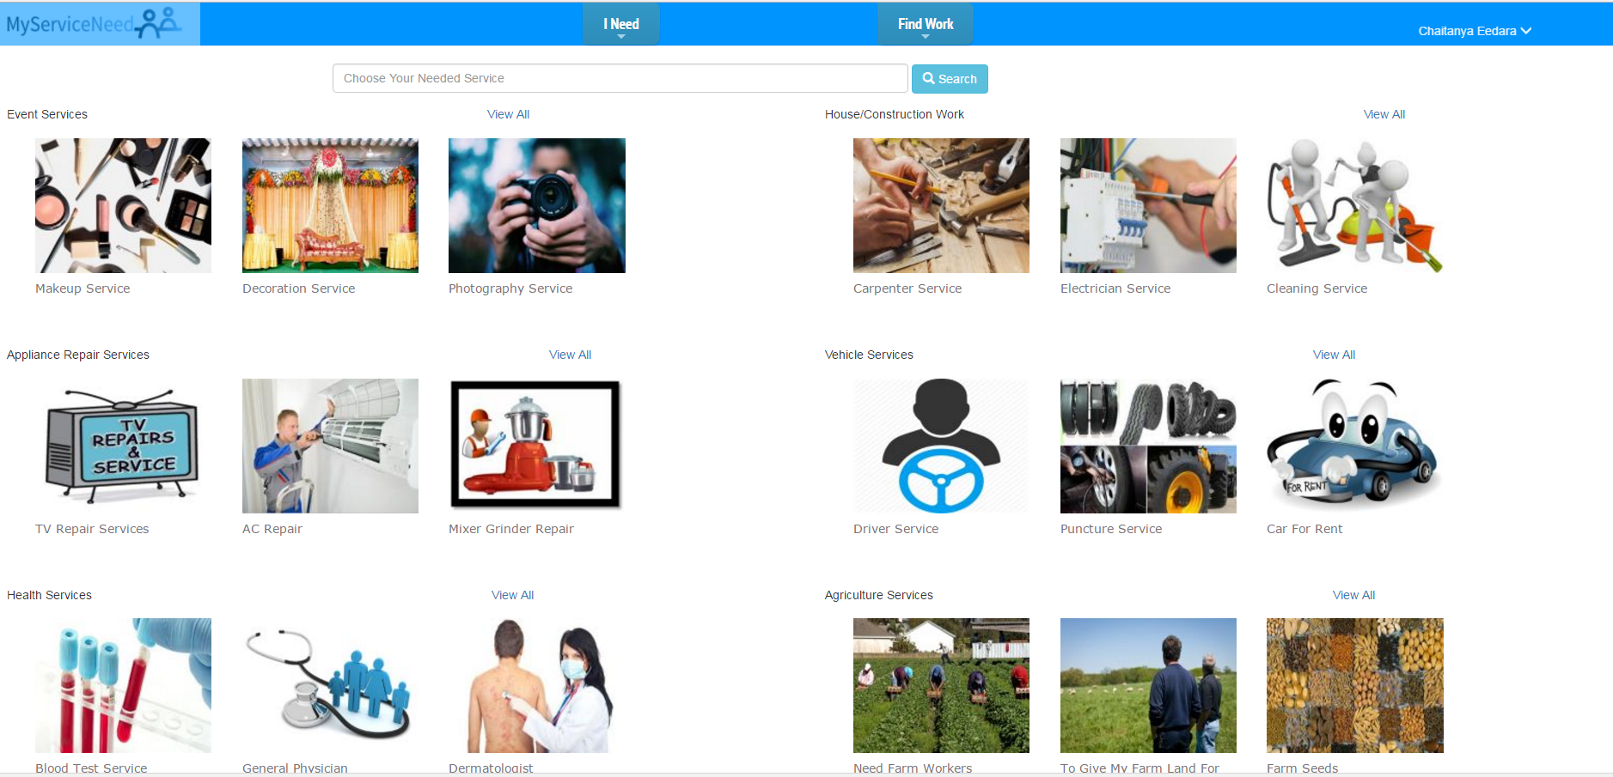

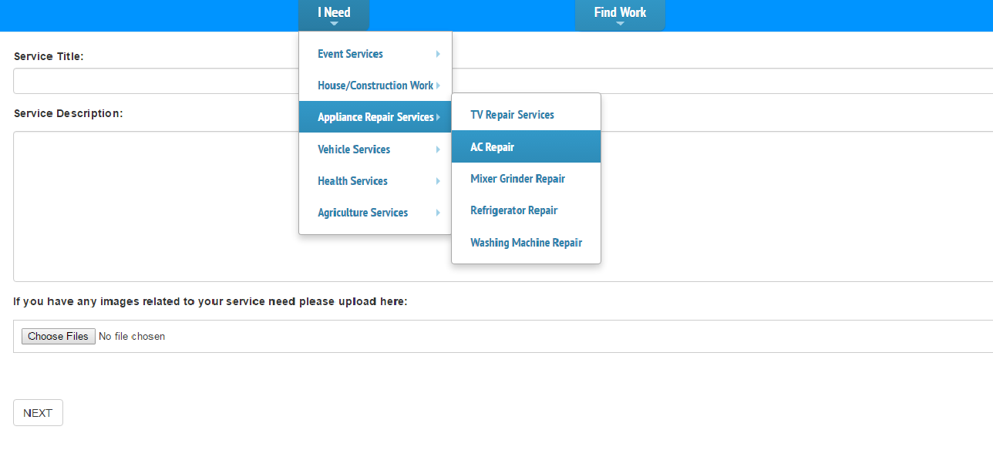
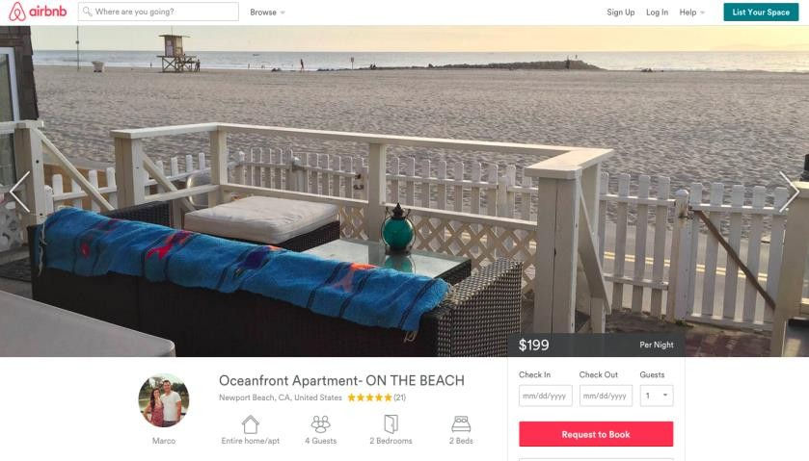

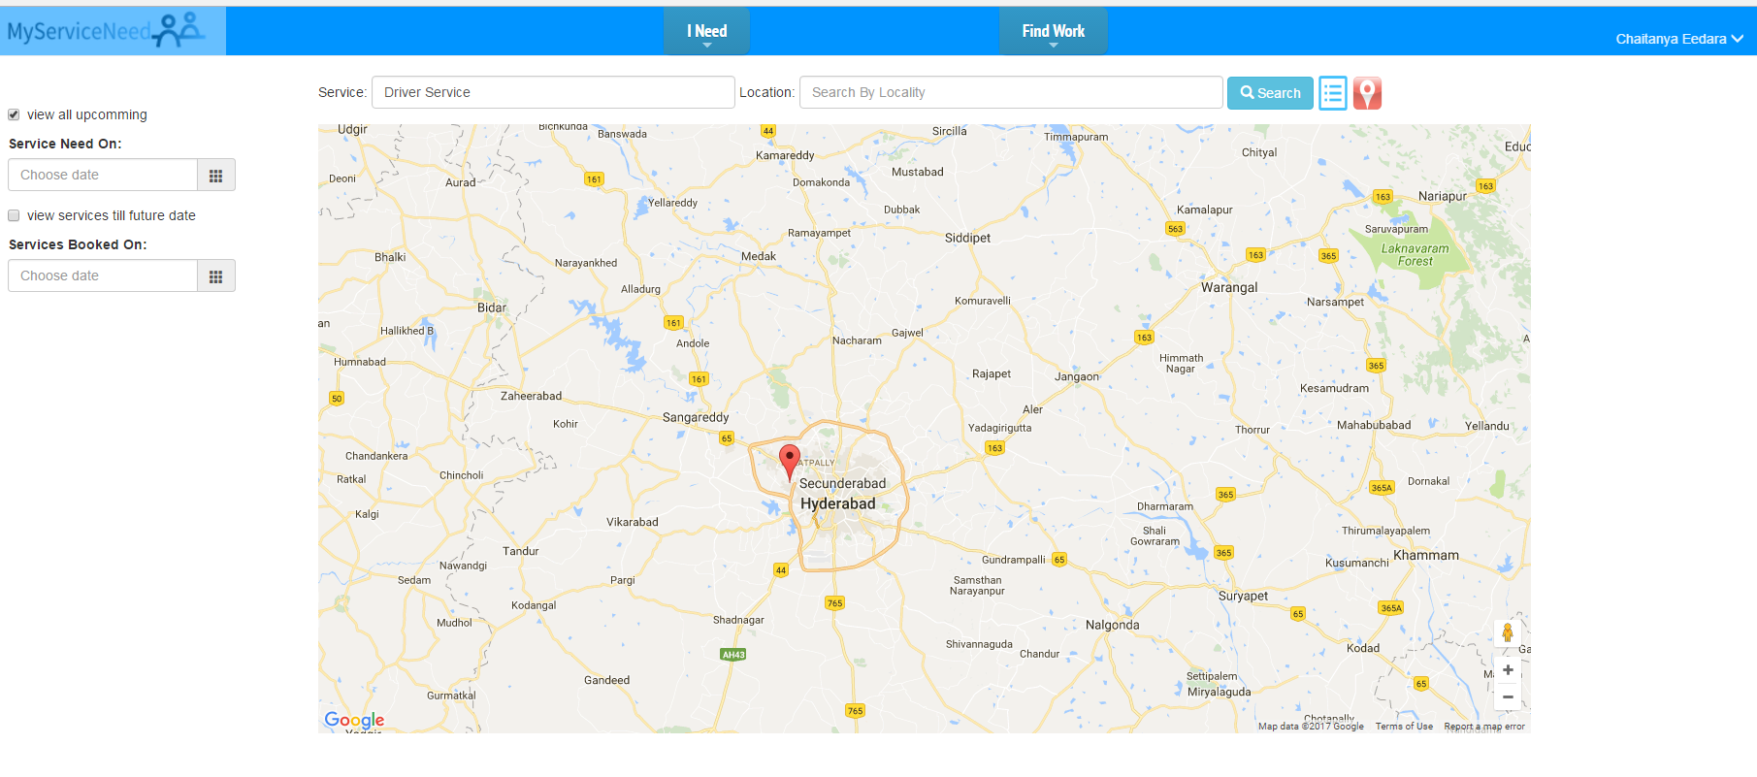
Product
7
CHOOSE YOUR NEED
POST YOUR SERVICE NEED
FIND SERVICE WORK
RESPOND TO SERVICE NEEDS NEAR TO YOU

Slide 8
Business Model
8
We charge from user who view more than 10 service needs per a Day(In find work section).
1crore /day
1million/day
Rs 10
MyServiceNeed
Share of Market
AVG FEE
View 50 Needs with Rs.10
REVENUE
2017-?
Note: Depends on type of service work viewed, number of views available will change.

Slide 9
Competition
9
AFFORDABLE
Urbanclap
Ramukaka
Sulekha
Quikr
Freelancer
Other sites
(exist in urban areas.)
OFFLINE TRANSACTION
ONLINE TRANSACTION
EXPENSIVE

Slide 10
Competitive Advantages
10
1st TO MARKET
Social Platform
EASE OF USE

Slide 11
Challenges
High marketing costs.
2) Consumer acceptance and brand recognition.
3) Identity of the service provider. (since we are making it as open platform for finding service works).

