Slide 1
LEAD SCORING CASE STUDY
Proposed by Abinesh, Binod, Chaithanya

Slide 2
PROBLEM STATEMENT
An education company named x education sells online courses to industry professionals. The company market its course on several websites and search engines like google.
Company wants to select most promising leads that can be converted to paying customers.
Though company generates a lot of leads, only a few get converted.
Company had 30% conversion rate by approaching those leads which are found to be having interest in taking the course.

Slide 3
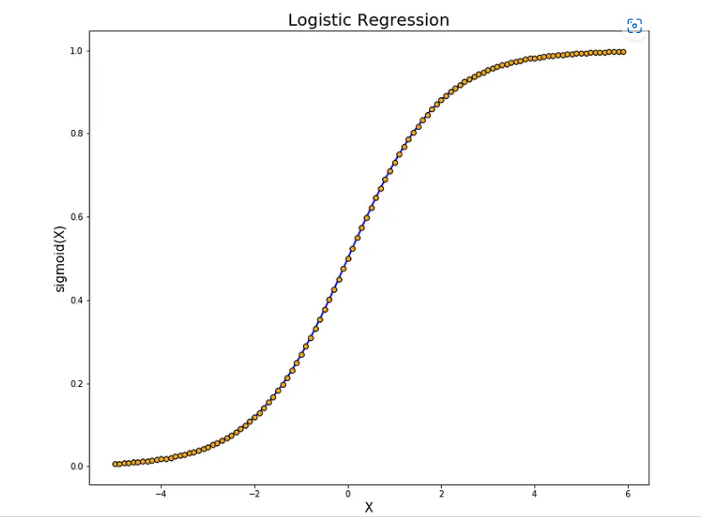
BUSINESS GOAL
Build a logistic regression model to assign a lead score between 0 to 100 to each of the leads, which can used by the company to target potential leads.
Higher lead score would mean “HOT LEAD” is having higher chance of getting convert.
The model to be built in lead conversion rate around 80% or more.

Slide 4
ANALYSIS APPROACH
Receiving the relevant data for analysis.
Clean the data and setup for further analysis.
EDA for relationship of various attributes within the data.
Separating out train and test set if separate test set is not available.
Scaling the features.
Build the model by referring P-value for significance of independent variable on the dependent variable and also VIF value.
Assigning the lead score to each leads.
Evaluation of model using different metrics.
Evaluate the model on test set like we did for train set.
Calculate lead score

Slide 5
ASSUMPTIONS TAKEN FOR THE ANALYSIS
Dropped the column with more than 40% missing values.
Dropped the duplicate rows from analysis.
Few columns have ‘select ’ as values. Replacing those values with null values.
In case of missing values less than 40% , missing values are replaced with median or mode or highest rank values.
for numerical values, outlier values have been replaced by maximum quartiles range.
Dropped the columns with highly skewed values.

Slide 6
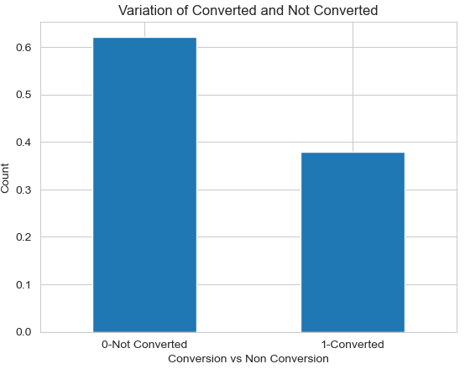
DATA IMBALANCE
For data imbalance, ratio of number of occurrences of converted to number of occurrences of not converted.
Converted values : 37%
Not Converted values : 62%
The resulting ratio represents the imbalance between the two classes, indicating whether one class is significantly more prevalent than other.

Slide 7
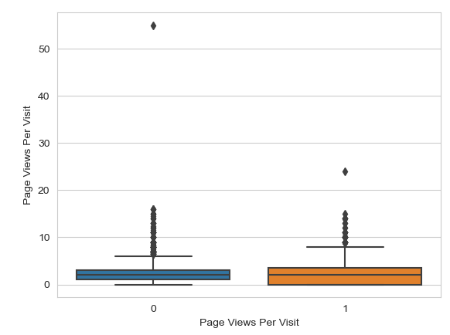
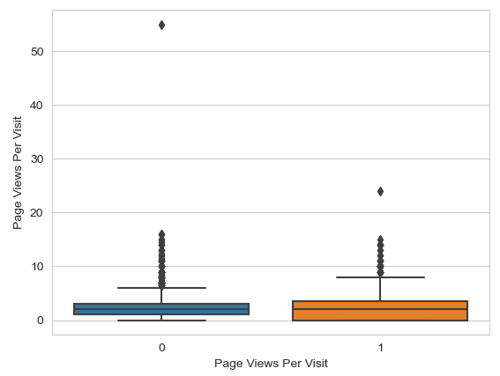
OUTLIER ANALYSIS
Considering the presence of outliers in the “Total visit”, “page view per visit”, it is advisable to employ a technique such as capping and flooring to achieve the desired variance in these values.
By setting appropriate upper and lower thresholds, extreme values can be truncated, ensuring that the data remains within a reasonable range and allowing for more meaningful analysis and interpretation.

Slide 8
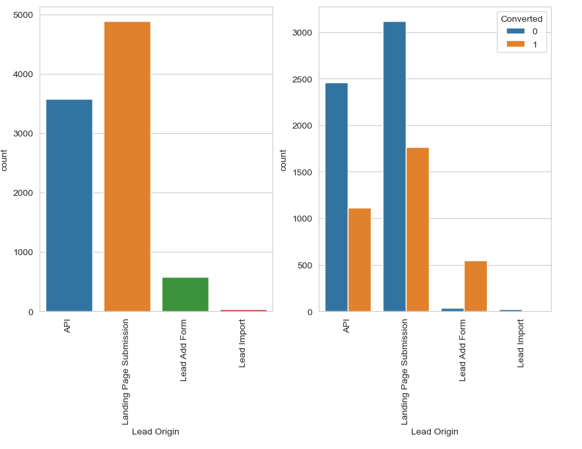
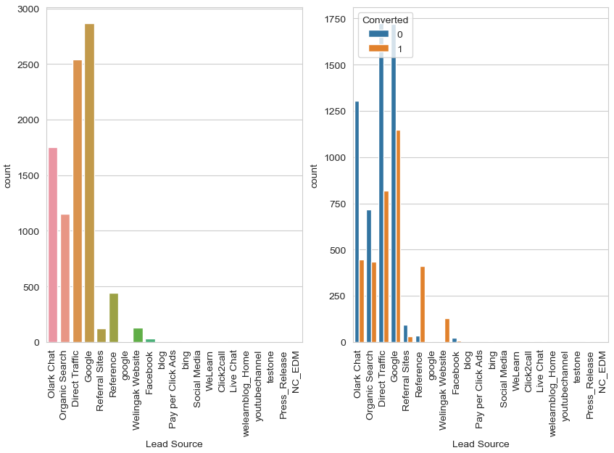
UNIVARIATE AND BIVARIATE ANALYSIS FOR CATEGORICAL VARIABLE

Slide 9
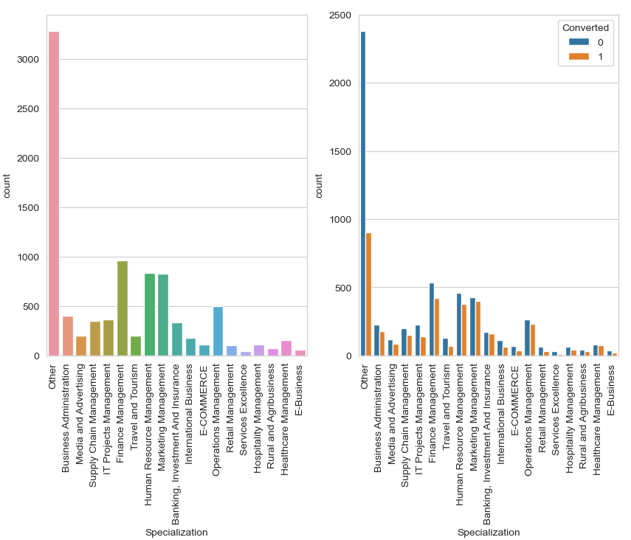
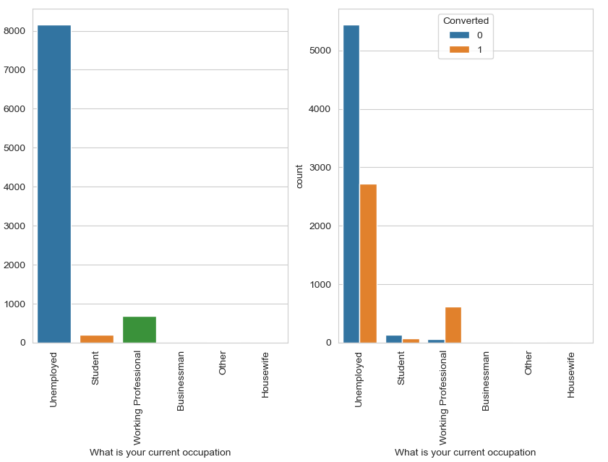
UNIVARIATE AND BIVARIATE ANALYSIS FOR CATEGORICAL VARIABLE

Slide 10
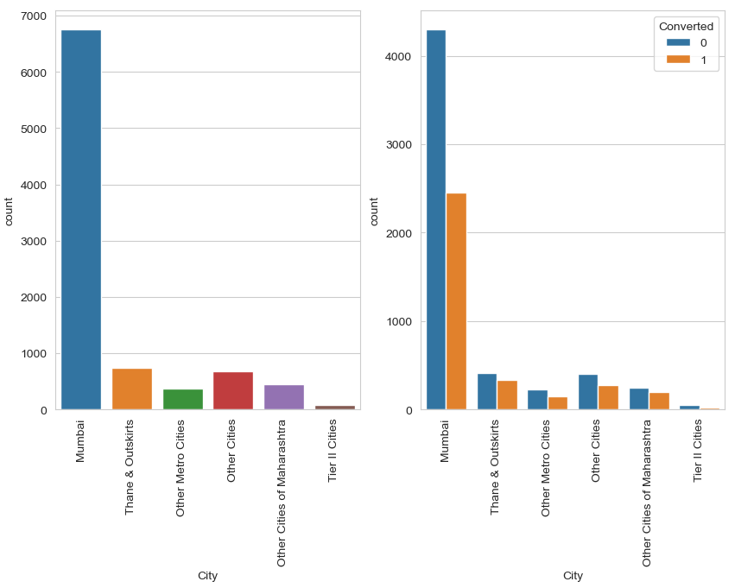
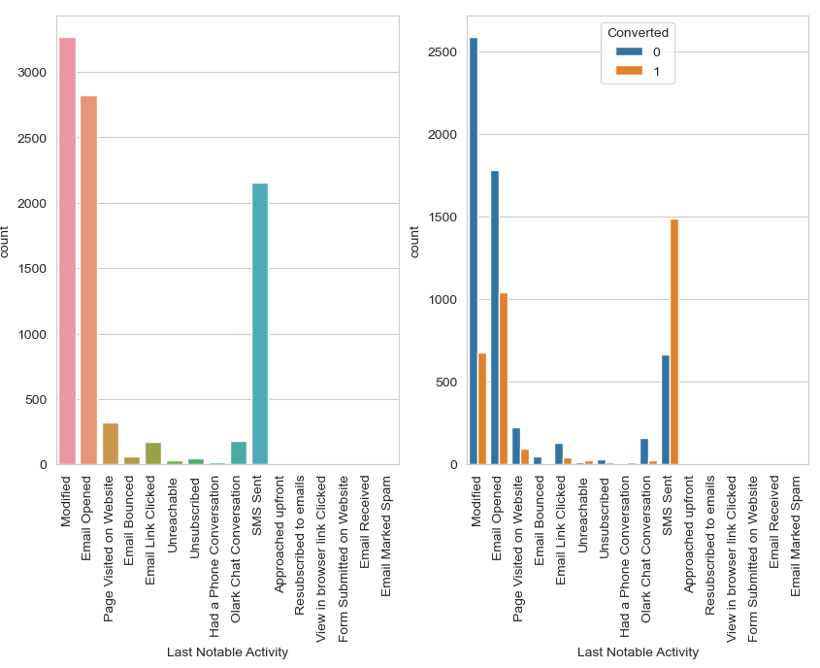
UNIVARIATE AND BIVARIATE ANALYSIS FOR CATEGORICAL VARIABLE

Slide 11
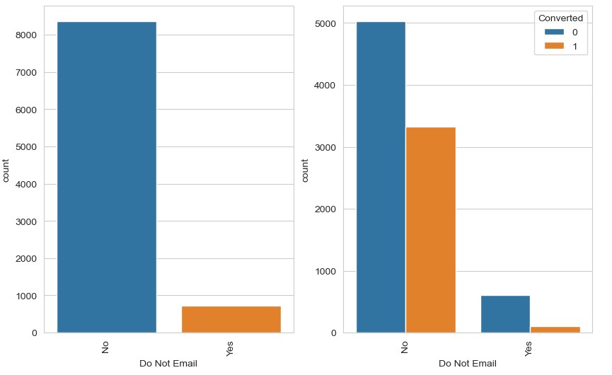
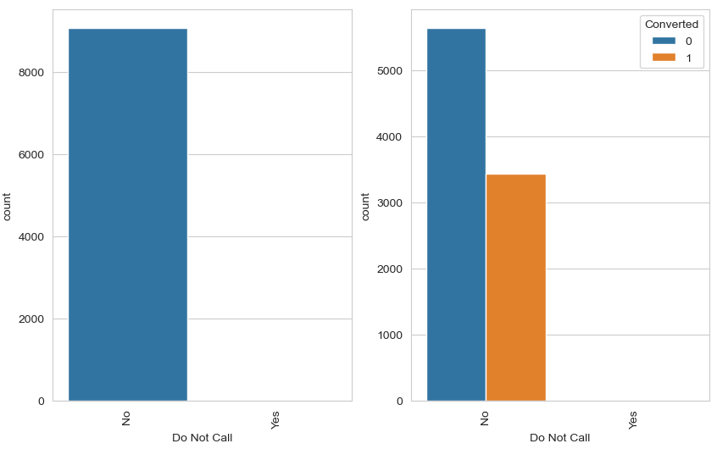
UNIVARIATE AND BIVARIATE ANALYSIS FOR BINARY VARIABLE

Slide 12
ANALYSIS OBSERVATION
"Lead Origin" is a category or source from which leads are generated, and "landing page submission" is one of the methods used to capture leads. It's good to hear that "landing page submission" is effective, and it's even better that customer conversions are proportional to these submissions. This suggests that the leads acquired through landing page submissions are more likely to convert into customers.
Google is the most popular search engine globally, and many people use it to find information, products, and services. By optimizing your online presence for Google search (Search Engine Optimization or SEO), you can attract organic traffic and leads.
Most customer prefers do not disturb as their option. It is understood that, they do not want to be influenced from the company, whether they are converted or not converted.
‘Email opened’ and ‘SMS sent’ seems higher in last activity segment.
Since most of the person don't prefer to fill specialization. However, focusing on finance management, human resource management, marketing management would give higher conversion ratio.
Unemployed customer have higher number as compare to working professional or student. However, working professional is having higher conversion ratio.
Customer belongs to Mumbai is the highest conversion ratio compare to other cities in Maharashtra state and also in tier-II cities.
"SMS Sent" last noted activity has highest conversion ratio compared to others.

Slide 13
MODEL BUILDING STEPS
Data preparation steps.
Splitting into train and test set
Scale variables in train set
Use RFE to eliminate less relevant variables
Build the first model
Eliminate variables based on high P-values and VIF values
Predict using train set
Evaluate accuracy and other metric
Predict using test set
Precision and recall analysis on test prediction.
Assign lead score to individual lead.

Slide 14
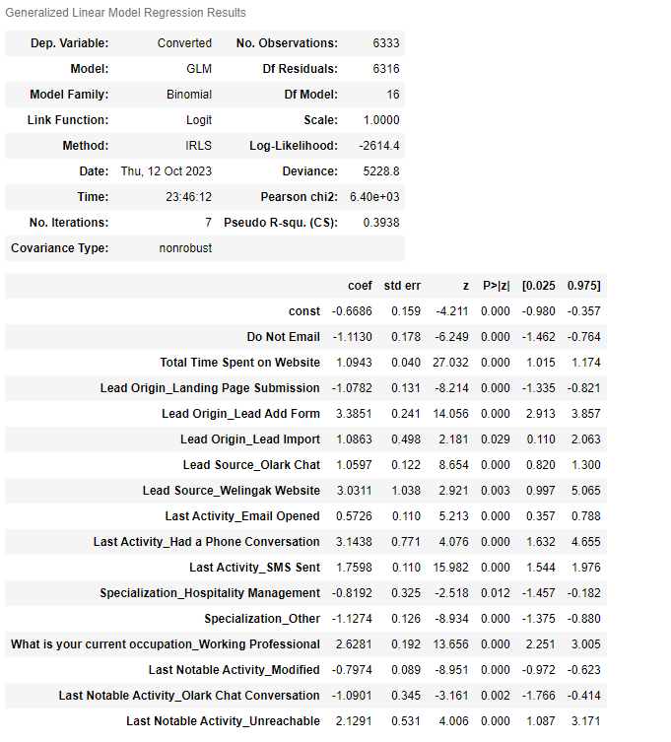
MODEL BUILDING
For model building , we used recursive feature elimination technique to get the top 20 features to build model.
We have build the 1st model.
We need to consider for P-value of variables and VIF.
We need to create model till P-values of all variables less than 0.05 and VIF less than 5 by dropping irrelevant feature recursively one by one.

Slide 15
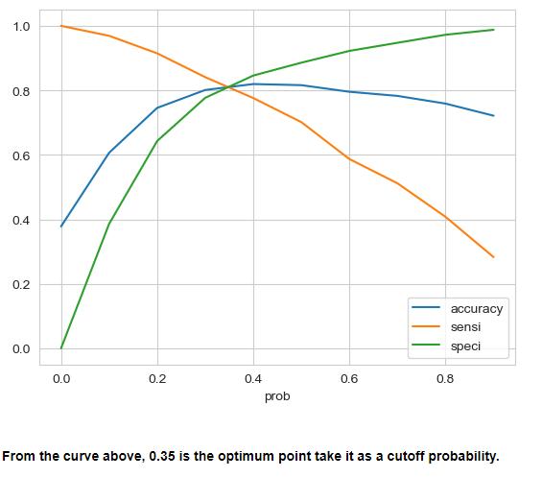
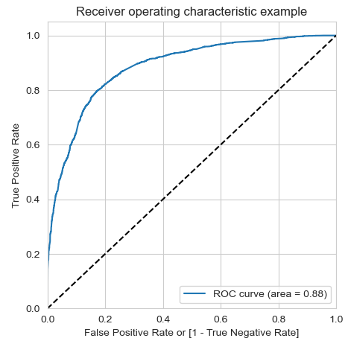

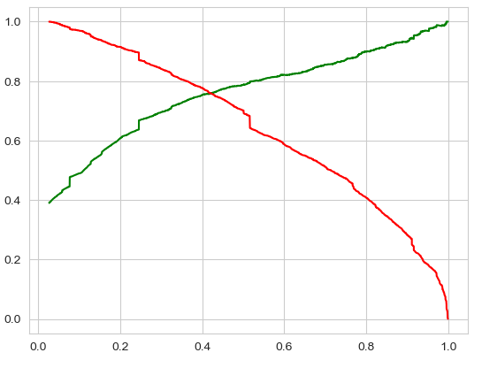

Model Evaluation(Train data)
ACCURACY : 81.24%
SENSTIVITY : 80.53%
SPECIFICITY : 81.67%
Model Evaluation(Test data)
ACCURACY : 81.36%
SENSTIVITY : 79.69%
SPECIFICITY : 82.39%

Slide 16
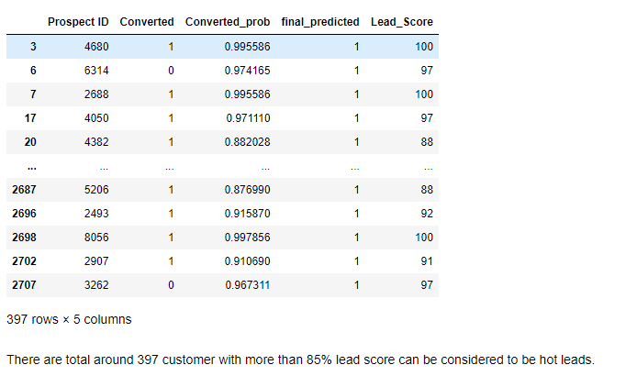
LEAD SCORE PREDICTION
The final predicted column shows the conversion probability of prospective lead.
Lead score above 85 have high tendency of converting to a hot lead category.
There are total around 397 customers with ore than 85% lead score.

Slide 17
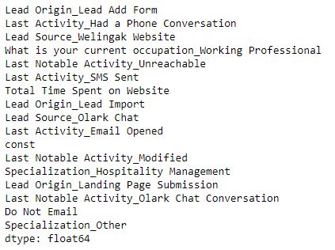
PARAMETERS OF MODEL
Important features consideration for model building.
Features impact either positively or negatively.
Starting from top up to “Last activity Email Opened” feature will positively impact to model.
Beyond constant all feature will negatively impact to model.

Slide 18
RECOMMENDATIONS
1. Company should actively pursue the leads who lead origin is "Lead Add Form.
2. Company should have a conversation with potential customer.
3. Company should make contact to the leads coming from the lead sources "Welingak Websites" and "Reference" as these are more likely to get converted.
4. Company should make contact to the leads who are the "working professionals" as they are more likely to get converted.
5. Company should make contact to the leads whose last activity was SMS Sent as they are more likely to get converted.
6. Company should make contact to the leads who spent "more time on the websites" as these are more likely to get converted.

Slide 19
THANK YOU

