Slide 1
Transforming Fashion Design: An Integrated Approach with MERN

Slide 2
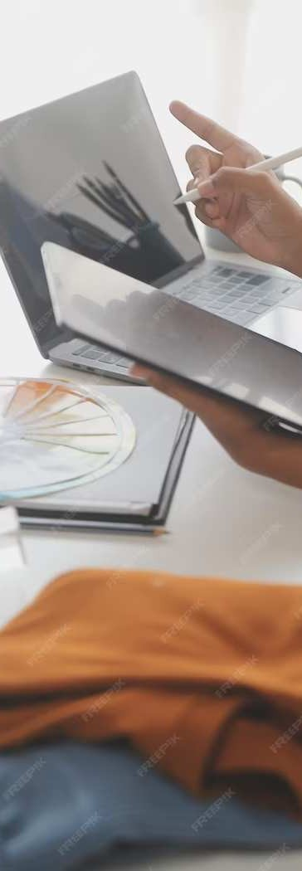
Introduction
Fashion Design iis an ever-evollviing iindustry that requires iinnovative approaches.. Thiis presentation explores the iintegration of MERN (MongoDB,, Express, React,, Node..jjs) stack iin fashiion design.. We wiillll discuss the potentiall beneﬁts and challenges of thiis approach..

Slide 3

Evolution of Fashion
The fashiion industry has witnessed a signiﬁcant transformatiion wiith the advent of technology.. From traditiional design processes to digiitall pllatforms, the evolutiion has been remarkablle. Thiis sliide wiillll delve iinto the iimpact of technology on fashiion design..

Slide 4

MERN Stack Overview
The MERN stack compriises MongoDB,, Express.js,, React,, and Node.jjs. It offers a comprehensive framework for buildiing dynamiic web appliicatiions. This slide proviides an overviiew of each component and their rellevance iin fashiion design..

Slide 5
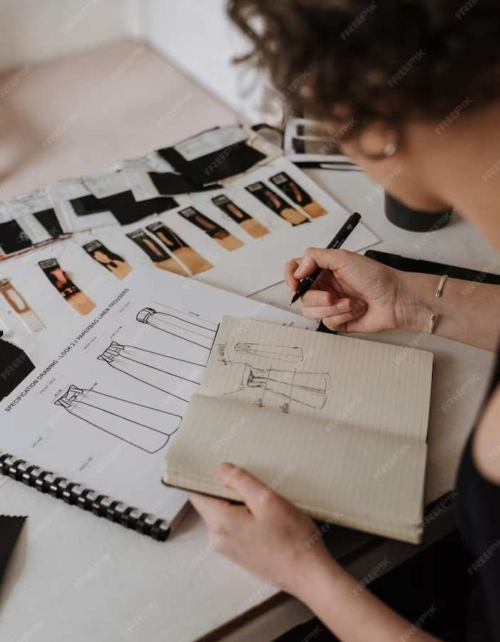
Integration of MERN in Fashion Design
Integrating the MERN stack iin fashion design enables seamless colllaboration,, reall-tiime design updates, and efﬁcient data management.. This slide explores the potentiall of MERN iin revollutioniizing the fashion design process.

Slide 6

Challenges and Opportunities
Whiile the iintegratiion of MERN in fashiion design offers numerous beneﬁts, iit allso presents challenges such as data securiity,, compatiibillity,, and scallability.. Thiis slide discusses the opportuniities and challenges associated with thiis iintegrated approach..

Slide 7
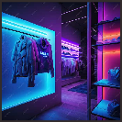
Express.js Node.js React.js
Components:
Modules:
CSS HTML
JAVASCRIPT BOOTSTRAP

Slide 8
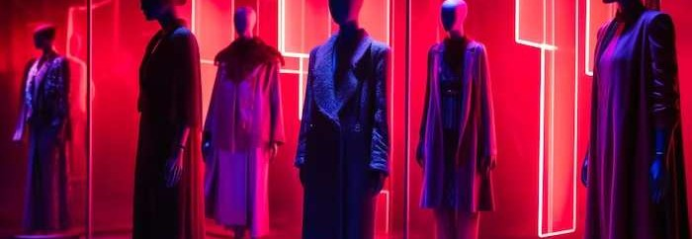
The future of fashion design lies in the seamless integration of technology.. This slide explores emerging trends such as AI-driven design assistants,, blockchain- based supply chain management,, and sustainable fashion initiatives powered by the MERN stack..

Slide 9
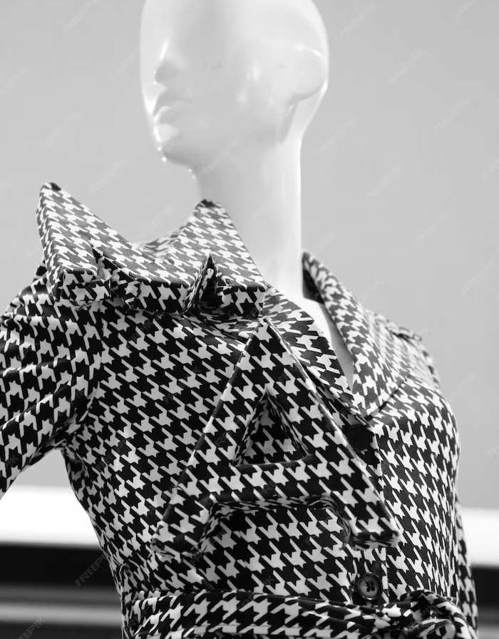
Conclusion
The integration of MERN presents a transformatiive opportuniity for the fashion design industry.. By leveragiing the power of modern technology,, designers can revollutiioniize the design process and create unparallleled user experiiences. This presentatiion has hiighllighted the potentiiall of MERN iin shaping the future of fashiion design..

Slide 10
Thanks!

