Slide 1
Data Analysis Dashboard
Task 2 – Exploratory Data Analysis
ApexPlanet Internship
Total Sales
Total Profit
Avg Sales
336873.89
51998.97
1104.50
K.Chaitra

Slide 2
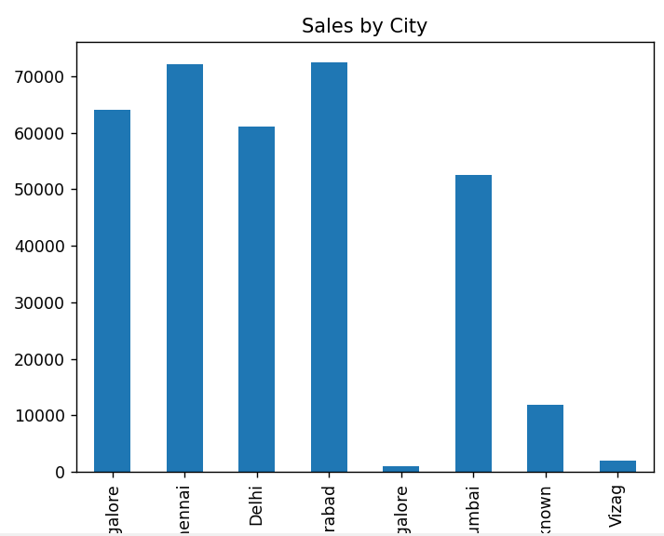
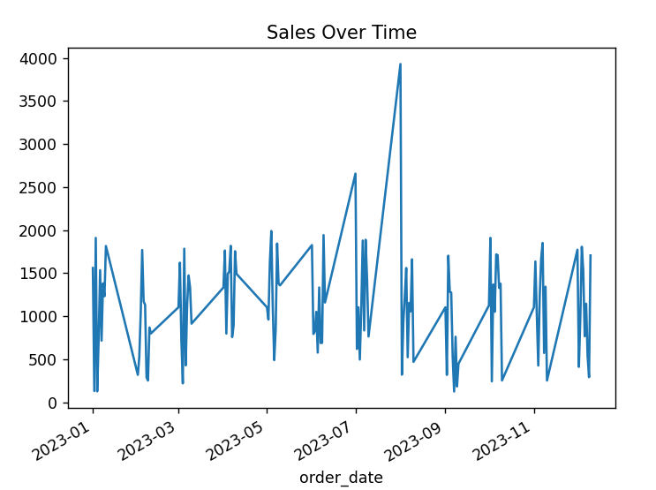
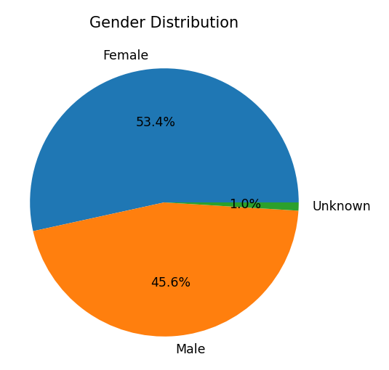
Key Insights:
Top Performing Cities: A significant portion of total sales is contributed by a few major cities, indicating higher customer concentration in those regions.
Customer Distribution: The dataset shows a noticeable dominance of one gender group, highlighting an uneven customer distribution.
Sales vs Profit Relationship: Higher sales do not always lead to higher profit, indicating variations in cost or pricing strategies.
Customer Segmentation: Certain age groups contribute more to overall sales, suggesting targeted customer segments.

