Slide 1
UE22AM351A – Algorithms and Optimizations in Machine Learning Course Project
Project Title : Privacy Preserving Techniques in a Federated RAG System
Team Name: DataVortex_005_020_044_045
Team member 1 SRN and name: ABHISHEK BHAT, PES1UG22AM005
Team member 2 SRN and name: ANAGHA S, PES1UG22AM020
Team member 3 SRN and name: C HEMACHANDRA, PES1UG22AM044
Team member 4 SRN and name: CHAITRA V, PES1UG22AM045

Slide 2
Topic
Define your problem statement crisply
In a Federated Retrieval-Augmented Generation (RAG) system, safeguarding sensitive information during data retrieval and processing is critical, as sharing data across multiple nodes can expose confidential data to potential privacy breaches.
The challenge lies in developing privacy-preserving techniques that allow effective and accurate information retrieval without compromising data security or utility.
The key issue is balancing the need for robust data protection with maintaining the system's performance and the quality of the retrieved results.

Slide 3
Uniqueness
Why you think this project is interesting or unique
This project is unique because it combines Federated Learning with Retrieval-Augmented Generation (RAG) and privacy-preserving techniques, addressing several key challenges:
Innovation: It explores safeguarding sensitive information in decentralized RAG systems while ensuring accurate retrieval.
Privacy vs. Performance: The project seeks to protect data privacy without compromising system efficiency and retrieval quality.
Data Security: As LLMs are used in critical sectors, this project develops methods to secure sensitive information during retrieval.
Trustworthy AI: It contributes to building secure and reliable AI systems, fostering user trust in privacy-sensitive applications.
Real-World Impact: The findings will benefit privacy-critical sectors like healthcare, finance, and legal, where protecting sensitive data is crucial.

Slide 4
Dataset
Dataset | Size | Attributes | Source
CIFAR-10 | 752.88 MB | ID, label (this is an image dataset) | https://www.kaggle.com/c/cifar-10/
CIFAR-100 | 186.3 MB | ID, label (this is an image dataset) | https://www.kaggle.com/datasets/fedesoriano/cifar100
MNIST | 54.95 MB | This is an image dataset | https://www.kaggle.com/datasets/hojjatk/mnist-dataset
regularization-images-man | 286.24 MB | Image dataset | https://www.kaggle.com/datasets/timothyalexisvass/regularization-images-man
Emotion Detection from Text | 3.77 MB | tweet_id, sentiment, and content (this is a text dataset) | https://www.kaggle.com/datasets/pashupatigupta/emotion-detection-from-text
Amazon Product Reviews | 300.9 MB | Id, ProductId, UserId, ProfileName, HelpfulnessNumerator, HelpfulnessDenomenator, Score, Time, Summary, Text (this is a text dataset) | https://www.kaggle.com/datasets/arhamrumi/amazon-product-reviews

Slide 5
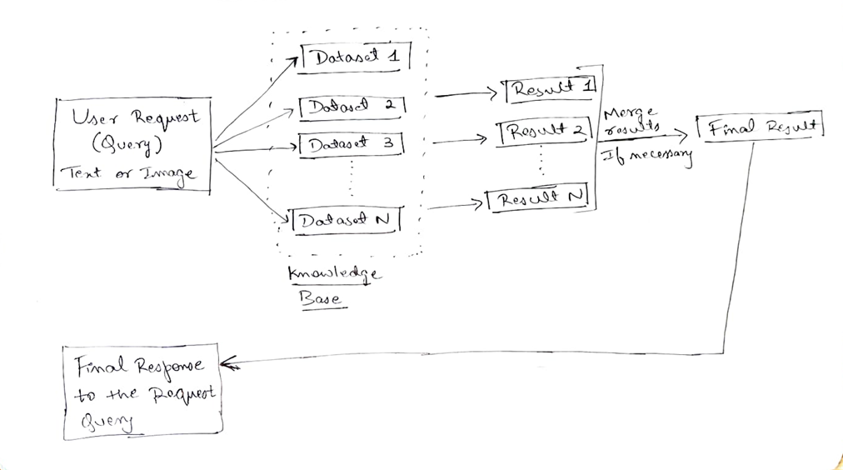
Overall design or approach in a free hand diagram

Slide 6
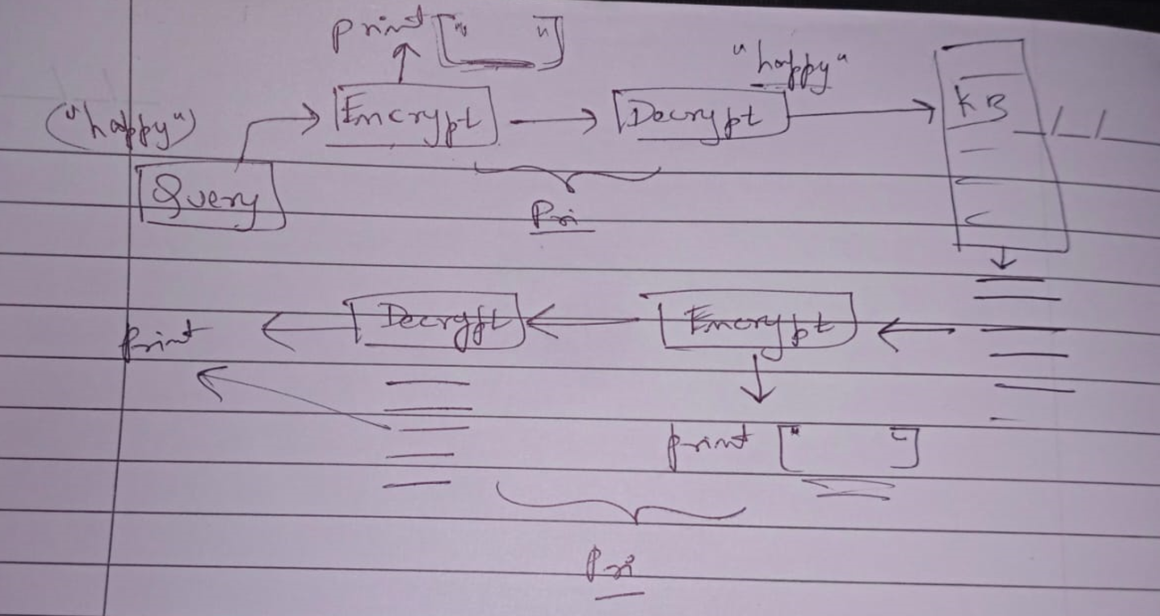
Overall design or approach in a free hand diagram

Slide 7
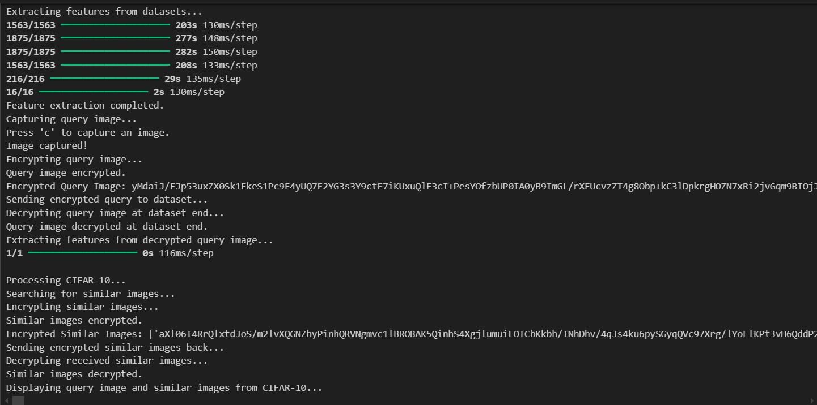
Final results so far
Using AES and Differential privacy

Slide 8
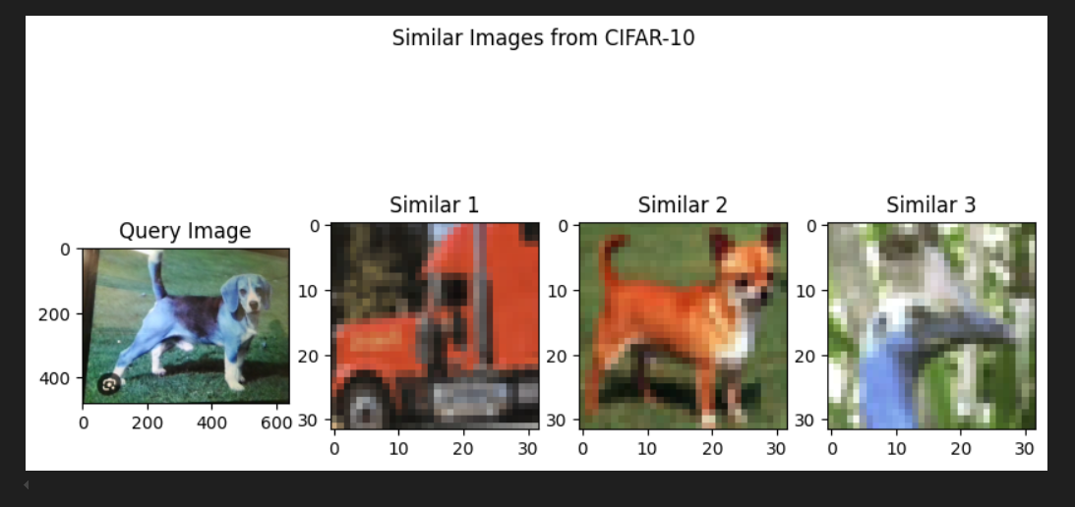
Final results so far

Slide 9
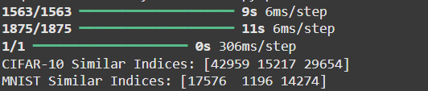
Final results so far
We use the CIFAR-10 and MNIST datasets for training and evaluation, FAISS to perform efficient similarity searches, Secure Data Transmission with ECC is implemented to encrypt and decrypt features and indices, and Federated averaging technique to aggregate local models' weights.

Slide 10
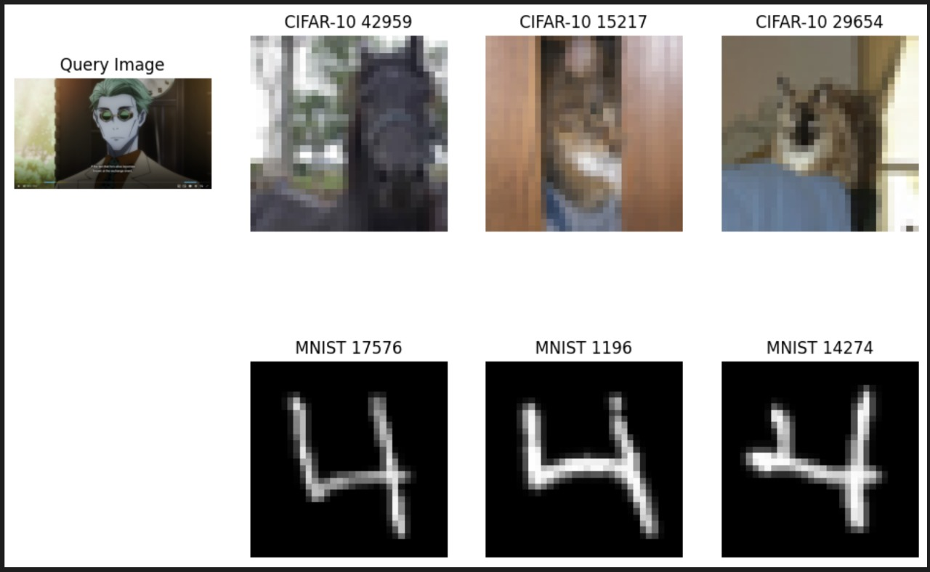
Final results so far

Slide 11
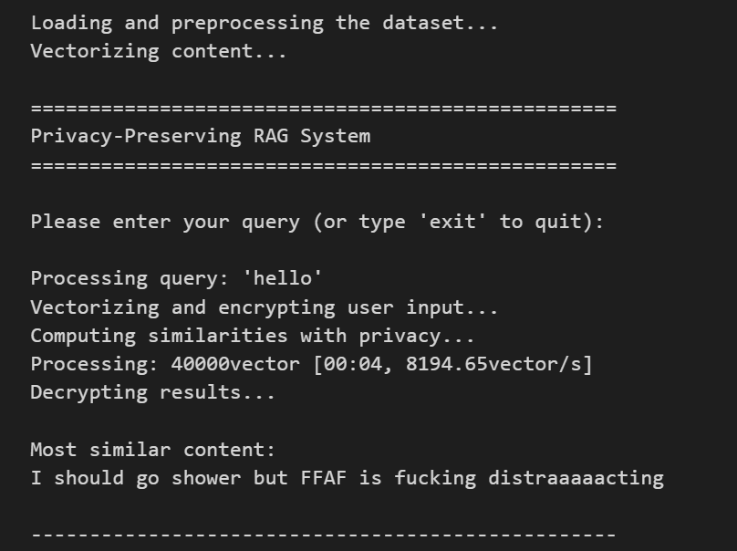
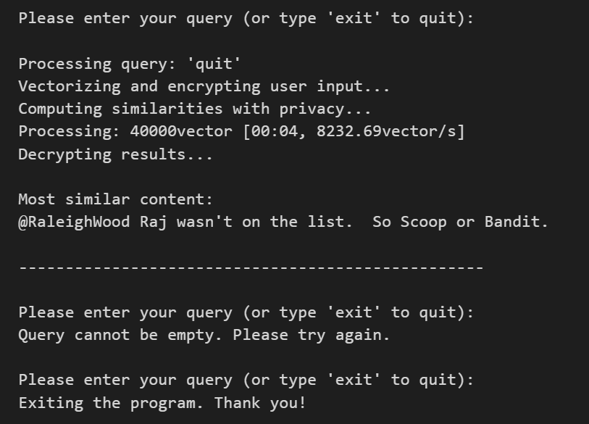
Final results so far
Using Simple homomorphic encryption simulation and Differential privacy: Laplace mechanism

Slide 12
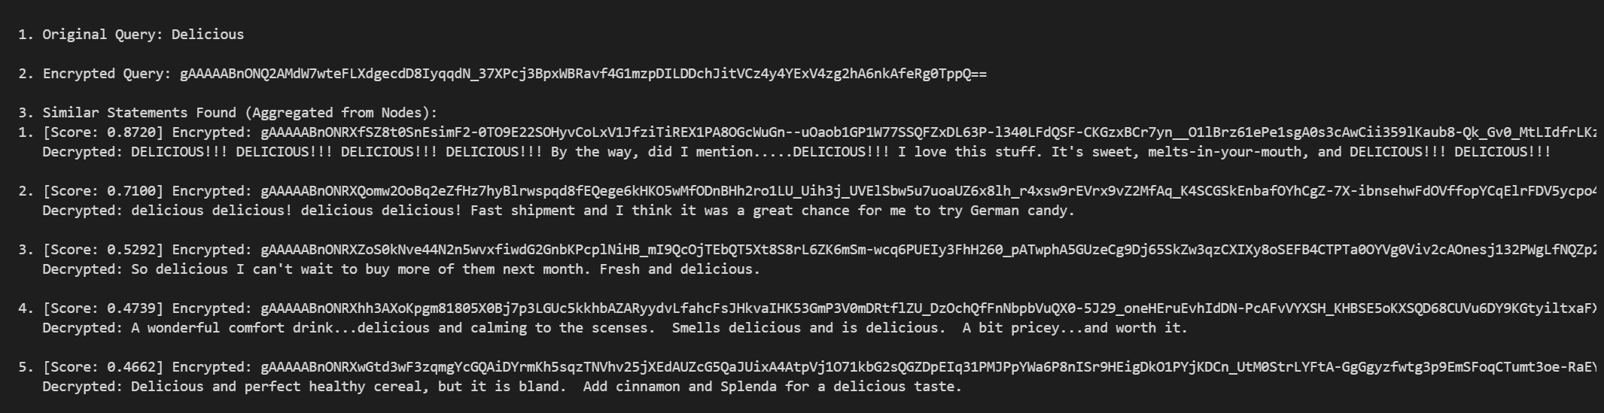
Final results so far
Using Secure Multi-Party Computation (SMPC) principles:

Slide 13
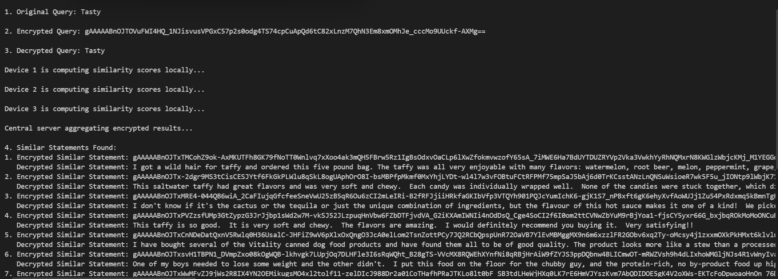
Final results so far
Using Federated Learning-based Techniques:

Slide 14
Done vs Remaining to be done ? (will be filled in next submission)
No | Description | Done or To be done
1 | Initialization of federated system with encryption keys | Done
2 | Implementation of data encryption and decryption (AES) | Done
3 | Feature extraction using pre-trained VGG16 model | Done
4 | Federated nodes setup with data handling capabilities | Done
5 | Implementation of privacy-preserving distributed search | Done
6 | Creation of a knowledge base and integration with search | Done
7 | Augmenting model predictions with federated search results | Done
8 | Adding differential privacy, Homomorphic Encryption, Secure Multi-Party Computation (SMPC) principles, Federated Learning Techniques to model predictions | Done

Slide 15
Quantity and quality of work (will be filled in next submission)
no | Code functionality | % Complete | Runs without problem (Y/N) | If there are minor issues, indicate
1 | Data Preprocessing: Loading and standardizing datasets (e.g., resizing, normalization). | 100% | YES | None
2 | Feature Extraction: Uses pre-trained VGG16 to generate meaningful feature representations. | 100% | YES | None
3 | Privacy-Preserving Encryption: Implements AES encryption/decryption for secure data handling. | 100% | YES | None
4 | Federated Indexing: FAISS-based distributed indices for efficient similarity queries. | 100% | YES | None
5 | Knowledge Base Search: TF-IDF-powered search with federated orchestration using threading. | 100% | YES | None
6 | Federated Query Augmentation and Prediction: Combines federated knowledge and privacy-preserving predictions. | 100% | YES | None
7 | Differential Privacy: Adds noise to model weights, preserving privacy during federated training. | 100% | YES | None

Slide 16
Top few learning
Serial No | Top learning in this project
1 | Privacy-Preserving Techniques: Learn methods like differential privacy and secure computation to protect sensitive data.
2 | Federated Learning & RAG Integration: Understand how to implement Federated Learning with Retrieval-Augmented Generation systems.
3 | Balancing Privacy and Performance: Master the trade-offs between data privacy and maintaining system efficiency.
4 | Data Security in AI: Learn how to secure data during retrieval without compromising utility.
5 | Trustworthy AI: Develop skills in building AI systems that ensure ethical data use and security.

Slide 17
Top unresolved challenges (will be filled in next submission)
Serial No | Brief description of unresolved challenges | Type of challenge (scope/data/design/implementation / others)
1 | Tuning the epsilon parameter in Differential Privacy to balance privacy and model accuracy effectively. | Design/Implementation
2 | Handling decryption failures in the AES implementation under certain edge-case inputs. | Implementation
3 | Improving scalability and response time of the FAISS index for extremely large datasets. | Data/Implementation
4 | Ensuring robustness in Federated Query Augmentation when retrieved results include outliers or irrelevant features. | Design/Implementation
5 | Optimizing threading for TF-IDF retrieval in federated systems to avoid bottlenecks with larger corpora. | Implementation/Design

Slide 18
Reference papers
No | Paper Title | Authors
1 | FeB4RAG: Evaluating Federated Search in the Context of Retrieval Augmented Generation | SHUAI WANG, The University of Queensland, Australia EKATERINA KHRAMTSOVA, The University of Queensland, Australia SHENGYAO ZHUANG, CSIRO, Australia GUIDO ZUCCON, The University of Queensland, Australia
2 | A Frequency Estimation on Algorithm under Local Differential Privacy | Desong Qin, Zhenjiang Zhang
3 | Research on Data Mining Technology of Internet Privacy Protection Based on Local Differential Privacy | Juan Yu
4 | A Study on Partially Homomorphic Encryption | Jihyeon Ryu, Keunok Kim, Dongho Won
5 | Analysis and Comparison of Various Fully Homomorphic Encryption on Techniques | Pratibha Chaudhary, Ritu Gupta, Abhilasha Singh, Pramathesh Majumder

Slide 19
THANK YOU !

