Slide 1
Multimodal Argumentative Fallacy Detection and Classification on Political Debates
PIP-4004 UNIVERSITY PROJECT
Review-0
Batch Number: CSE_CST_CAP_08
Under the Supervision of,
Dr.Sandeep Albert
Assistant Professor
School of Computer Science and Engineering
Presidency University
20211CST0067 | WARALE AVINASH KALYAN
20211CST0059 | SIDDHARTH PAGARIA
20211CST0076 | CHAITRA V
20211CST0085 | SPOORTHI HG
Roll Number | Student Name
Name of the Program: B.Tech Computer Science & Technology(AI&ML)
Name of the HoD: Dr.Saira Banu Atham
Name of the Program Project Coordinator: Dr.H M Manjula(AP)
Name of the School Project Coordinators: Dr. Abdul Khadar A

Slide 2
Content
Problem Statement
Github Link
Analysis of Problem Statement
Timeline of the Project
References

Slide 3
Problem Statement Number: N/A
Organization: The 12th Workshop on Argument Mining
Category : Software
Problem Description:
Political debates often include misleading arguments, called fallacies, that can confuse people. Most tools for detecting fallacies focus only on text, but debates also involve tone of voice, facial expressions, and gestures. This project aims to build an AI system that detects and classifies fallacies using text, audio, and video. By analyzing speech, expressions, and words, the system will identify misleading arguments. The main challenges include understanding context, speaking styles, and debate formats. This project will help journalists, researchers, and the public recognize false arguments, promoting more informed discussions and reducing misinformation.

Slide 4
Github Link
The Github link provided should have public access permission.
Github Link :- https://github.com/p4rz1v4l26/MM-ArgFallacy2025

Slide 5
Analysis of Problem Statement
Technology Stack Components:
DataCollection & Preprocessing: Datasets, TextProcessing & AudioProcessing.
Data Storage: MAMkit Databases.
NLP: Preprocessing libraries, language models.
Machine Learning: Training frameworks, pre-trained models.
Model Training & Evaluation: Computing resources, evaluation metrics.
Feature Engineering: text features, audio features, video features.
Deployment: Model serving, scalable deployment.
User Interface: Web application
Monitoring & Maintenance: Logging, model updating.

Slide 6
Analysis of Problem Statement (contd...)
Software Requirements:
Python
PyTorch/TensorFlow + Hugging Face Transformers
Audio Processing: Librosa, TorchAudio, OpenSmile.
Speech-to-Text: Whisper, SpeechRecognition (Python).
Web frameworks(Streamlit)

Slide 7
Analysis of Problem Statement (contd...)
To build a system that detects logical fallacies in text-audio arguments, we’ll use datasets provided by MAMkit , which offers standardized access to annotated multimodal argument datasets (text + audio), storing raw data in MAMkit-compatible formats .
For Natural Language Processing (NLP) and Audio Processing, we’ll leverage MAMkit’s built-in utilities for dataset loading and preprocessing, alongside SpaCy for linguistic analysis, OpenAI Whisper for speech-to-text, and PyTorch-based models (e.g., Wav2Vec 2.0 for audio, BERT for text) for multimodal feature fusion.
Model Training and Evaluation will use MAMkit’s benchmarking tools and PyTorch Lightning for scalable training on cloud platforms (AWS/GCP), with evaluation metrics like class-specific F1-score and cross-modal robustness checks.
The User Interface will be a web app with Streamlit, integrating MAMkit’s API for dataset/model access, plus an Admin Dashboard for real-time monitoring of model performance and data annotations.

Slide 8
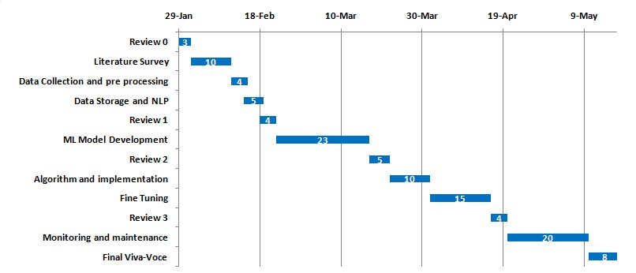
Timeline of the Project (Gantt Chart)

Slide 9
References (IEEE Paper format)
Goffredo et al. (2022) Fallacious Argument Classification in Political Debates https://doi.org/10.24963/ijcai.2022/575
Haddadan et al. (2019) Yes, we can! Mining Arguments in 50 Years of US Presidential Campaign Debates https://aclanthology.org/P19-1463.pdf

Slide 10


