Slide 1
Multimodal Argumentative Fallacy Detection and Classification on Political Debates
PIP-4004 UNIVERSITY PROJECT
Review-1
Batch Number: CSE_CST_CAP_08
Under the Supervision of,
Dr.Sandeep Albert
Assistant Professor
School of Computer Science and Engineering
Presidency University
20211CST0067 | WARALE AVINASH KALYAN
20211CST0059 | SIDDHARTH PAGARIA
20211CST0076 | CHAITRA V
20211CST0085 | SPOORTHI HG
Roll Number | Student Name
Name of the Program: B.Tech Computer Science & Technology(AI&ML)
Name of the HoD: Dr.Saira Banu Atham
Name of the Program Project Coordinator: Dr.H M Manjula(AP)
Name of the School Project Coordinators: Dr. Abdul Khadar A

Slide 2
Content
Abstract
Literature survery
Objective and existing drawbacks
Proposed Method and Architecture
Timeline of the Project
References

Slide 3
Problem Statement Number: N/A
Organization: The 12th Workshop on Argument Mining
Category : Software
Problem Description:
Political debates often include misleading arguments, called fallacies, that can confuse people. Most tools for detecting fallacies focus only on text, but debates also involve tone of voice, facial expressions, and gestures. This project aims to build an AI system that detects and classifies fallacies using text, audio, and video. By analyzing speech, expressions, and words, the system will identify misleading arguments. The main challenges include understanding context, speaking styles, and debate formats. This project will help journalists, researchers, and the public recognize false arguments, promoting more informed discussions and reducing misinformation.

Slide 4
Abstract
Argumentative fallacies in political debates can mislead audiences and distort public discourse. Identifying and classifying these fallacies is a challenging task, particularly when integrating multimodal data sources such as text and audio. Traditional text-based approaches are often insufficient in capturing the nuances of spoken arguments, including tone, emphasis, and delivery style.
Leveraging Artificial Intelligence (AI) and Machine Learning (ML) for multimodal argument analysis can enhance fallacy detection by combining textual and paralinguistic features. The MM-ArgFallacy2025 shared task introduces a dataset derived from U.S. presidential debates (1960–2020), providing labeled instances of argumentative fallacies across multiple categories. Participants can explore text-only, audio-only, and combined text-audio approaches to develop robust classification models.
However, achieving high accuracy in multimodal fallacy detection requires overcoming challenges such as noisy audio data, speaker variations, and dataset limitations. This task aims to advance research in multimodal argument mining by fostering innovative AI-driven methods. The presentation will discuss key methodologies, dataset details, and evaluation criteria while emphasizing the significance of responsible AI use in political discourse analysis.

Slide 5
Objective
To develop and evaluate AI-driven multimodal models for detecting and classifying argumentative fallacies in political debates, integrating textual and audio features for improved accuracy and robustness. The task aims to:
Enhance Fallacy Detection – Identify whether a given statement contains an argumentative fallacy using AI-powered analysis of text and speech.
Improve Multimodal Understanding – Leverage both textual and paralinguistic features to capture tone, emphasis, and delivery style for better fallacy classification.
Automate Argument Analysis – Develop machine learning models that classify fallacies into predefined categories without manual intervention.
Optimize Dataset Utilization – Utilize the MM-USED-fallacy dataset and additional resources to train more effective classification models.

Slide 6
Existing Drawbacks
At the moment, there is no functional model available for this project.

Slide 7
Proposed Methodology
Multimodal Data Integration – Combine textual and audio inputs from political debates to improve argumentative fallacy detection and classification.
Text & Speech-Based Feature Extraction – Utilize Natural Language Processing (NLP) for text analysis and Speech Processing techniques to extract tone, pitch, and other paralinguistic cues.
Multimodal Fusion Model – Develop deep learning models that integrate textual and audio modalities to enhance classification accuracy.
Context-Aware Classification – Incorporate previous debate utterances to improve the contextual understanding of arguments and their logical consistency.
Fallacy Type Categorization – Implement supervised learning models to classify detected fallacies into predefined categories based on linguistic and prosodic patterns.
Model Training & Optimization – Fine-tune large language models and speech analysis networks on the MM-USED-fallacy dataset for robust performance across diverse debate settings.
This methodology ensures an advanced AI-driven approach to detecting argumentative fallacies by leveraging both textual and audio signals.

Slide 8
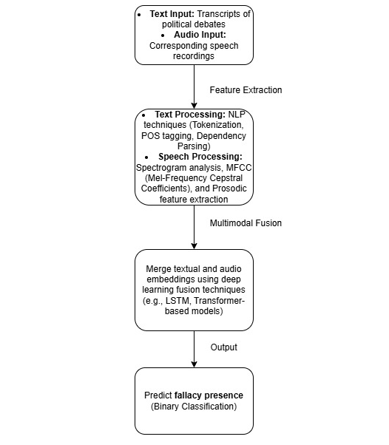
Architecture

Slide 9
Github Link
The Github link provided should have public access permission.
Github Link :- https://github.com/p4rz1v4l26/MM-ArgFallacy2025

Slide 10
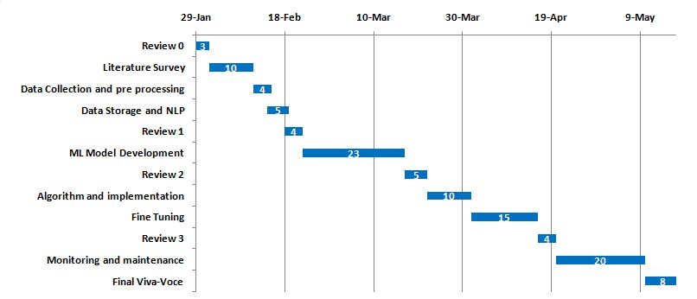
Timeline of the Project (Gantt Chart)

Slide 11
References (IEEE Paper format)
Goffredo et al. (2022) Fallacious Argument Classification in Political Debates https://doi.org/10.24963/ijcai.2022/575
Haddadan et al. (2019) Yes, we can! Mining Arguments in 50 Years of US Presidential Campaign Debates https://aclanthology.org/P19-1463.pdf

Slide 12


