Slide 1
Module-1
A model for Network Security, Classical encryption techniques:
Symmetric cipher model, Substitution ciphers-Caesar Cipher,
Monoalphabetic Cipher, Playfair Cipher, Hill Cipher,
Polyalphabetic Ciphers, One time pad, Steganography Block
Ciphers and Data Encryption Standards: Traditional Block Cipher structures, data Encryption Standard (DES),
A DES Example, The strength of DES, Block cipher design principles

Slide 2
Introduction
A message is to be transferred from one party to another across some sort of Internet service.
The two parties, who are the principals in this transaction, must cooperate for the exchange to take place.
A logical information channel is established by defining a route through the Internet from source to destination and by the cooperative use of communication protocols (e.g., TCP/IP) by the two principals.

Slide 3
Network Model
All the techniques for providing security have two components:
■ A security-related transformation on the information to be sent. Examples include the encryption of the message, which scrambles the message so that it is unreadable by the opponent, and the addition of a code based on the contents of the message, which can be used to verify the identity of the sender.
■ Some secret information shared by the two principals and, it is hoped, unknown to the opponent. An example is an encryption key used in conjunction with the transformation to scramble the message before transmission and unscramble it on reception

Slide 4
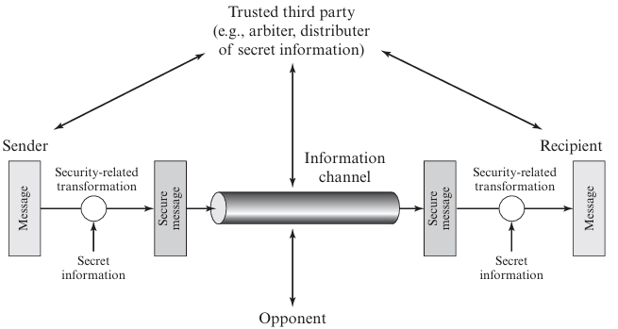
Network Model

Slide 5
Contd..
This general model shows that there are four basic tasks in designing a particular security service:
1. Design an algorithm for performing the security-related transformation. The algorithm should be such that an opponent cannot defeat its purpose.
2. Generate the secret information to be used with the algorithm.
3. Develop methods for the distribution and sharing of the secret information.
4. Specify a protocol to be used by the two principals that makes use of the security algorithm and the secret information to achieve a particular security service

Slide 6
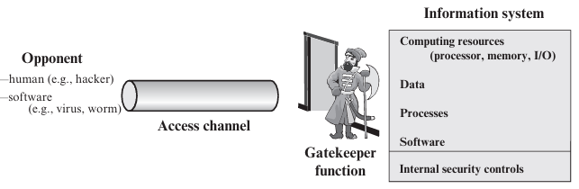
Kinds of Threats
Programs can present two kinds of threats:
■ Information access threats: Intercept or modify data on behalf of users who should not have access to that data.
■ Service threats: Exploit service flaws in computers to inhibit use by legitimate users

Slide 7
Examples…
Viruses and worms are two examples of software attacks.
Such attacks can be introduced into a system by means of a disk that contains the unwanted logic concealed in otherwise useful software.
They can also be inserted into a system across a network; this latter mechanism is of more concern in network security.

Slide 8
Chapter 3-Classical Encryption Techniques
An original message is known as the plaintext, while the coded message is called the ciphertext.
The process of converting from plaintext to ciphertext is known as enciphering or encryption; restoring the plaintext from the ciphertext is deciphering or decryption.
Many schemes used for encryption constitute the area of study known as cryptography. Such a scheme is known as a cryptographic system or a cipher. Techniques used for deciphering a message without any knowledge of the enciphering details fall into the area of cryptanalysis.
Cryptanalysis is what the lay person calls “breaking the code.” The areas of cryptography and cryptanalysis together are called cryptology.

Slide 9
Cryptography
Cryptographic systems are characterized along three independent dimensions:
1. The type of operations used for transforming plaintext to ciphertext.
2. The number of keys used.
    a. If both sender and receiver use the same key, the system is referred to as symmetric, single-key, secret-key, or conventional encryption.
    b. If the sender and receiver use different keys, the system is referred to as asymmetric, two-key, or public-key encryption.
3. How is the plaintext processed??? A block cipher processes the input one block of elements at a time, producing an output block for each input block. A stream cipher processes the input elements continuously, producing output one element at a time, as it goes along.

Slide 10
A symmetric Encryption Scheme
A symmetric encryption scheme has five ingredients
■ Plaintext: This is the original intelligible message or data that is fed into the algorithm as input.
■ Encryption algorithm: The encryption algorithm performs various substitutions and transformations on the plaintext.
■ Secret key: The secret key is also input to the encryption algorithm. The key is a value independent of the plaintext and the algorithm. The algorithm will produce a different output depending on the specific key being used at the time. The exact substitutions and transformations performed by the algorithm depend on the key.

Slide 11
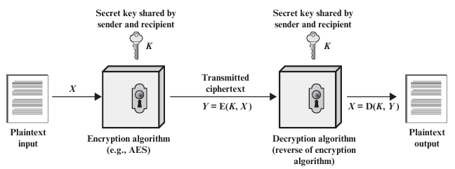
Simplified Model of Symmetric Encryption

Slide 12
Contd..
Encryption Algorithm: - Ciphertext: This is the scrambled message produced as output. It depends on the plaintext and the secret key. For a given message, two different keys will produce two different ciphertexts. The ciphertext is apparently an random stream of data and, as it stands, is unintelligible.
Decryption algorithm: This is essentially the encryption algorithm run in reverse. It takes the ciphertext and the secret key and produces the original plaintext

Slide 13
There are two requirements for secure use of conventional encryption:
1. We need a strong encryption algorithm. At minimum, we would like the algorithm to be such that an opponent who knows the algorithm and has access to one or more ciphertexts would be unable to decipher the ciphertext or figure out the key.
2. Sender and receiver must have obtained copies of the secret key in a secure fashion and must keep the key secure. If someone can discover the key and knows the algorithm, all communication using this key is readable.

Slide 14
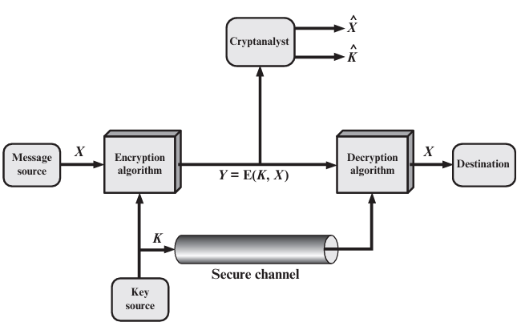
Model of Symmetric Cryptosystem

Slide 15
Cryptanalysis and Brute-Force Attack
Cryptanalysis: Cryptanalytic attacks rely on the nature of the algorithm, plus perhaps some knowledge of the general characteristics of the plaintext or even some sample plaintext–ciphertext pairs. This type of attack exploits the characteristics of the algorithm to attempt to deduce a specific plaintext or to deduce the key being used.
Brute-force attack: The attacker tries every possible key on a piece of cipher text until an intelligible translation into plaintext is obtained. On average, half of all possible keys must be tried to achieve success

Slide 16
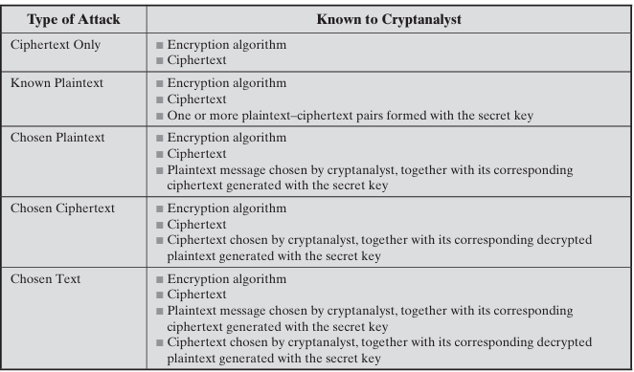

Slide 17
Encryption Scheme
An encryption scheme is unconditionally secure if the ciphertext generated by the scheme does not contain enough information to determine uniquely the corresponding plaintext, no matter how much ciphertext is available.
Therefore, all that the users of an encryption algorithm can strive for is an algorithm that meets one or both of the following criteria:
■ The cost of breaking the cipher exceeds the value of the encrypted information.
■ The time required to break the cipher exceeds the useful lifetime of the information
An encryption scheme is said to be computationally secure if either of the foregoing two criteria are met.

Slide 18
A brute-force attack
A brute-force attack involves trying every possible key until an intelligible translation of the ciphertext into plaintext is obtained. On average, half of all possible keys must be tried to achieve success.
That is: if there are X different keys, on average an attacker would discover the actual key after X/2 tries. It is important to note that there is more to a brute-force attack than simply running through all possible keys.

Slide 19
Substitution
The two basic building blocks of all encryption techniques are substitution and transposition.
A substitution technique is one in which the letters of plaintext are replaced by other letters or by numbers or symbols.
If the plaintext is viewed as a sequence of bits, then substitution involves replacing plaintext bit patterns with ciphertext bit patterns.
The earliest known, and the simplest, use of a substitution cipher was by Julius Caesar. The Caesar cipher involves replacing each letter of the alphabet with the letter standing three places further down the alphabet.
For example,

Slide 20
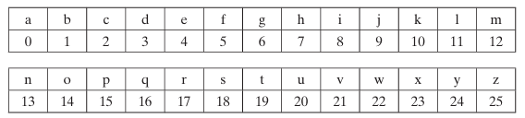
A numerical equivalent to each letter:
plain: | meet | me | after | the | toga | party
cipher: | PHHW | PH | DIWHU | WKH | WRJD | SDUWB

Slide 21
Formula
The encryption algorithm
C = E(3, p) = (p + 3) mod 26
A shift may be of any amount, so that the general Caesar algorithm is
C = E(k, p) = (p + k) mod 26
where k takes on a value in the range 1 to 25.
The decryption algorithm is simply p = D(k, C) = (C- k) mod 26.
Three important characteristics of this problem enabled us to use a brute force cryptanalysis:
1. The encryption and decryption algorithms are known.
2. There are only 25 keys to try.
3. The language of the plaintext is known and easily recognizable

Slide 22
Monoalphabetic Cipher
With only 25 possible keys, the Caesar cipher is far from secure.
A dramatic increase in the key space can be achieved by allowing an arbitrary substitution. Before proceeding, we define the term permutation.
A permutation of a finite set of elements S is an ordered sequence of all the elements of S, with each element appearing exactly once.
For example, if S = {a, b, c},
there are six permutations of S: abc, acb, bac, bca, cab, cba.
In general, there are n! permutations of a set of n elements, because the first element can be chosen in one of n ways, the second in n- 1 ways, the third in n- 2 ways, and so on. Recall the assignment for the Caesar cipher

Slide 23
Contd..
If, instead, the “cipher” line can be any permutation of the 26 alphabetic characters, then there are 26! or greater than 4 * 1026 possible keys.
This is 10 orders of magnitude greater than the key space for DES and would seem to eliminate brute-force techniques for cryptanalysis.
Such an approach is referred to as a monoalphabetic substitution cipher, because a single cipher alphabet (mapping from plain alphabet to cipher alphabet) is used per message.

Slide 24
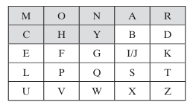
Play Fair Cipher
The best-known multiple-letter encryption cipher is the Playfair, which treats digrams in the plaintext as single units and translates these units into ciphertext digrams
The Playfair algorithm is based on the use of a 5 * 5 matrix of letters constructed using a keyword. In this case, the keyword is monarchy. The matrix is constructed by filling in the letters of the keyword (minus duplicates) from left to right and from top to bottom, and then filling in the remainder of the matrix with the remaining letters in alphabetic order. The letters I and J count as one letter. Plaintext is encrypted two letters at a time, according to the following rules:

Slide 25
Steps
1. Repeating plaintext letters that are in the same pair are separated with a filler letter, such as x, so that balloon would be treated as ba lx lo on.
2. Two plaintext letters that fall in the same row of the matrix are each replaced by the letter to the right, with the first element of the row circularly following the last. For example, ar is encrypted as RM.
3. Two plaintext letters that fall in the same column are each replaced by the letter beneath, with the top element of the column circularly following the last. For example, mu is encrypted as CM.
4. Otherwise, each plaintext letter in a pair is replaced by the letter that lies in its own row and the column occupied by the other plaintext letter. Thus, hs becomes BP and ea becomes IM (or JM, as the encipherer wishes).

Slide 26
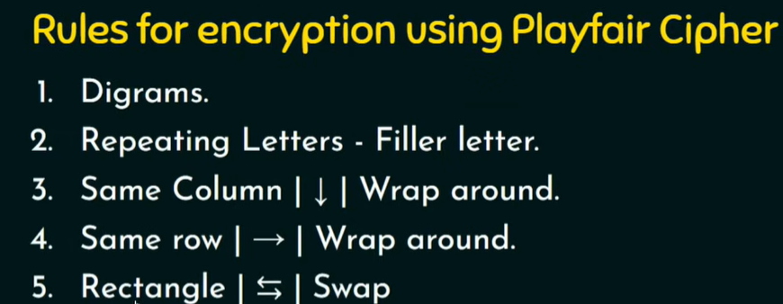

Slide 27
Hill Cipher
Another interesting multi letter cipher is the Hill cipher, developed by the mathematician Lester Hill in 1929.

Slide 28
polyalphabetic substitution cipher
Another way to improve on the simple monoalphabetic technique is to use different monoalphabetic substitutions as one proceeds through the plaintext message. The general name for this approach is polyalphabetic substitution cipher.
All these techniques have the following features in common:
1. A set of related monoalphabetic substitution rules is used.
2. A key determines which particular rule is chosen for a given transformation

Slide 29
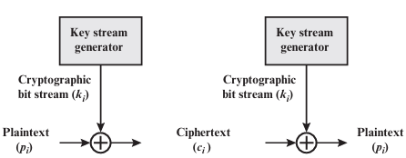
Vernam Cipher

Slide 30
One Time Pad
An Army Signal Corp officer, Joseph Mauborgne, proposed an improvement to the Vernam cipher that yields the ultimate in security.
Mauborgne suggested using a random key that is as long as the message, so that the key need not be repeated.
In addition, the key is to be used to encrypt and decrypt a single message, and then is discarded.
Each new message requires a new key of the same length as the new message. Such a scheme, known as a one-time pad, is unbreakable.
It produces random output that bears no statistical relationship to the plaintext. Because the ciphertext contains no information whatsoever about the plaintext, there is simply no way to break the code.

Slide 31
Contd…
Consider the ciphertext
ANKYODKYUREPFJBYOJDSPLREYIUNOFDOIUERFPLUYTS
We now show two different decryptions using two different keys:
ciphertext: ANKYODKYUREPFJBYOJDSPLREYIUNOFDOIUERFPLUYTS
key: pxlmvmsydofuyrvzwctnlebnecvgdupahfzzlmnyih
plaintext: mr mustard with the candlestick in the hall
ciphertext: ANKYODKYUREPFJBYOJDSPLREYIUNOFDOIUERFPLUYTS
key: pftgpmiydgaxgoufhklllmhsqdqogtewbqfgyovuhwt
plaintext: miss scarlet with the knife in the library

Slide 32
Contd..
In theory, we need look no further for a cipher. The one-time pad offers complete security but, in practice, has two fundamental difficulties:
1. There is the practical problem of making large quantities of random keys. Any heavily used system might require millions of random characters on a regular basis. Supplying truly random characters in this volume is a significant task.
2. Even more daunting is the problem of key distribution and protection. For every message to be sent, a key of equal length is needed by both sender and receiver. Thus, a mammoth key distribution problem exists.

Slide 33
Stegnography
We conclude with a discussion of a technique that (strictly speaking), is not encryption, namely, steganography. A plaintext message may be hidden in one of two ways. The methods of steganography conceal the existence of the message, whereas the methods of cryptography render the message unintelligible to outsiders by various transformations of the text, A simple form of steganography, but one that is time-consuming to construct, is one in which an arrangement of words or letters within an apparently innocuous text spells out the real message. For example, the sequence of first letters of each word of the overall message spells out the hidden message.

Slide 34
Contd..
Various other techniques have been used historically;
Character marking: Selected letters of printed or typewritten text are over written in pencil. The marks are ordinarily not visible unless the paper is held at an angle to bright light.
■ Invisible ink: A number of substances can be used for writing but leave no visible trace until heat or some chemical is applied to the paper.
■ Pin punctures: Small pin punctures on selected letters are ordinarily not visible unless the paper is held up in front of a light.
■ Typewriter correction ribbon: Used between lines typed with a black ribbon, the results of typing with the correction tape are visible only under a strong light

Slide 35
Contd..
Steganography has a number of drawbacks when compared to encryption.
It requires a lot of overhead to hide a relatively few bits of information, although using a scheme like that proposed in the preceding paragraph may make it more effective.
Also, once the system is discovered, it becomes virtually worthless.
This problem, too, can be overcome if the insertion method depends on some sort of key Alternatively, a message can be first encrypted and then hidden using steganography.

Slide 36
Contd..
The advantage of steganography is that it can be employed by parties who have something to lose should the fact of their secret communication (not necessarily the content) be discovered.
Encryption flags traffic as important or secret or may identify the sender or receiver as someone with something to hide.

Slide 37
Chapter 4: Block Ciphers and Data Encryption Standard
A stream cipher is one that encrypts a digital data stream one bit or one byte at a time. Examples of classical stream ciphers are the auto keyed Vigenère cipher and the Vernam cipher.
In the ideal case, a one-time pad version of the Vernam cipher would be used.
A block cipher is one in which a block of plaintext is treated as a whole and used to produce a ciphertext block of equal length.
Typically, a block size of 64 or 128 bits is used.
As with a stream cipher, the two users share a symmetric encryption key

Slide 38
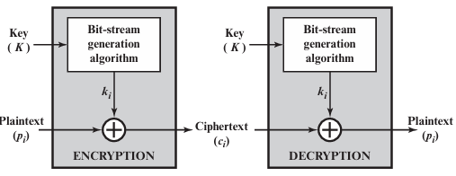
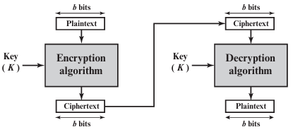
Stream cipher using algorithmic bit-stream generator
Block Cipher

Slide 39
Feistel Cipher
Feistel proposed [FEIS73] that we can approximate the ideal block cipher by utilizing the concept of a product cipher, which is the execution of two or more simple ciphers in sequence in such a way that the final result or product is cryptographically stronger than any of the component ciphers.
The essence of the approach is to develop a block cipher with a key length of k bits and a block length of n bits, allowing a total of 2k possible transformations, rather than the 2 power n! transformations available with the ideal block cipher.

Slide 40
In particular, Feistel proposed the use of a cipher that alternates substitutions and permutations, where these terms are defined as follows:
Substitution: Each plaintext element or group of elements is uniquely replaced by a corresponding ciphertext element or group of elements.
Permutation: A sequence of plaintext elements is replaced by a permutation of that sequence. That is, no elements are added or deleted or replaced in the sequence, rather the order in which the elements appear in the sequence is changed.

Slide 41

Diffusion and Confusion
The terms diffusion and confusion were introduced by Claude Shannon to capture the two basic building blocks for any cryptographic system [SHAN49]. Shannon’s concern was to thwart cryptanalysis based on statistical analysis. The reasoning is as follows. Assume the attacker has some knowledge of the statistical characteristics of the plaintext.
In diffusion, the statistical structure of the plaintext is dissipated into long-range statistics of the ciphertext. This is achieved by having each plaintext digit affect the value of many ciphertext digits; generally, this is equivalent to having each ciphertext digit be affected by many plaintext digits.
An example of diffusion is to encrypt a message M = m1, m2, m3, c of characters with an averaging operation:

Slide 42
Contd..
Confusion seeks to make the relationship between the statistics of the ciphertext and the value of the encryption key as complex as possible, again to thwart attempts to discover the key.
Thus, even if the attacker can get some handle on the statistics of the ciphertext, the way in which the key was used to produce that ciphertext is so complex as to make it difficult to deduce the key.
This is achieved by the use of a complex substitution algorithm. In contrast, a simple linear substitution function would add little confusion.

Slide 43
Substitution & Permutation
A substitution is performed on the left half of the data. This is done by applying a round function F to the right half of the data and then taking the exclusive-OR of the output of that function and the left half of the data.
The round function has the same general structure for each round but is parameterized by the round subkey Ki. Another way to express this is to say that F is a function of right-half block of w bits and a subkey of y bits, which produces an output value of length w bits: F(REi, Ki+1).
Following this substitution, a permutation is performed that consists of the interchange of the two halves of the data.6 This structure is a particular form of the substitution-permutation network (SPN) proposed by Shannon

Slide 44
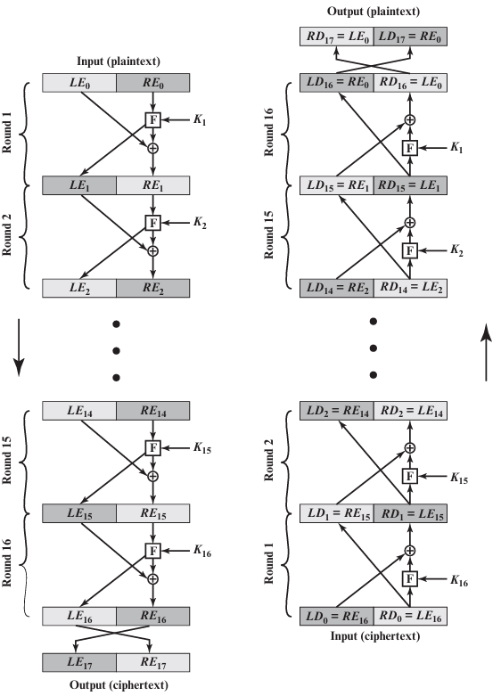
Feistel Encryption and Decryption (16 rounds)

Slide 45
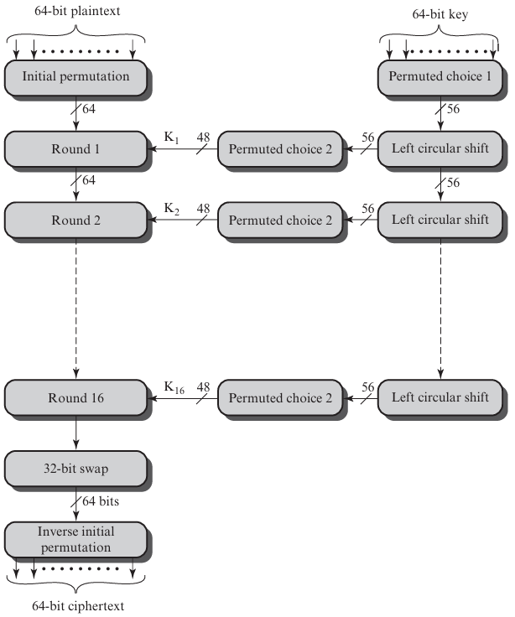
Data Encryption Standard-General Depiction of DES Encryption Algorithm

Slide 46
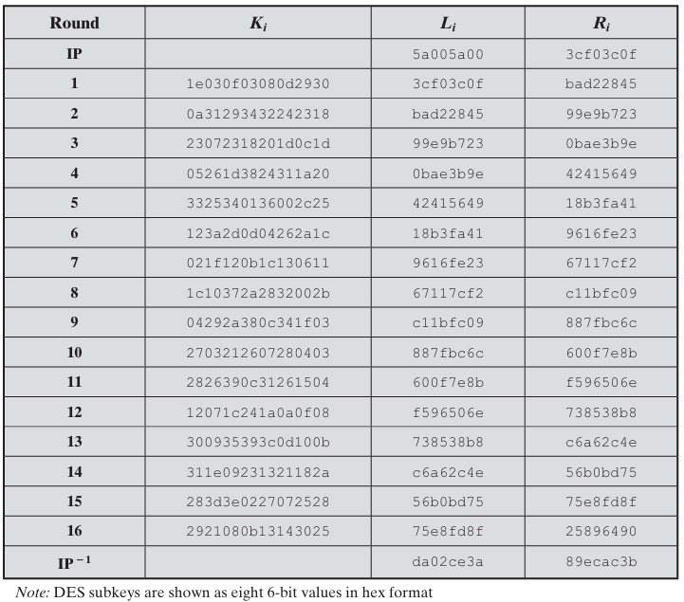
Example
For this example, the plaintext is a hexadecimal palindrome. The plaintext, key, and resulting ciphertext are as follows

Slide 47
Strength of DES
Key Size and Security
  DES uses a 56-bit key, which was secure when introduced in the 1970s.
  With modern computing power, brute-force attacks can try all 2562^{56}256 possible keys in feasible time, making it vulnerable.
Avalanche Effect
  A small change in plaintext or key results in a large change in ciphertext.
  This enhances confusion and diffusion, strengthening resistance to simple statistical attacks.
Resistance to Cryptanalysis
  DES is designed to resist:
    Differential cryptanalysis (later discovered formally, but DES was already secure against it for practical rounds).
    Linear cryptanalysis (hard but possible with enough known plaintext-ciphertext pairs).
  Still, advances in cryptanalysis have shown that DES is not fully secure against large-scale attacks.
Performance
  DES is fast in both hardware and software implementations.
  Widely used in early financial and government applications.
Main Weakness
  The primary weakness is its short key length (56-bit) rather than flaws in the algorithm itself.
  This led to the development of Triple DES (3DES) and later AES as replacements.

Slide 48
Block cipher design principles
Number of Rounds: Enough to resist known attacks, balance security vs. speed.
Function F: Nonlinear, mixes substitution & permutation, ensures confusion & diffusion.
Key Generation: Produces unique, complex subkeys; prevents related-key attacks; efficient.

Slide 49
Contd..
Confusion and Diffusion (Shannon’s Principles)
Confusion: Makes the relationship between the key and ciphertext as complex as possible, usually achieved through substitution.
Diffusion: Spreads the influence of each plaintext bit over many ciphertext bits, usually achieved through permutation.
Together, they obscure patterns and resist statistical attacks.

Slide 50
Contd..
Round Function Properties
Non-linearity: Use nonlinear S-boxes to resist linear/differential cryptanalysis.
Avalanche Effect: A single bit change in input should flip ~50% of the output bits after a few rounds.
Balanced Mixing: Substitution + permutation ensure strong bit mixing.

Slide 51
Contd..
Substitution–Permutation Network (SPN) and Feistel Structure
SPN: Uses repeated rounds of S-boxes (nonlinear substitution) and P-boxes (permutation). Example: AES.
Feistel Structure: Splits data into halves; one half is transformed with a round function and combined with the other half. Allows easy decryption. Example: DES.

Slide 52
Key Generation Algorithm (Key Schedule)
Determines how round subkeys are derived from the main cipher key.
Principles:
  Each round key should be different and appear independent of the others.
  Small changes in the main key → large changes in round keys (avalanche effect).
  Must prevent related-key attacks (where knowledge of relationships between keys helps cryptanalysis).
Should be efficient (not dominate overall encryption time).
Examples:
  DES: shifts and permutations on the key.
  AES: uses Rijndael key schedule with byte substitution, rotation, and XOR with round constants.

Slide 53
Thank You

