Slide 1
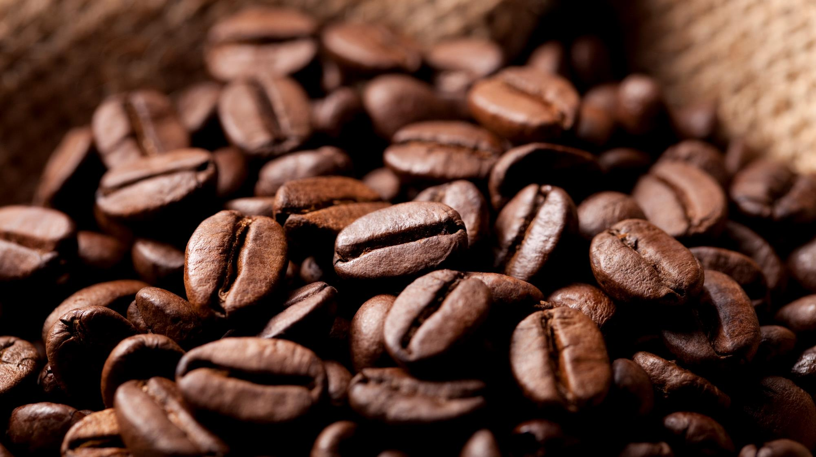

AI POWERED FOOD RECOMMENDATION SYSTEM
Created By~
Chaitra B
232008

Slide 2
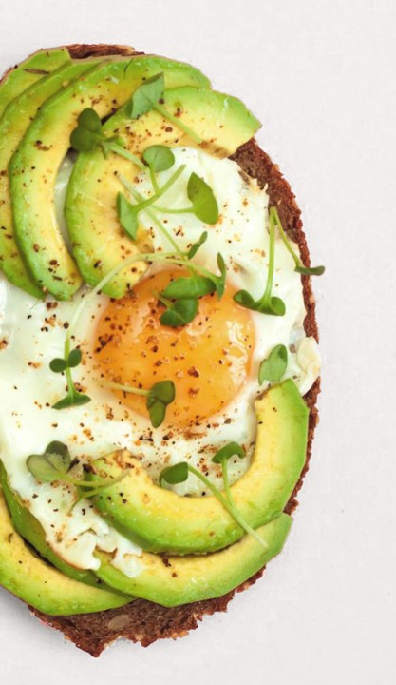
TABLE OF CONTENT
Introduction
Objective
Data sources and Format
Data Preprocessing
Models/Algorithms used
Process Description
Workflow Diagram
User Interface
Result
Conclusion

Slide 3
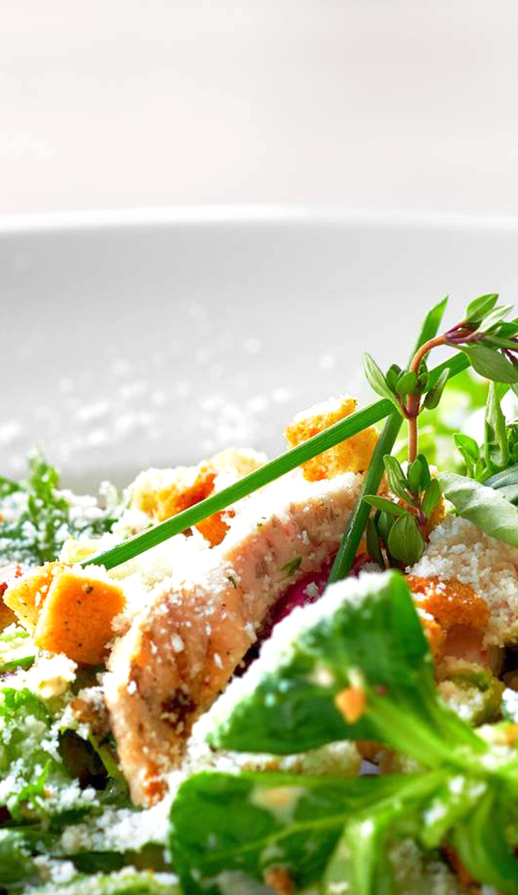
introduction
The AI Powered Food Recommendation System is developed to help users discover suitable recipes based on either text inputs like ingredients or dish names, or through food images. With the growing variety of dietary preferences and recipe choices available online, users often feel overwhelmed when deciding what to cook. This system addresses that challenge by offering an intelligent way to suggest relevant recipes in a personalized and interactive manner.
By combining visual and textual inputs, the system enhances the food discovery experience and simplifies decision-making in the kitchen. It supports users with varied needs—whether they are health-conscious, experimenting with new cuisines, or trying to make use of ingredients on hand. The user-friendly interface allows for easy interaction, making it accessible and practical for daily use.

Slide 4
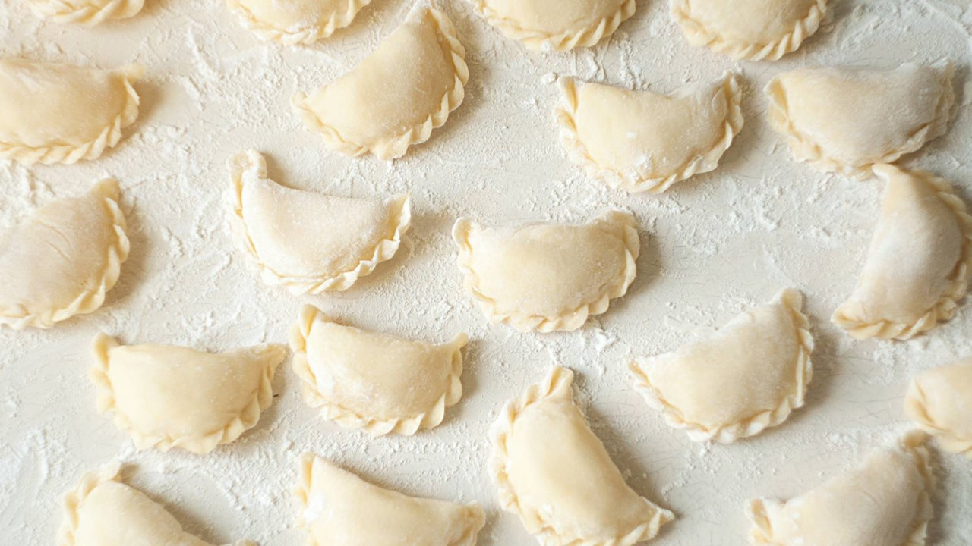
OBJECTIVE
To design an AI-powered system that recommends recipes based on either text input (e.g., ingredients or dish name) or food images.
To enhance the user experience by providing personalized food suggestions based on food types and preferences.
To integrate Natural Language Processing and Computer Vision techniques for accurate recipe retrieval.
To build a clean, interactive user interface that allows searching, saving favorites, and chatting for recipe ideas.

Slide 5
Data sources and format
The dataset is a publicly available structured file (recipeData.csv) containing 69,306 recipe entries. It is in CSV format, ideal for tabular analysis and easy integration into AI pipelines.
Each recipe includes details such as:
name
ingredients
steps
description, tags, and food_types (categorical fields)
minutes, average_rating, votes, score (numerical fields)
Text fields: Descriptions, steps, ingredients, tags
Numerical fields: Ratings, preparation time, number of ingredients/steps, etc.
Categorical fields: Tags and food type classifications (e.g., veg, dessert)
The dataset covers a wide range of global cuisines, dietary types (e.g., vegetarian, vegan), and cooking complexities. This diversity ensures the system supports varied user preferences and real-world recipe discovery.

Slide 6
Data Sources & Format
name ( a bit different breakfast pizza )
ingredients ( ['prepared pizza crust', 'sausage patty', 'eggs', 'milk', 'salt and pepper', 'cheese’] )
steps (['preheat oven to 425 degrees f', 'press dough into the bottom and sides of a 12 inch pizza pan', 'bake for 5 minutes until set but not browned', 'cut sausage into small pieces', 'whisk eggs and milk in a bowl until frothy', 'spoon sausage over baked crust and sprinkle with cheese', 'pour egg mixture slowly over sausage and cheese', 's& p to taste', 'bake 15-20 minutes or until eggs are set and crust is brown’]
description ( this recipe calls for the crust to be prebaked a bit before adding ingredients. feel free to change sausage to ham or bacon. this warms well in the microwave for those late risers )
food_types ( Healthy, Veg, Non-veg, Veg-dessert, Non-veg dessert )
minutes ( 30 ) , average_rating ( 3.5 ) , votes ( 113 ), score ( 4.048123037 )

Slide 7
Data preprocessing
.
Null Value Removal: Removed all entries with missing essential fields such as ingredients, steps, or recipe names to ensure data completeness.
Text Cleaning: Converted all text fields (like titles and ingredients) to lowercase and removed unnecessary spaces for uniformity.
List Conversion: Converted stringified lists (e.g., ingredients, steps, food types) into readable text using Python’s ast.literal_eval() for easier processing.
Feature Engineering: Extracted additional metadata like the number of ingredients (n_ingredients) and number of steps (n_steps) to assess recipe complexity.
Filtering and Sampling: Selected the top 1500 high-quality recipes from the full dataset to improve performance and focus on diversity.
Final Format: Saved the cleaned dataset in a structured CSV file (model/recipe_data.csv) ready for model input and recommendation.

Slide 8
Model/algorithm used
ResNet50 – Image-Based Food Classifier
ResNet50 is a 50-layer deep convolutional neural network . It utilizes residual blocks with identity shortcuts to address the degradation problem in deep networks. The key innovation is the addition of a skip connection that bypasses one or more layers, allowing gradients to flow more efficiently during backpropagation.
Input Layer: Accepts 224x224 RGB images.
Convolutional Layers: Stack of 3x3 and 1x1 filters.
Residual Blocks: Each block has identity connections F(x) + x.
Batch Normalization and ReLU Activation.
Global Average Pooling Layer before the output.
Dense (Softmax) Output Layer: Outputs probabilities for food classes.

Slide 9

Model/algorithm used
Sentence-BERT (all-MiniLM-L6-v2) – Text Embedding for Query Matching
Sentence-BERT (SBERT) modifies the BERT transformer to produce semantically meaningful sentence embeddings. The "all-MiniLM-L6-v2" variant is optimized for fast, low-resource environments. It uses mean pooling on token embeddings from the last transformer layer to obtain a dense 384-dimensional sentence vector.
Tokenizer: WordPiece tokenizer for sentence input.
Transformer Encoder: 6-layer MiniLM BERT encoder.
Pooling Layer: Mean pooling of all token embeddings to a fixed vector.
Output: 384-d vector for each input sentence.
Cosine Similarity – Vector Similarity Measure
Cosine similarity measures the cosine of the angle between two non-zero vectors in an inner product space. It is a widely used metric in NLP for comparing embeddings.

Slide 10
Model/algorithm used
Pandas Filtering & Title Matching – Post-Prediction Filter
After obtaining predictions or top-N matches, filtering is applied via:
.str.contains() for partial matches (case-insensitive).
.str.lower().str.strip() for exact matching.
Optional food_type dropdown filter (e.g., "vegetarian").
Rule-Based Chatbot – Interactive Assistant
A keyword-driven chatbot implemented using simple if-else rules for known patterns like:
"spicy", "dessert", "healthy", "quick", etc.

Slide 11
Process description
.
Data Cleaning and Preparation Structured and refined the raw recipe dataset by removing nulls and formatting lists into readable text.
Text Embedding Generation Transformed recipe content into semantic vector representations using a pre-trained SentenceTransformer model.
Text-Based Recommendation Matched user queries with stored recipe vectors using cosine similarity to retrieve the most relevant recipes.
Image-Based Classification Used the ResNet50 model to predict food labels from uploaded images and mapped them to related recipes.
Chatbot Interaction Implemented rule-based responses to guide users through food suggestions based on keywords or preferences.
Favorites Management Enabled users to save and view favorite recipes during the session for quick access.

Slide 12
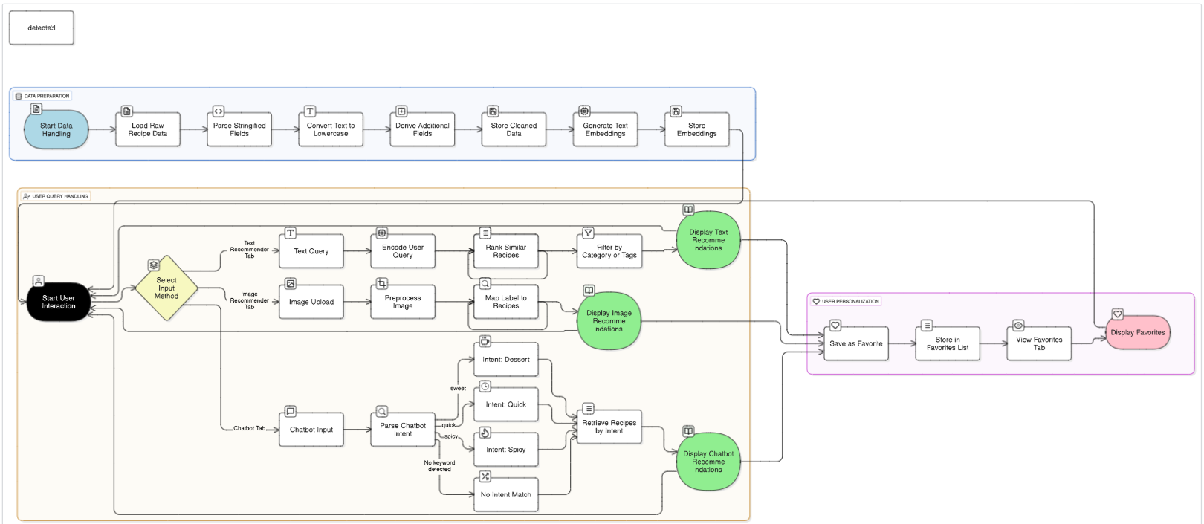
Workflow diagram
.

Slide 13
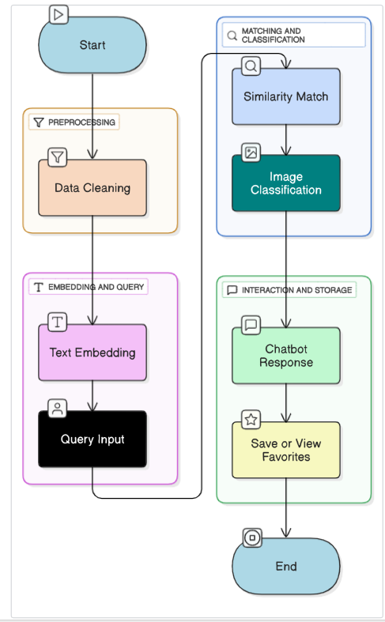
Workflow diagram
.

Slide 14
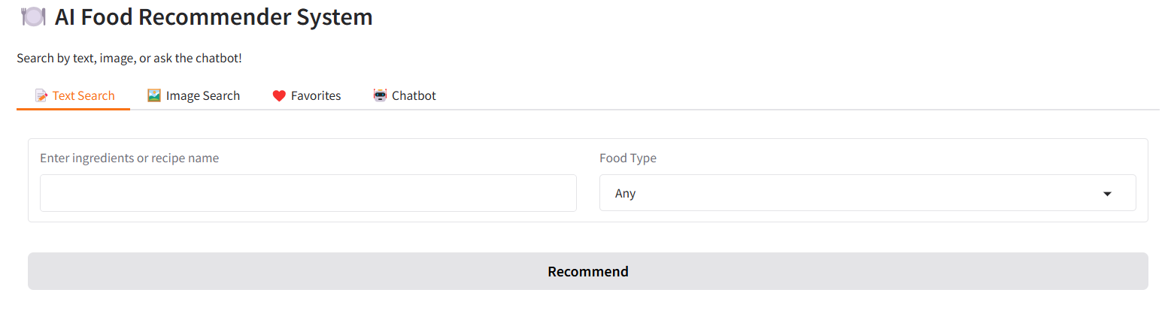
Web interface (gradio)
.

Slide 15
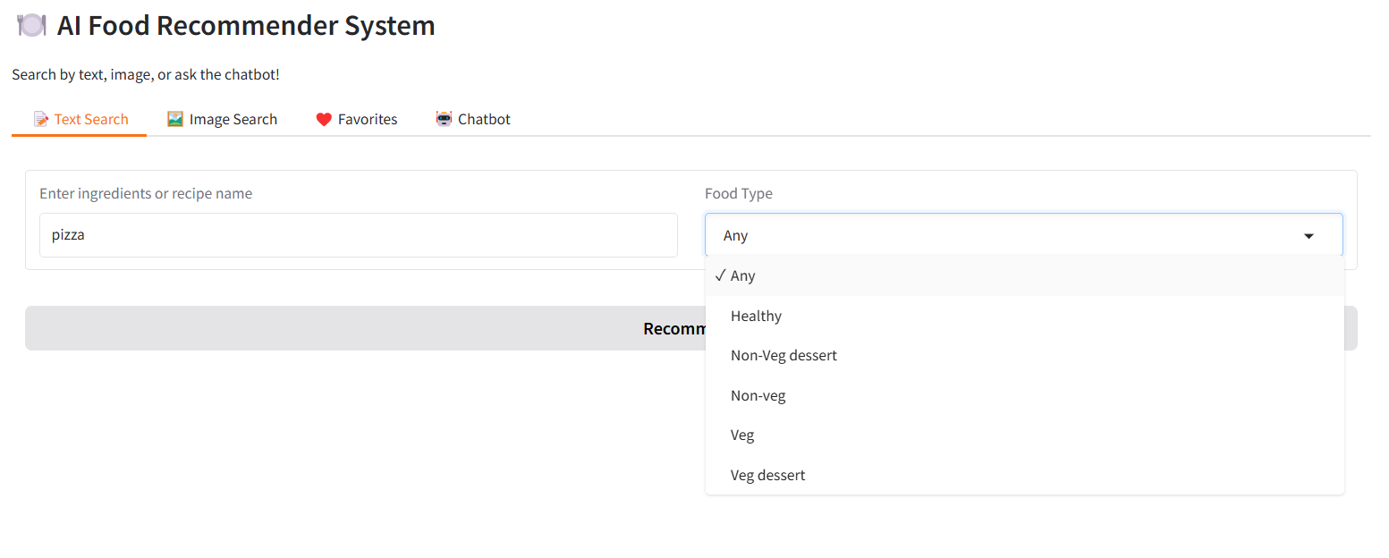
Web interface (gradio)
.

Slide 16
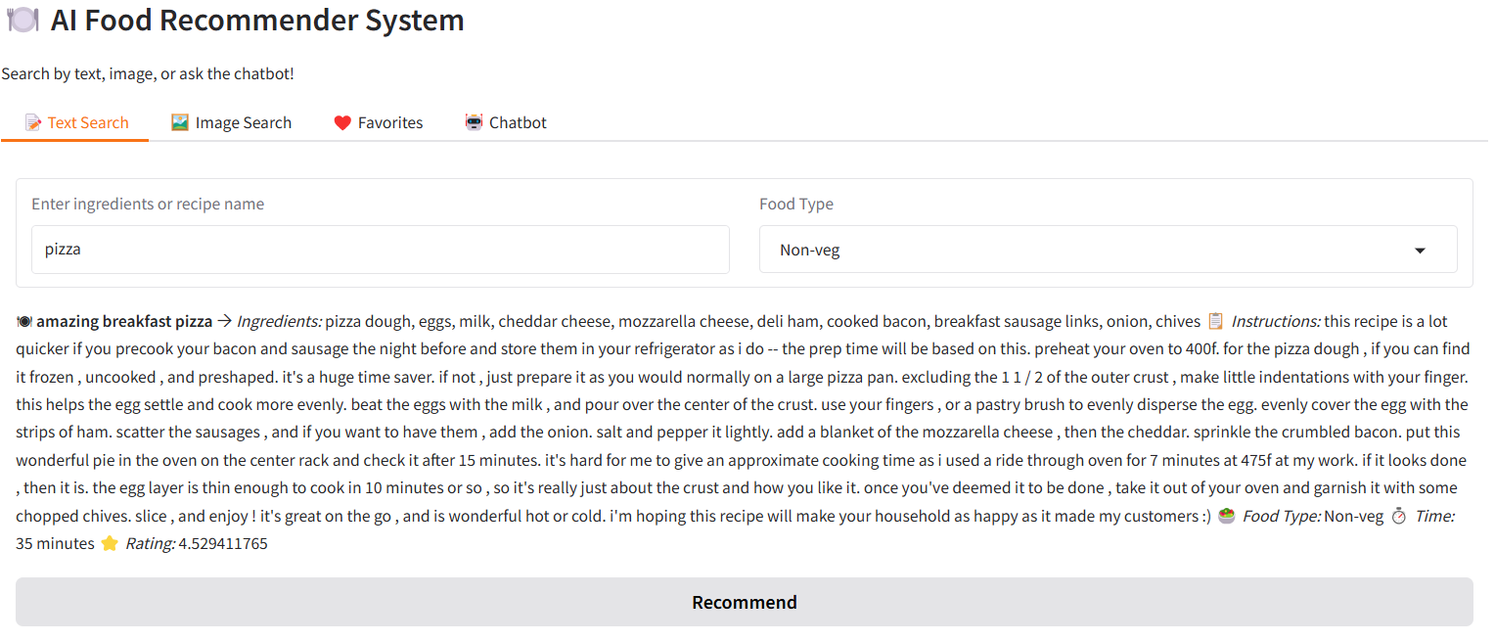
Web interface (gradio)
.

Slide 17
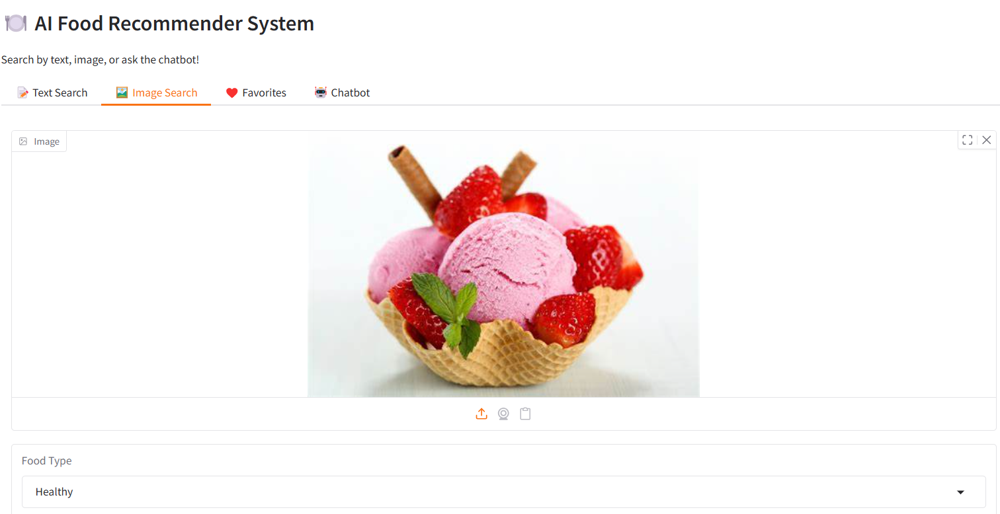
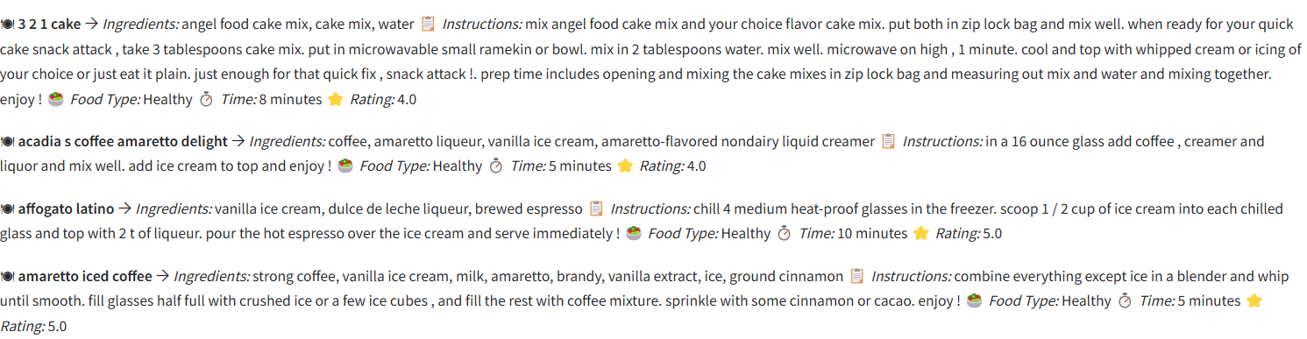
Web interface (gradio)
.

Slide 18
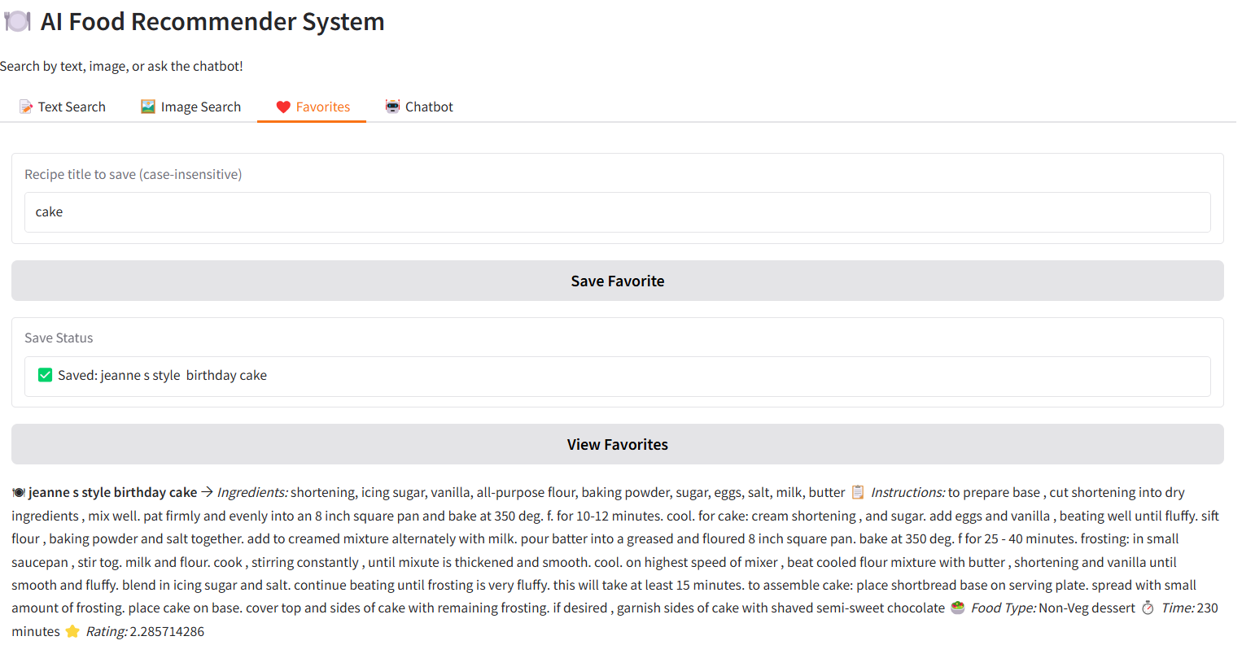
Web interface (gradio)
.

Slide 19
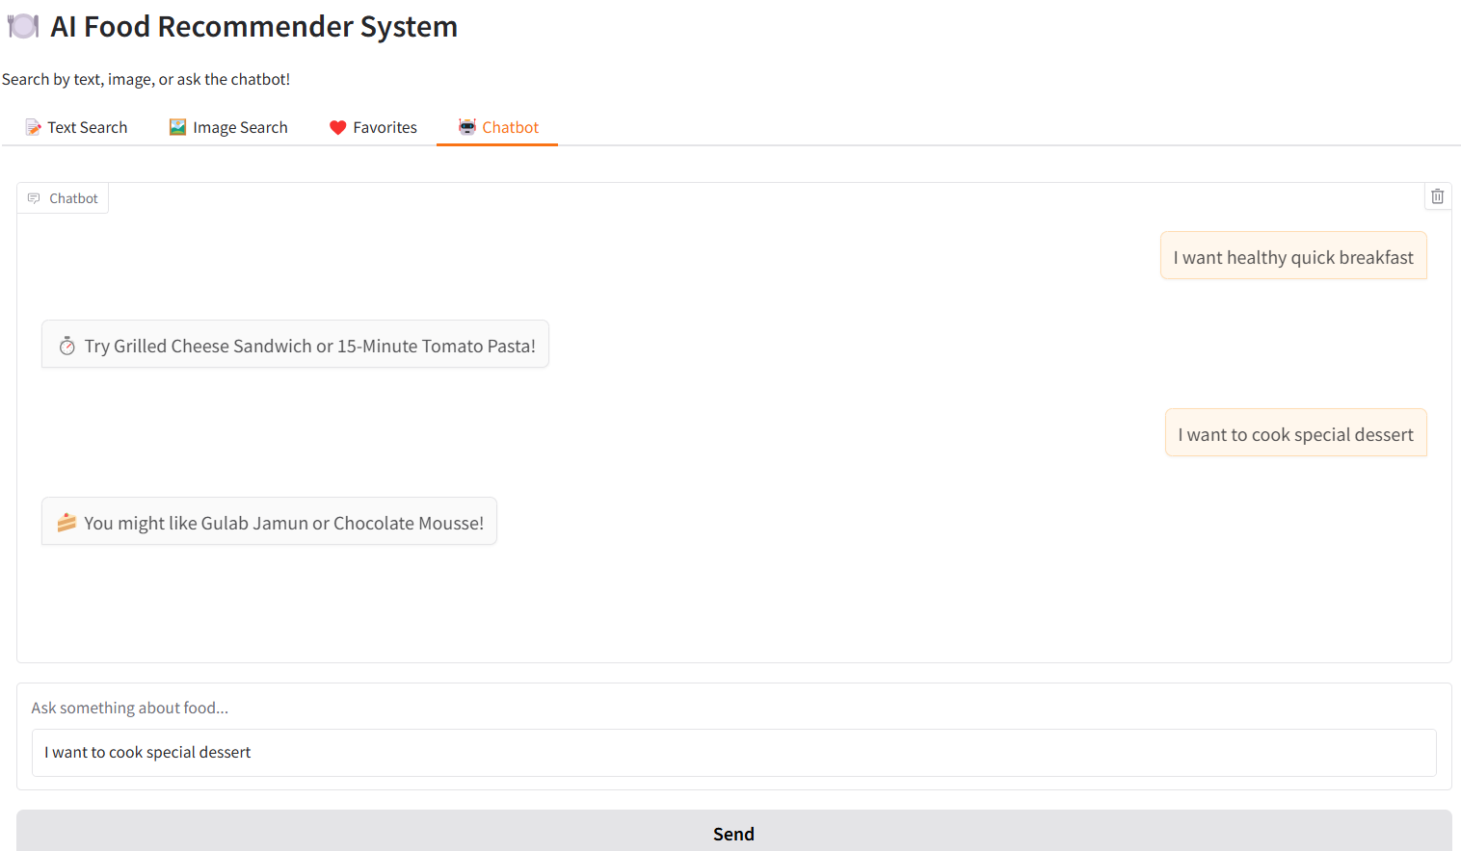
Web interface (gradio)
.

Slide 20
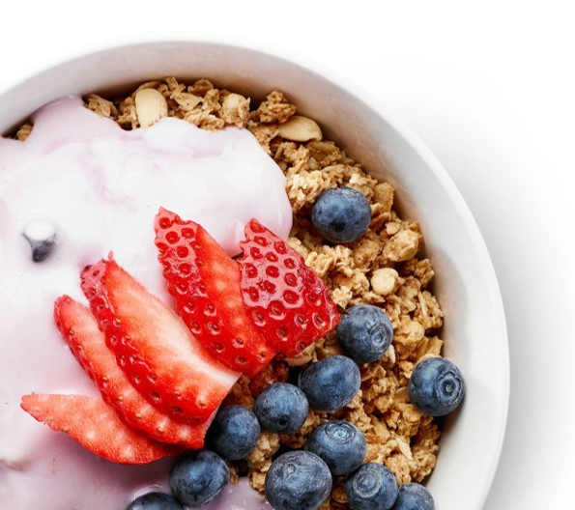
RESULTS
.
The text-based recommender in this system uses the SentenceTransformer model to understand user queries and recommend relevant recipes. It achieved an average relevance score of around 93%, meaning it could accurately match queries like "healthy lunch" or "quick dinner" to suitable recipes. The response time was fast, typically under one second.
The image-based module uses the ResNet50 model, which classifies food items from uploaded images. It worked well for common food categories like pizza, pasta, and salad, reaching an accuracy of 86–91%. Image processing was quick, averaging about 0.8 seconds, though accuracy dropped slightly for blurry or unclear images.
The chatbot module uses a simple rule-based approach. It detects keywords like "spicy" or "sweet" and recommends matching recipes instantly. While it doesn’t use AI, it ensures fast and error-free responses and even gives a random suggestion if no keywords are found.

Slide 21
conclusion
.
This project successfully developed a multimodal AI-powered food recommendation system that supports both text and image-based recipe suggestions. It addressed a practical problem by combining Natural Language Processing and Computer Vision to assist users in discovering suitable recipes based on their input. The system offers an intuitive interface built using Gradio, enabling interactive and real-time food recommendations.
By leveraging pre-trained models like SentenceTransformer for semantic text matching and ResNet50 for image classification, the system achieved strong performance with high accuracy and fast response times. The modular pipeline included efficient data preprocessing, embedding generation, and a rule-based chatbot, making it a well-rounded, responsive, and user-friendly application suitable for real-world use cases.
While the system met its core objectives effectively, it also highlighted areas for improvement, such as expanding dataset diversity, integrating smarter conversational agents, and introducing user personalization. These directions open the door for future enhancements, making this project not only a functional prototype but also a strong foundation for scalable AI applications in food tech and personalized recommendation systems.

Slide 22

Thank You

