Slide 1

AI-POWERED MEDICAL REPORT GENERATION (X-RAY IMAGES)
PRESENTED BY:
CHAITRA B
232008

Slide 2
TABLE OF CONTENT
Introduction
Objective
Methodology
Models/Algorithms used
Process Description
Workflow Diagram
Hardware and software specifications
Result
Web Interface
Reference

Slide 3
INTRODUCTION
In today’s fast-paced healthcare environment, radiologists and doctors often face challenges
in analyzing large volumes of medical data such as X-ray images, clinical findings, and
prescriptions. Manual interpretation of this information can be slow, inconsistent, and
sometimes prone to oversight.
This project introduces an AI-based medical assistant that automatically analyzes chest X-ray images, detects possible diseases, and generates a readable medical report. The system uses deep learning models for image segmentation and classification, combined with a language model to produce detailed, human-like medical summaries. The goal is to support healthcare professionals by making diagnosis faster, more consistent, and accessible—even in resource-limited settings.

Slide 4
OBJECTIVE
To develop a deep learning system that accurately detects and classifies multiple diseases from chest X-ray images.
To generate structured and coherent radiology reports using NLP models based on visual features extracted from X-ray images.
To apply image segmentation (U-Net) for highlighting abnormal regions, improving transparency and aiding clinician interpretation.
To assist healthcare professionals by accelerating diagnosis, reducing workload, and improving reporting consistency in radiological practice.

Slide 5
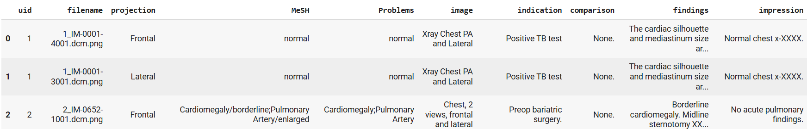
METHODOLOGY
Data Sources & Format
Dataset from NIH Open-i, curated by Indiana University. It Contains 7,470 PNG chest X-ray images originally in DICOM format.
The images were converted from DICOM to PNG format, with the top and bottom 0.5% of intensity values clipped to remove noise. Pixel values were then normalized to the 0–255 range, and the images were resized such that the shorter side is 2048 pixels, while maintaining the original aspect ratio.
The indiana_projections.csv file includes image-level metadata such as a unique ID (uid), the image filename, and the type of X-ray projection (frontal or lateral).
The file indiana_reports.csv includes problems, MeSH terms, findings, impressions, and other relevant details, all associated with each X-ray through a unique identifier (UID).

Slide 6
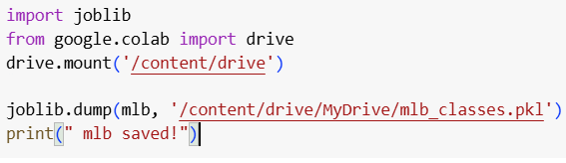
METHODOLOGY
Data Preprocessing
Loading and Understanding the Metadata
Standardizing Column Names
Merging Metadata with Clinical Labels
Mapping Images to UIDs (1000_IM-0001-4001.dcm.png)
Integrating Image Paths into the DataFrame
Visual Verification and Sanity Checks
Multi-label Parsing and Cleaning ("cardiomegaly|effusion”)
Multi-Label Binarization for Model Compatibility
Train-Validation Split for Model Training
Saving the Multi-Label Encoder

Slide 7
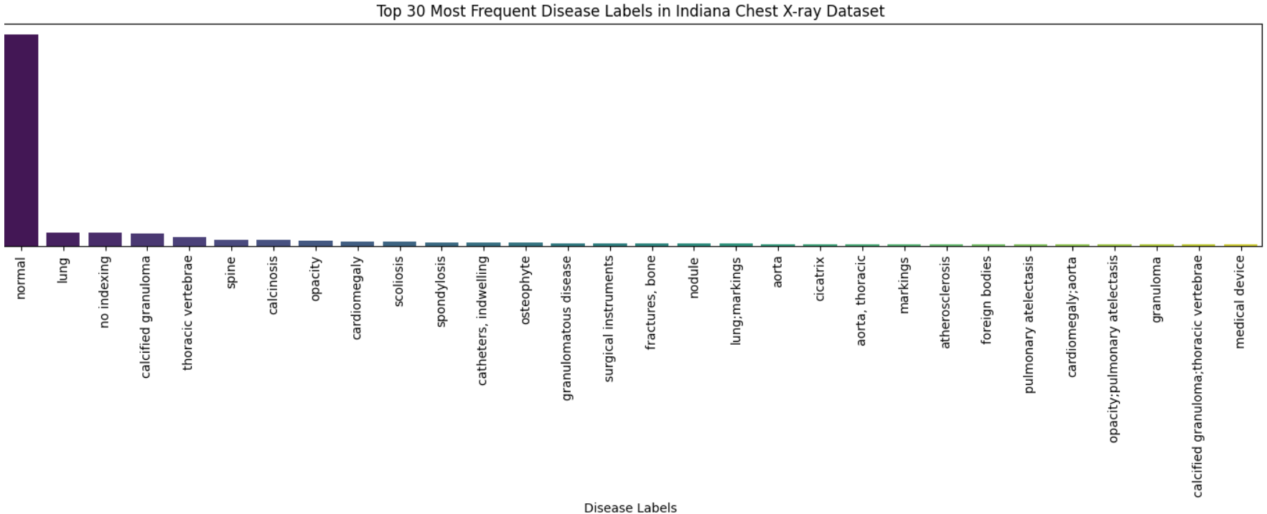
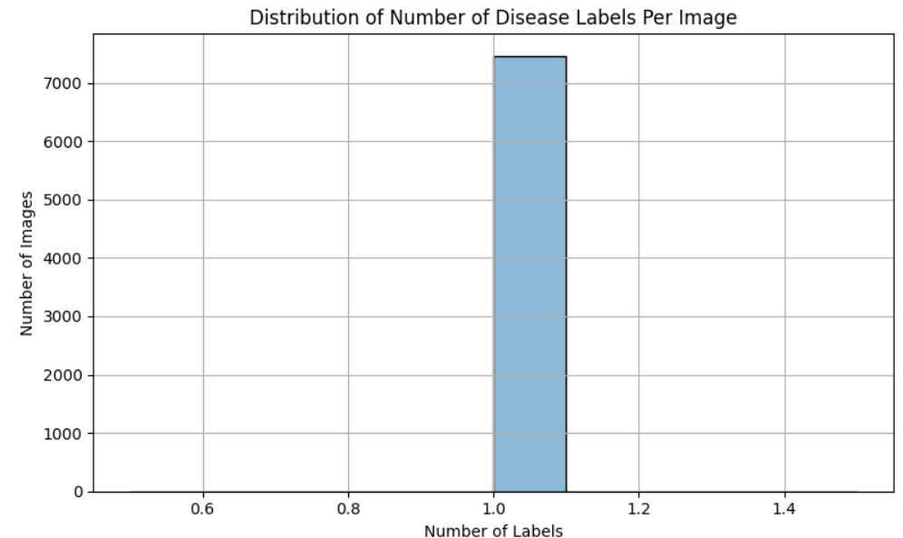
METHODOLOGY
Data Exploration & Analysis

Slide 8
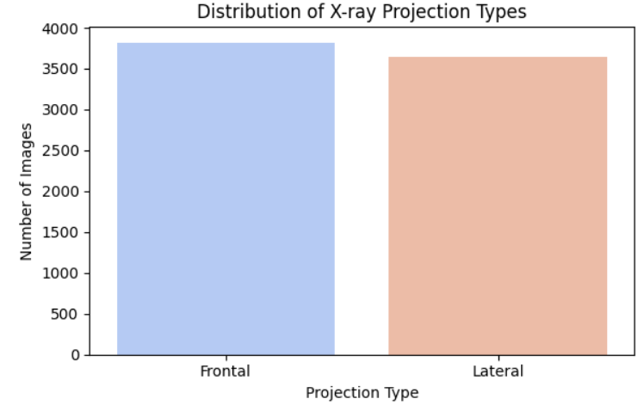
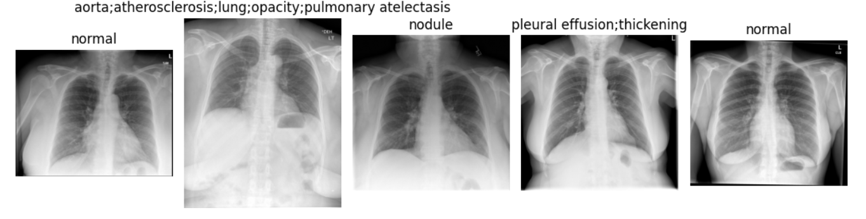

Slide 9
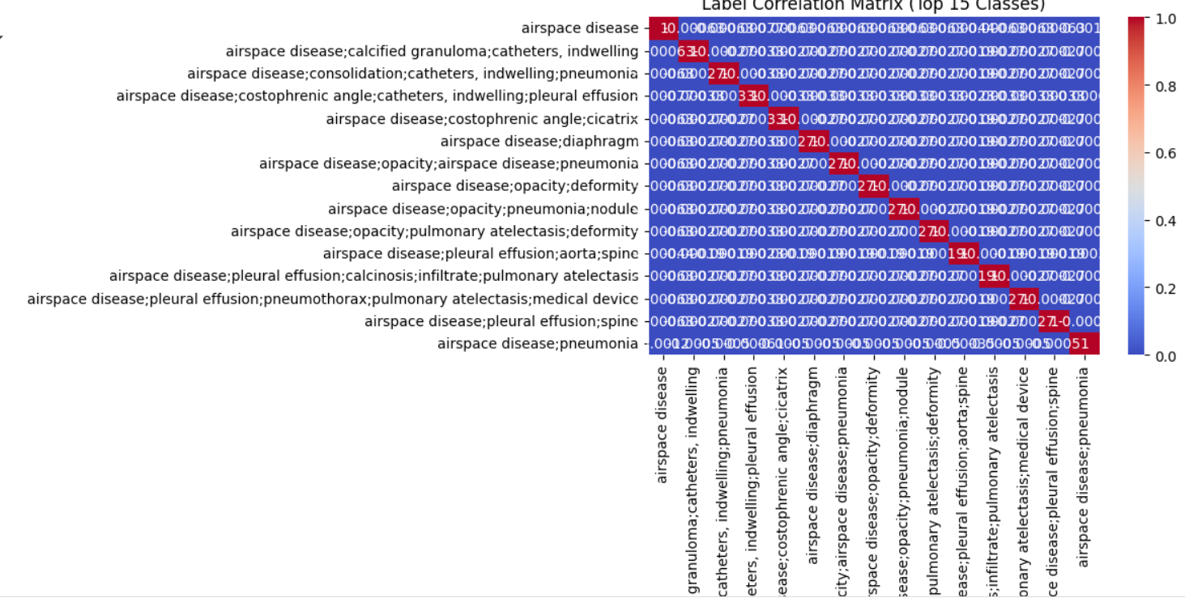

Slide 10
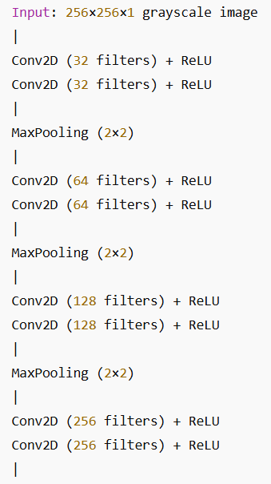
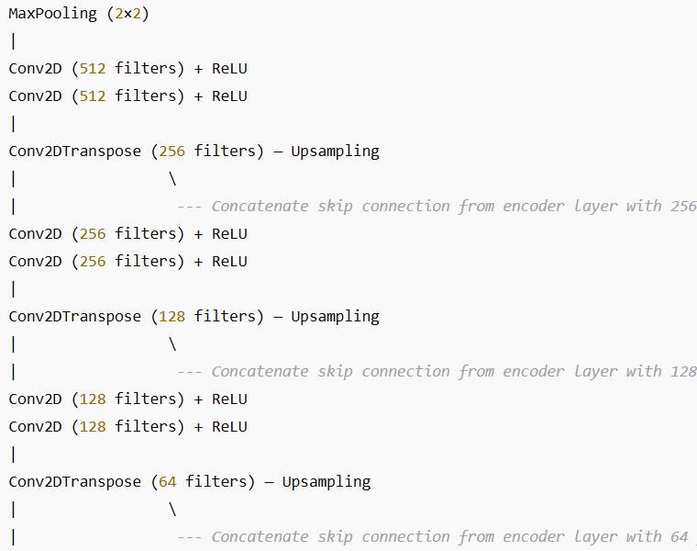
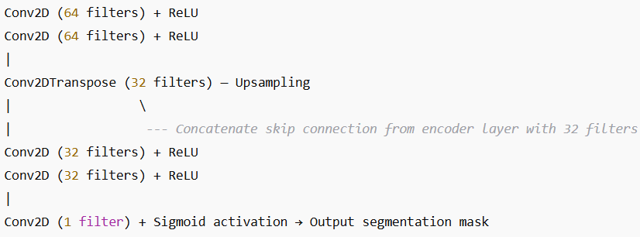
MODELS/ALGORITHMS USED
U-Net Model for Lung Segmentation
U-Net is a convolutional neural network architecture designed for precise image segmentation tasks, especially in medical imaging. In this project, U-Net is used to segment the lung regions from chest X-ray images, enabling the system to focus on relevant areas for accurate disease detection and report generation.
Layer-by-Layer Architecture

Slide 11
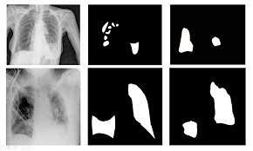

Slide 12
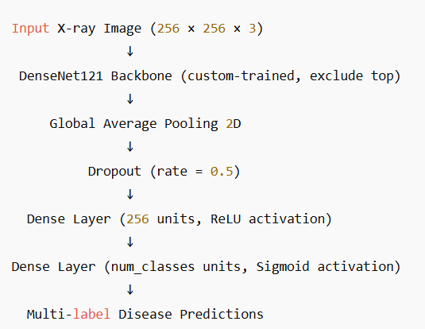
MODELS/ALGORITHMS USED
DenseNet121 for Multi-label Disease Classification
The model is built on DenseNet121, a deep convolutional neural network custom-trained on ImageNet, known for its dense connections that improve feature reuse and gradient flow. The top layers are removed to allow for a custom classification head, which includes global average pooling, dropout for regularization, a dense ReLU layer, and a sigmoid output layer for multi-label disease prediction.
Disease Prediction Architecture (DenseNet121-based)

Slide 13
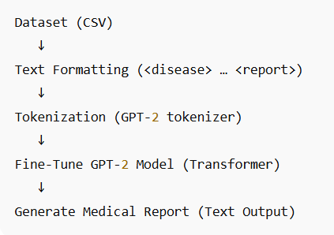
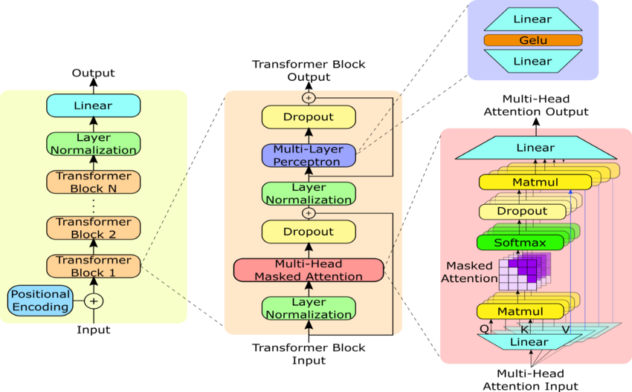
MODELS/ALGORITHMS USED
GPT-2 for Medical Report Generation Using Hugging Face
GPT-2 (Generative Pre-trained Transformer 2) is a powerful transformer-based language model developed by OpenAI. It excels at generating coherent, contextually relevant text by predicting the next word in a sequence, making it ideal for tasks like automatic medical report generation from disease classification tags or image features.
GPT-2 Model Architecture

Slide 14
PROCESS DESCRIPTION
Automates chest X-ray report generation using deep learning. Integrates U-Net (lung segmentation), Fine-tuned DenseNet121 (multi-label classification), and fine-tuned GPT-2 (report generation).
Converts grayscale X-rays to RGB by channel replication . Resizes to 256×256 and normalizes pixel values to [0,1]. Standardizes input for consistent model performance.
Uses a U-Net model to segment lung regions from the X-ray. Outputs a binary lung mask to focus the analysis. Enhances classification by removing irrelevant background.
Modified DenseNet121 with a custom head (GAP → Dropout → Dense → Sigmoid). Supports multi-label prediction of co-existing diseases. Trained in two phases (freeze base, then fine-tune top layers) and uses focal loss to handle class imbalance.
Takes disease predictions as input. Generates coherent diagnostic reports using GPT-2 transformer and Produces natural-language summaries of predicted disease.
Upload X-ray → Preprocess → Segment lungs (U-Net) → Classify diseases (DenseNet121) → Generate medical report (GPT-2)

Slide 15
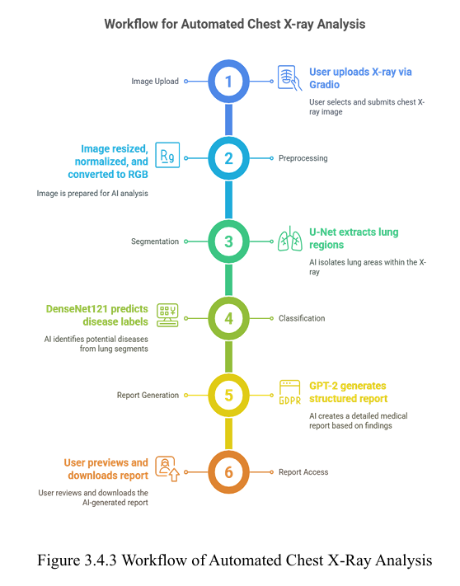

Slide 16
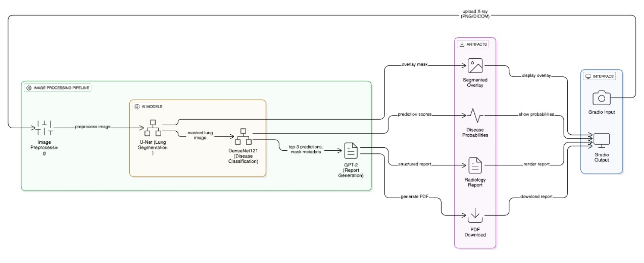

Slide 17
HARDWARE & SOFTWARE SPECIFICATIONS
Hardware Requirements
Processor: 11th Gen Intel® Core™ i5-1135G7 @ 2.40GHz, 4 physical cores and 8 logical threads
RAM (Memory): Installed Physical Memory: 8.00 GB DDR4
System Architecture:64-bit Operating System, x64-based Processor
Edition: Microsoft Windows 11 Home Single Language (64-bit)
Software Requirements
Programming Language: Python ≥ 3.10
Core Machine Learning Libraries: tensorflow==2.18.0, keras>=3.5.0, torch==2.2.0
NLP & Report Generation: transformers==4.38.2
Web Interface: gradio==4.24.0
Image Processing: Pillow==10.2.0
Numerical Computing & Data Handling: numpy>=1.26.0,<2.0 , joblib==1.3.2
Machine Learning Utilities: Scikit-learn==1.3.2
Development Environment: Google Colab or VSCode (Colab preferred for access to free GPU)

Slide 18
RESULT
The DenseNet121 model was trained and fine-tuned for multi-label chest X-ray classification, achieving an AUC of 82.98%. While accuracy metrics are commonly reported, they can be misleading in medical multi-label tasks where exact label matching is required. Thus, metrics like precision, recall, and F1-score are more indicative of clinical reliability.
A pre-trained U-Net model was used for lung field segmentation, which helped localize disease-affected regions. The segmentation model demonstrated high overlap accuracy with ground truth masks, enhancing interpretability and focus for downstream analysis.
For automated report generation, a GPT-2 model was fine-tuned on the Indiana University Chest X-ray dataset using “Problems,” “Findings,” and “Impressions” sections. After 5 epochs, the model achieved a training loss of 0.2378 and evaluation loss of 0.2991, and it generated coherent, radiologist-style impressions aligned with clinical findings.

Slide 19
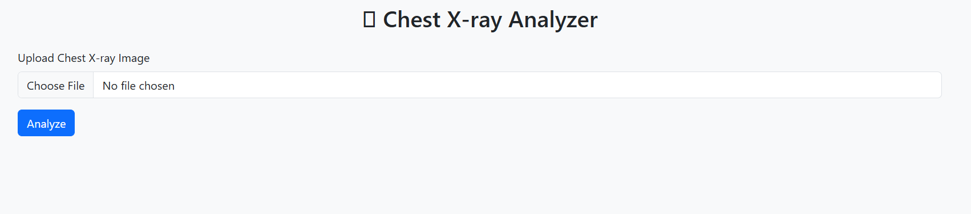
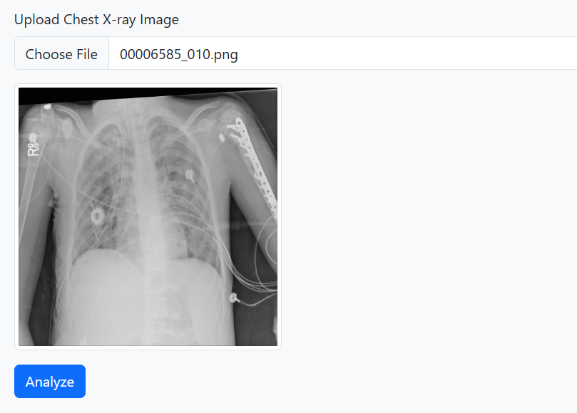
WEB INTERFACE (FLASK)

Slide 20
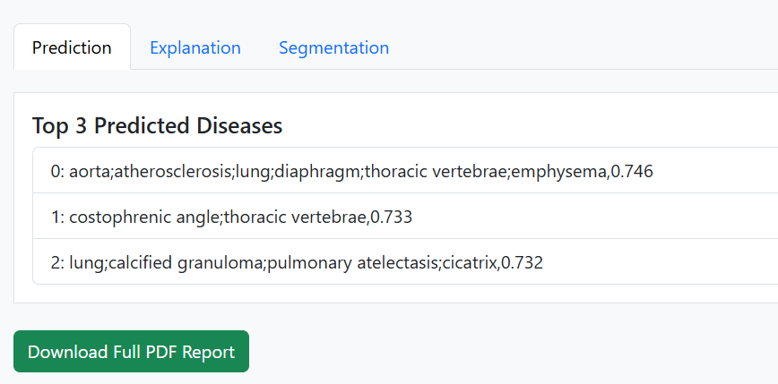
WEB INTERFACE (FLASK)

Slide 21
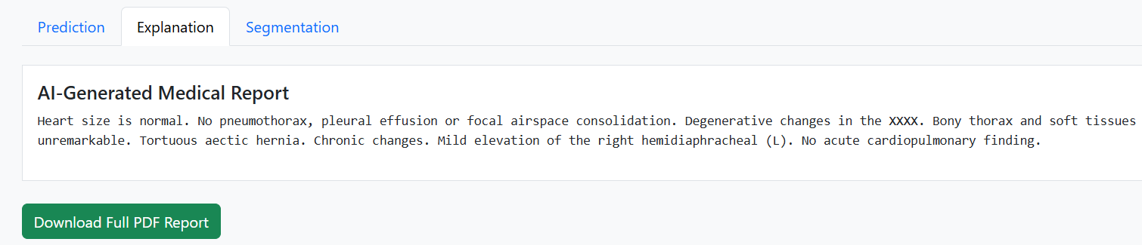
WEB INTERFACE (FLASK)

Slide 22
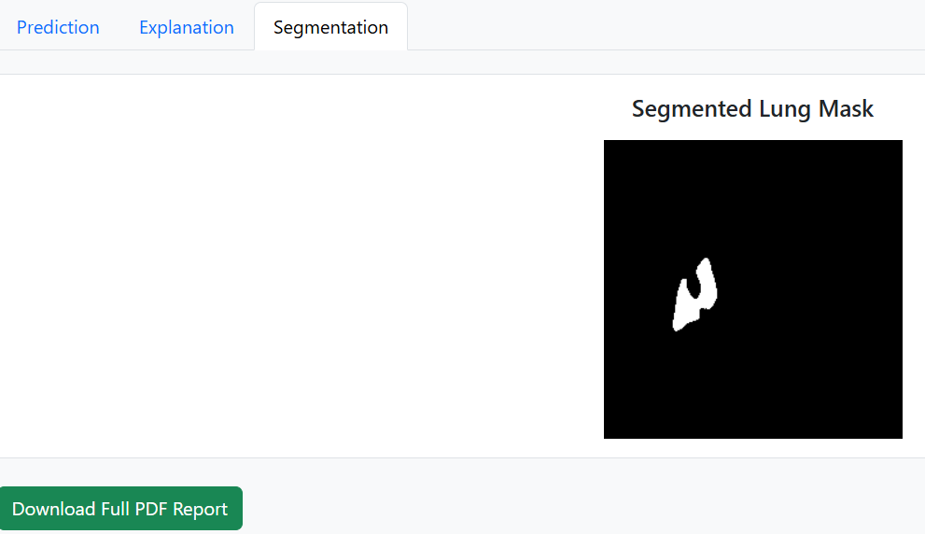
WEB INTERFACE (FLASK)

Slide 23
REFERENCE
Kuşcu, Ö. C., & Akkaya, A. M. (2023, December 9). Examining the human-like proficiency of GPT-2 in recognizing self-generated texts. Research Archive of Rising Scholars. https://doi.org/10.58445/rars.768
Sultana, S., Pramanik, A., & Rahman, M. S. (2023, January 19–20). Automated radiology report generation using conditioned transformers. In Proceedings of the 2023 3rd International Conference on Intelligent Communication and Computational Techniques (ICCT). Jaipur, India: IEEE. https://doi.org/10.1109/ICCT56969.2023.10075968
Siddique, N., Sidike, P., Elkin, C., & Devabhaktuni, V. (2021). U-Net and its variants for medical image segmentation: Theory and applications. IEEE Access, 9, 82031–82057. https://doi.org/10.1109/ACCESS.2021.3086020 81
Pham, T., Tao, X., Zhang, J., Yong, J., Li, Y., & Xie, H. (2021). Graph-based multi-label disease prediction model learning from medical data and domain knowledge. Knowledge-Based Systems, 235, Article 107662. https://doi.org/10.1016/j.knosys.2021.107662
Alfarghaly, O., Khaled, R., Elkorany, A., Helal, M., & Fahmy, A. (2021). Automated radiology report generation using conditioned transformers. Informatics in Medicine Unlocked, 24, Article 100557. https://doi.org/10.1016/j.imu.2021.100557
Li, R., Liu, W., Lin, Y., Zhao, H., & Zhang, C. (2017, June 15). An ensemble multilabel classification for disease risk prediction. Journal of Healthcare Engineering, 2017, Article 8051673. https://doi.org/10.1155/2017/8051673

