Slide 1
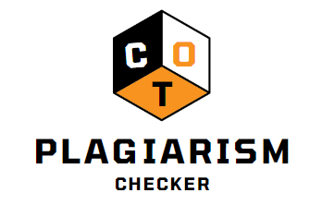
Chaitra Boggaram Oluwabusayo Omotosho Tengjiao Zhu

Slide 2

Contents
Introduction to COT
01
How COT Works?
02
Demo
03
Results comparison
04
Future implementation & Conclusion
05

Slide 3


Slide 4
Introduction
Chat GPT is an advanced tool for natural language processing developed by OpenAI that has the ability to analyze and understand text at a high level.
COT is a plagiarism checker that uses advanced algorithms and machine learning techniques to identify instances of potential plagiarism in text-based files. The goal of this project is to provide a user-friendly and effective tool that helps individuals maintain academic and professional integrity by detecting any instances of copied or paraphrased content in their work.

Slide 5
Working of COT
COT detects potential instances of plagiarism in text-based files.
It extracts the title from the input file and sends it to ChatGPT, which generates 10 different responses.
COT then uses cosine similarity and TfidfVectorizer modules from sklearn library to compare the input file to the files generated by ChatGPT
Displaying the plagiarism percentage as a pie chart and highlighting the matching text.

Slide 6
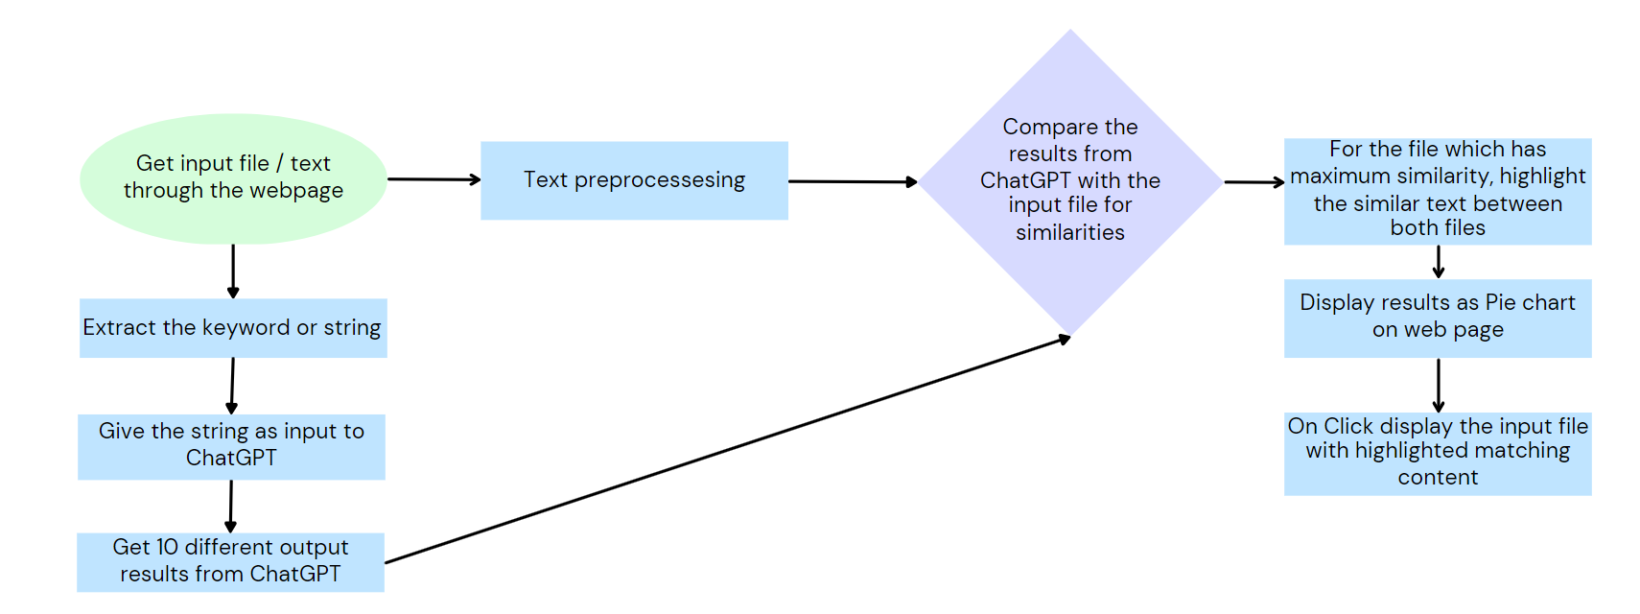
Architecture

Slide 7









Technologies used
Frontend
Backend

Slide 8
Don’t Get COT!

Slide 9
Comparing Plagiarism Checkers
Websites | Plagiarized Percentage | Detection Time (in Seconds)
https://www.duplichecker.com/ | 0% | 40.71
https://smallseotools.com/plagiarism-checker/ | 0% | 50.22
https://www.quetext.com/plagiarism-checker | 0% | 42.51
https://www.plagiarismchecker.co/ | 0% | 65.05
https://plagiarismdetector.net/ | 0% | 37.66
https://copyleaks.com/plagiarism-checker | 68.8% | 77.33
https://www.editpad.org/tool/plagiarism-checker | 0% | 15.55
https://grammica.com/plagiarism-checker | 0% | 10.68
https://rewriteguru.com/plagiarism-checker/ | 0% | 88.78
COT | 83% | 100.90

Slide 11
Future Improvements
Improving detection time
Scalability
Mainly for ChatGPT
Detect code snippets
Performance benchmark (reduce false positives)

Slide 12
Conclusion
COT is a developing tool to the conclusion emphasizes the potential for further improvement and expansion of its capabilities. Despite any current limitations, the dedication of the developers to advancing the technology ensures that it will continue to be an effective tool for detecting potential instances of plagiarism.
COT is a resource for maintaining academic and professional integrity, and its ongoing development ensures that it will only become more effective over time.

Slide 13

Questions for team COT?
Chaitra Boggaram
Oluwabusayo Omotosho
Tengjiao Zhu

Slide 14
References
(8) References slide with links to references (for prof. use during your presentation. You do not need to display)

