Slide 1
WEB FRAMEWORKS PROJECT
TITLE: BOOK MANIAC

Slide 2
BOOK MANIAC
DESCRIPTION OF THE WEBSITE:
Our website is about online purchase of books.
This website basically stores different categories of books namely, action & adventure, education, fiction & comics, history and drama books.
And for the user, this website has Authenticated Login and Logout options. After Logging in user can view, or change his/her profile.
User can also add the interested books to his/her cart, this website contains home page, in which we will display different categories.

Slide 3
BOOK MANIAC
Link to the Website in GitHub:
https://github.com/chaitrahp/BookManiac.git
Link to the Website hosted in Pythonanywhere:
http://nidhu3.pythonanywhere.com/accounts/

Slide 4
BOOK MANIAC
INDIVIDUAL CONTRIBUTION TO THE PROJECT:
NISHA:
I linked all the files namely category pages to respective pages and login, logout, register, edit profile, change password etc using urls.py file and base.html
CHAITRA & NIVEDITHA:
We both did Authentication namely login, logout, register, edit profile, profile and change password pages.
WE TRIED TO DO CART PAGE ALSO BUT WE DIDN'T HAVE ENOUGH TIME TO COMPLETE THAT.

Slide 5
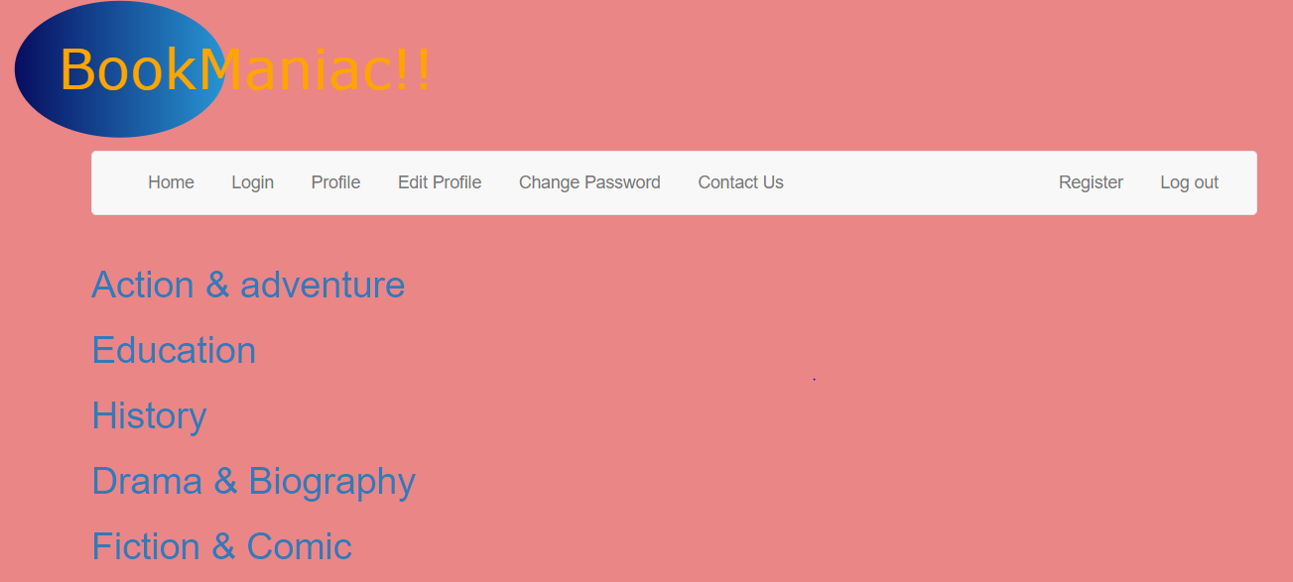
BOOK MANIAC
SCREENSHOTS OF THE PROJECT:
a) Home page:

Slide 6
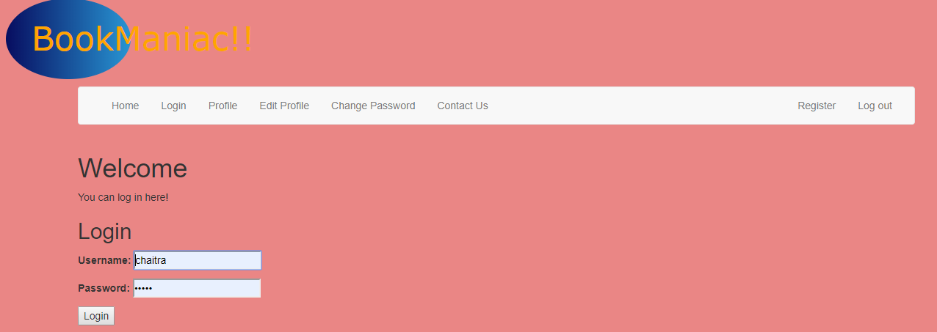
BOOK MANIAC
b) Login Page

Slide 7
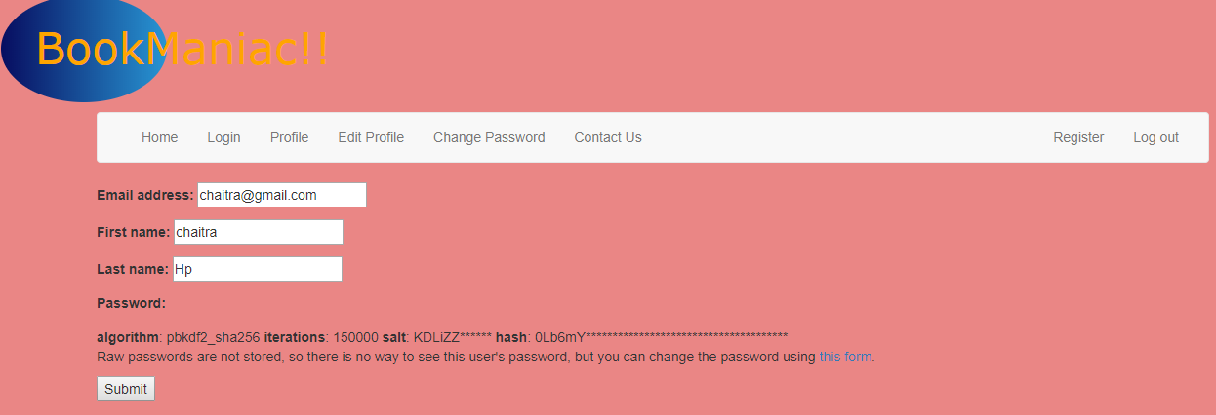
BOOK MANIAC
C) edit profile

Slide 8
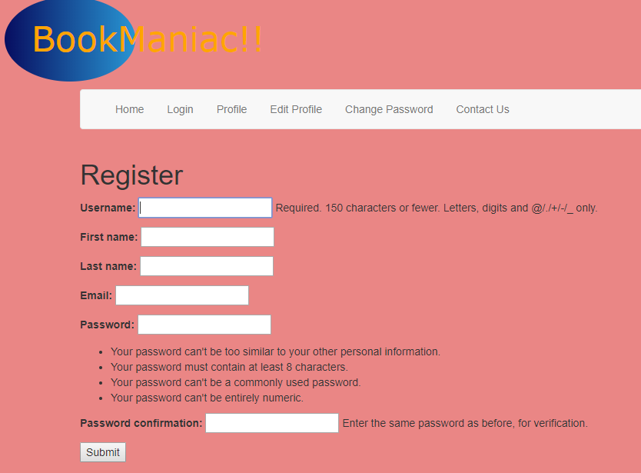
BOOK MANIAC
d) Register

Slide 9

BOOK MANIAC
e) Education Page

Slide 10
BOOK MANIAC
TAKEAWAYS:
Creating model, form
How models can be used to make better website easily than using JavaScript, HTML & CSS
Authentication
Linking all the pages
Creating Database in admin and keeping track of data.

Slide 11
BOOK MANIAC
CHALLENGES:
We got so many errors while linking the pages
And we got an HttpResponse error.
We also tried to create Cart page, but we got some error, we were unable to complete it within a given time.

Slide 12
BOOK MANIAC
CONTACT INFO:
MEMBER 1:
NAME: CHAITRA H P
USN: PES1201701370
EMAIL ID: chaitrahp99@gmail.com
MEMBER 2:
NAME: NIVEDITHA C U
USN: PES1201701640
EMAIL ID: nivedithaudai@gmail.com
MEMBER 3:
NAME: NISHA NEMASING RATHOD
USN:PES1201701672
EMAIL ID: rathodnisha6688@gmail.com

Slide 13
BOOK MANIAC
THANK YOU!!

