Slide 1
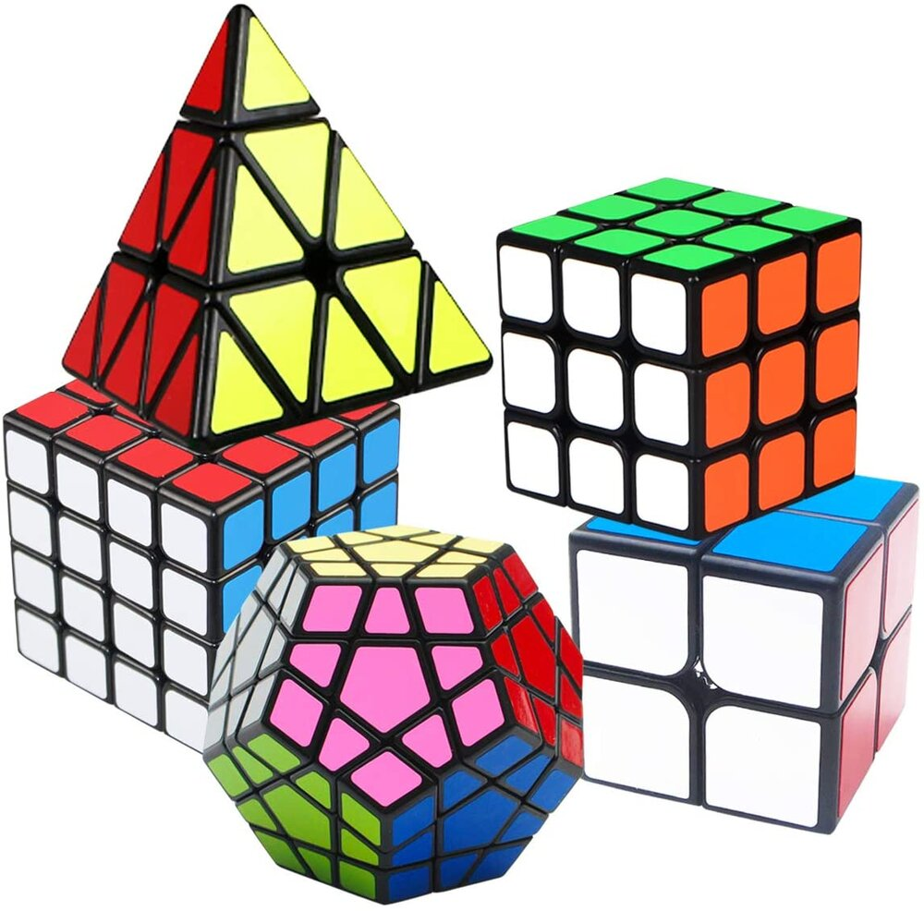
How to solve puzzles in short time?
Let your child adopt a new hobby – Solving the Rubik’s Cube !
Its engaging and challenging, guaranteed to keep children focused and determined!
Join
“Rubik’s Cube Course’’

