Slide 1
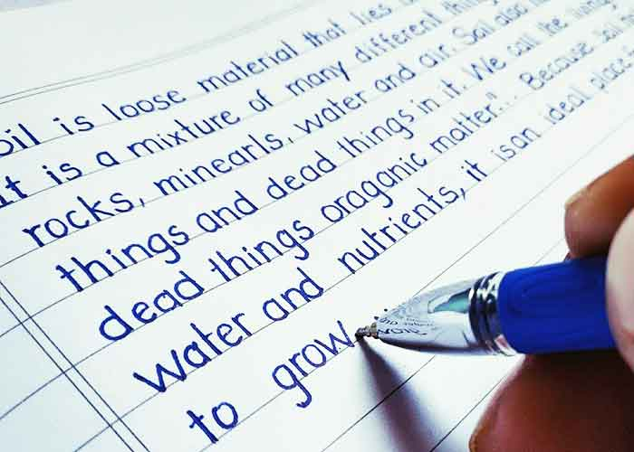
Do you know that researchers say that, a good handwriting activates the brain and develops the kid in all subject areas.
Join
“Handwriting Course’’

