Slide 1
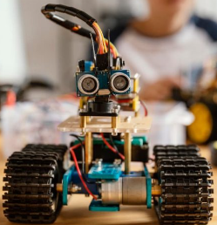
Are you someone who is very creative and curious to learn skills of Maths, Science and Engineering?
Join
“Robotics Course’’

