Slide 1
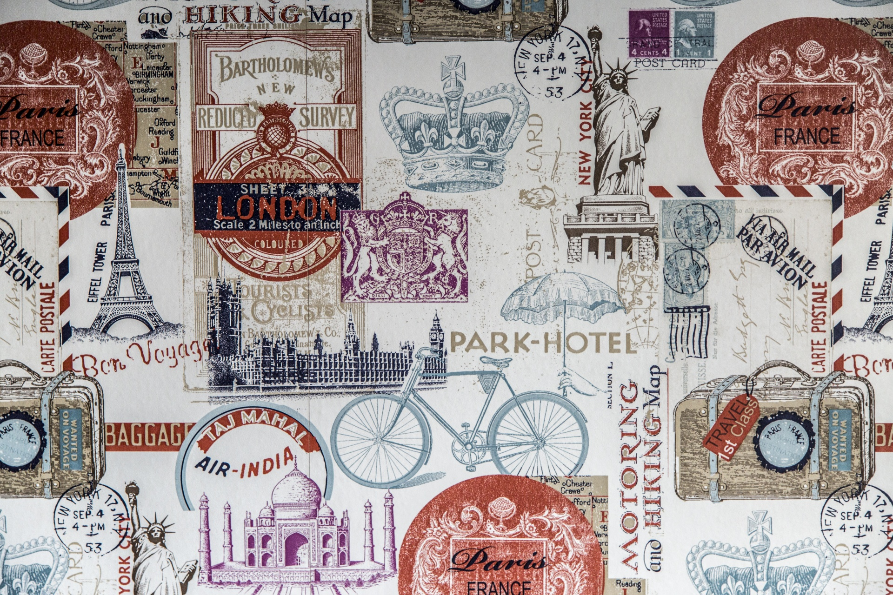
WORLD TRAVELLER

Slide 2
Problem Statement
Every place has its own story, it’s always fascinating to see and feel those stories which have been presented to us in the form of sculptures, buildings, temples, forts or in any form.
Some people visit new places for adventure, where as some people to spend quality time with family and friends. Some people will be interested in the history of the new places whereas some people don't care.
We should to have an application that should take care of all such things. It should also take care of other problems that a tourist might face when he/she visits a new place.

Slide 3
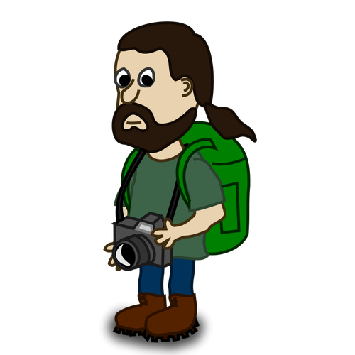
I want to visit all the beautiful places near by
I’m new to this place
INCEPTION
Lets imagine ourselves in the shoes of a traveller to have a look at some of the problems that he might face.
But I don’t know where to start from!!
Let me hire a tourist guide

Slide 4
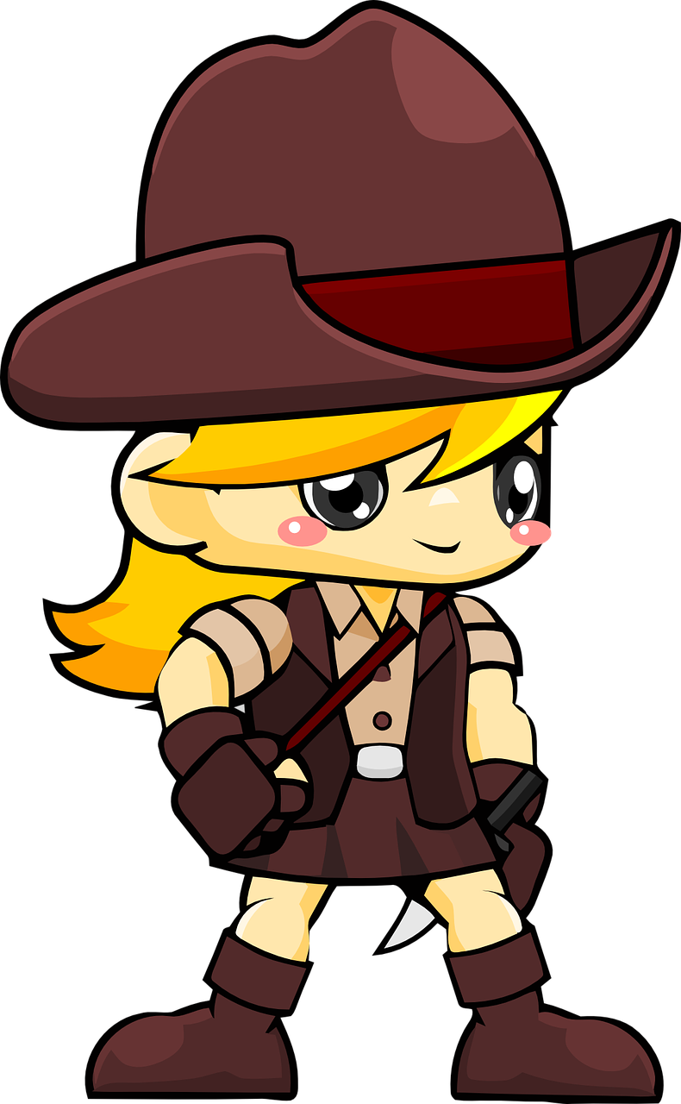
Ohh Sure!!
You need to pay 1000 bugs for one day
We are delighted to present you
“WORLD TRAVELLER”
Okay… Don’t waste my time..Find someone else
Hey!! I’m new to this place, Can you take me to all the best places here.
That’s a fixed rate!!
That’s too costly
I wish I had someone to help me out here!!
But!!

Slide 5

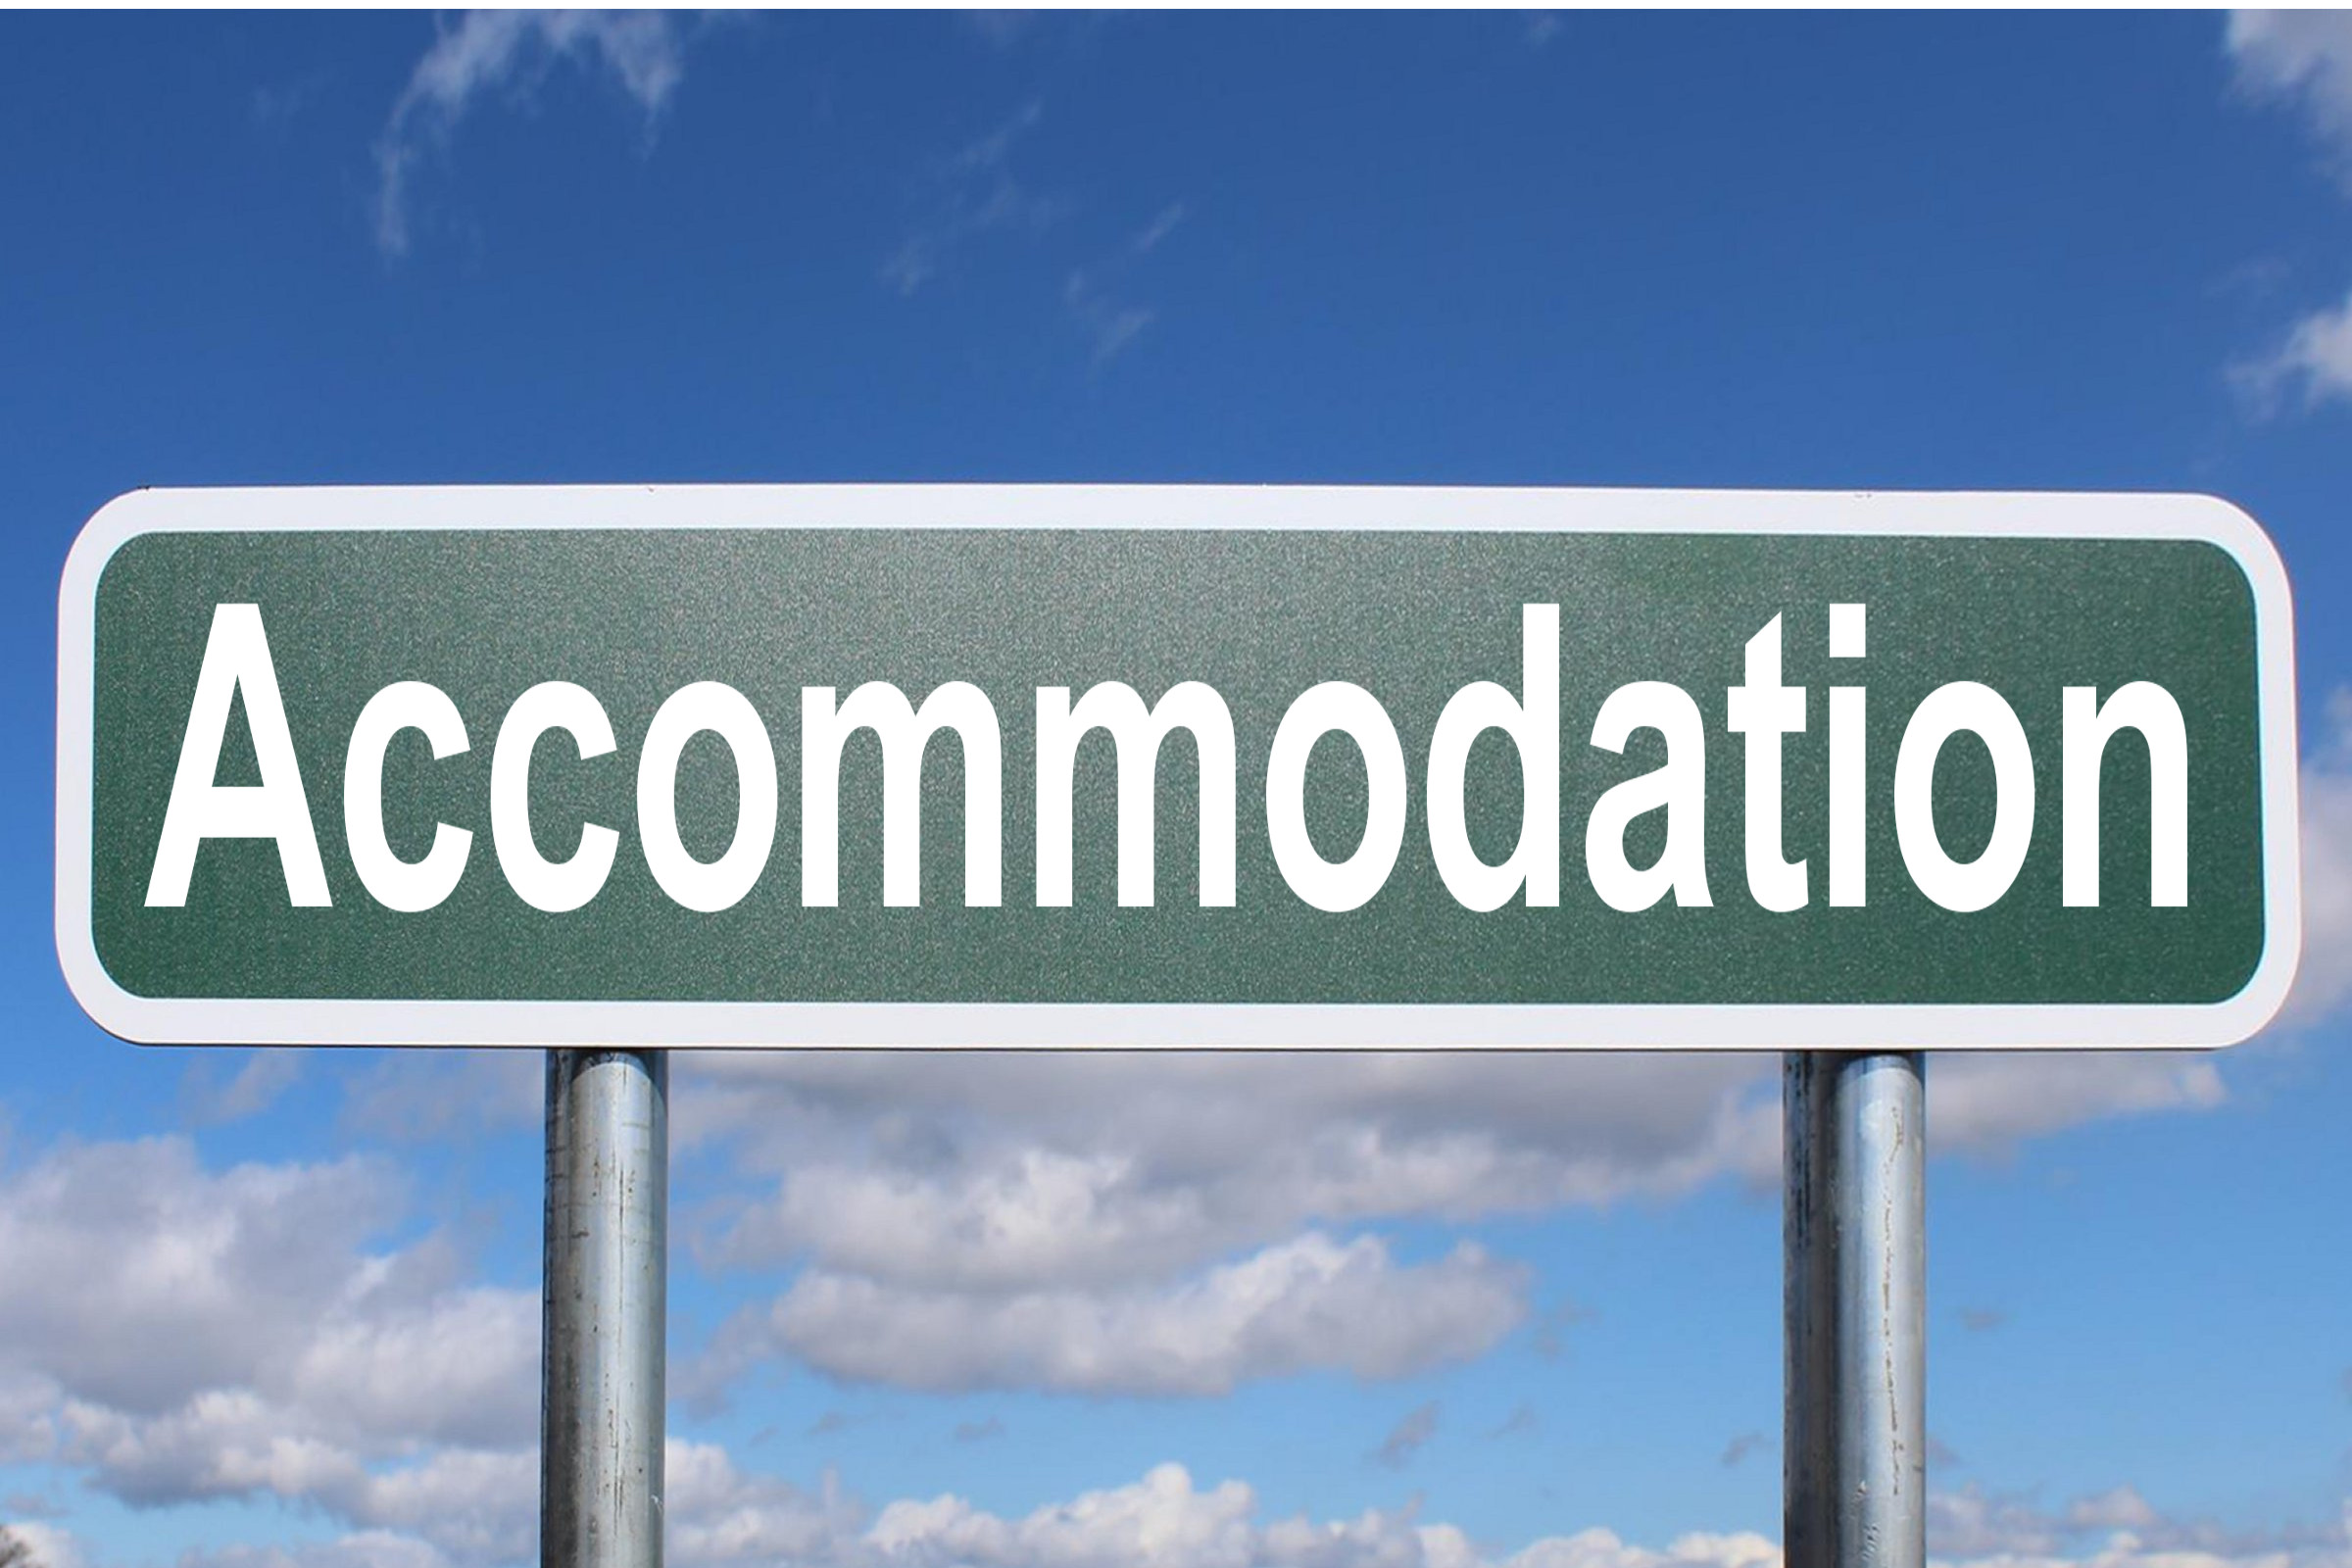
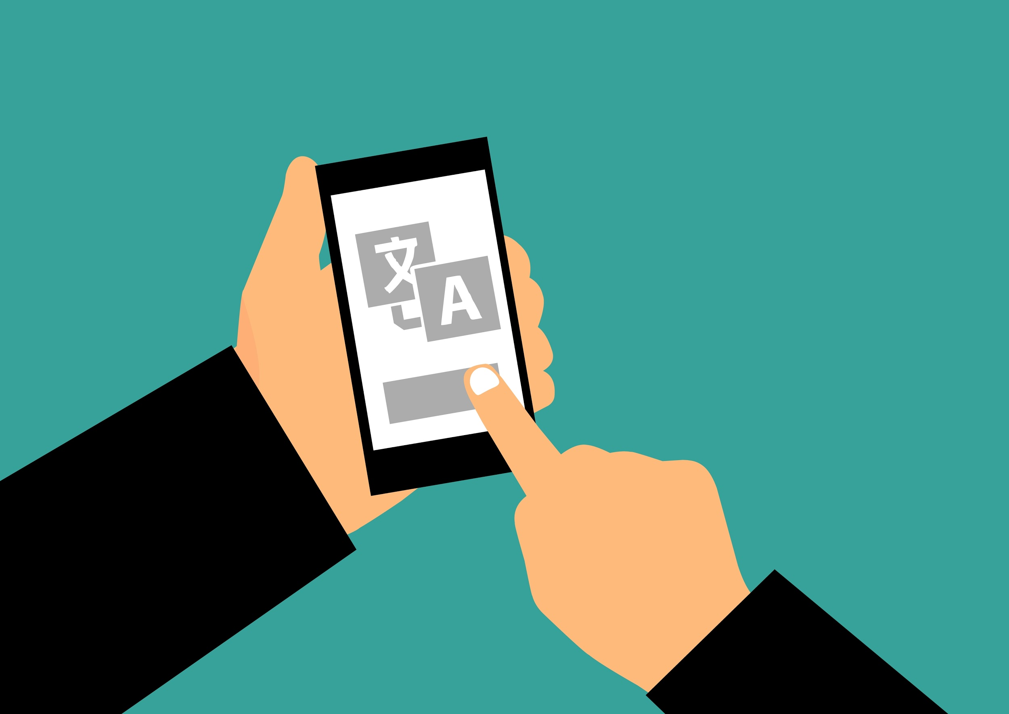
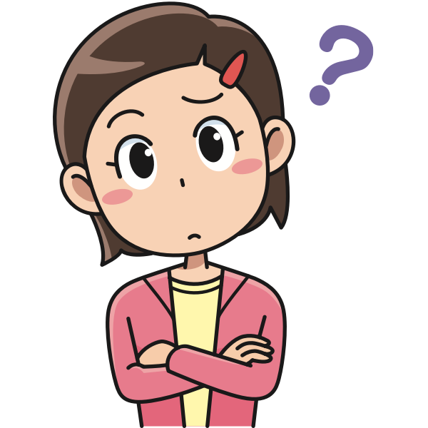
Problems Faced During Travelling

Slide 6
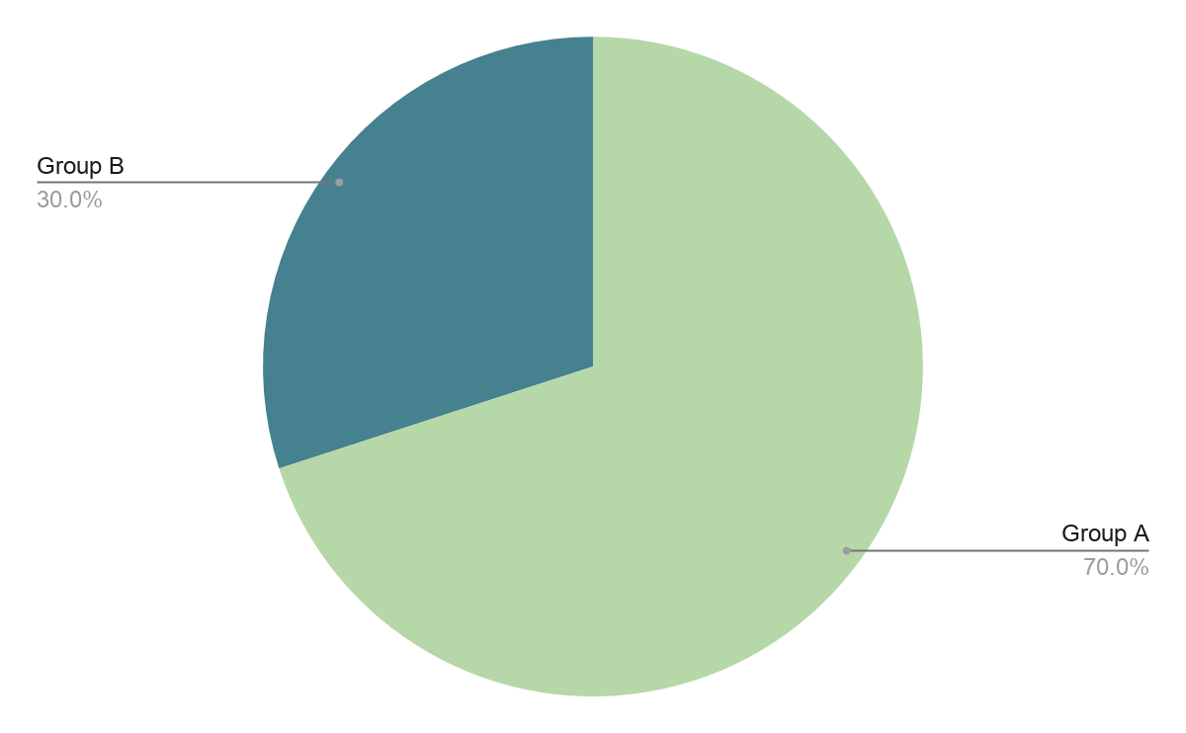
Why don’t people prefer Tourist Guides?
Tourist guides invade people’s privacy
Charge More
Some people don’t behave properly
Group A : People who don’t prefer using tourist guides.
Group B : People who wish to prefer tourist guides

Slide 7

Why World Traveller?
Basically everything in one app!!!
No issues with language
No issues with privacy
More than one options available
Best facilities at low prices

Slide 8
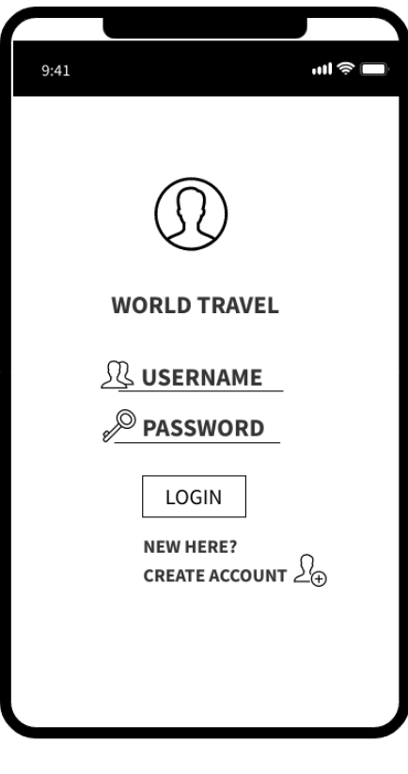
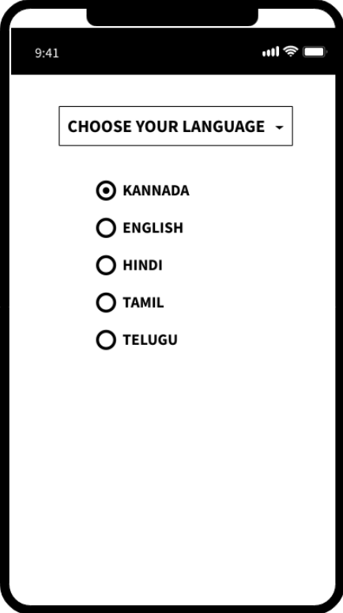
LOW FIDELITY PROTOTYPE
The user can customise the app according to his needs :
Login is essential
Can select language of his choice
Can choose his type of travel and even itinerary.

Slide 9
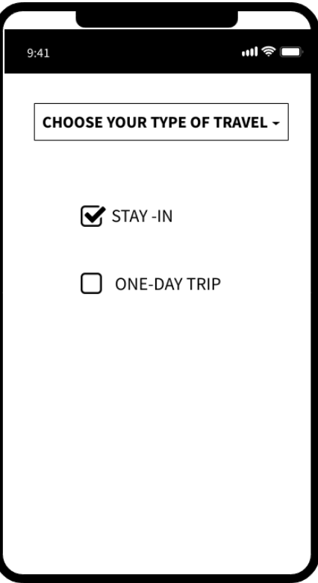
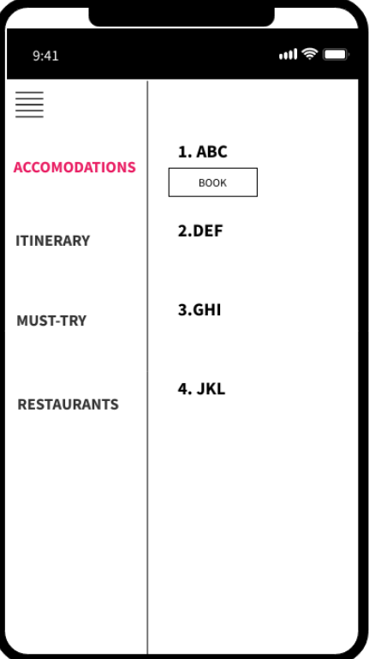
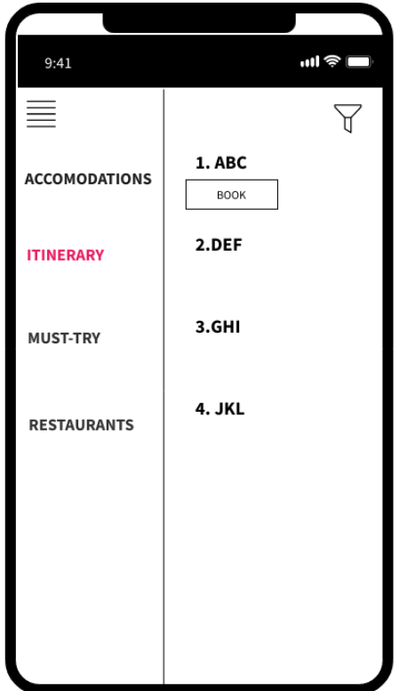

Slide 10
Travels regularly
Visiting in wrong seasons
Waste of time in searching for places and gets confused
Precise use of time
Takes the help of tourist guide
Says
Getting to know the place takes some time
Does
Thinks
Can be more comfortable by knowing more about the place
Feels
Does research before visiting any place
Proper details should be included, details like climate and so on

Slide 11
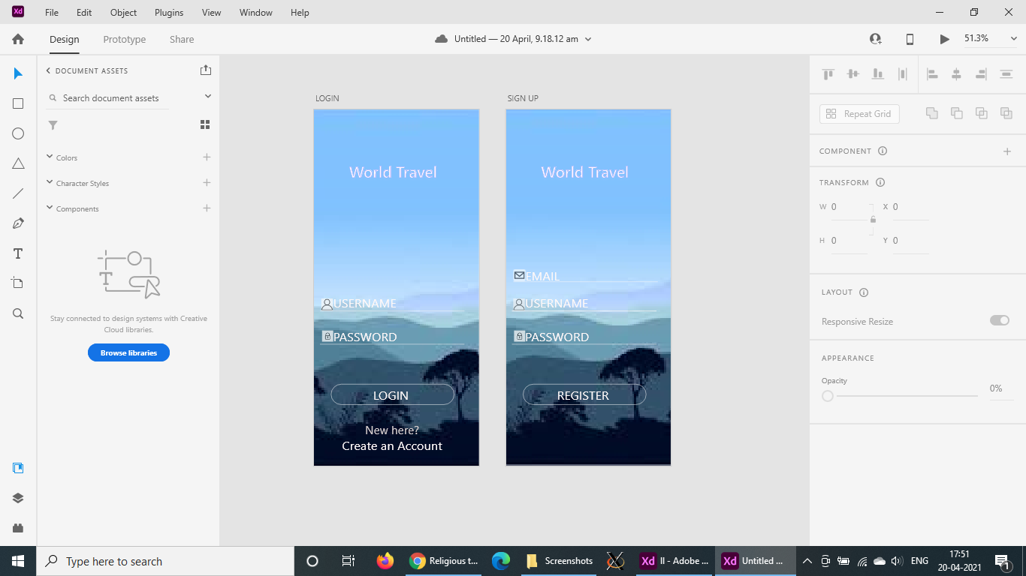
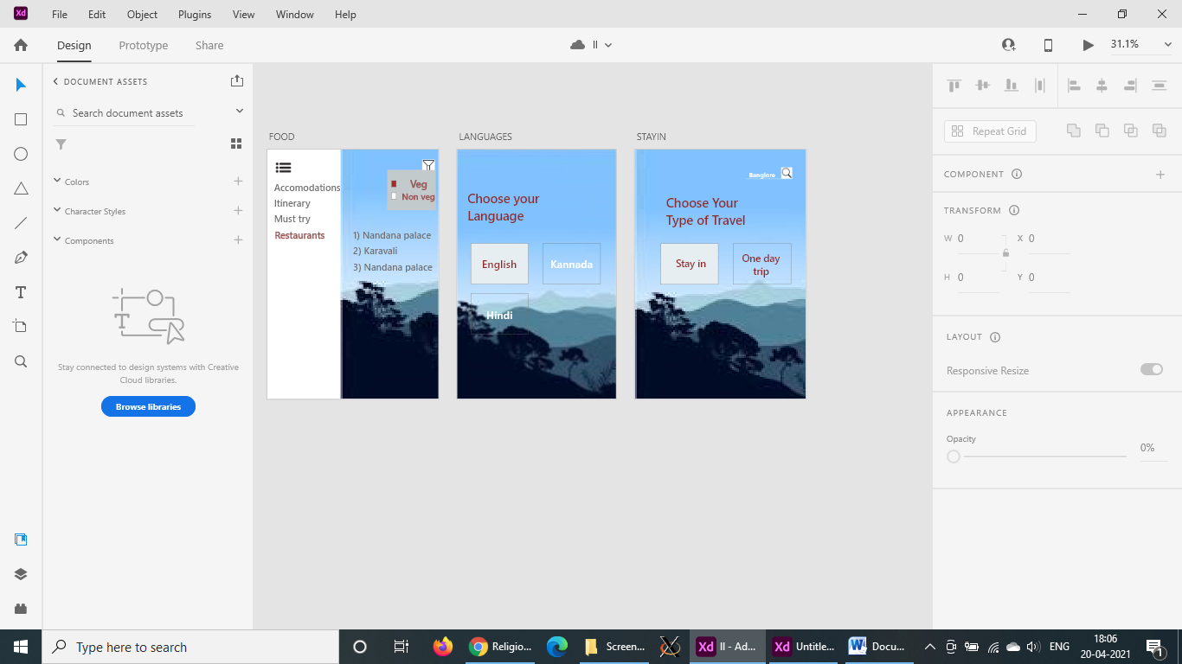
HIGH FIDELITY PROTOTYPE

Slide 12
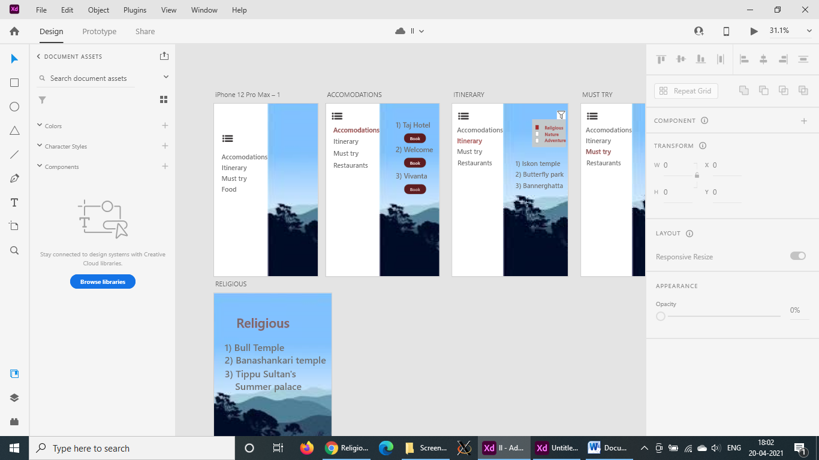
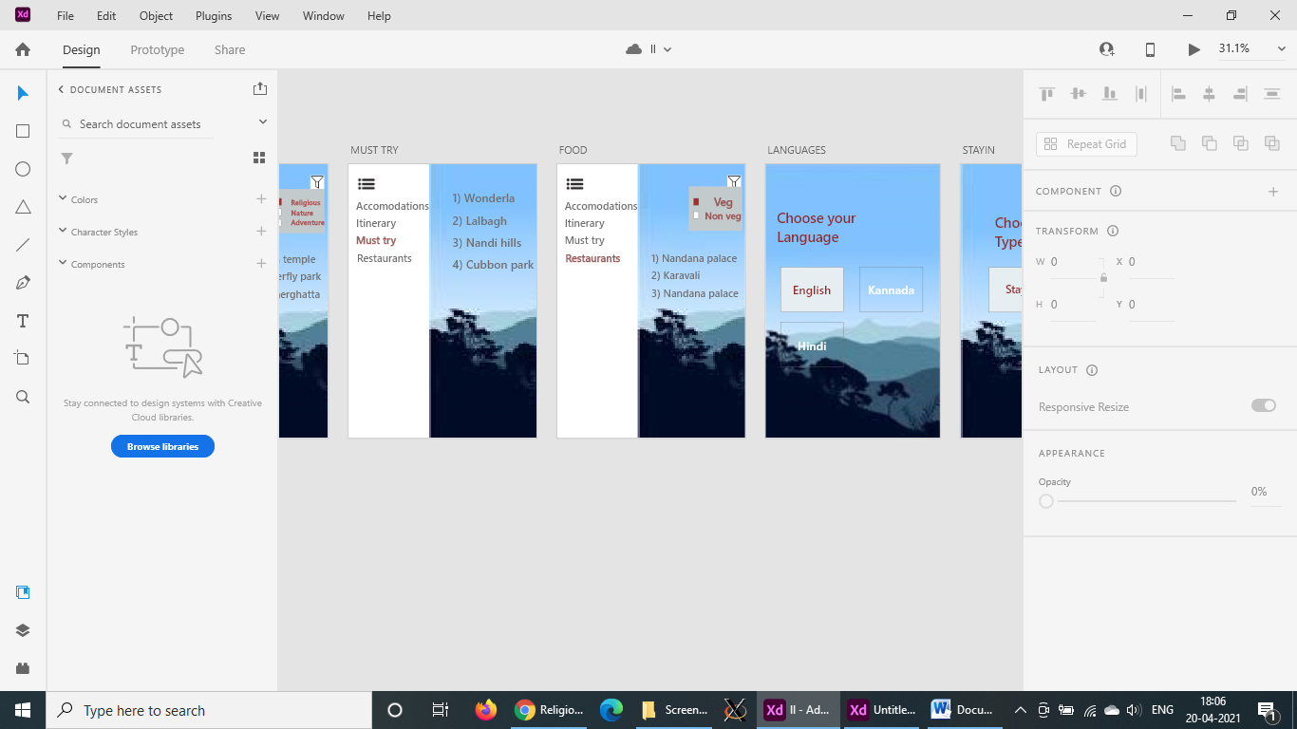
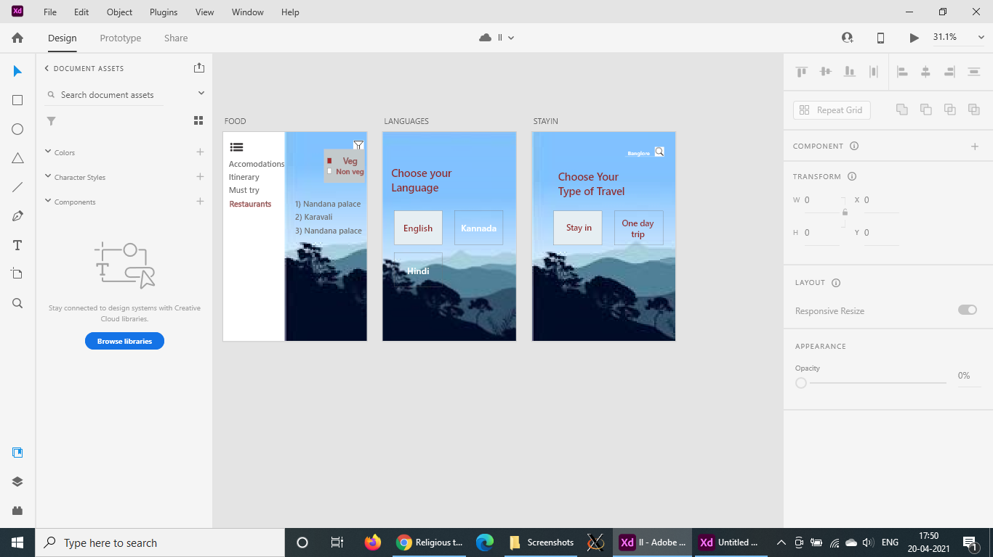
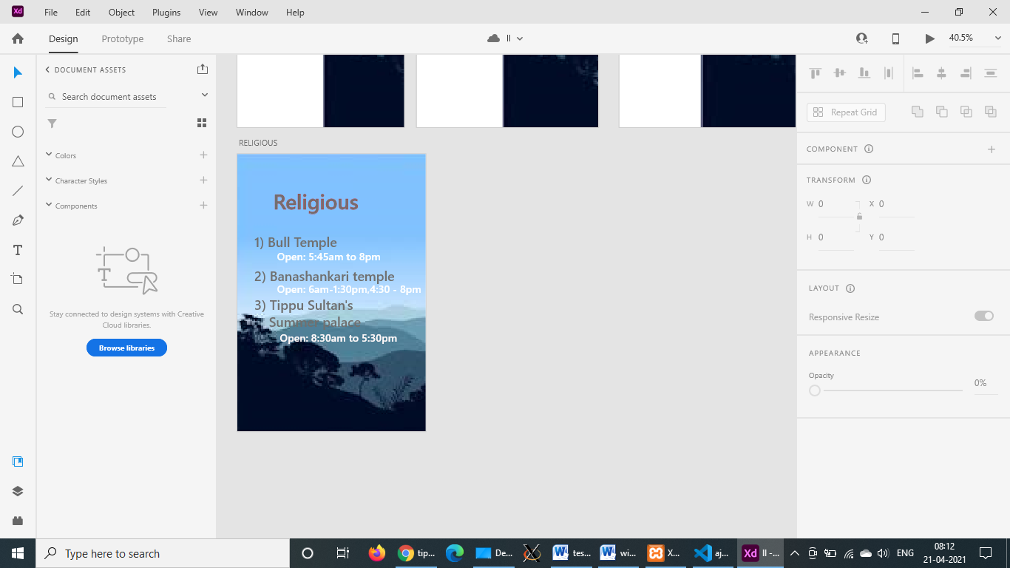

Slide 13
HEURISTIC EVALUATION
Visibility of the system status
As the user applies filters and performs search the results are displayed that matches the user’s preferences.
When the user becomes familiar with the app, he would know that what filters he has to apply to get the required result.
Match between system and the real world
Simple Interface is designed so that the user feels comfortable while using the app

Slide 14
3. Error prevention
As the user registers and logins, the username and password is checked every time the user logins
4. Flexibility and efficiency of use
The UI is simple and elegant so that both experienced and inexperienced users can use
5. Recognition rather than recall
Information required to use the design should be visible or easily retrievable when needed.

Slide 15
6. Aesthetic and minimalist design
The interface doesn’t consist of any information which is irrelevant to the app
7. Help and documentation
The system is simple and doesn’t require any additional explanation

Slide 16
THANKYOU

