Slide 1
Question Classification : What people are asking about Covid?
Chaitree Baradkar
2021HCS7248

Slide 2
Aim of the project:
To classify the questions asked related to Covid into different classes or categories
Explore different words embedding methods like Tf-idf and word2vec in NLP
Compare the performance of different classifiers like Support Vector Machine (SVM) and MLP (Multi layer perceptron) with both the embeddings considered
Dataset Used - https://github.com/JerryWei03/COVID-Q
No of classes – 16

Slide 3
Project pipeline
Train data Embeddings
Data Preprocessing
Set up embedding and classifier parameters in config file
Train Embeddings/
load saved model
Word
embeddings
as features
Training classifiers using embeddings
Preprocessed
Data
Saved
Models
Test Data Embeddings
Exploratory Data Analysis
Inference on test data and evaluation

Slide 4
Libraries Used
Environment – python3 and jupyter-lab
Data
Pandas - dataframes
numpy - array
NLP and classifiers
Nltk – data preprocessing
sklearn – classifiers (SVM and MLP), tf-idf
nlpAUG – Augmentation of text
Gensim – word2vec embeddings
Visualization
Matplotlib – plotting graphs for exploratory data analysis
Seaborn - plotting graphs for exploratory data analysis
wordcloud - visual representations of words that give greater prominence to words that appear more frequently
Others
Yaml – for config files to set parameters and changing parameters efficiently
random
os

Slide 5
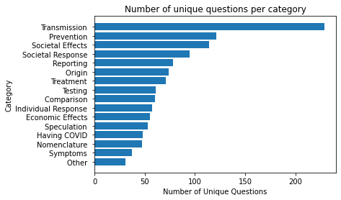
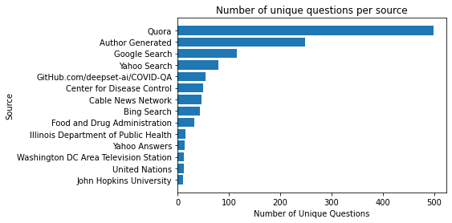
Exploratory Data Analysis
Class balancing is required using data augmentations
Transmission, prevention and Societal effects has more number questions
Most questions asked on Quora

Slide 6
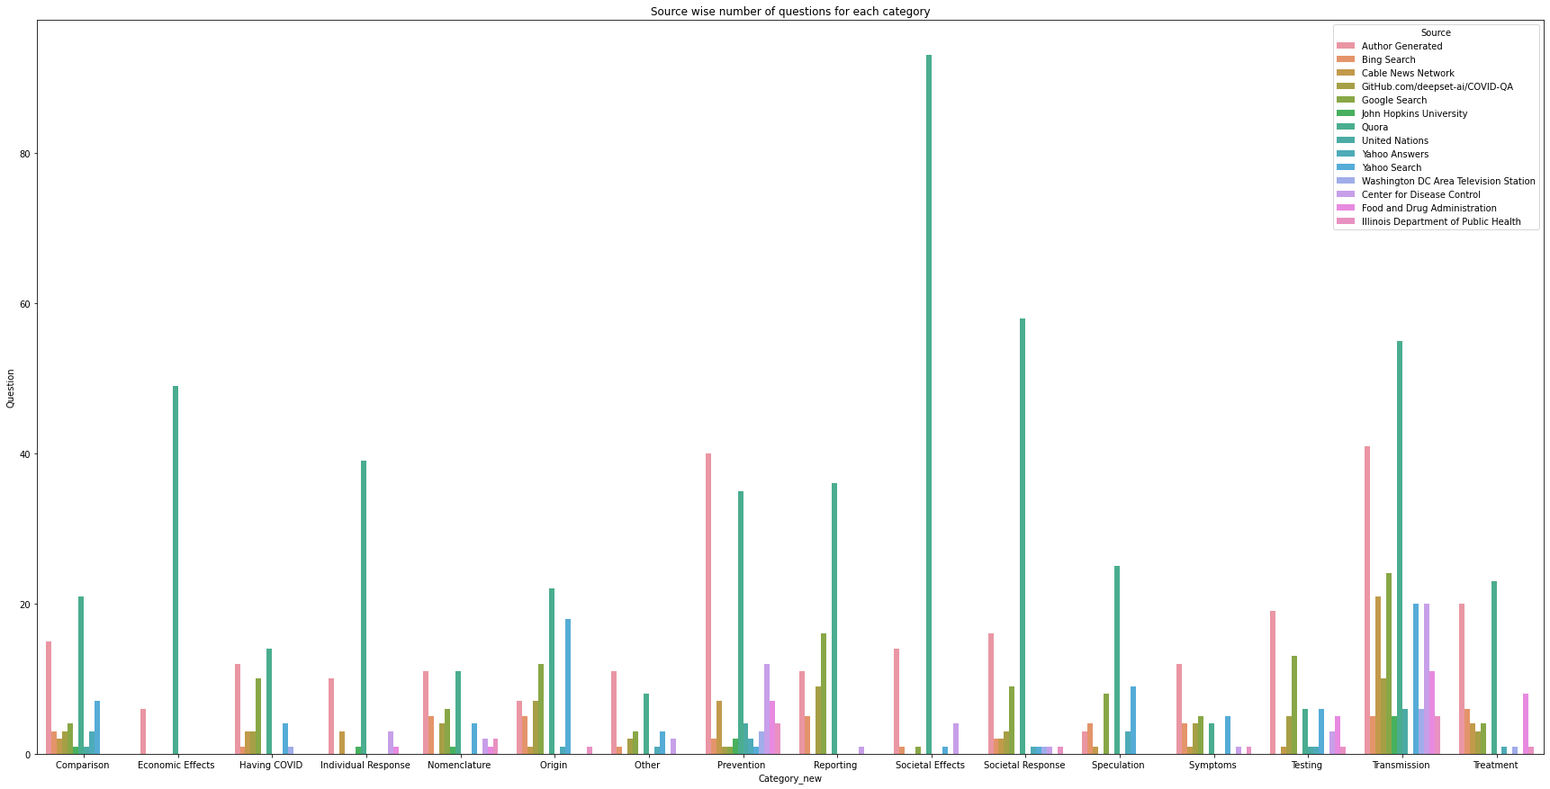

Slide 7
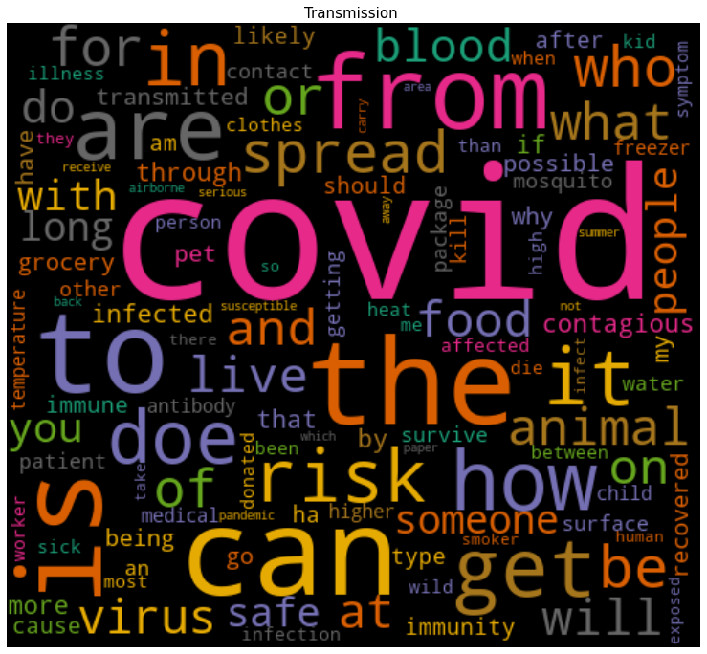
WordCloud representations for major categories

Slide 8
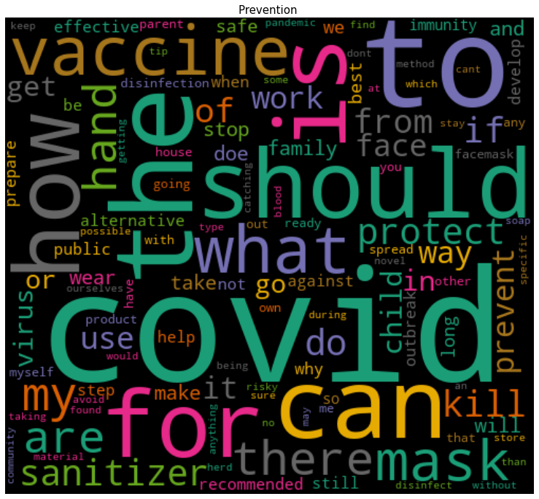

Slide 9
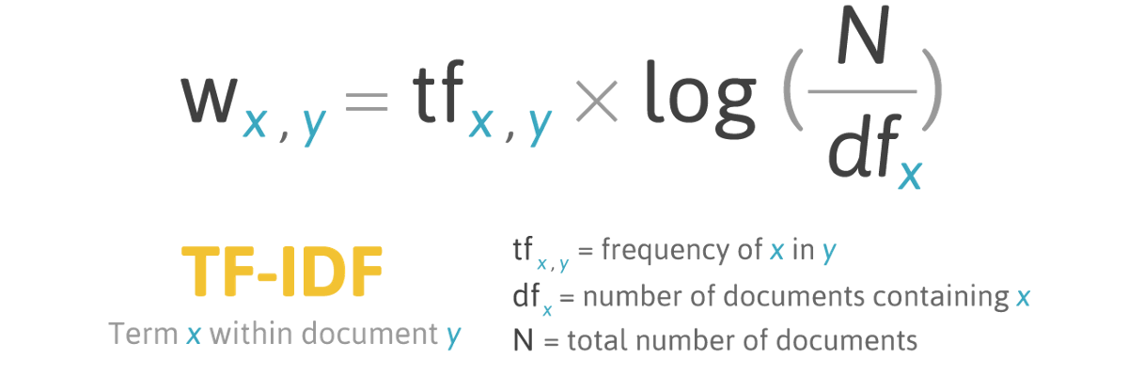
Word Embeddings
Tf-Idf (term frequency-inverse document frequency):
measures how relevant a word is to a document in a collection of documents.
Used to transform that text into numbers, also known as text vectorization

Slide 10
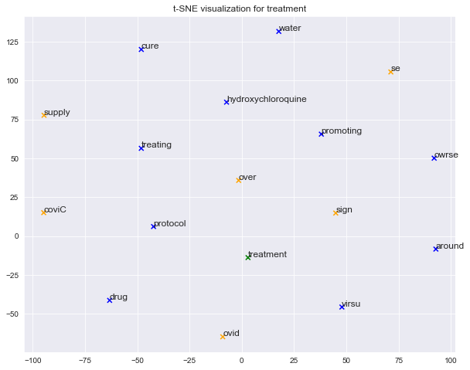
Word2Vec:
The word2vec algorithm uses a neural network model to learn word associations from a large corpus of text.
It finds similar and dissimilar words and synonyms have similar representation of vectors vs antonyms have different vectors that are far apart in vector space.

Slide 11
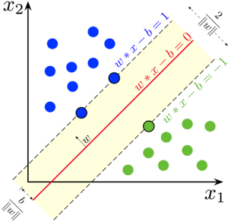
Classifiers
SVM (Support Vector Machine)
Supervised learning method useful for high dimensional data
different Kernel functions can be specified for the decision function
Samples on boundaries are support vectors
Hyperplane separates classes
W*x – b = 0 , hyperplane
Source : Internet

Slide 12
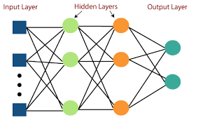
MLP ( Multilayer Perceptron):
Feedforward neural network with number of hidden layers, input and output layers
MLP has number of hidden layers that transforms input to output
MLP has number of neurons in each hidden layer having specific activation function
The activation functions are non-linear for non -linear data
This supervised algorithm learns using technique called backpropagation
Weights from each node to another node is learned automatically
Source : Internet

Slide 13
Results
Accuracy on test data (30% of total data)
 | TF-IDF | Word2Vec
SVM (linear classifier, balanced classes) | 50.94% | 45.15%
SVM (linear classifier, unbalanced classes) | 51.23% | 44.86%
SVM (sigmoid classifier, balanced classes) | 50.21% | 41.09%
SVM (sigmoid classifier, unbalanced classes) | 50.07% | 43.99%
MLP ([128, 64, 32] – hidden layer neurons) | 47.61% | 43.41%
MLP ([64, 32] – hidden layer neurons) | 50.36% | 46.88%
Note : Total data has all the data expect the data generated for author, author generated data has kept for separate testing

Slide 14
Results (continued)
Accuracy on author generated test data
 | TF-IDF | Word2Vec
SVM (linear classifier, balanced classes) | 47.39% | 44.17%
SVM (linear classifier, unbalanced classes) | 47.39% | 43.77%
SVM (sigmoid classifier, balanced classes) | 46.18% | 41.76%
SVM (sigmoid classifier, unbalanced classes) | 48.59% | 40.96%
MLP ([128, 64, 32] – hidden layer neurons) | 41.76% | 44.17%
MLP ([64, 32] – hidden layer neurons) | 51.40% | 44.57%

Slide 15
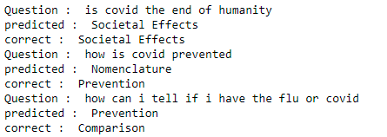

Results on own questions:
Author Generated Questions :
Own Question :

Slide 16
Challenges and further improvement
Challenges -
Data is very imbalanced, some of the question types have very less data and hence accuracy is coming lower
Train accuracy is quite high and hence data is overfitting.
Data is becoming high dimensional compared to number of samples when we use tf-idf.
Further Improvements –
Use 20% train test split or use cross validation to get results.
Find a different loss function that deals with imbalanced classes.
Apply more accurate augmentation for classes having a smaller number of samples
Apply feature reduction techniques

