Slide 1
STAGE 1 OF 7 · PROBLEM
SPOTIFY MUSIC DATA ANALYSIS
Exploring Music Genres, Popularity, and Audio Features
Exploratory Data Analysis and Visualization using Python, Pandas, and Microsoft Power BI
Team Name: Code Breakers

Slide 2
Problem Statement
STAGE 1 OF 7 · PROBLEM
1
How can a large music dataset be analyzed efficiently?
Why manual analysis is hard
How are the 10 music genres compared by popularity?
9,873 tracks across 10 genres is too many to scan by hand
Patterns are hard to spot by reading rows
Manual counting invites errors
Code and charts are faster and repeatable
2
3
What patterns exist in track popularity and energy?
4
How do danceability, energy and valence vary?
5
How can charts make music data easier to understand?
Takeaway: This is a student exploration of one dataset, not a study of Spotify's internal business.

Slide 3
Dataset Overview
STAGE 2 OF 7 · DATA
9,873
Information type | Columns
Track identity | track_id
Genre label | track_genre
Popularity and length | popularity, duration_ms
Content flag | explicit
Audio features (0 to 1) | danceability, energy, valence
tracks (dashboard total)
10
music genres
Tools
Python · Pandas · Power BI
One row = one track (track_id). The dashboard KPI shows 9,873 tracks while the donut chart counts 9.916K track IDs, so the two visuals report slightly different totals.
Takeaway: Each row is a track record, and totals can differ slightly between visuals.

Slide 4
Data Cleaning Process
STAGE 2 OF 7 · DATA
1
Inspect the dataset
Check shape, columns, types
6
Trim extra spaces
Clean text values
2
Drop 'Unnamed: 0'
Unneeded index column
7
Fix data types
Numbers, True/False, text
3
Handle missing values
Check for blanks
8
Check value ranges
Audio features within 0 to 1
4
Remove exact duplicates
Identical full rows only
9
Final quality audit
Re-check everything
5
Check track IDs
Count tracks by track_id
10
Save cleaned file
final_cleaned_dataset.csv
Final dataset on the dashboard: 9,873 tracks · 10 genres · average popularity 35.64 · average duration 229.11K ms · about 10.09% explicit. Original (before-cleaning) row count: not shown, as no raw file or cleaning log was provided.

Slide 5
Analysis Methodology
STAGE 3 OF 7 · ANALYSIS
1
2
3
4
Genre popularity
Track counts
Average popularity
Explicit vs non-explicit
Average popularity per genre
Count of track_id
Mean of the 0 to 100 score
Compare track counts
5
6
7
Scope
Only counts, averages, grouping and charts. No machine learning.
Audio features
Popularity vs energy
Track duration
Average danceability, energy, valence
Scatter of summed energy
Average of duration_ms
Takeaway: Simple, repeatable steps that a beginner can follow in Pandas and Power BI.

Slide 6
Key Metrics
STAGE 3 OF 7 · ANALYSIS
9,873
35.64
10
Total tracks
Average popularity
Total genres
Count of tracks on the dashboard
Spotify score from 0 to 100, not stream counts
Different track_genre labels
229.11K ms
10.09%
≈ 57
Average duration
Explicit tracks
Top genre popularity
Mean of duration_ms (about 3 min 49 s)
About 1K of 9.916K tracks
k-pop has the highest average popularity
Takeaway: Average popularity is 35.64, but genres range from about 13.5 (classical) to about 57 (k-pop).

Slide 7
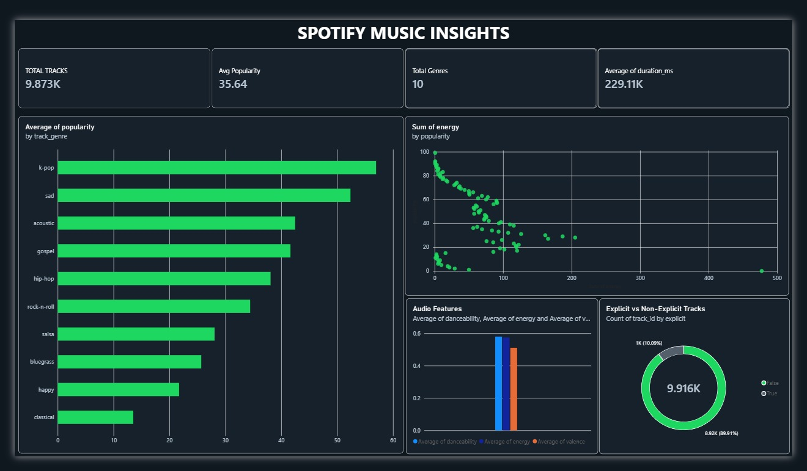
Dashboard Overview
STAGE 4 OF 7 · VISUALIZATION
Dashboard components
4 KPI cards on top
Bar: popularity by genre
Scatter: energy by popularity
Column: audio features
Donut: explicit tracks
Built in Microsoft Power BI from the cleaned dataset.

Slide 8
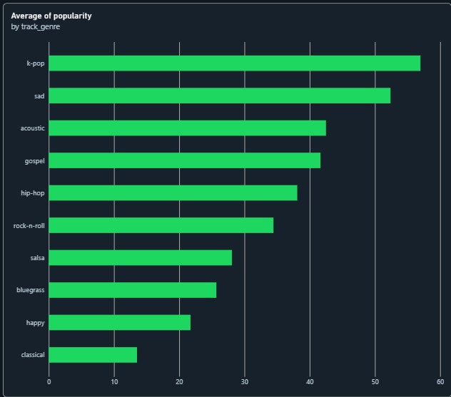
Genre Analysis: Average Popularity by Genre
STAGE 4 OF 7 · VISUALIZATION
Reading the chart
Highest: k-pop (about 57), then sad (about 52) and acoustic (about 42).
Lowest: classical (about 13.5) and happy (about 22).
Values are read from the chart, so they are approximate.
Takeaway: Popularity differs strongly by genre: k-pop averages roughly four times classical.

Slide 9
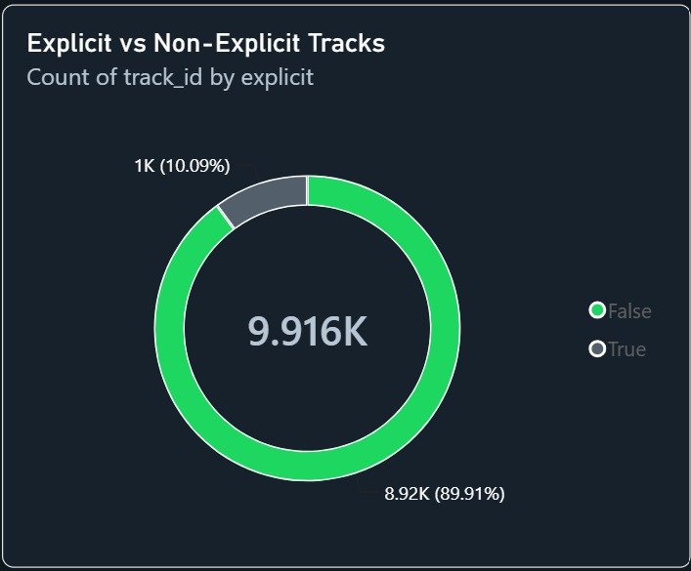
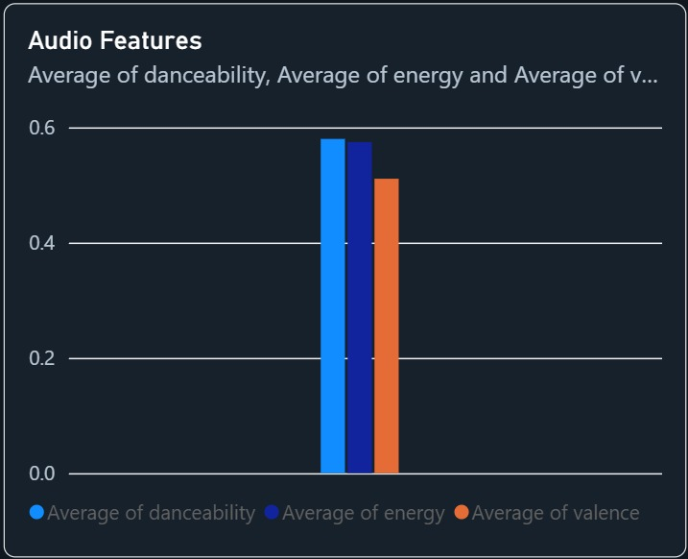
Explicit Content and Audio Features
STAGE 4 OF 7 · VISUALIZATION
Non-explicit: 8.92K tracks (89.91%); explicit: about 1K (10.09%). The centre shows 9.916K tracks in total.
Average danceability is about 0.58, energy about 0.57 and valence about 0.51 (all on a 0 to 1 scale).
Takeaway: Most tracks are non-explicit, and average audio features sit in the middle of the scale.

Slide 10
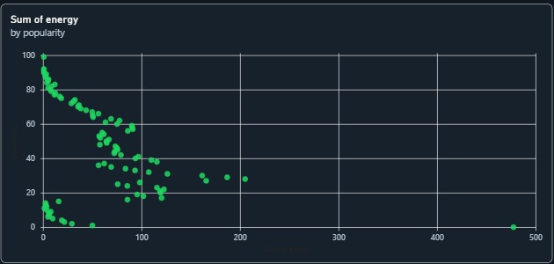
Popularity and Energy
STAGE 4 OF 7 · VISUALIZATION
Reading the chart
Each point is one popularity score (y) against the total energy of its tracks (x).
Sums grow with track count, so low totals at high scores mean few tracks, not low energy.
The outlier near 480 sits at popularity 0, likely where many tracks score 0.
Summed energy falls as popularity rises: low scores hold more tracks, so they add up to more total energy.
Takeaway: The energy total reflects how many tracks share each score, not energy per track.

Slide 11
Key Findings
STAGE 5 OF 7 · FINDING
1
Genre popularity varies
2
Few explicit tracks
3
Moderate popularity
k-pop leads at about 57; classical is lowest at about 13.5.
About 10.09% of tracks (1K of 9.916K) are explicit.
Average popularity is 35.64 on the 0 to 100 scale.
4
Mid-range audio
5
Energy vs popularity
6
Typical track length
Danceability ≈ 0.58, energy ≈ 0.57, valence ≈ 0.51.
Summed energy is highest at low scores, peaking near 480 at 0.
Average duration is 229.11K ms, about 3 min 49 s.
Takeaway: Popularity differs most across genres, while explicit tracks are a small share of the data.

Slide 12
Insights and Interpretation
STAGE 6 OF 7 · INSIGHT
FINDING (what the data shows)
INSIGHT (what it may suggest)
Average popularity differs widely by genre.
→
K-pop and sad tracks score highest and classical lowest, but the dataset cannot explain why.
About 1 in 10 tracks is explicit.
→
Explicit content is a small part of the data, so it says little about what makes a track popular.
Danceability and energy average about 0.58; valence is lower (about 0.51).
→
Tracks lean slightly more danceable and energetic than cheerful; these are averages across genres.
Charts exposed patterns quickly.
→
Interactive visuals help beginners explore large data.
Takeaway: Findings describe the data; insights stay cautious about listener behavior and Spotify's algorithm.

Slide 13
Conclusion
STAGE 7 OF 7 · CONCLUSION
Cleaning first: the data was inspected and tidied before analysis.
Python and Pandas prepared and summarized the data.
Power BI presents the results as a simple dashboard.
Main results: 9,873 tracks, 10 genres, average popularity 35.64, about 10% explicit, k-pop most popular.
Charts made these patterns easy to see
Limitations
Popularity is a score, not stream counts
Only 10 genres are included
Summed energy reflects track counts
Correlation is not causation
Totals differ slightly between visuals (9,873 vs 9.916K)

Slide 14
Future Scope
STAGE 7 OF 7 · CONCLUSION
Possible next steps (not yet done)
Compare popularity across more genres
Explore more audio features
Add more interactive filters
Plot average energy per track instead of summed energy
Apply deeper statistical analysis
Thank You
Patel Yash Mukeshkumar
Patel Vraj Mineshkumar
Patel Sambhav Mukeshbhai
Patel Snehkumar Pareshbhai
Pathak Chaitrik Amrish

