Slide 1
Citi Bike Data Analysis
By Muthyala Chaitrika

Slide 2
Project Goal:
The goal of this analysis is to optimize Citi Bike operations and enhance user experience by leveraging data-driven insights. Specifically, we aim to:
Improve Bike Availability & Accessibility – Identify high-demand locations and optimize bike distribution to reduce shortages and enhance service efficiency.
Enhance User Engagement & Retention – Develop targeted initiatives for different rider segments, such as loyalty programs for frequent users and promotions for casual riders, to increase ridership.
Optimize Marketing & Strategic Expansion – Use rider behaviour insights to refine marketing strategies and plan future bike station placements based on demand trends.

Slide 3
Key questions:
What are the most popular pick-up locations across the city for Citi Bike rental?
How does the average trip duration vary across different age groups?
Which age group rents the most bikes?
How does bike rental vary across the two user groups (one-time users vs long-term subscribers) on different days of the week?

Slide 4
Findings & Insights

Slide 5
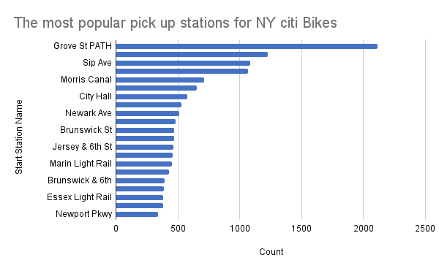
What are the most popular Citi Bike pick-up locations?
The most popular Citi Bike locations across the city include: Grove St PATH, Sip Ave, Morris Canal, City Hall, Newark Ave, Brunswick St, Jersey & 6th St, Marin Light Rail, Brunswick & 6th, Essex Light Rail, Newport Pkwy.
These stations are high-traffic areas, often located near transportation hubs, busy commercial districts, and popular residential zones.

Slide 6
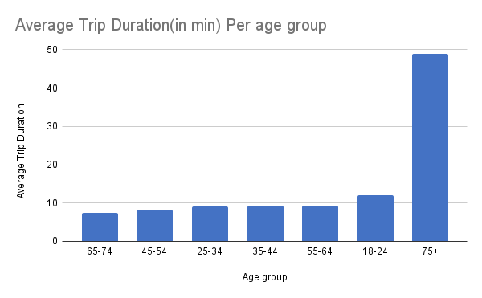
2. How does the average trip duration vary across different age groups?
Seniors (75+) tend to take the longest trips on average, possibly due to leisure or recreational use.
Young adults (25-34) and older adults (65-74) typically have shorter trips on average, which could be due to commuting or quick errands.

Slide 7
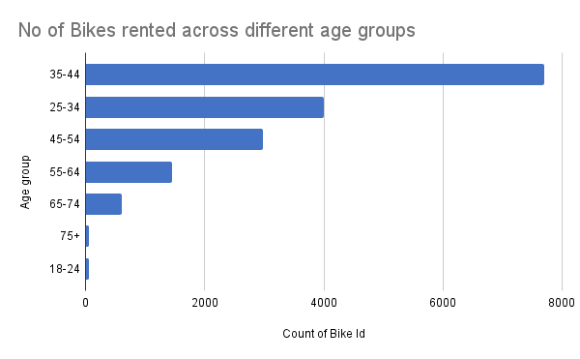
3. Which age group rents the most bikes?
The 35-44 age group rents the most bikes on Citi Bike.
This group is the most active, likely using the service frequently for commuting, errands, or leisure activities.

Slide 8
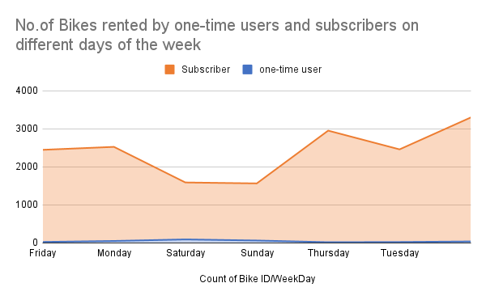
4. How does bike rental vary across the two user groups (one-time users vs long-term subscribers) on different days of the week?
Long-Term Subscribers:
They are more active on weekdays, using Citi Bike primarily for commuting or regular trips. This group tends to have a more consistent and predictable usage pattern.
One-Time Users:
They are more active on weekends, often using the service for leisure or tourist activities. Their trips are less frequent but tend to be clustered around weekends when people are more likely to engage in recreational activities.

Slide 9
Summary

Slide 10
Summary of findings:
Top 5 pick-up locations for bikes:
Grove St Path, Exchange Place, Sip Ave, Hamilton Park, & Morris Canal
Customer base:
Mostly long-term subscribers who are more active during the week
One-time users more active at weekends
Most bikes rented by 35-44 year olds
Citi Bike customer behaviour:
75+ year olds take longest average trips, but rent the least bikes
65-74 and 25-34 year olds take the shortest trips on average

Slide 11
Actions & Recommendations

Slide 12
Recommended actions:
Product recommendations:
Senior-Friendly Bikes:
Develop and introduce comfort-enhanced bikes or e-bikes specifically designed for older riders (75+). These could include features like lower step-through frames and electric assistance to make long trips easier.
Reward System for Short Trips:
Introduce a short-trip incentive program to encourage the 65-74 and 25-34 age groups to ride more frequently. This could include rewards such as discounts or free rides after completing a certain number of short trips.

Slide 13
Recommended actions:
Market Recommendations:
Targeted Promotions for Different Age Groups:
For seniors (75+), promote comfort features and senior discounts.
For younger riders (25-34, 65-74), highlight the convenience and affordability of Citi Bike for short trips.
Weekday Engagement for Subscribers:
Focus marketing efforts on weekday promotions for long-term subscribers, offering discounts or special rewards for frequent weekday rides, and create content highlighting the benefits of using Citi Bike for commuting.
Weekend Campaigns for Casual Riders:
Develop weekend-specific offers targeted at one-time users, such as discounted rides or family packs. Additionally, explore partnerships with local events and tourist attractions to draw more riders on weekends.

Slide 14
Thank you!

