Slide 1

EMO TRACK
- Mapping Faces to Moods
Presented By: PADALA ANIRUDH (210304124140) NALLI DINESH DAS (210304124108)
CHAMAL KOWSHIK REDDY (210303124306) NALAJALA GREESHMA (210304124106)
Guided By:
Asst Prof. BHAVESH ATULBHAI VAGHELA
& Asst Prof. Jeenal Patel
CSE Department
PIET, Parul University
Internal Project Presentation August, 2024

Slide 2
Content
Introduction
Problem Statement
Research Paper Summary (in Tabular form)
Flowchart of the system
Implementation Details
Demonstration of the Project
Testing
  Test cases
Conclusion
Future Work
References
2

Slide 3
Introduction
Overview of the Project
  This project focuses on face emotion detection and sentiment analysis, aiming to interpret human emotions through facial expressions and text. It combines AI techniques to analyze non-verbal cues from faces and verbal cues from text, providing a comprehensive understanding of emotional states.
Objective
  The goal is to develop a system that accurately detects emotions from facial images and analyzes sentiments from text inputs, offering insights into user emotions for applications like customer service, mental health monitoring, and social media analysis.
Motivation
  Understanding emotions is vital in many fields. This technology enhances human-computer interaction, improves customer experiences, and supports mental health by recognizing and responding to emotions and sentiments in real-time
3

Slide 4
Problem Statement
Current Challenges
  Detecting emotions from facial expressions and sentiments from text poses several challenges. For facial emotion detection, varying lighting conditions, occlusions (like glasses or masks), and diverse expressions across different individuals make accurate recognition difficult. The complexity increases when dealing with subtle emotions or when facial expressions are ambiguous. In sentiment analysis, understanding the context and nuances of language, including sarcasm, slang, and varying tones, is challenging. Additionally, language diversity and the presence of mixed sentiments in a single text further complicate the analysis.
Research Gap
  While there are many systems available for either facial emotion detection or sentiment analysis, few provide an integrated solution that effectively combines both. Most existing models focus on one domain, either facial or textual, lacking the ability to simultaneously process and analyze multimodal data. This gap highlights the need for a unified system that can handle both visual and textual information to provide a comprehensive understanding of human emotions, which is crucial for more effective human-computer interaction.
4

Slide 5

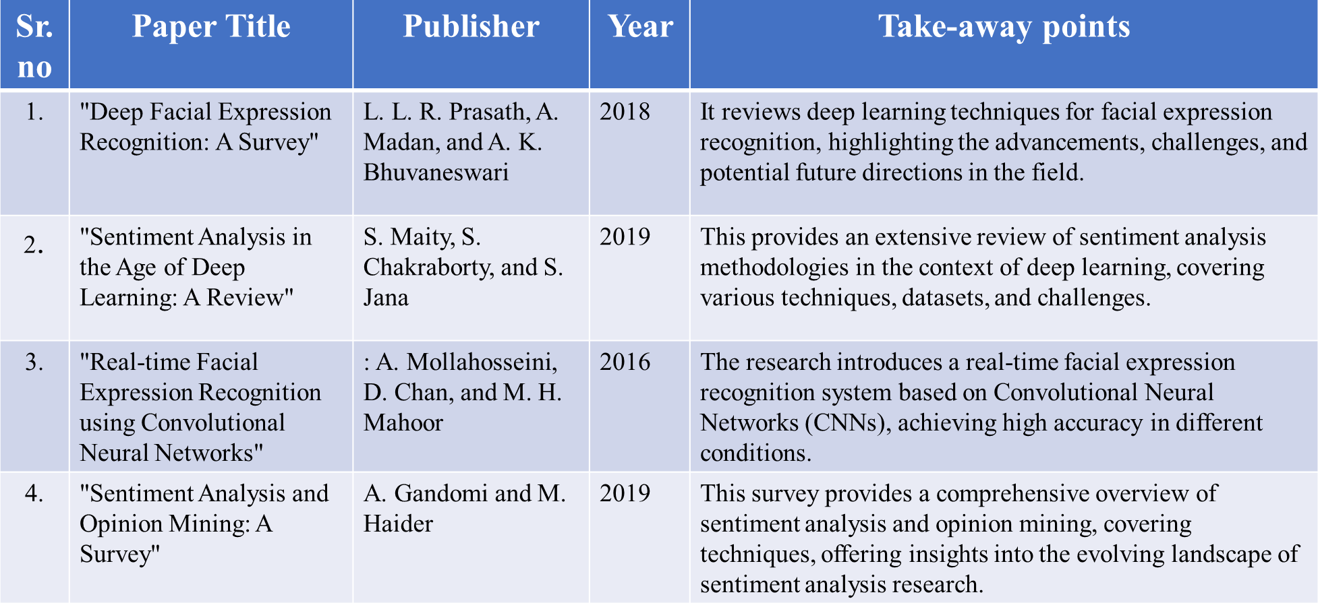
Research Paper Summary
5

Slide 6
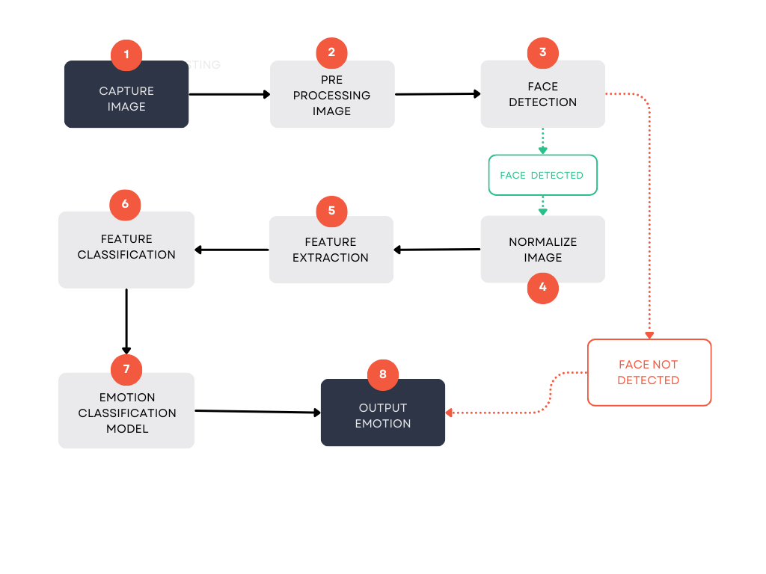
Flowchart of the system
Input: Face image, Image Preprocessing: Face detection, text cleaning Feature Extraction: Extract facial features, tokenize text.
Classification: Use ML/DL models for emotion and sentiment classification.
Output: Emotion label

Slide 7
Implementation Details
Technologies Used
  Programming Language: Python
  Libraries/Frameworks:
    OpenCV: For image processing and face detection.
    TensorFlow/Keras: For building and training neural networks for emotion detection.
    NLTK/VADER: For text preprocessing and sentiment analysis.
Methodology
  Data Collection:
    Facial Emotion Data: Collected from datasets like FER2013 or CK+ containing labeled facial images.
    Text Sentiment Data: Gathered from sentiment-labeled datasets like IMDB reviews or Twitter Sentiment Analysis Dataset.

Slide 8
  Preprocessing:
    Face Detection: Used OpenCV to detect faces and extract relevant regions from images.
    Text Cleaning: Removed noise, stop words, and tokenized the text for sentiment analysis.
  Feature Extraction
    Facial Features: Extracted using Dlib’s facial landmarks for more detailed emotion detection
    Text Features: Used TF-IDF or word embeddings to convert text into numerical vectors.
  Model Training:
    Emotion Detection: Trained a Convolutional Neural Network (CNN) on the facial data to classify emotions.
    Sentiment Analysis: Used a Recurrent Neural Network (RNN) or pre-trained models like BERT for sentiment classification.
  Testing and Evaluation:
    Evaluated both models on test data using metrics like accuracy, precision, recall, and F1-score to ensure reliability.
8

Slide 9
Architecture
  Input Layer:
    Face Image: Passed through a CNN for feature extraction and emotion classification.
    Text Input: Tokenized and passed through an embedding layer followed by an RNN for sentiment analysis.
  Hidden Layers:
    Emotion Detection: Multiple convolutional layers followed by pooling and fully connected layers in the CNN.
    Sentiment Analysis: LSTM or GRU layers in the RNN for capturing sequential dependencies in text data.
  Output Layer:
    Emotion Detection: Softmax layer for classifying emotions into categories like Happy, Sad, Angry, etc.
    Sentiment Analysis: Softmax layer for classifying sentiments as Positive, Negative, or Neutral

Slide 10
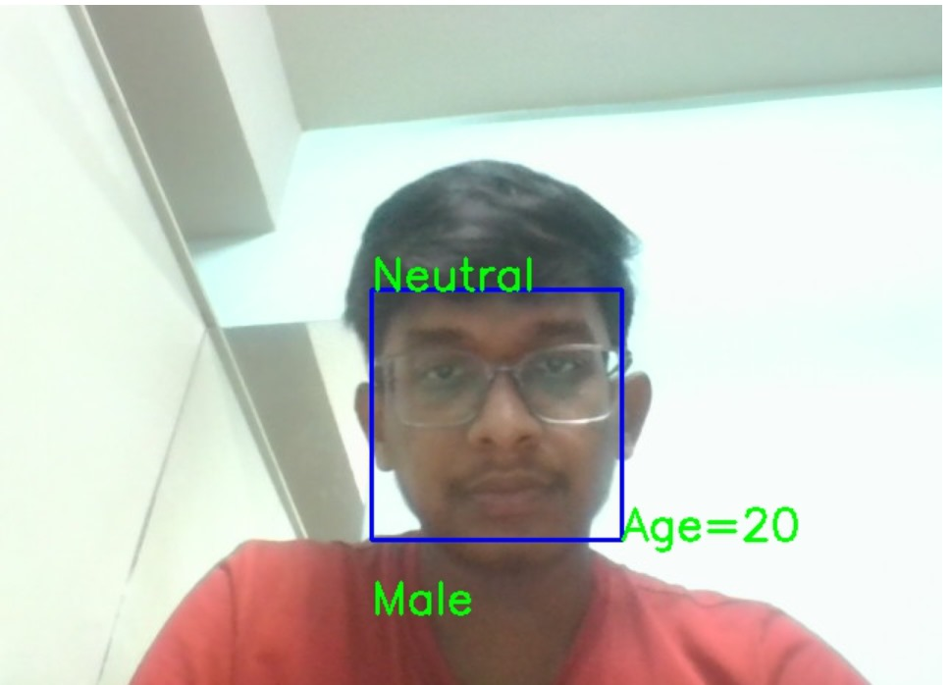
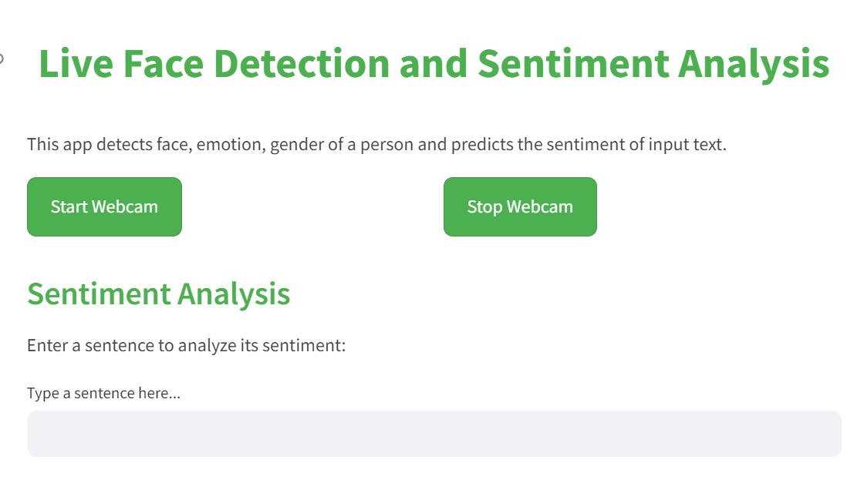
Screen shots of implemented work
25-08-2024
Project Presentation 2024
9

Slide 11
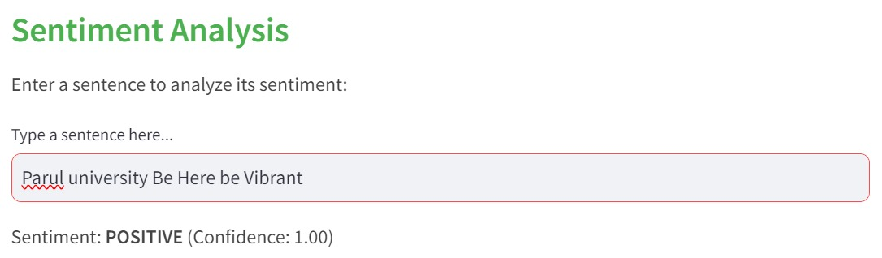
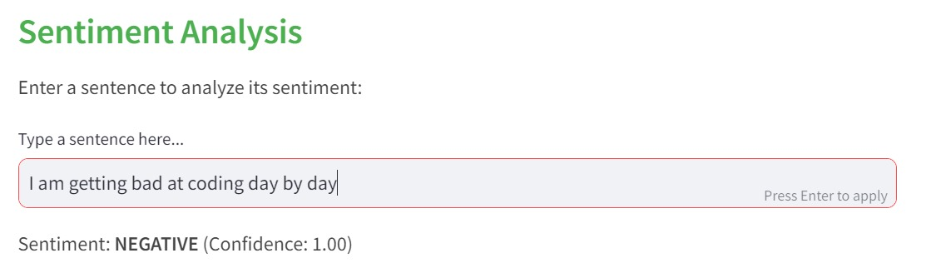

Slide 12
Testing of the Project
  Unit Testing: Verifies the functionality of individual components like facial feature extraction and sentiment tokenization.
  Integration Testing: Ensures that different components, such as the emotion detection model and sentiment analysis model, work together seamlessly.
  System Testing: Evaluates the complete system, testing the end-to-end workflow from input to output, ensuring that the system behaves as expected in real-world scenarios.
  Tools Used
  Py Test: Used for unit testing to ensure each module functions correctly.
  Unit test (Python): Employed for integration testing to validate the interaction between components.
  Manual Testing: Performed for system testing, focusing on the overall user experience and the accuracy of the results.
Test Cases
Test Case ID | Description | Input | Expected Output | Actual Output | Status
TC1 | Detect Happy Emotion | Image of a smiling face | Happy | Happy | Pass
TC2 | Analyze Positive Sentiment | "I love this product!" | Positive | Positive | Pass

Slide 13
Conclusion
  The project successfully developed a robust system for detecting facial emotions and analyzing sentiments with high accuracy. Key achievements include the implementation of advanced facial recognition algorithms, effective emotion classification, and precise sentiment analysis. The system demonstrates reliable performance in real-world scenarios, providing valuable insights into user emotions and sentiments.
  Challenges Faced: Significant hurdles included handling variations in lighting conditions and facial expressions, as well as integrating emotion detection with sentiment analysis. These challenges were addressed through the use of diverse training datasets, robust preprocessing techniques, and fine-tuning of machine learning models. The iterative approach and continuous testing ensured the system’s reliability and effectiveness.

Slide 14
Future Work
Advanced Emotion Recognition Models: Explore and integrate state-of-the-art deep learning models enhance accuracy, especially in capturing subtle and complex emotional expressions.
Multimodal Integration: Investigate the integration of multiple modalities, such as voice and text, to create a more comprehensive understanding of user emotions and sentiments.
Cross-Domain Applications: Explore and adapt the system for cross-domain applications, such as mental health monitoring, human-robot interaction, and educational technology, to broaden its impact.
Privacy-Preserving Techniques: Research and implement advanced privacy-preserving techniques, such as federated learning or on-device processing, to address concerns related to user data privacy.
Enhanced Sentiment Analysis Algorithms: Improve sentiment analysis algorithms by considering context, sarcasm, and cultural nuances, enhancing the system's ability to accurately interpret and respond to diverse sentiments.

Slide 15
References
Huang, ZY., Chiang, CC., Chen, JH. et al. A study on computer vision for facial emotion recognition. Sci Rep 13, 8425 (2023). https://doi.org/10.1038/s41598-023-35446-4
J. Li, S. Fong, Y. Zhuang and R. Khoury, "Hierarchical Classification in Text Mining for Sentiment Analysis", 2014 International Conference on Soft Computing and Machine Intelligence, pp. 46-51, september. 2014.
Gathr Data Inc. (http://surl.li/qjloh)

Slide 16

Thank you

