Slide 1
CafeNextDoor ChatBot System
By
Krishna Chaitanya Bogavalli

Slide 2
Conversation flow of the agent built. (2 possible use-case scenarios)
Default Welcome Intent
User want to Purchase some kind of drink?
User want to know list of available drinks
Un-Recognised Input?
Call to Action
Dine-in / Take Away
List of Some Possible Events based on user Input Parameters and bot Suggestions
Final Meal Selected
Meal Selected Directly From Menu
Order Succesfully
Placed!!!!!
Payment [Cash/Wallet/Card]

Slide 3
Important Parameters
Drink (Tea / Coffee)
Type of Drink (Black / Milk)
Size (Regular / Medium / Large)
Order Type (Have it Here / Take Away)
Payment type (Cash / Card / Wallet)

Slide 4
Collecting Parameters && Intent Flow
Each Parameter is collected from the end user by processing through sequence of intents.
Sequence of Intents to fill missed PARAM’s. {Intent Flow}
menu-getdrink (Get Drink [Coffee / Tea]).
menu-drink-type (Get either Black / Milk).
menu-drink-size (Get either Regular / Medium / Large).
get-order-type (Get either Take Away / Have it here).
payment-selection (Get Mode of payment either Cash / Credit / Wallet.
Notes:
Regular Black Coffee

Slide 5
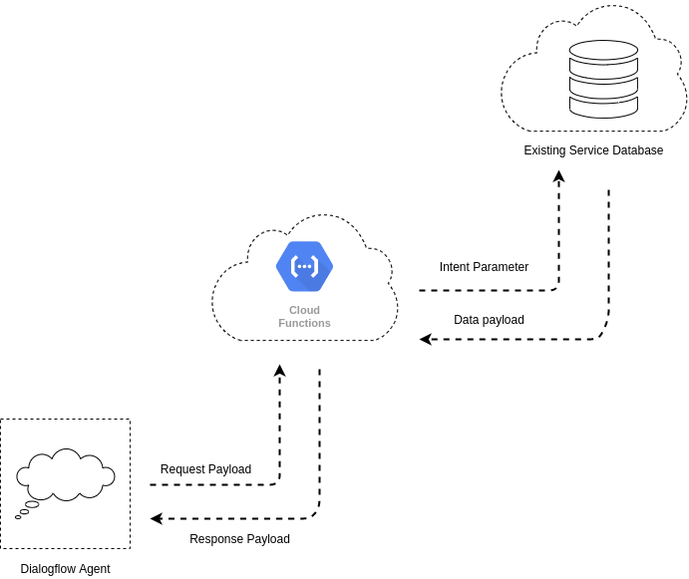
Data-Flow Delivery Diagram
The Dialog flow agent sends the parameter extracted from an end user’s text at any intent to the cloud function in a fulfillment request payload and
the cloud function, in turn, queries the database for the document using the received drink name and sends back the queried data in a response payload to the agent.

Slide 6
Back-end [Nodejs Server + Mongo DB]
Data related to menu-items are stored in MongoDB database.
Fetching Data From Server
Cloud function initiates a connection to a MongoDB Atlas cluster, then it opens the collection storing all the drinks list.
Next, using the parameter [collected from user] is passed into the POST request . I ran a find method on the collection to query the requested drink / price of drink from the Database.
Sending back the entire data to the agent after the iteration in a JSON body

Slide 7
Code Walkthrough
Created a tunnel to expose the localhost port running the cloud function to the internet with an SSL certificate attached to the secured connection . [Using Ngrok]
FoodFunction Walkthrough [Show how functions handles different cases and collects user responses in different intents].
Dialog Flow fulfilment setup, Entity Management, and Intent walkthrough.

Slide 8
Future Thoughts
Improvement to take orders with multiple quantities of same product.
Adding Separate Cart functionality to handle the multiple orders with different quantities.
Storing order and User information in Database.

Slide 9
Final Demo of the BoT

Slide 10
Thank you!!!!!

