Slide 1
Project on Sentiment analysis on hotel reviews
By:-
Tadicharla Rama Chaitanya.

Slide 2
Introduction
Sentiment analysis is part of the Natural Language Processing (NLP) techniques that consists in extracting emotions related to some raw texts. This is usually used on social media posts and customer reviews in order to automatically understand if some users are positive or negative and why. The goal of this study is to show how sentiment analysis can be performed using python.
Objective
Analyze customer reviews of hotels to understand sentiment and identify areas for improvement.
Develop a machine learning model to classify reviews as positive, negative, or neutral.
Deploy the model in the cloud for real-time sentiment analysis.
Key Components
Data Preprocessing and cleaning.
Model training and evaluation.
Model deployment using streamlit.

Slide 3
Methodology Used:
CRISP-ML(Q):-
Cross-Industry Standard Process for the development of Machine Learning applications with Quality assurance methodology (CRISP-ML(Q)).
There are total of 6 steps to be followed in CRISP-ML(Q) methodology.
Business and Data Understanding
Data Preparation
Model Building
Model Evaluation
Model Deployment
Monitoring & Maintenance

Slide 4
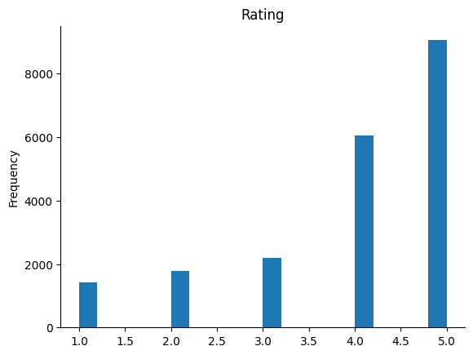
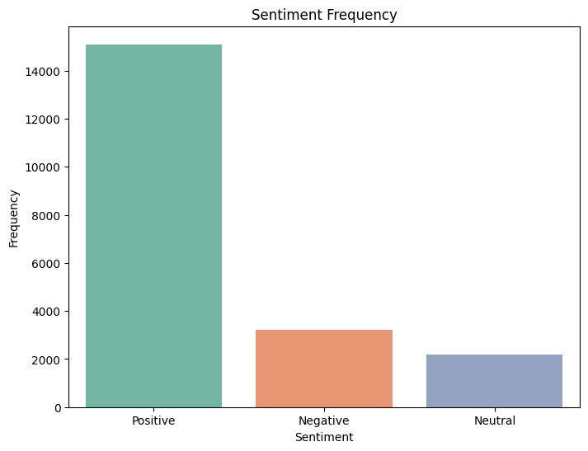
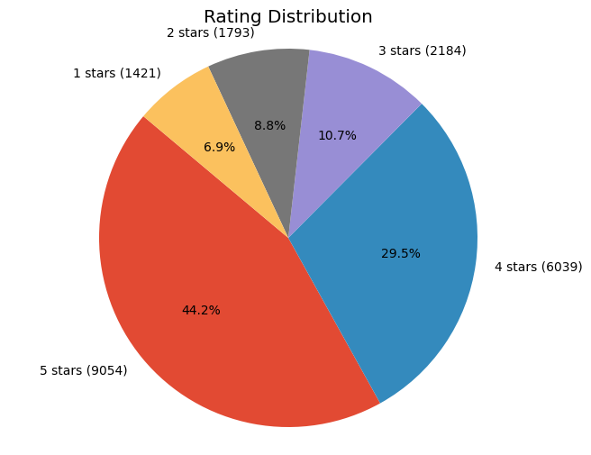
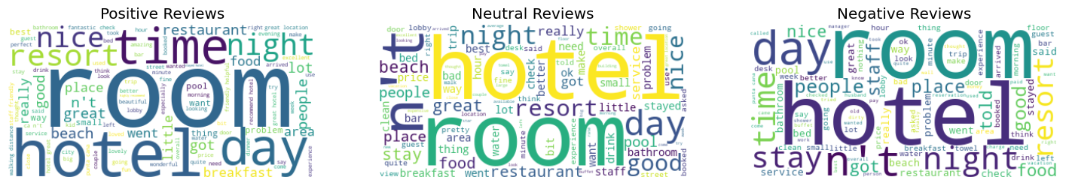
Data Visualization
From the above bar graph we can see the total number of positive, negative and neutral reviews.
The above pie-chart tells us the info about the percentage and count of customers wrt reviews.
The above histogram gives the info about the frequency of ratings.
From the above word cloud the size of each word indicates its frequency or importance within the text.

Slide 5
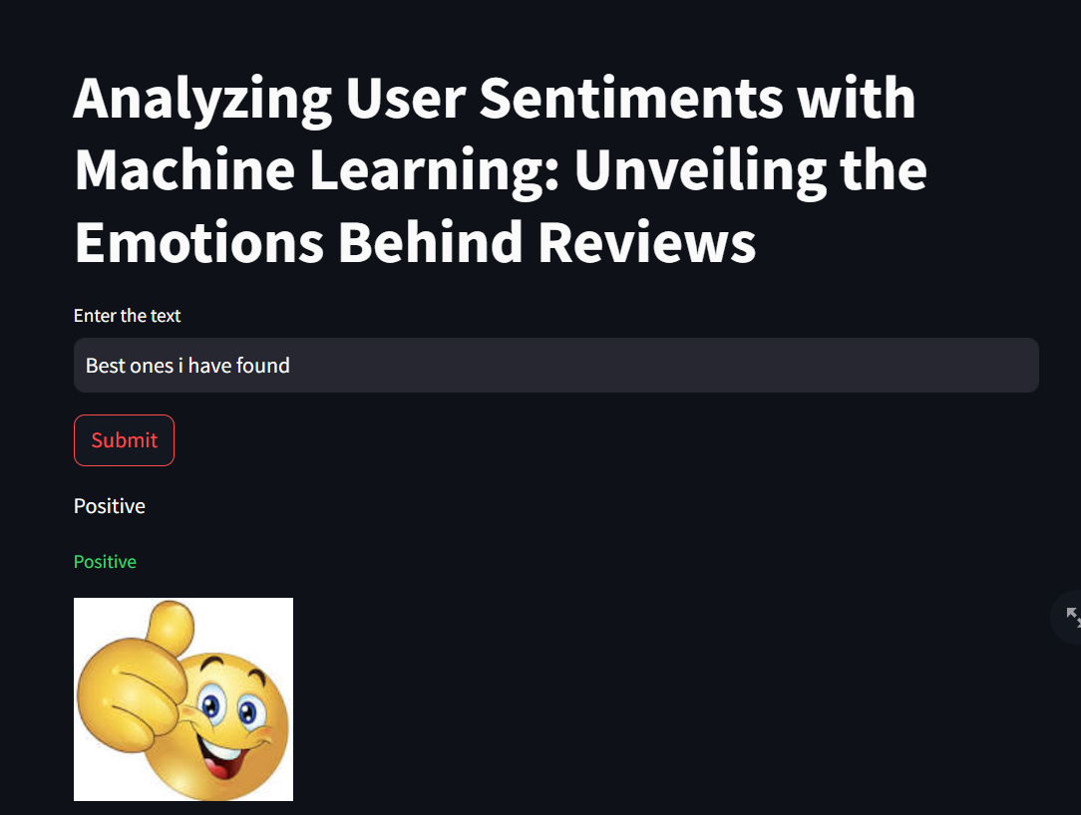
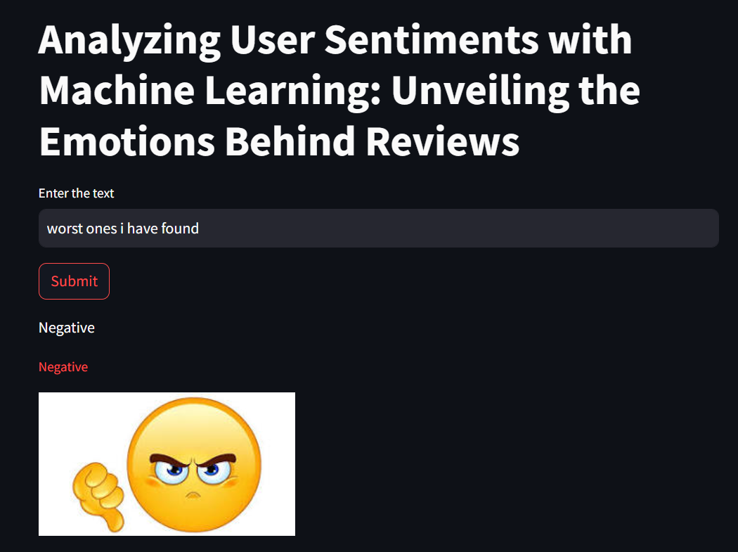
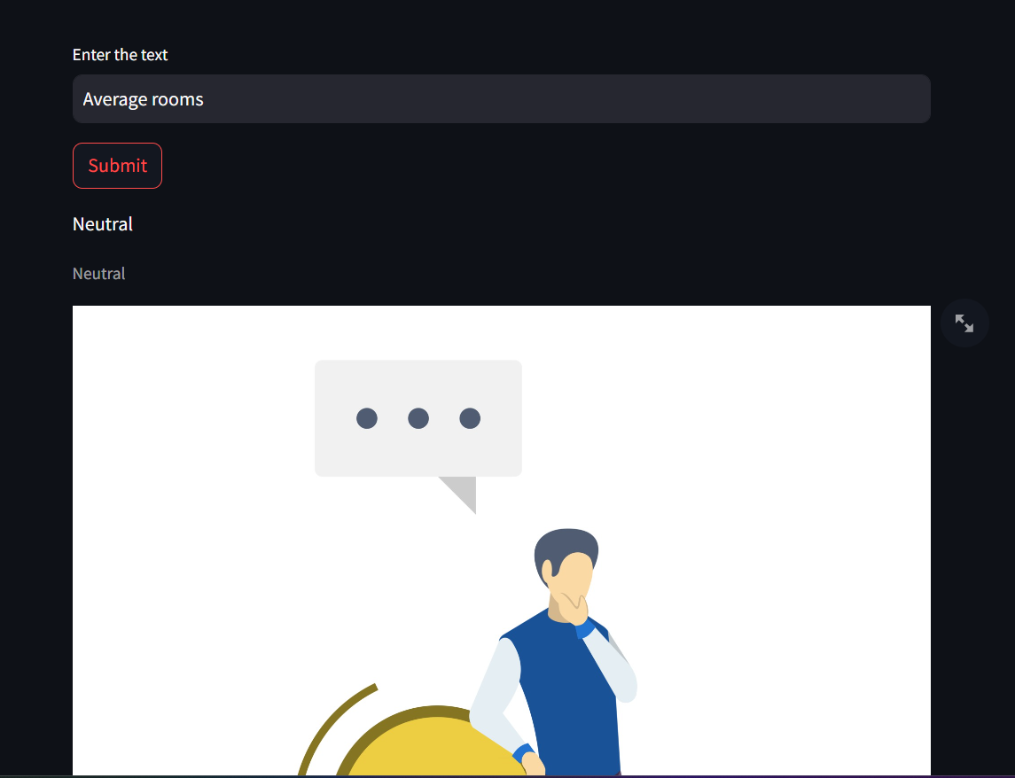
Streamlit output

Slide 6
Conclusion
In conclusion, the sentiment analysis project on hotel reviews has provided valuable insights into customer opinions and satisfaction levels. Through the application of natural language processing techniques, we were able to analyze a large dataset of hotel reviews and classify them into positive, negative, and neutral sentiments.
Key Findings:
Sentiment Distribution: Our analysis revealed that the majority of hotel reviews were positive, indicating overall satisfaction among customers. However, there were also a notable number of negative reviews highlighting areas for improvement.
Model Performance: We evaluated the performance of our sentiment analysis models, including TF-IDF and Bag of Words approaches, and found that [insert findings here, e.g., TF-IDF achieved higher accuracy but Bag of Words had higher recall].
Deployment and Usability: The deployment of our sentiment analysis model in the cloud, coupled with a user-friendly interface developed in Visual Studio and Streamlit, allows for real-time analysis of customer feedback and facilitates data-driven decision-making for hotel management.

Slide 7
Thank you

