Slide 1
Use case 3.1
Problem Statement :- Develop a customer segmentation model that can group the customers based on their churn prediction.
Description :- The telco industry faces the challenge of retaining customers in a highly competitive market. Customer churn, or the rate at which customers stop using the services provided by the telco company, is a critical metric that directly impacts revenue and profitability. Identifying customers at risk of churning and implementing effective retention strategies is essential for sustainable business growth. Kaggle Telco Customer Churn (kaggle.com)

Slide 2
Solution Approach:-
Data collection and Understanding:-
. Gather the dataset and understand the structure of the data including all the features.
. Analyze the data to identify the patterns, distributions.
2. Data Preprocessing
. Handle the missing values :- Imputation or removal based on the missing nature
. Encoding the categorical variables :- Convert the categorical features into numerical features by using the label encoder.
. Feature Engineering :- Create the new features and transform the existing features to improve the model performance.
3. Exploratory data analysis
. Visualize the data to get insights into customer behaviour and service usage.
. Identify the correlated features with target variable.
4. Model selection and training
. Chosen the machine learning algorithm as Random Forest classifier.
. Split the data into train and test subsets.
. Trained the model on training data.

Slide 3
5. Model Evaluation
. Evaluated the model performance by using the metrics like accuracy, precision, recall, F1-score.
6. Insights and Recommendations
. Interpreting the model results and identify the key factors influencing the customer churn.
. Provide the actionable recommendations and insights to the customers to reduce the churn.
. Offer the strategies for retain the customers back.

Slide 4
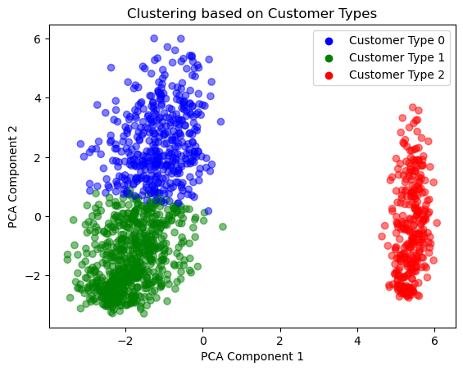
Results
Predictions :-
Micro-average Metrics:
Accuracy: 0.8388928317955997
Precision: 0.8388928317955997
Recall: 0.8388928317955997
F1-Score: 0.8388928317955997
Macro-average Metrics:
Precision: 0.7721536015441388
Recall: 0.7267591431817921
F1-Score: 0.7461579908011776

