Slide 1
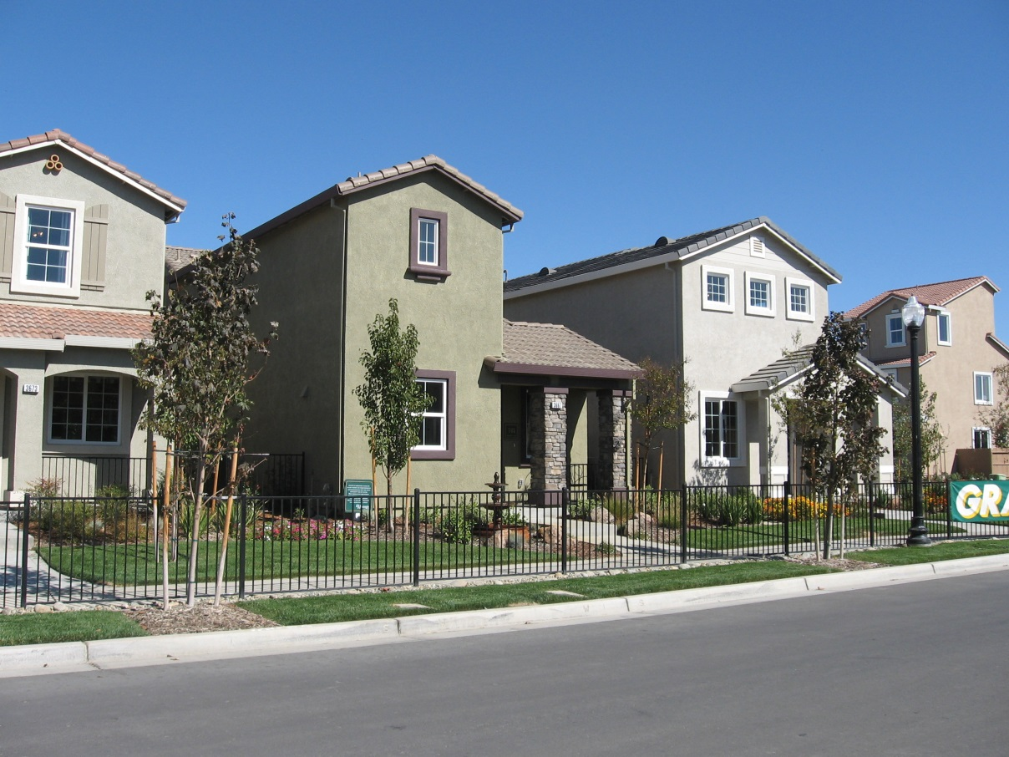
House Price Prediction

Slide 2
Introduction
This notebook is going to be focused on solving the problem of predicting house prices for house buyers and house sellers.
A house value is simply more than location and square footage. It is a dream for every person. House buyer check for the features before buying an house. In the dataset available have all the features and we will use this data to analyze and predict house prices.
We will follow the steps that allow us to ensure the cleanest, most realistic data for our model to make accurate predictions from
Load Data and Packages.
Analyzing the test variable "SalePrice"
Missing data and Clean Data
Feature Engineering
Modelling and predictions.

Slide 3
A benefit to this study is that we can have two clients at the same time with no conflict of interest!
Client Housebuyer: This client wants to find their next dream home with a reasonable price tag. They have their locations of interest ready. Now, they want to know if the house price matches the house value. With this study, they can understand which features (ex. Number of bathrooms, location, etc.) influence the final price of the house. If all matches, they can ensure that they are getting a fair price.
Client Houseseller: Think of the average house-flipper. This client wants to take advantage of the features that influence a house price the most. They typically want to buy a house at a low price and invest on the features that will give the highest return. For example, buying a house at a good location but small square footage. The client will invest on making rooms at a small cost to get a large return.

Slide 4
Import Packages
import pandas as pd
import numpy as np
import matplotlib as mpb
import matplotlib.pyplot as plt
import pandas_profiling
from scipy import stats
import seaborn as sb
%matplotlib inline

Slide 5
Data Description
This dataset consists of 80 Columns. This is a multivariable dataset having both Numerical and Categorical Variables. Following are the brief introduction of each and every column in the dataset.
SalePrice - the property's sale price in dollars. This is the target variable that you're trying to predict.
MSSubClass: The building class
MSZoning: The general zoning classification
LotFrontage: Linear feet of street connected to property
LotArea: Lot size in square feet
Street: Type of road access
Alley: Type of alley access
LotShape: General shape of property
LandContour: Flatness of the property
Utilities: Type of utilities available
LotConfig: Lot configuration
LandSlope: Slope of property
Neighborhood: Physical locations within Ames city limits
Condition1: Proximity to main road or railroad

Slide 6
Contd….
GarageType: Garage location
GarageYrBlt: Year garage was built
GarageFinish: Interior finish of the garage
GarageCars: Size of garage in car capacity
GarageArea: Size of garage in square feet
GarageQual: Garage quality
GarageCond: Garage condition
PavedDrive: Paved driveway
WoodDeckSF: Wood deck area in square feet
OpenPorchSF: Open porch area in square feet
EnclosedPorch: Enclosed porch area in square feet
3SsnPorch: Three season porch area in square feet
ScreenPorch: Screen porch area in square feet
PoolArea: Pool area in square feet
PoolQC: Pool quality
Fence: Fence quality
MiscFeature: Miscellaneous feature not covered in other categories
MiscVal: $Value of miscellaneous feature
MoSold: Month Sold
YrSold: Year Sold
SaleType: Type of sale
SaleCondition: Condition of sale

Slide 7
Contd…
Condition2: Proximity to main road or railroad (if a second is present)
BldgType: Type of dwelling
HouseStyle: Style of dwelling
OverallQual: Overall material and finish quality
OverallCond: Overall condition rating
YearBuilt: Original construction date
YearRemodAdd: Remodel date
RoofStyle: Type of roof
RoofMatl: Roof material
Exterior1st: Exterior covering on house
Exterior2nd: Exterior covering on house (if more than one material)
MasVnrType: Masonry veneer type
MasVnrArea: Masonry veneer area in square feet
ExterQual: Exterior material quality
ExterCond: Present condition of the material on the exterior
Foundation: Type of foundation
BsmtQual: Height of the basement
BsmtCond: General condition of the basement
BsmtExposure: Walkout or garden level basement walls
BsmtFinType1: Quality of basement finished area
KitchenQual: Kitchen quality
TotRmsAbvGrd: Total rooms above grade (does not include bathrooms)

Slide 8
Contd…
BsmtFinSF1: Type 1 finished square feet
BsmtFinType2: Quality of second finished area (if present)
BsmtFinSF2: Type 2 finished square feet
BsmtUnfSF: Unfinished square feet of basement area
TotalBsmtSF: Total square feet of basement area
Heating: Type of heating
HeatingQC: Heating quality and condition
CentralAir: Central air conditioning
Electrical: Electrical system
1stFlrSF: First Floor square feet
2ndFlrSF: Second floor square feet
LowQualFinSF: Low quality finished square feet (all floors)
GrLivArea: Above grade (ground) living area square feet
BsmtFullBath: Basement full bathrooms
BsmtHalfBath: Basement half bathrooms
FullBath: Full bathrooms above grade
HalfBath: Half baths above grade
Bedroom: Number of bedrooms above basement level
Kitchen: Number of kitchens
Functional: Home functionality rating
Fireplaces: Number of fireplaces
FireplaceQu: Fireplace quality

Slide 9
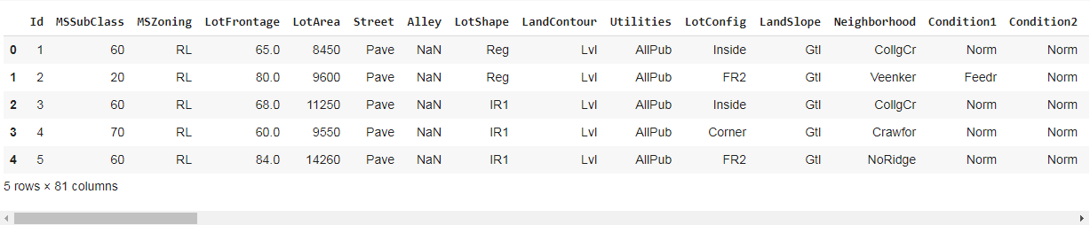
Data Loading
read_csv function reads the file and store it in dataframe.
housedata = pd.read_csv("house_data.csv")
housedata.head()

Slide 10
Drop the Id column
Id column has no meaning. Hence dropped using drop function in pandas.
housedata.drop(columns=['Id'],inplace=True)

Slide 11
Preprocessing
housepriceprofile = pandas_profiling.ProfileReport(housedata)
housepriceprofile.to_file(outputfile="house_price_pre_profiling.html")
Processed data with pandas profiling and the data set have following anamolies.
2ndFlrSF has 829 / 56.8% zeros Zeros
3SsnPorch has 1436 / 98.4% zeros Zeros
Alley has 1369 / 93.8% missing values Missing
BsmtCond has 37 / 2.5% missing values Missing
BsmtExposure has 38 / 2.6% missing values Missing
BsmtFinSF1 has 467 / 32.0% zeros Zeros
BsmtFinSF2 has 1293 / 88.6% zeros Zeros
BsmtFinType1 has 37 / 2.5% missing values Missing
BsmtFinType2 has 38 / 2.6% missing values Missing
BsmtFullBath has 856 / 58.6% zeros Zeros
BsmtHalfBath has 1378 / 94.4% zeros Zeros
BsmtQual has 37 / 2.5% missing values Missing
BsmtUnfSF has 118 / 8.1% zeros Zeros
EnclosedPorch has 1252 / 85.8% zeros Zeros
Fence has 1179 / 80.8% missing values Missing
FireplaceQu has 690 / 47.3% missing values Missing

Slide 12
Contd…
Fireplaces has 690 / 47.3% zeros Zeros
GarageArea has 81 / 5.5% zeros Zeros
GarageCars has 81 / 5.5% zeros Zeros
GarageCond has 81 / 5.5% missing values Missing
GarageFinish has 81 / 5.5% missing values Missing
GarageQual has 81 / 5.5% missing values Missing
GarageType has 81 / 5.5% missing values Missing
GarageYrBlt has 81 / 5.5% missing values Missing
HalfBath has 913 / 62.5% zeros Zeros
LotFrontage has 259 / 17.7% missing values Missing
LowQualFinSF has 1434 / 98.2% zeros Zeros
MasVnrArea has 861 / 59.0% zeros Zeros
MiscFeature has 1406 / 96.3% missing values Missing
MiscVal has 1408 / 96.4% zeros Zeros
MiscVal is highly skewed (γ1 = 24.477) Skewed
OpenPorchSF has 656 / 44.9% zeros Zeros
PoolArea has 1453 / 99.5% zeros Zeros
PoolQC has 1453 / 99.5% missing values Missing
ScreenPorch has 1344 / 92.1% zeros Zeros
TotalBsmtSF has 37 / 2.5% zeros Zeros
WoodDeckSF has 761 / 52.1% zeros Zeros

Slide 13
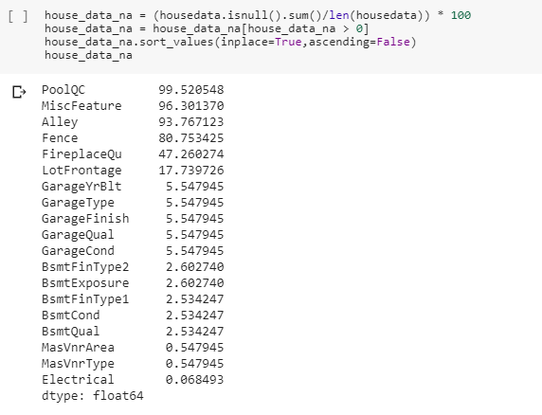
Missing data Analysis without data profiling
Missing data analyses without data profiling module and display using bar plot.

Slide 14
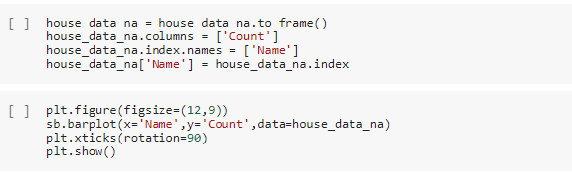
Convert the series to dataframe and plot the graph.

Slide 15
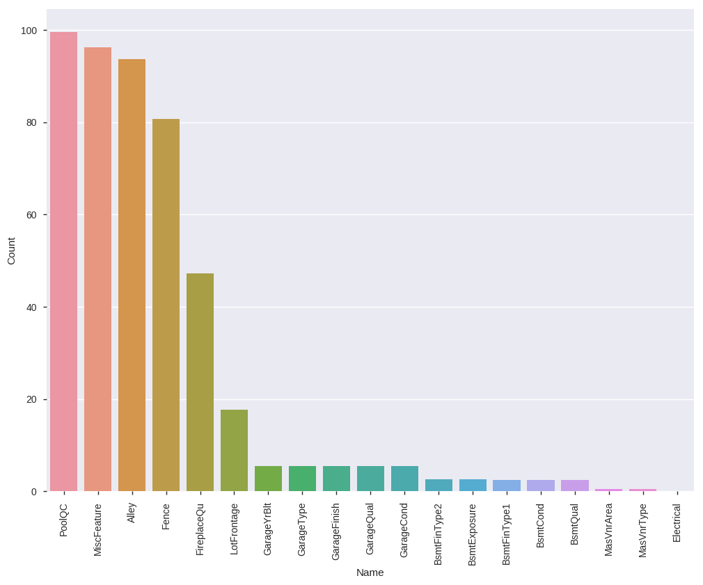
PoolQC, MiscFeature, Alley variables are having more than 90% missing data.
Fence variable is having 80% missing data.
Most of the data in these fields are missed. It is difficult to analyze these columns.

Slide 16
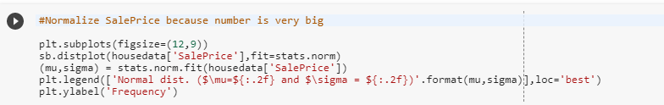
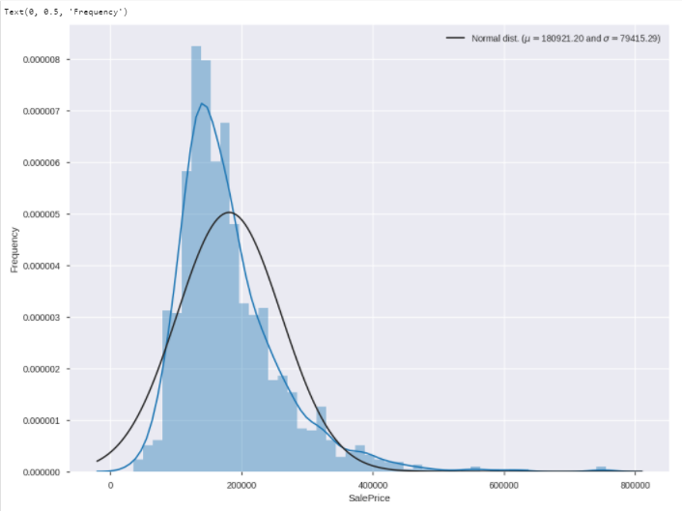
Sale Price Normalization
"SalePrice" column is having bigger numbers and right skewed because of outliers. Hence Normalizing the column with log transformation. Further analysis it is required that target variable should be Normally Distributed.
SalePrice is right skewed here. From 40000 $ to 80000 $ we can consider Outliers which effect the median.

Slide 17
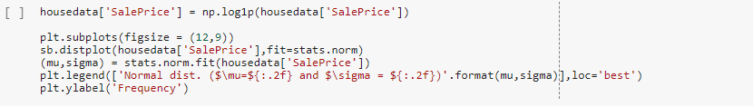
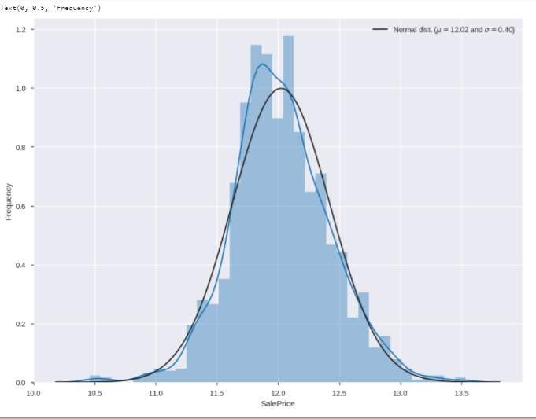
From the graph we can say that SalePrice is Normally distributed.

Slide 18
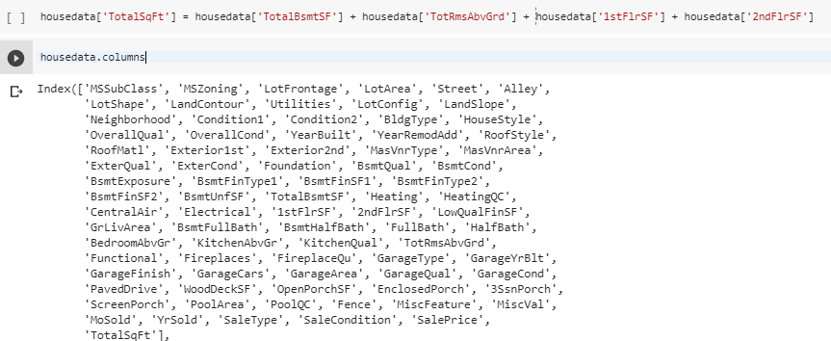
TotalSqFt column will represent the complete built-up area of an house. As we have separate columns for each level of the house

Slide 19
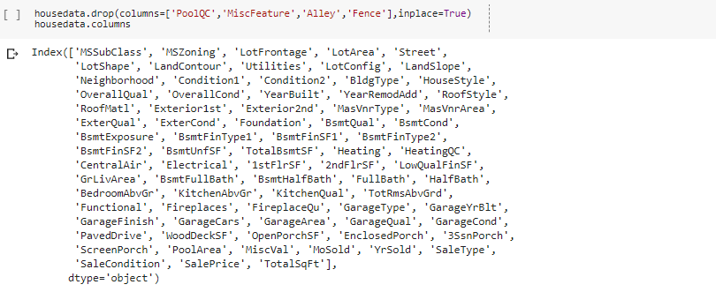
Drop Columns having more null values
These columns are having more than 80% null values. Hence drop these columns.

Slide 20
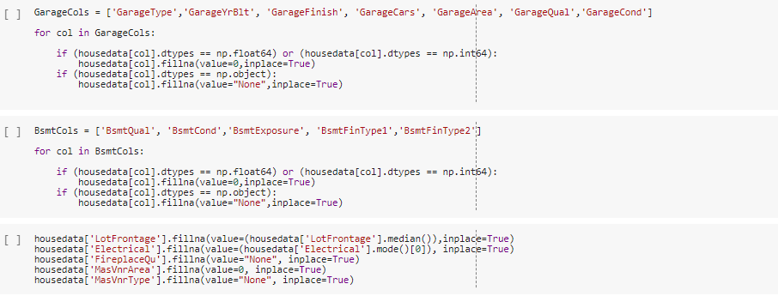
Fill Missing Values
For missing data, Replacing int and float types with 0 and object type with "None". To ensure all the data to be consistent across all the columns

Slide 21

DATA VISUALIZATION
Construction of houses for years

Slide 22
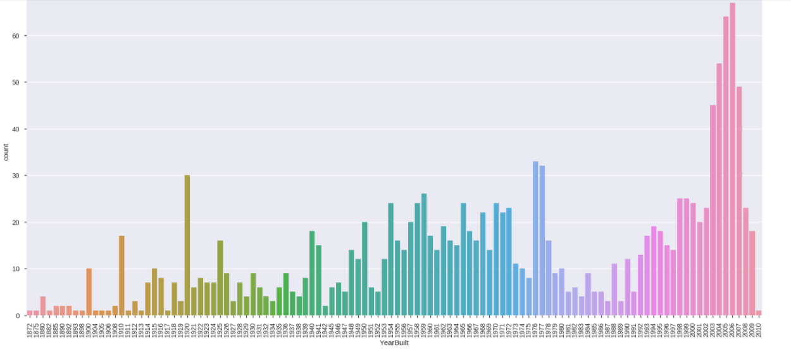
If we observe the graph, We can say
From year 2002 to 2009, demand for construction of houses are high
From year 1872 to 1913, demand for house construction is very less.

Slide 23


Neighborhood and overall condition of houses
OverallCond are having values range from 0 to 10. Bid the column with "<5" for range 0 - 5 and "<10" for range 5 - 10 for further analysis.
Plot countplot

Slide 24
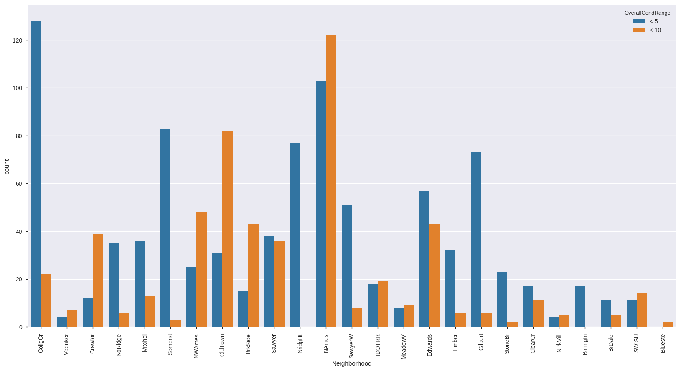
Observations in above graph,
CollgCr neighborhood houses are having OverallCond in between 0 to 5.
NAmes neighborhood houses are having OverallCond in between 0 - 5 and 5 - 10. But Compared to all the neighborhood houses with OverallCond is high in NAmes.
All the houses in Blueste are having OverallCond in between 5 - 10.
All the houses in Blmngtn are having OverallCond in between 0 - 5.

Slide 25

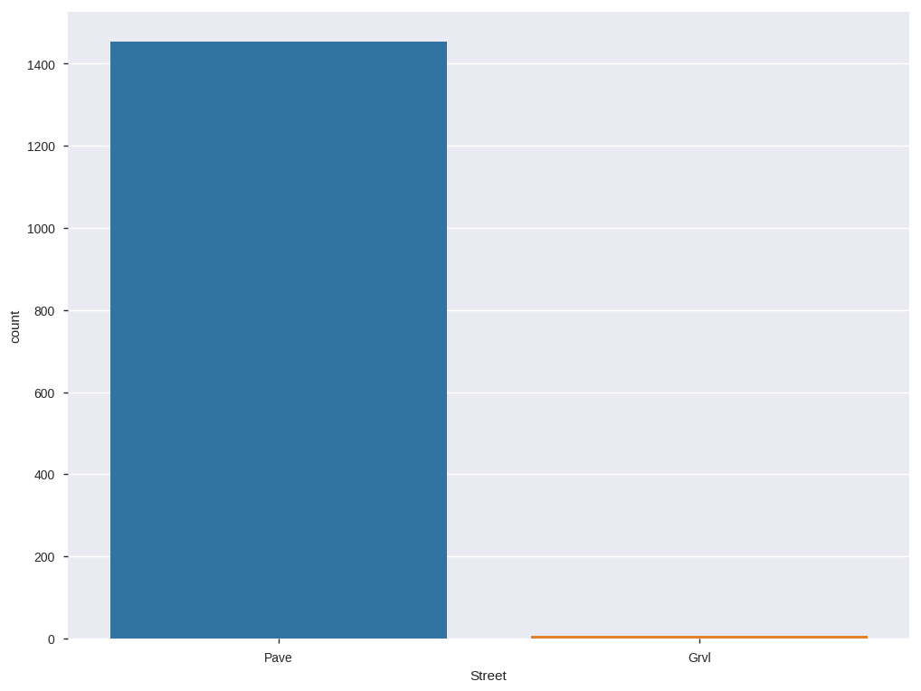
What is the type of road access to the house?
Observations from above count plot,
98 % of the houses are having "Pave" road access to the houses.

Slide 26

Correlation between variables
corr() function gives correlation between the variables. To show visually, we use heatmap to display the correlation values

Slide 27
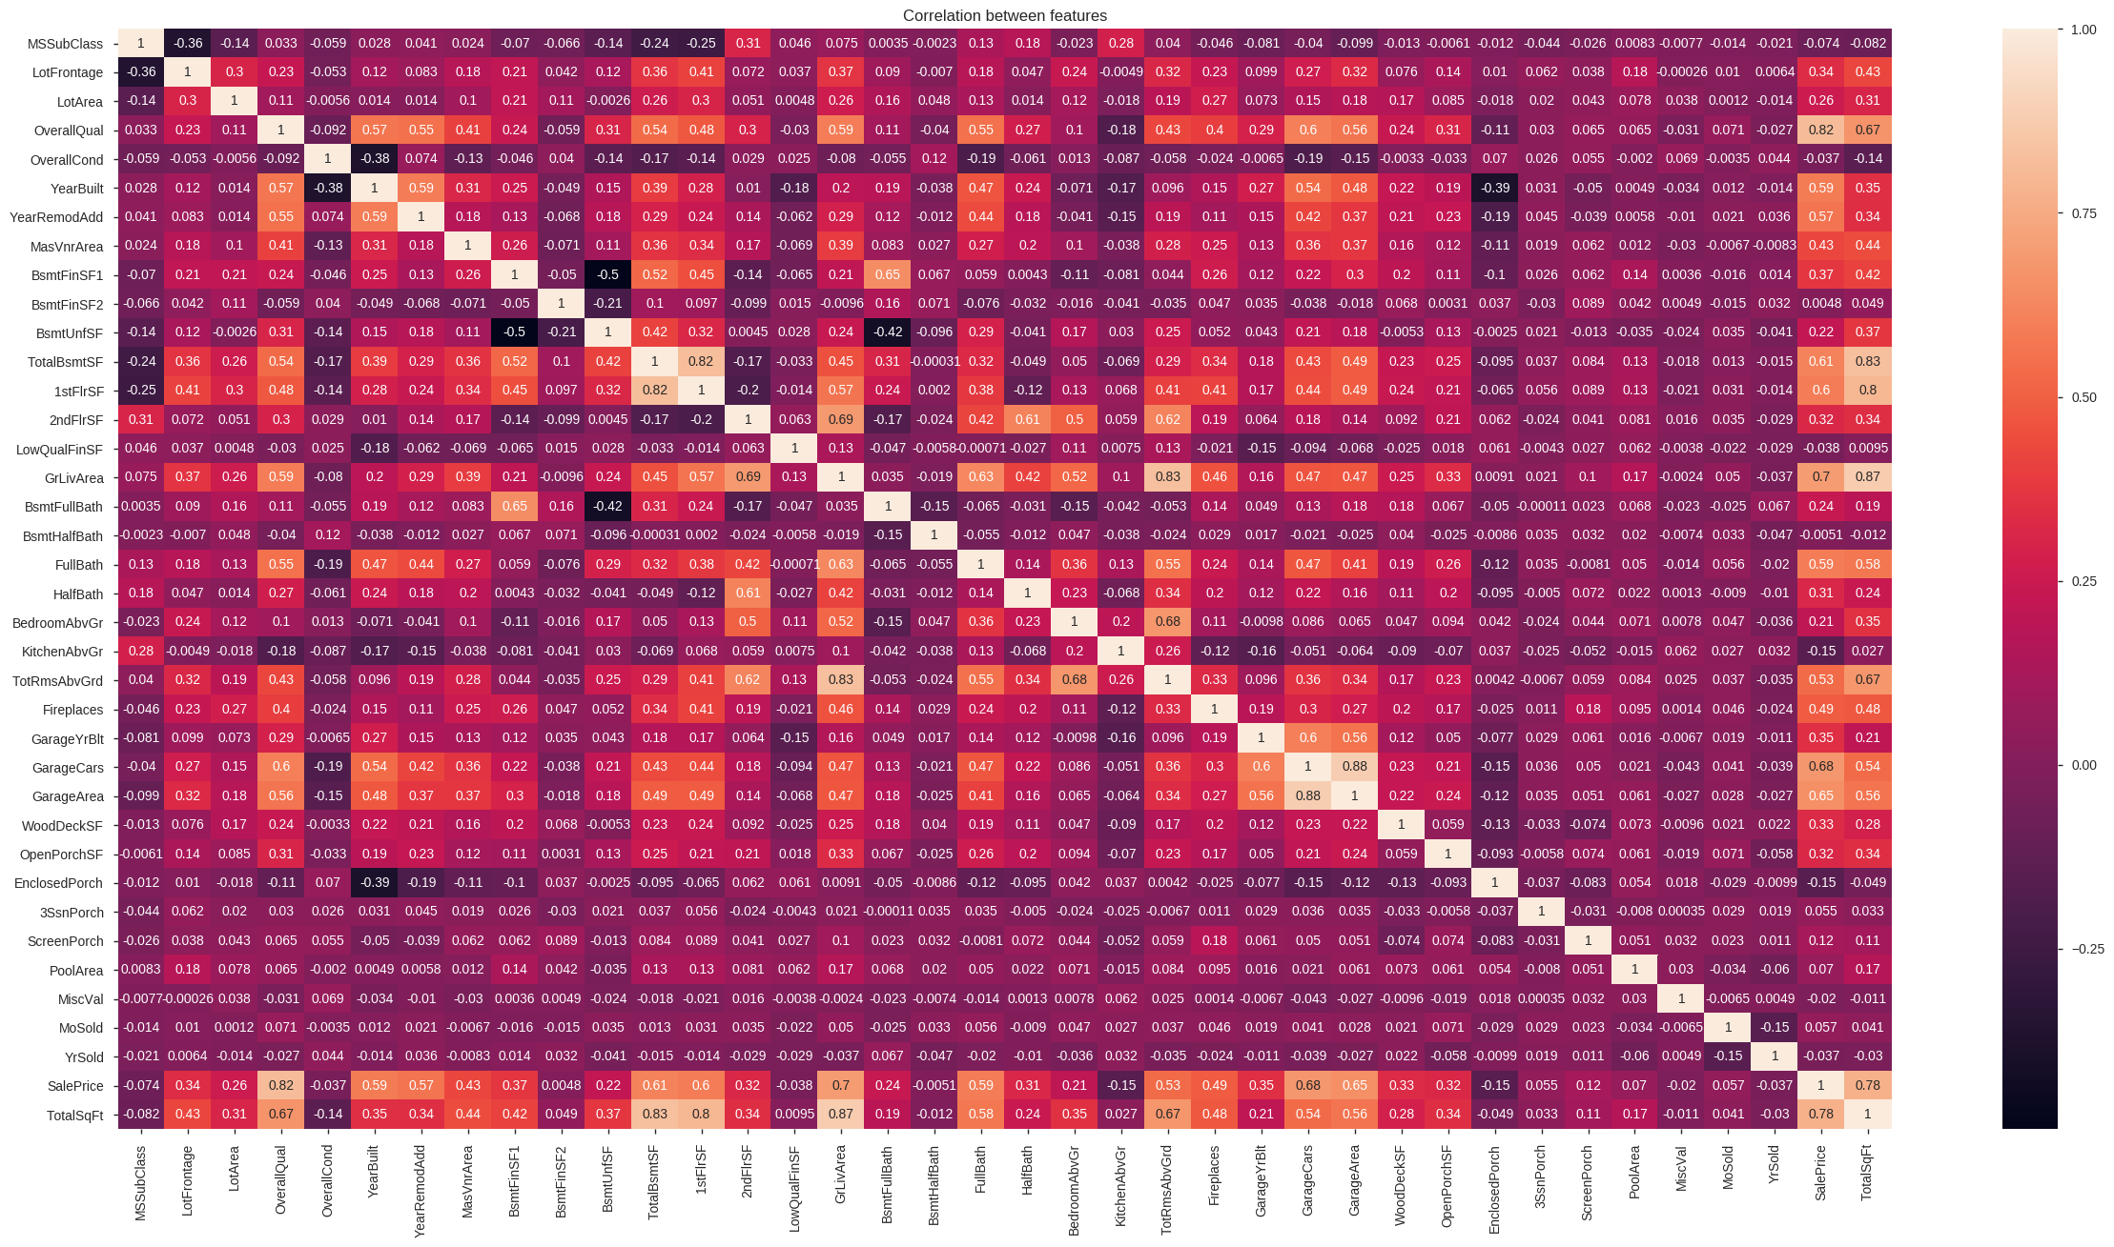
Observations:
GrLivArea and TotalSqFt are highly correlated with each other.
OverallQual and SalePrice are highly correlated.
TotalBsmtSF and TotalSqFt are also highly correlated.
BsmtFinSF1 and BsmtUnfSF are high negatively correlated.
TotalBsmtSF and BsmtHalfBath are slightly negatively correlated.

Slide 28
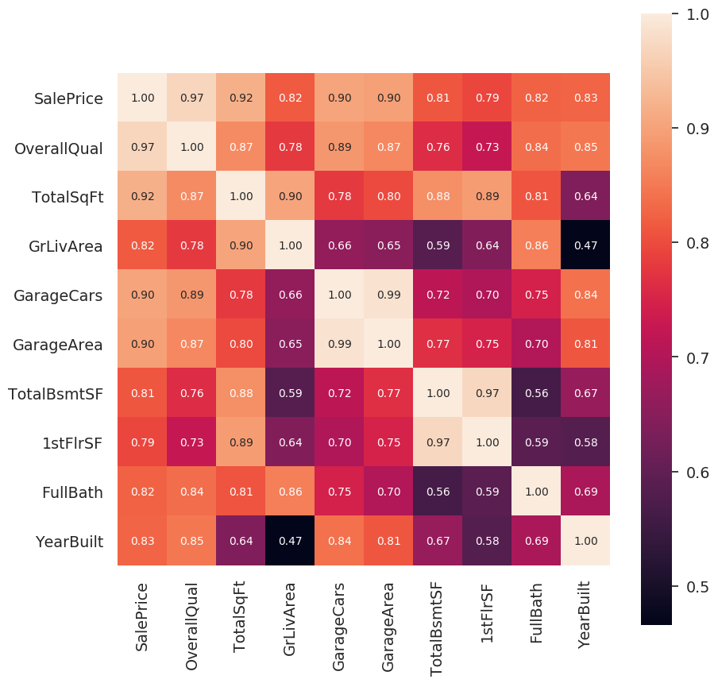
Zoomed Heat Map
Observations:
OverallQual and SalePrice are highly positively correlated.
GrLivArea and YearBuilt are slightly positively correlated.

Slide 29
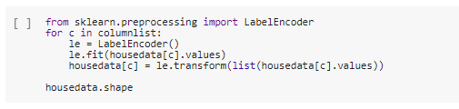
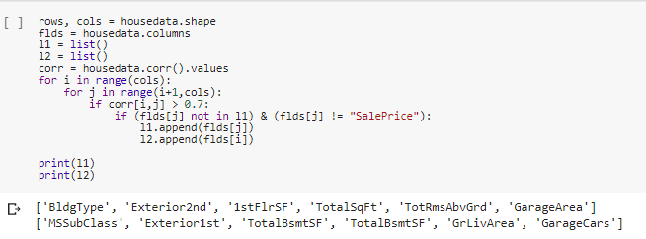
Feature Engineering
Label Encoder is used to transform categorical values to numerical values. Transformation can be done in other ways like "get_dummies".
Remove one highly correlated independent variables using correlation matrix. If we have highly correlated variables in our model, then the results will not be accurate.

Slide 30
Contd..
Drop highly correlated labels from dataset.

Slide 31
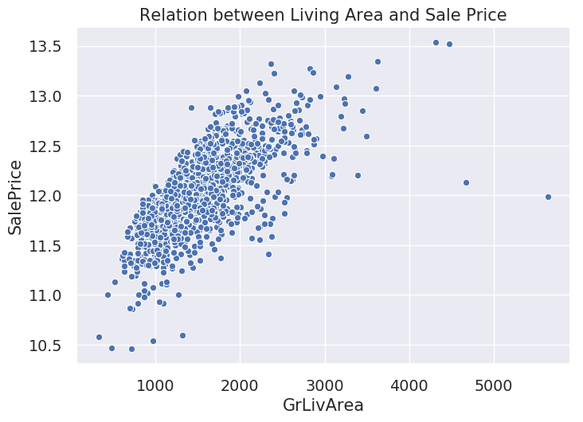

Visualization of Highly Correlated Variables
Check the distribution of independent variables which are highly correlated with "SalePrice". Like "GrLivArea", "OverallQual" and "YearBuilt" are highly correlated with "SalePrice" compared to other labels in dataset.
Observations:
There are few outliers present in the graph for living area below 600 and above 4000.
Most of the houses having Living Area in between 600 to 3000.

Slide 32
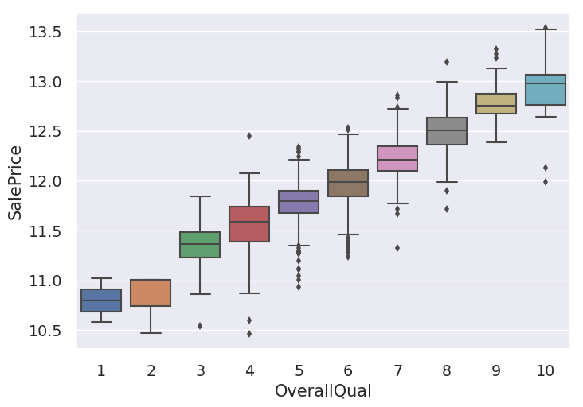
OverallQual and SalePrice
Observations:
Outliers are more for OverallQual "5" compared to other values.
SalePrice is highly distributed at OverrallQual "4".
SalePrice is high for houses which are having OverallQual "10".

Slide 33

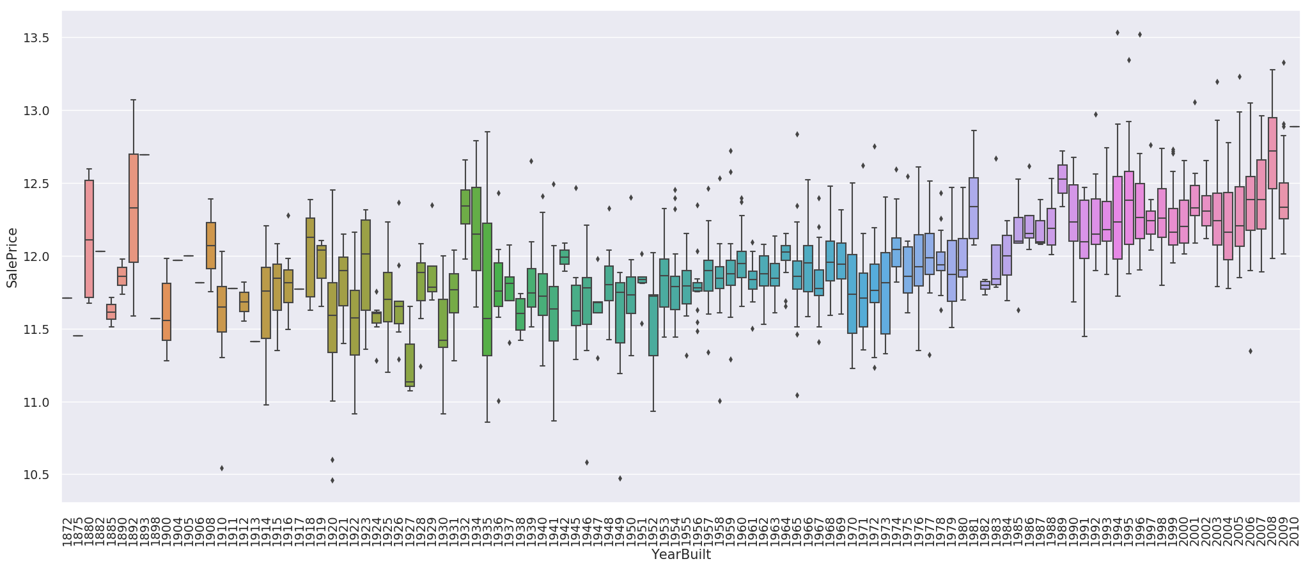
YearBuilt and SalePrice
Observations:
Sale prices are high for the houses built in past 10 years.
There is continuous growth in Sale price of houses built in year 1989 to 2010.
SalePrices are highly distributed for the houses built in the year 1935.

Slide 34
MODEL AND PREDICTIONS

Slide 35
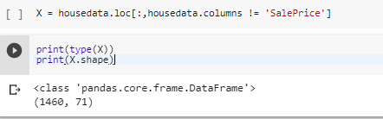
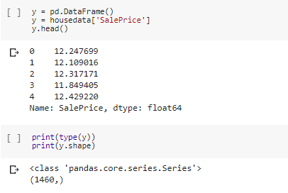
Preparing X and y using pandas
Keep all the independent variables separately into X
Create a dataframe with dependent variable "SalePrice" into y.

Slide 36
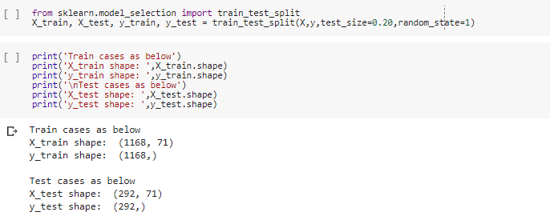
Splitting X and y into training and test datasets
Split X and y dataframes into training and testing dataset to make predictions. I have taken the size of the testing is 20%.

Slide 37
LINEAR REGRESSION

Slide 38

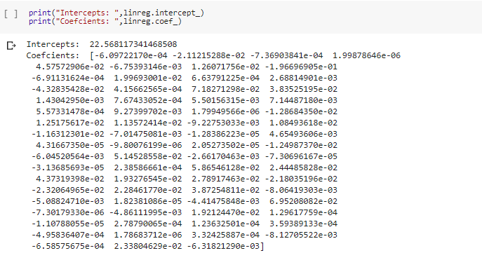
Linear Regression in Scikit-learn
Import Linear Regression from sklearn and fit the training data into it.
You can see the intercept and coefficients for the training data.

Slide 39

Using the model for prediction
Using predict function, predict the y train and y test values.

Slide 40
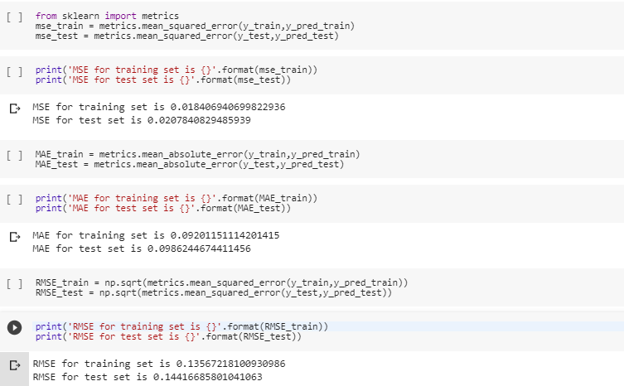
Finding Error Values
Calculate the Error values using Mean Squared Error, Mean Absolute Error and RMSE.
If you see, error values are very less for this model. So it is a good model.

Slide 41
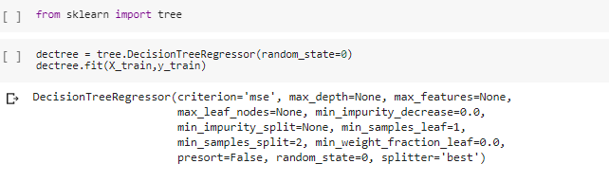
Decision Tree Regressor
Decision Tree in scikit-learn
Fitting the model into Decision Tree Regressor.

Slide 42
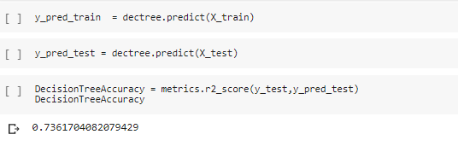
Using the model for prediction
Here r2_score value is 74%. So the model is good for decision tree.

Slide 43
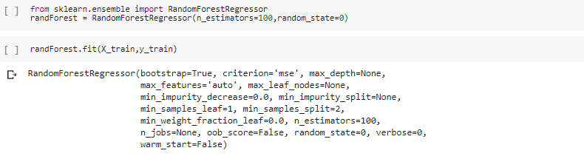
Random Forest Regressor
Random Forest in scikit-learn
Fitting the model into Random Forest Regressor

Slide 44
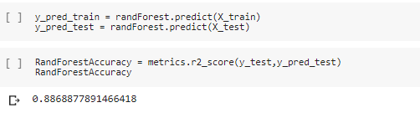
Using the model for prediction
Here r2_score value is 89% which indicates this model is a good model.

Slide 45


