Slide 1

Car Sales Analysis
By Chaitanya

Slide 2
Story
This is the car dataset for the year 2016. Every year there is a significant change in car industry. Many people are willing to buy cars either diesel, petrol or gas versions. Prices are varying by considering different factors i.e., engine volume, engine type and body type. Low end cars having less engine volume and body type and High end cars are having more engine volume and body type.

Slide 3
Data in depth
The dataset consists of the information about multiple brands, Various variables present in the dataset includes Car brand, price, body, mileage etc.
The dataset comprises of 9576 observations of 10 columns. Below are the columns and their description of dataset.
Car : Manufacturer brand *
Price : Seller’s price of car (in USD) *
Body : Car body type *
Mileage : In kilometers (‘000 Km) *
engV : Rounded engine volume (‘000 cubic cm) *
engType : Type of fuel (“Other” in this case should be treated as NA) *
Registration : Whether car registered or not *
Year : Year of production *
Model : Specific model name *
Drive : Drive type
(contd..)

Slide 4
Data in depth
Below is the overview of dataset before pre-processing
drive has 511 / 5.3% missing values Missing
engV has 434 / 4.5% missing values Missing
mileage has 348 / 3.6% zeros Zeros
price has 267 / 2.8% zeros Zeros
Dataset has 113 duplicate rows Warning

Slide 5
Problem Statement
This dataset is from a 2016 car sale values that measures the increasing car sales and fuel variant every year.

Slide 6
What did you do
Before starting analysis of dataset did Pandas profiling on dataset to find any anomalies likes missing values, duplicates, Zeros.
Also looked at the dataset to find relation between variables.
Below actions are taken to cleanup the date
Duplicate rows have been dropped
Replaced Zeros in price column with mean derived by grouping car, year, and engine type
Replaced missing values in Engine type with mean derived by grouping Car, Body, Engine type
Replaced missing values in Mileage with mean derived by grouping Engine Volume, Engine Type, Drive.

Slide 7
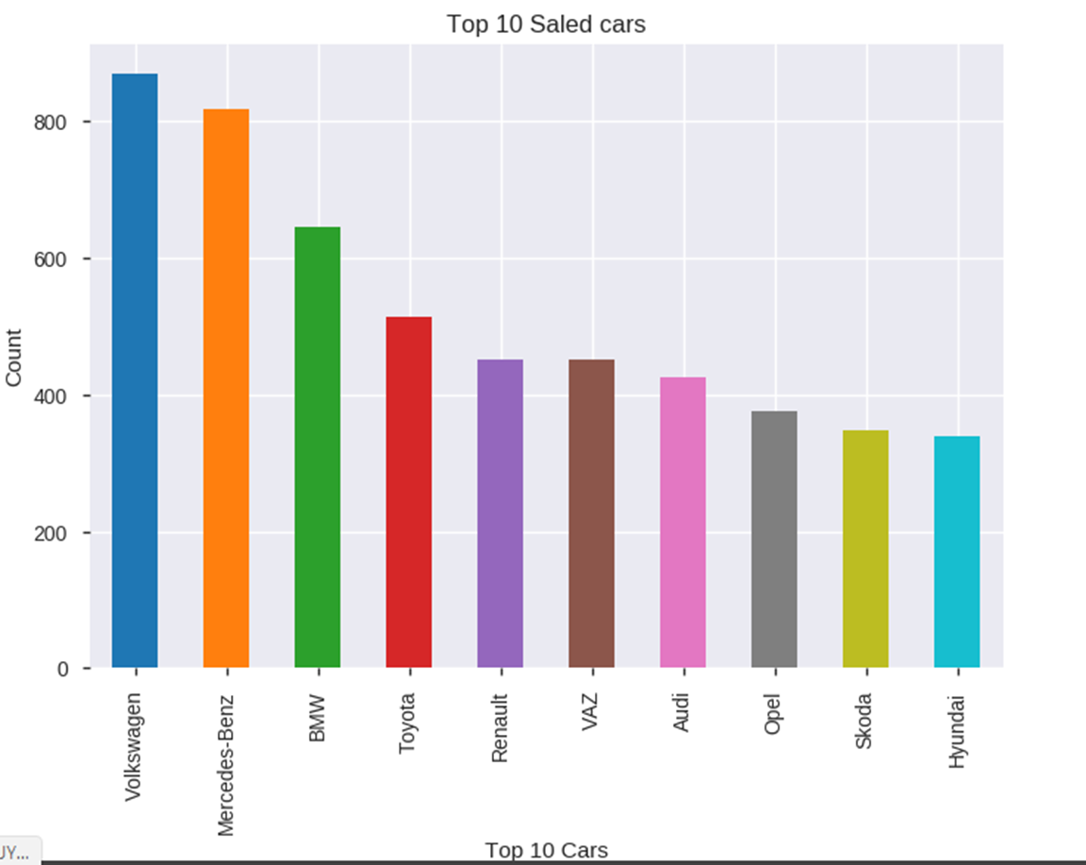
Which brand cars are mostly sold?
 | Volkswagen is highly sold in all the categories. Mercedes-Benz is second highest sold car brand.

Slide 8
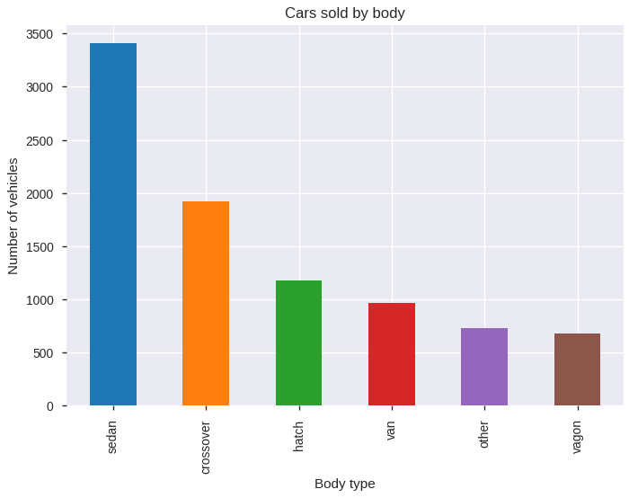
Which body type is mostly sold?
 | We can say most sold car is body type "Sedan". It is very comfortable for small family and within low budget. So it is most preferable car by the people.

Slide 9
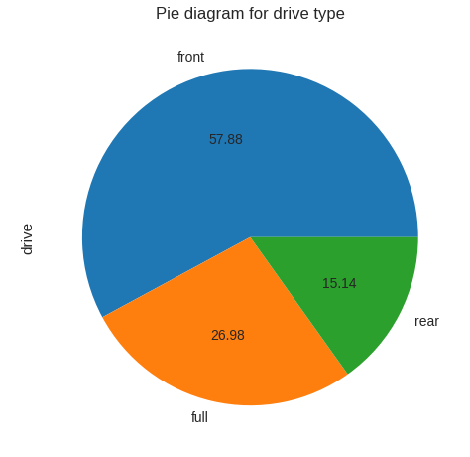
Percentage of Drive type Sold
 | We can say that the most sold cars in front drive type, in terms of percentage we can say that, approx. 58% of total cars sold in front drive type, 27% in full drive type and 15% in rear drive type

Slide 10
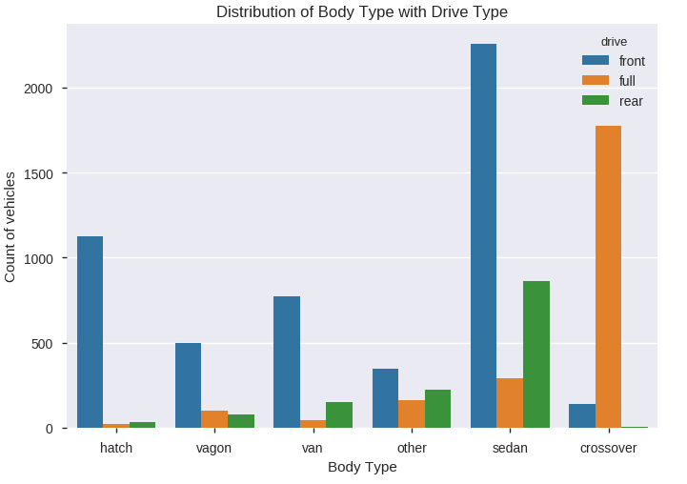
Which body and drive type are sold most?
 | "Front" wheel drive cars are the top most cars in all body type except in "Crossover" body type. In "Crossover" body type "Full" wheel drive cars are leading.

Slide 11
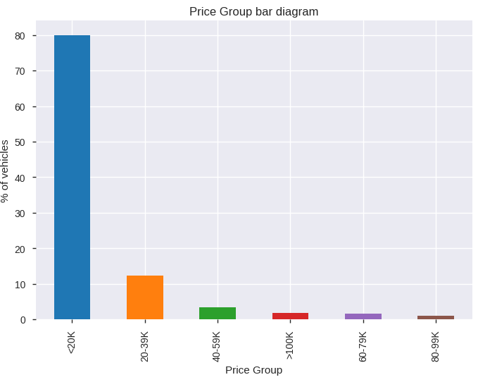
Which price group are having more demand?
 | From the above bar plot, we can say that approx. 75% of cars are sold at price range of "<20K"

Slide 12
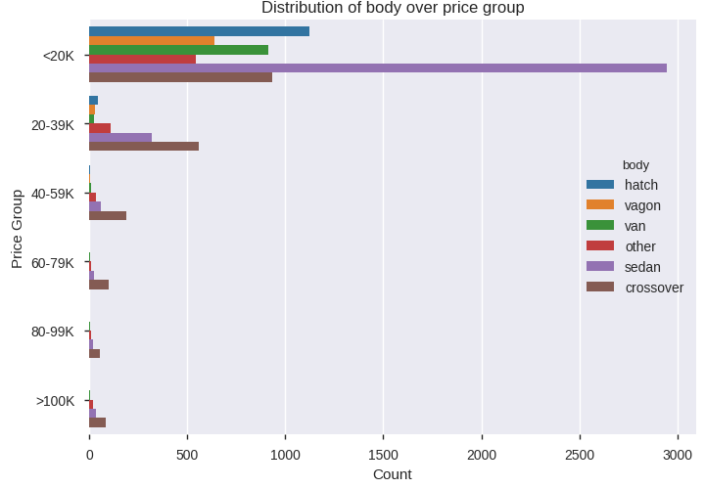
How the body of the car and price related to each other
 | We can say that most of the sold cars are "<20K" price group. Body type "Sedan" will be the highly sold in all the car brands under "<20K" price group.

Slide 13
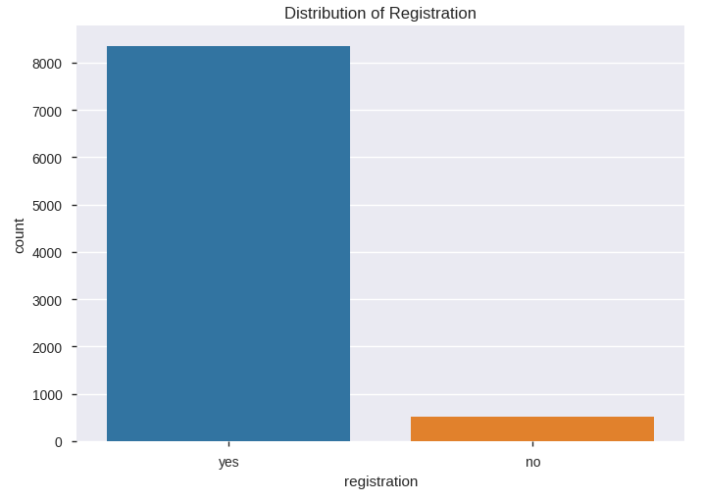
Does the cars have registered
 | From this chart, we can say more than 90% of the cars are registered.

Slide 14
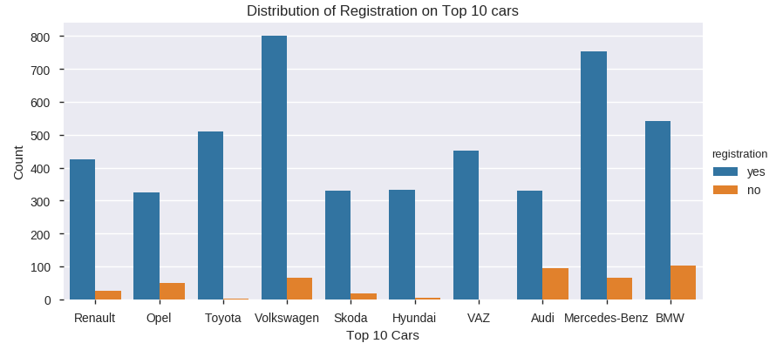
How does top 10 cars relate to registration
 | Volkswagen is most sold cars in all the price ranges which is approx. 800+. We can say, some cars are not registered.

Slide 15
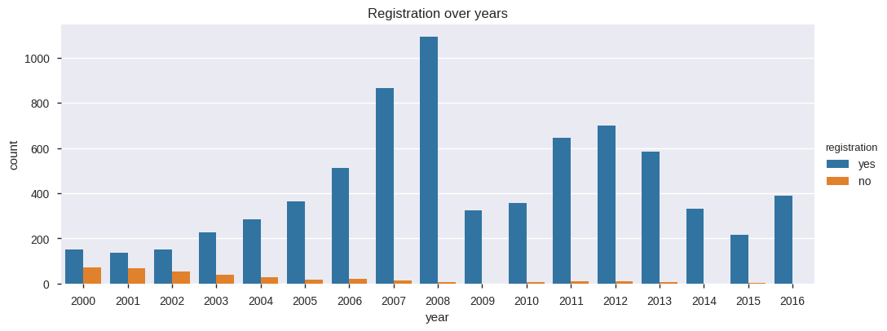
How does year relate to registration of cars
By this chart we can say that majority of the cars sold in year 2008

Slide 16
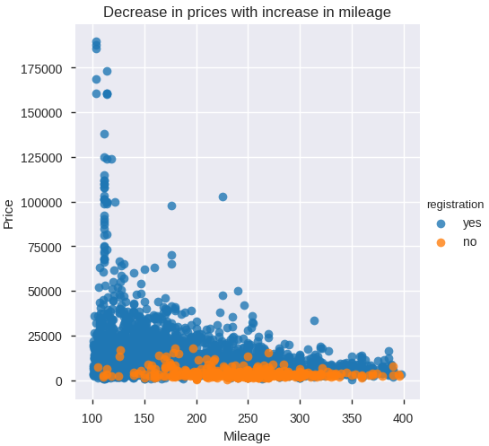
How the price and mileage related to each other?
 | When mileage increases, price of the cars decreases. Most of the cars mileage is in between 100 to 400, For clear understanding we have taken the x-axis scale from 100 to 400. Here, price and mileage have strongly negative correlation in sold car dataset , i.e. lower price segment has higher mileage and higher price segment has lower mileage.

Slide 17
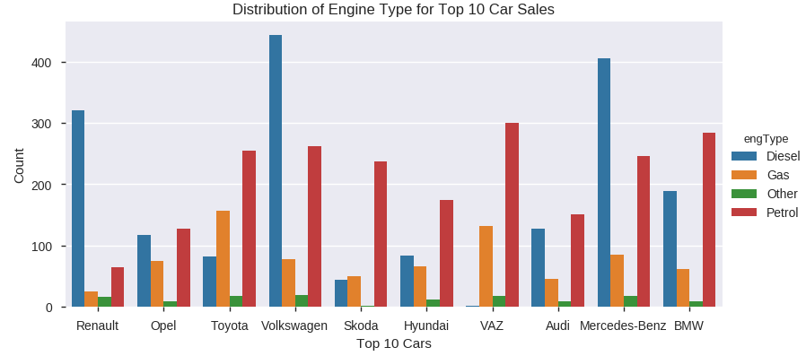
How does top 10 car sales relate to engine type
Diesel type cars are highly sold in "Volkswagen", "Mercedes-Benz", "Renault". In other car brands, we can say Petrol type is highly sold. Most of the cars sales are in approx. range of 1 to 300 for every individual engine type

Slide 18
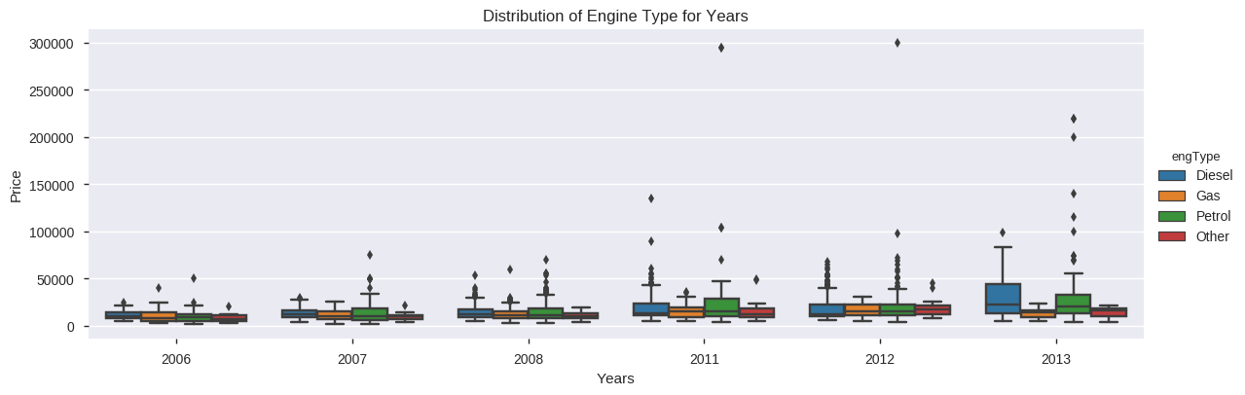
What is the rate of increase in car sales over years with engine type
Sales of cars increasing every year from 2006 to 2013. There is increasing trend in sales of Diesel fuel type from 2006 to 2013 which says diesel cars are having high demand. There are prices more than 200000 dollars in petrol fuel type, which are high end cars.

Slide 19
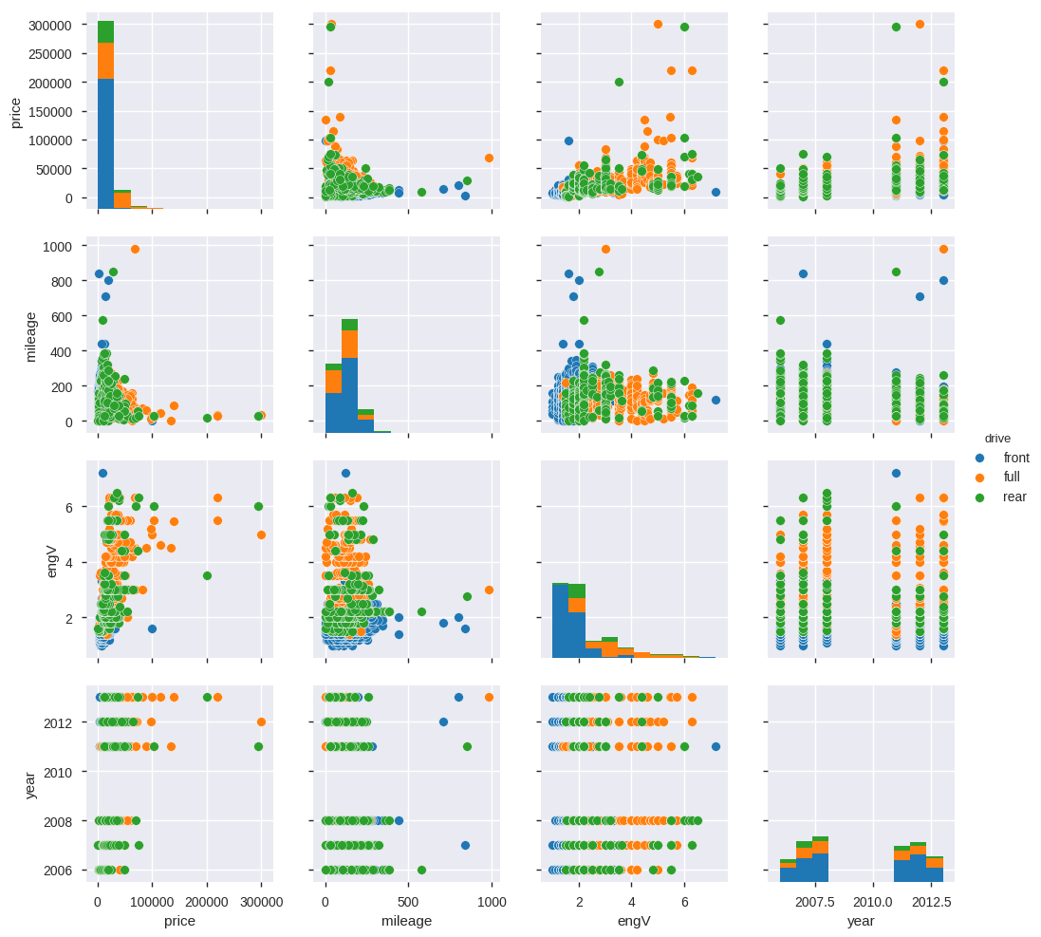
How is the relationship between different variants of data
 | Price and year plot, we can say car prices are increasing every year. Because, car sales are increasing and high end cars like "Mercedes" and "BMW" releasing luxury cars every year. Increase in Mileage depreciates the car price from "price" and "mileage" plot. mileage and engV plot, we can say most of the cars sold with engine volume in between 1.5CC to 2.5CC. engine volume (engV) and price plot, it clearly says that high end cars having more engine volume.

Slide 20
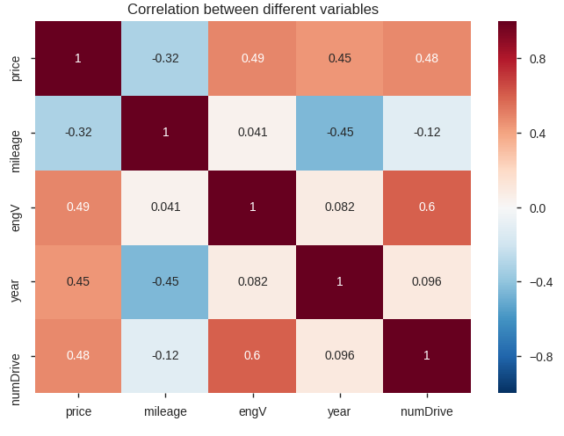
Correlation between all the features in heat map
 | "Drive" and "engV" are strongly correlated compared to other variables of car sales dataset. Where as, "mileage" and "price" are strongly negative correlated.i.e. lower price cars have higher mileage and higher price cars have lower mileage. Year and price are also positive correlated after "Drive" and "engV". Latest production cars have higher price . engine volume (engV) and mileage also have some mild positive correlation. In our data most of the cars have engine volume in between 1.5 CC to 2.5 CC, due to that mileage and engine volume have mild positive correlation. engine volume (engV) and year also have some mild positive correlation

Slide 21
Hypothesis : Sales for diesel variant cars likely to increase every year?
We can conclude that car sales are increasing every year for fuel type "Diesel".
Most of the people are interested to buy diesel cars.
By proliferate diesel cars production will increase the revenue of the company.

Slide 22
Conclusion
In this dataset we have total 9463 records excluding duplicates.
We observe that out of total cars sold, majority of the cars sold by "Volkswagen", "Mercedes-Benz" and "BMW" brand.
"Front" wheel drive cars are the top most cars in all body type except in "Crossover" body type. In "Crossover" body type "Full" wheel drive cars are leading.
Mostly sold body types are "crossover", "hatch" and "Sedan"
80% of the cars sold in range 200 to 20000 with body type "Sedan". Because it is the most affordable car for middle class people.
We can say more than 90% of the cars are registered.
We can say that the most sold cars in front drive type, in terms of percentage we can say that, approx. 58% of total cars sold in front drive type, 27% in full drive type and 15% in rear drive type.
Majority of the cars with year 2008 are registered.
Sales of cars increasing every year from 2006 to 2013.
Drive is strongly correlated with "engV".
"mileage" and "price" are strongly negative correlated.i.e. lower price cars have higher mileage and higher price cars have lower mileage.
mileage and engV plot, we can say most of the cars sold with engine volume in between 1.5CC to 2.5CC.

