Slide 1
Data Analysis and Model Building for Efficient project management by Employee Over-Time prediction
Chaitanya Kanth Vadlapudi
Batch 42

Slide 2
Understanding the Data
The dataset consists of information of employees in an organization.
Attributes are mainly centered around employee details like education background, professional background and appraisal details. Some important attributes are Date of first job, Monthly income, Designation etc.
Based on the above attributes we have to predict if employee works for overtime, which is a sign for poor project planning.
So the intuition here would be the above attributes would influence employee to work for extra hours leading to poor project planning.

Slide 3
Analyzing the Problem
We have 50,341 instances with 36 independent variables(IV) and a Target/Predictor variable from which we have to filter train data and test data based on “istrain” attribute
After filtering, we have train data with 40303 rows and 36 columns and test data with 10038 rows and 36 columns.
Two approaches of building the model
Unsupervised Learning
Supervised Learning
As we are aware of our predictor variable, it can modelled as a Supervised Learning approach
Under Supervised, it is classic problem of Binary Classification.

Slide 4
Understanding the Domain
The attributes are fairly self explanatory.
There is nothing unexplanatory attribute except “Emolumnet_in_Pecentage” which refers mainly to salary or in some cases goodies received by the employee.

Slide 5
Feature Engineering
CUTe3 has taught us the importance of feature engineering and significant difference it can make in model building.
Have read couple of research papers on feature engineering involving numeric attributes.
Paper titled “Feature selection and classification in multiple class datasets: An application to KDD Cup 99 dataset” mentions few important techniques that can boost the model influence significantly
Two main models that deal with feature engineering
Filter Methods
Wrapper Methods

Slide 6

Filter Based Methods
Correlation based Feature Selection (CFS) is a simple filter algorithm that ranks feature subsets according to a correlation based heuristic evaluation function (Hall, 1999).
The bias of the evaluation function is toward subsets that contain features that are highly correlated with the class and uncorrelated with each other.
rcf – mean correlation btw class and subset of features
Rff – mean feature-feature correlation
Easy to compute and computationally less intensive
Many more approaches under this category based on Information Gain etc.

Slide 7
Wrapper Based Methods
In wrapper methods, we try to use a subset of features and train a model using them. Based on the inferences that we draw from the previous model, we decide to add or remove features from your subset.
Creates shadow features (shuffled copies of features), trains random classifier, apply feature importance.
Check if real feature has more importance than shadow feature and constantly remove features which are unimportant
Computationally intensive operation
More at this link feature selection
Boruta package in R achieves the same. And ‘rfe’ (recursive feature engineering) method in caret package does the same.

Slide 8
Feature Engineering on Train data – Numerical attributes
Removing all the “Zero variance” attributes. A total of 5 attributes
Making use of 3 date columns viz, “datacollected”, “FirstJobDate”, “DateOfjoiningintheCurrentCompany”
Created two new columns namely “workExp” and “daysInCurrentCompany” by subtracting from datacollected attribute
Now Split the data into train and validation in 70:30 proportion because further feature engineering should not be affecting validation data.

Slide 9
Feature Engineering on train data – Numerical Attributes
Correlation matrix
Have used findCorrelation() from caret, a good find !!
The absolute values of pair-wise correlations are considered.
If two variables have a high correlation, the function looks at the mean absolute correlation of each variable and removes the variable with the largest mean absolute correlation.
“Joblevel” is the only correlated column with at 0.8 cutoff
Was also interested in “hourlyrate”, “monthlyrate” and “salary” to be correlated, but turned out to be uncorrelated.

Slide 10
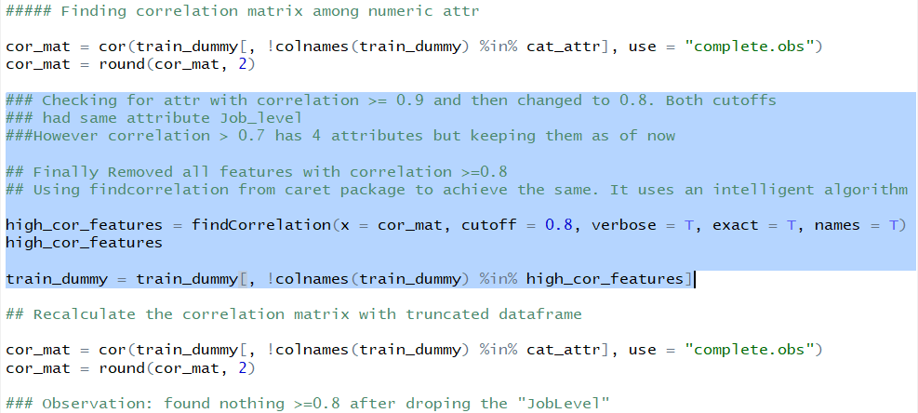
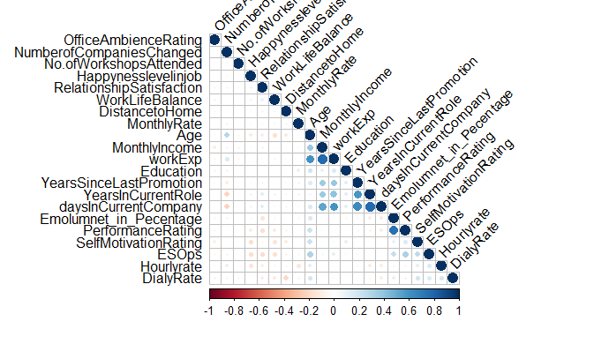

Slide 11
Feature Engineering on train data - Categorical
“JobRole” attribute has similar roles. Hence grouped certain levels into single level.
Has transformed the “travelfrequency” into ordinal variable with levels of 0,1,3
Scope for more feature engineering on categorical values.

Slide 12
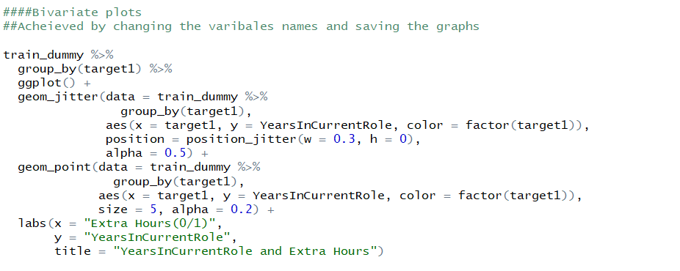
Data Visualization
Have plotted some graphs to understand the distribution of these ratios for the two classes.
BiVariate

Slide 13
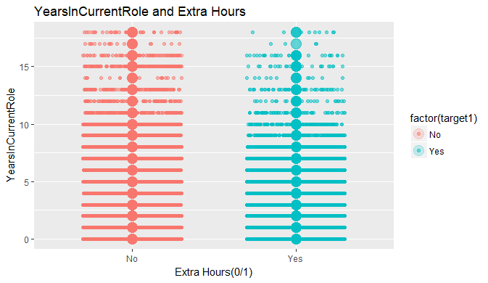
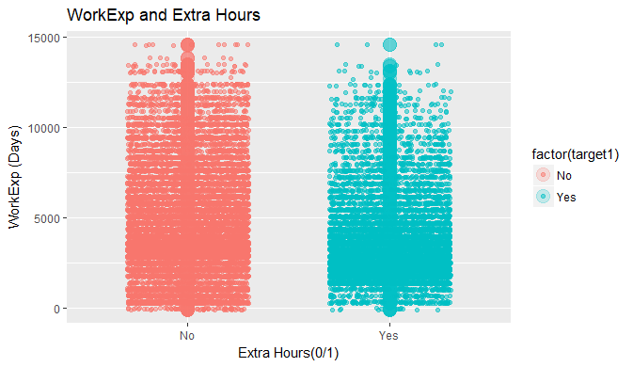

Slide 14
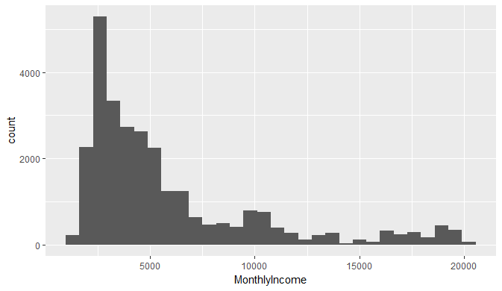
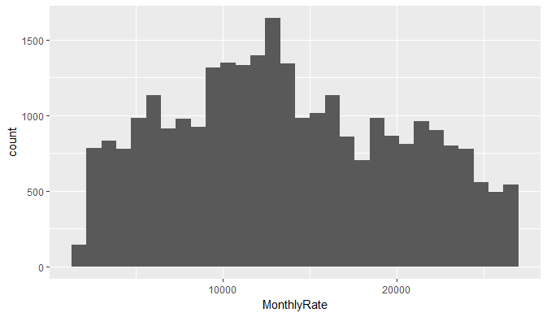

Slide 15
Birds View of the Data
Looked at proportion of the classes in the dataset. Class variable is balanced. No class imbalance.
Dummified all the categorical variables. Except xgboost, which requires matrix data, none of the algorithms require dummified attributes.

Slide 16
Model Approach
Have decided to approach the problem using logistic regression, decision trees, Random forests and xgboost
On average, all the models were giving around 75% accuracy and recall. Xgboost was able to reach 85.7% on grader.

Slide 17
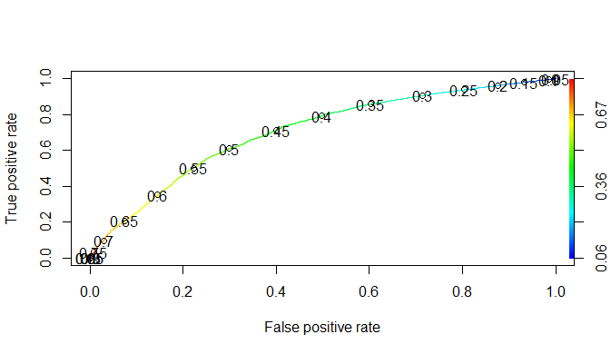
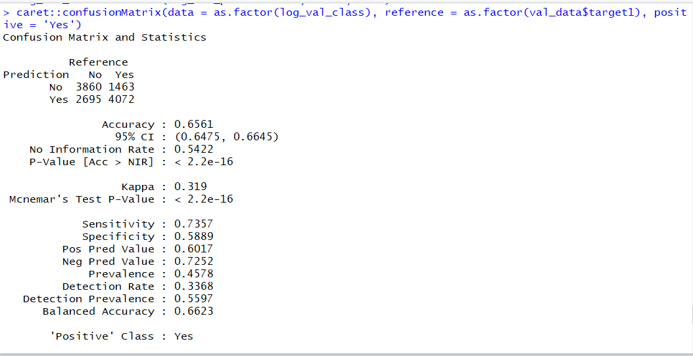
Logistic Regression

Slide 18
Have to repeatedly tune between 0.4 and 0.5 for optimal accuracy and recall
Finally 0.44 gave better results. Even 0.44 and 0.45 has significant change in accuracy and recall

Slide 19
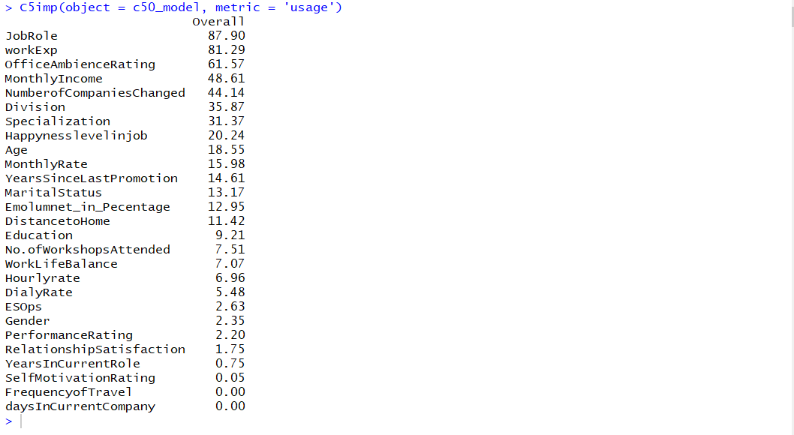
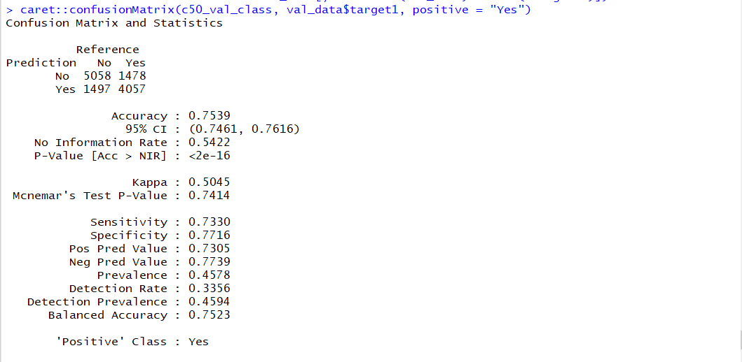
Decision Trees
C50 decision trees

Slide 20
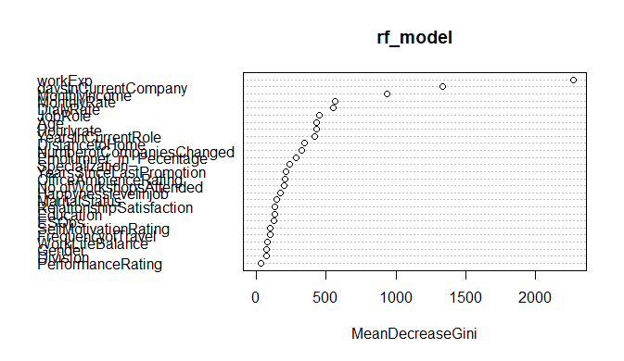
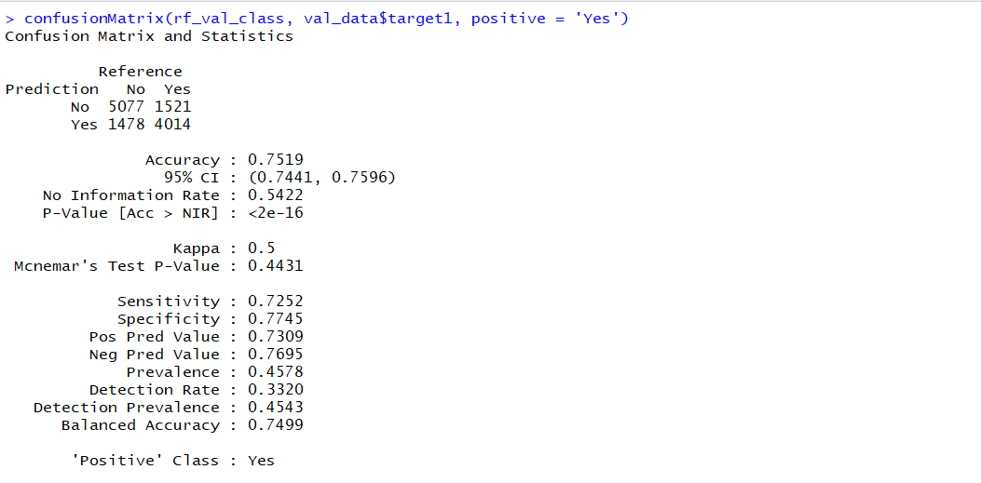
Random Forest

Slide 21
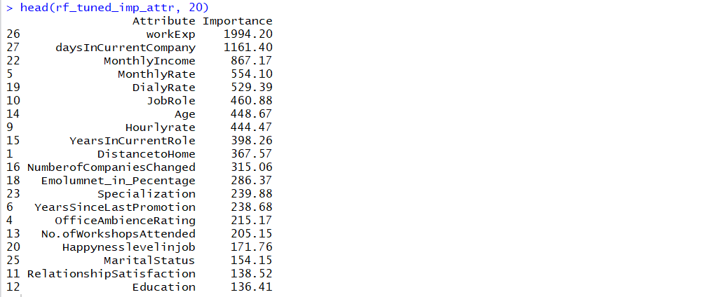
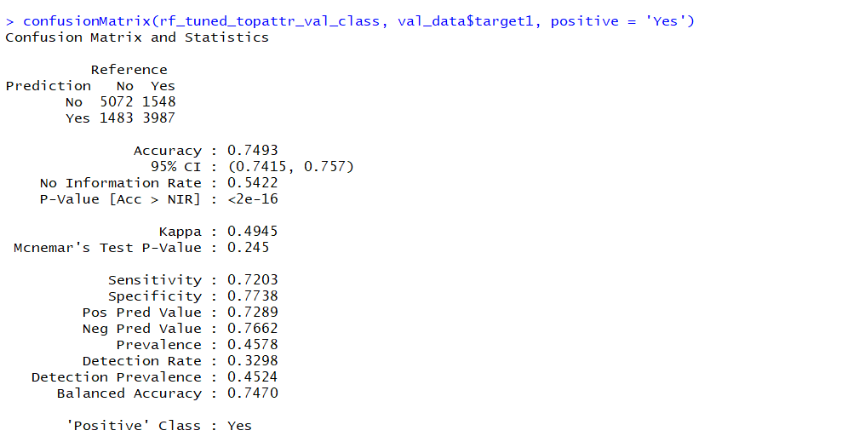
Tuned Random Forest

Slide 22
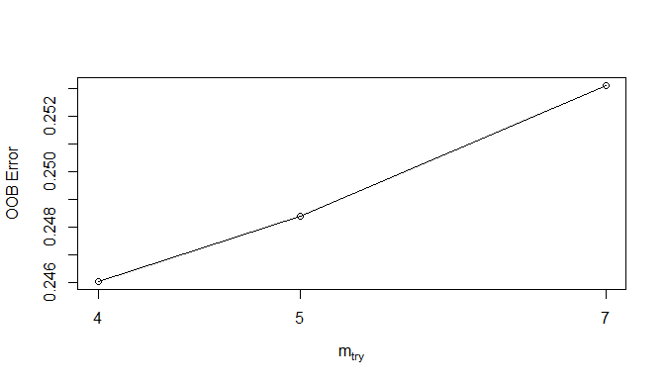
Random forest – Top 20 Important variables

Slide 23
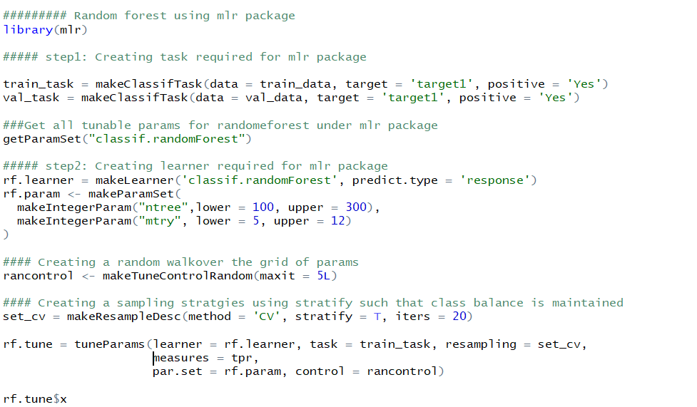
Random Forest Tuning using mlr package

Slide 24
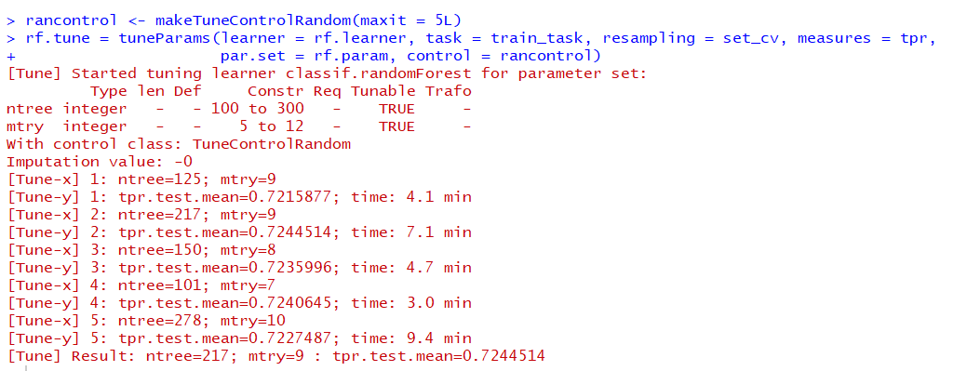
As we can see no improvement of tpr from tuned random forest

Slide 25
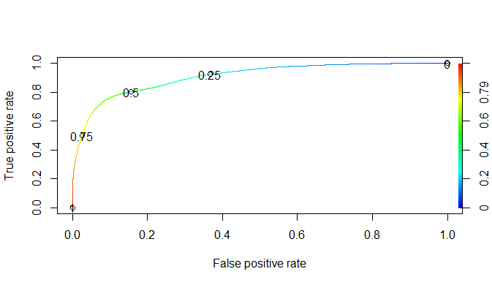
Boosting- xgboost

Slide 26
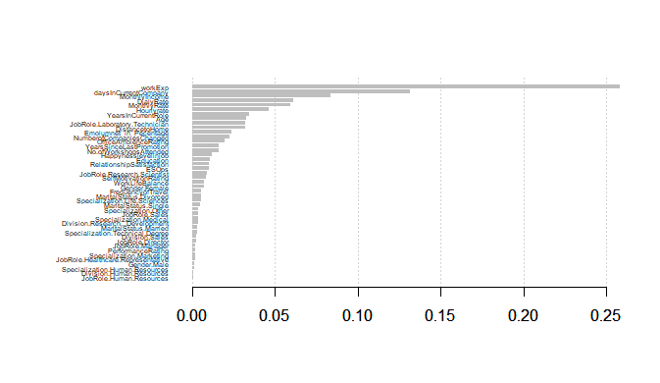

Slide 27
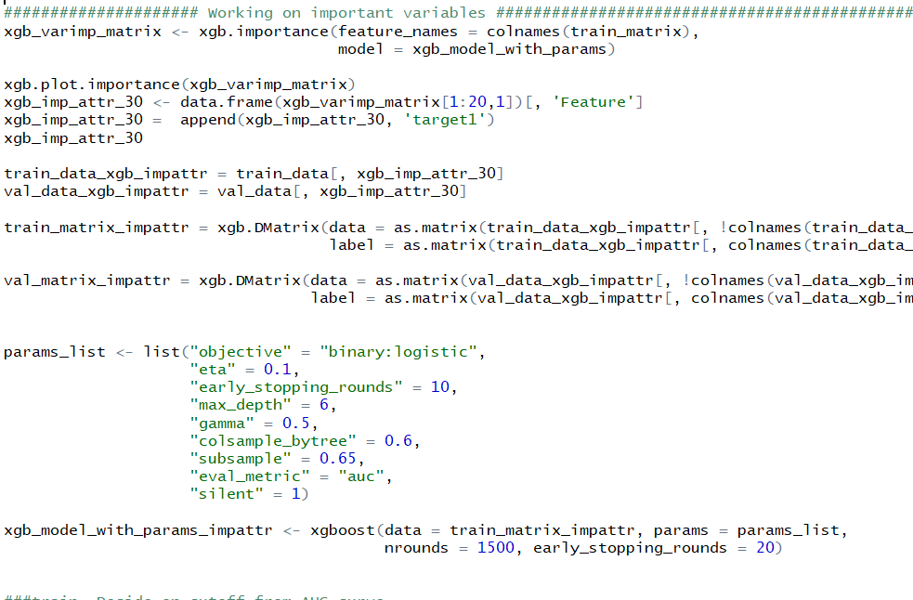
Xgboost – Important Variables

Slide 28
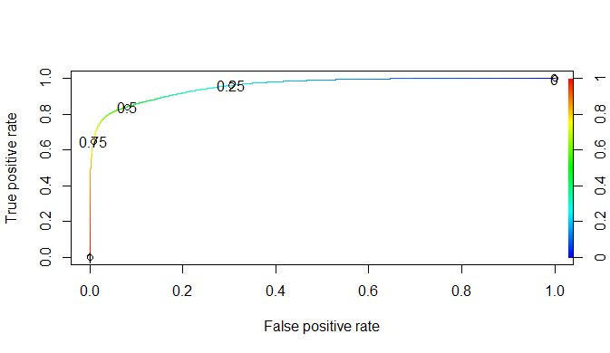
After tuning choose a probability of 0.2

Slide 29
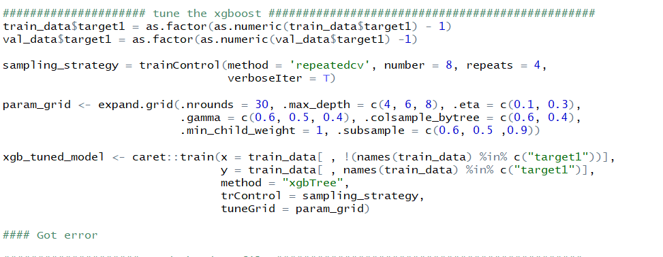
Xgboost tuning with caret package

Slide 30
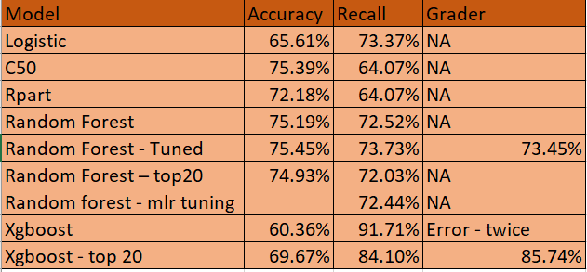
On grader i have achieved best score of 85.74% recall from xgboost with top 20 variables

Slide 31
Final Result
Final result of xgboost with top 20 attributes was uploaded and achieved 85.74% recall.
Way forward ?
More tuning along with cross validation
Better Feature Engineering

Slide 32
END

