Slide 1
Image Classification Using Transfer Learning With PyTorch
Chaitanya Kanth Vadlapudi INSOFE Batch 42

Slide 2
Agenda
Introduction to PyTorch
Learning Rate
Image Classification Using Transfer Learning
Comparison between Pytorch and Tensorflow

Slide 3
Introduction to PyTorch
PyTorch is a Python-based scientific computing package that is a replacement for NumPy, and uses the power of GPU’s
It has strong focus on Object Oriented Programming (OOP) in python
Basics
Tensors: Multi-dimensional matrices that contain elements of single data type
Torch package:
torch.nn is a neural network library deeply integrated with autograd
torch.autograd is an automatic differentiation library that supports all differentiable tensor operations in torch
torch.optim is a package that implements various optimization algorithms

Slide 4
torch.nn module
The base class for all neural network modules is torch.nn.Module
At each node/neuron, the operation is given by (y =Wx+b), where W is the weights and b is the bias
torch.nn.Linear applies linear transformation to the incoming data
forward(*input) defines the computation performed at every call and all subclasses should override it

Slide 5
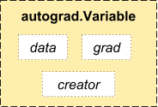
torch.autograd module
The way neural network learns is by updating weights.
torch.autograd.Variable helps in keeping track of the weights.
A Variable is a thin wrapper around a Tensor object that holds the gradient and a reference to the Function created it.

Slide 6
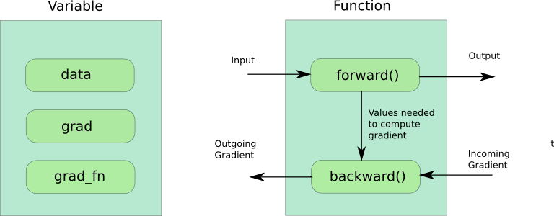
Variable and Function – A Detailed View
Consider the below operation
c = a + b
c is a new variable and it’s grad_fn is something called ‘AddBackward’
PyTorch abstracts the need to write two separate functions into two members of single class called torch.autograd.Function

Slide 7
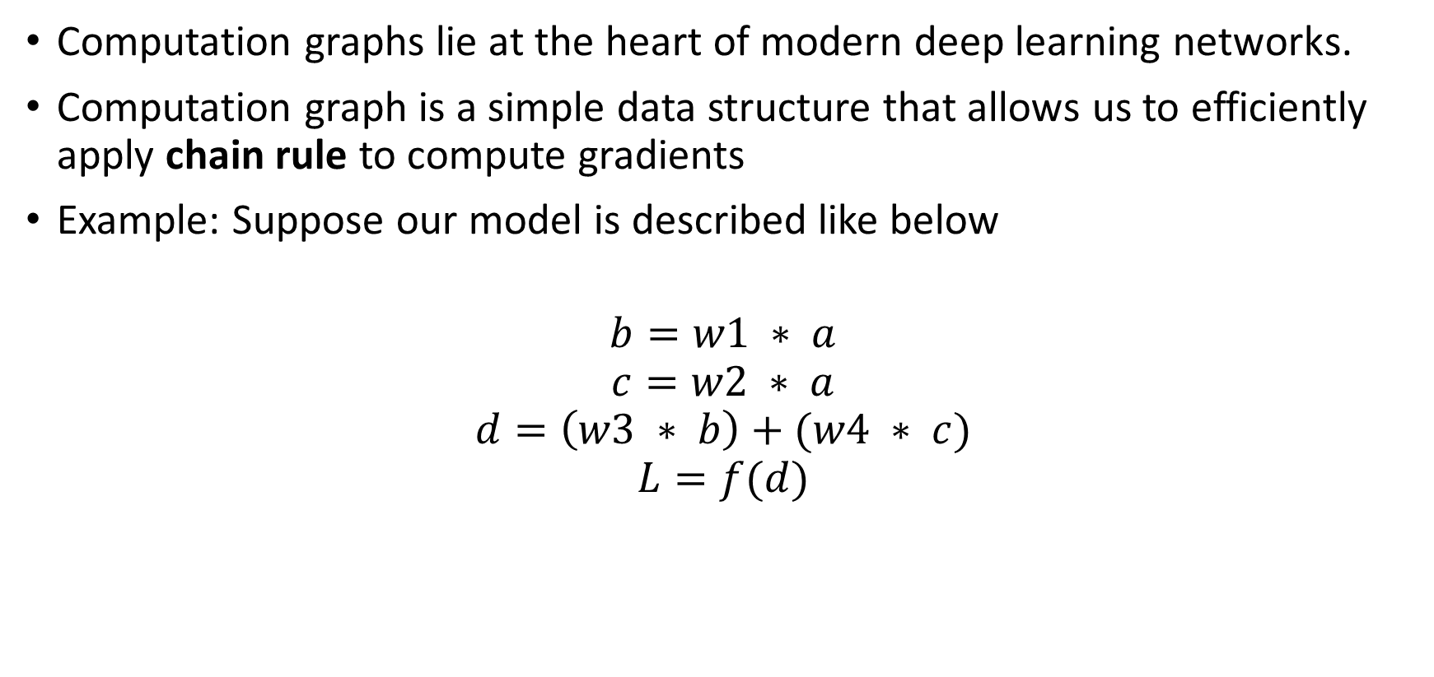
Computation Graphs
Computation graphs lie at the heart of modern deep learning networks.
Computation graph is a simple data structure that allows us to efficiently apply chain rule to compute gradients
Example: Suppose our model is described like below
$$b=w1 ∗ a$$
$$c=w2 ∗ a$$
$$d=\left(w3 ∗ b\right)+(w4 ∗ c)$$
$$L=f(d)$$

Slide 8
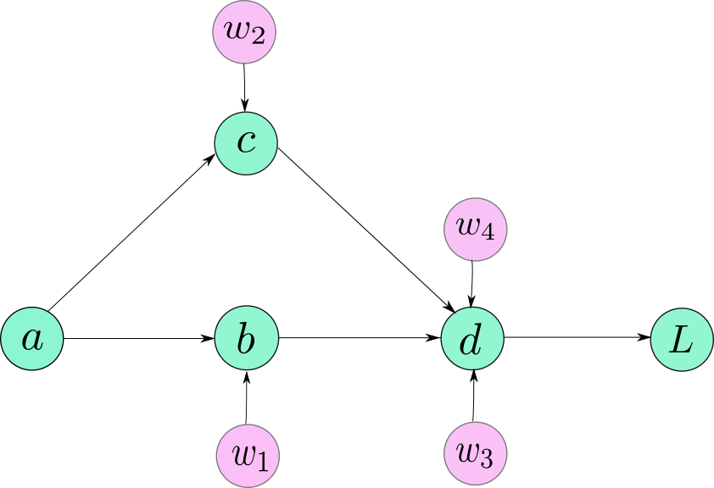
Computation Graph – Forward pass

Slide 9

Computation Graph – Backward pass & Chain rule

Slide 10
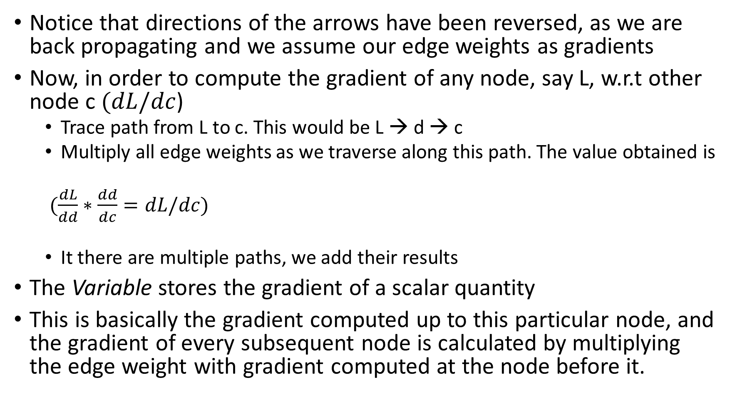
Notice that directions of the arrows have been reversed, as we are back propagating and we assume our edge weights as gradients
Now, in order to compute the gradient of any node, say L, w.r.t other node c $(dL/dc$)
Trace path from L to c. This would be L → d → c
Multiply all edge weights as we traverse along this path. The value obtained is
$(\frac{dL}{dd}∗\frac{dd}{dc}=dL/dc)$
It there are multiple paths, we add their results
The Variable stores the gradient of a scalar quantity
This is basically the gradient computed up to this particular node, and the gradient of every subsequent node is calculated by multiplying the edge weight with gradient computed at the node before it.

Slide 11
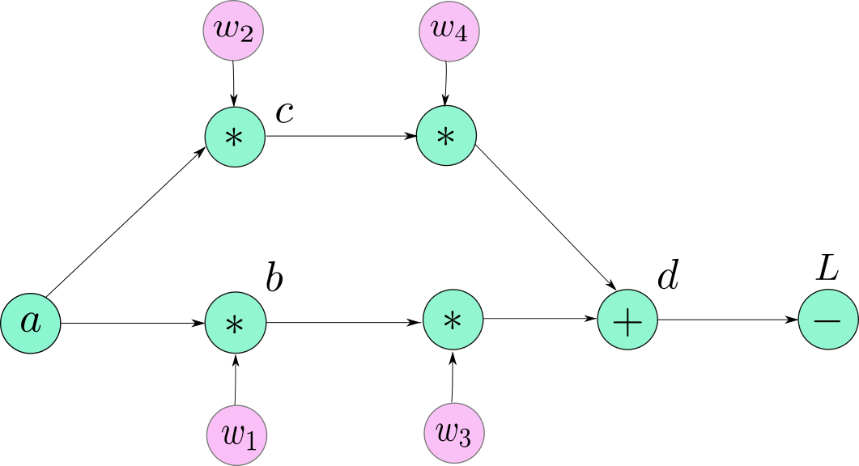
Actual Computation graph

Slide 12
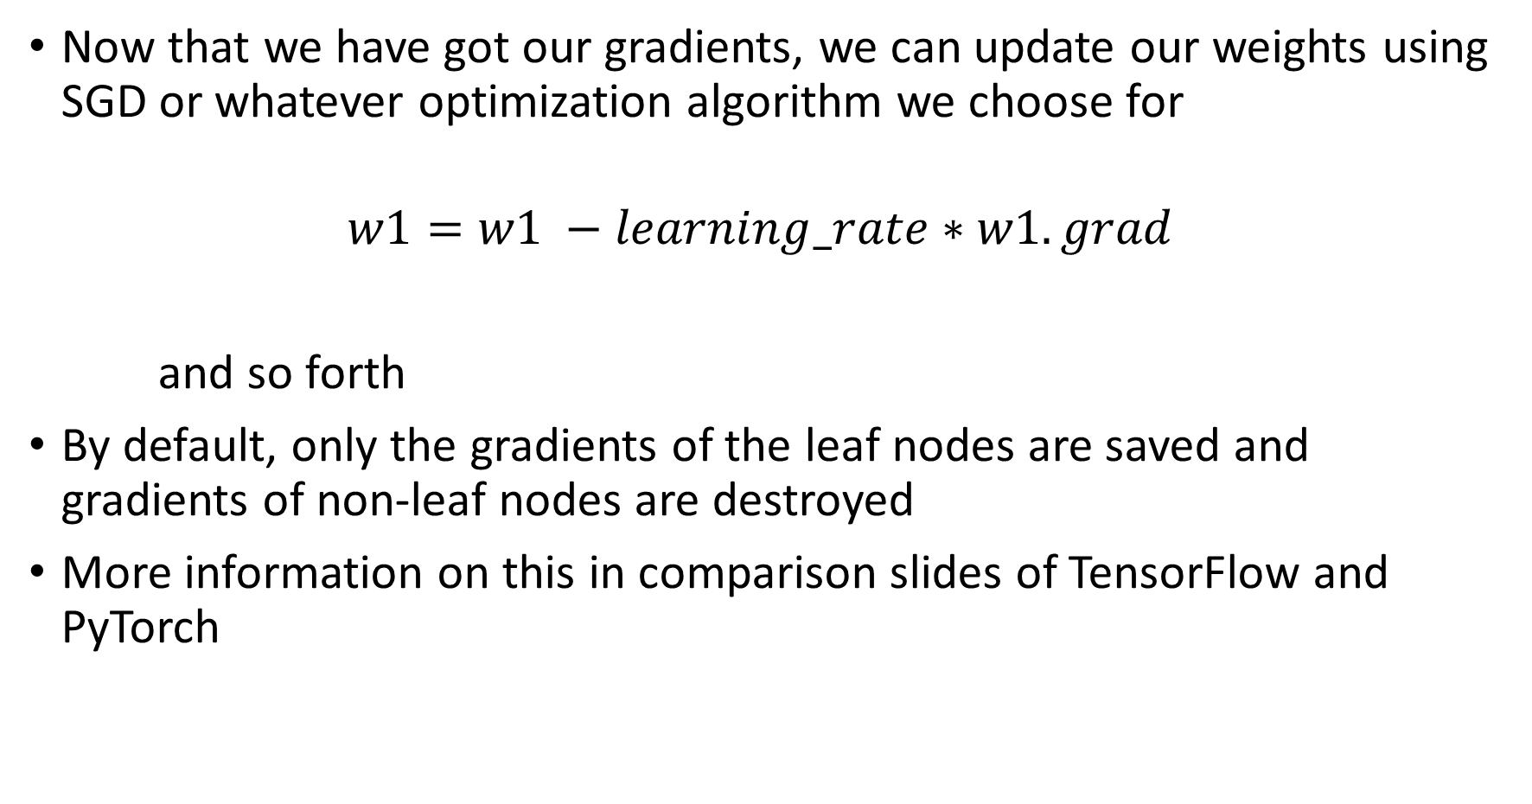
Now that we have got our gradients, we can update our weights using SGD or whatever optimization algorithm we choose for
$$w1=w1 −learning_rate∗w1.grad$$
and so forth
By default, only the gradients of the leaf nodes are saved and gradients of non-leaf nodes are destroyed
More information on this in comparison slides of TensorFlow and PyTorch

Slide 13
‘Learning’s from fast.ai lectures
Jeremy Howard in his fast.ai lectures emphasizes on the importance of choosing the right learning rate(lr)
The basic idea of learning rate is that it is going to decide how quickly we zoom/hone in on the solution.
If the learning rate is too small, then training will take very long time to get to the optimum
If the learning rate is too big, then training may not converge or even diverge either.

Slide 14
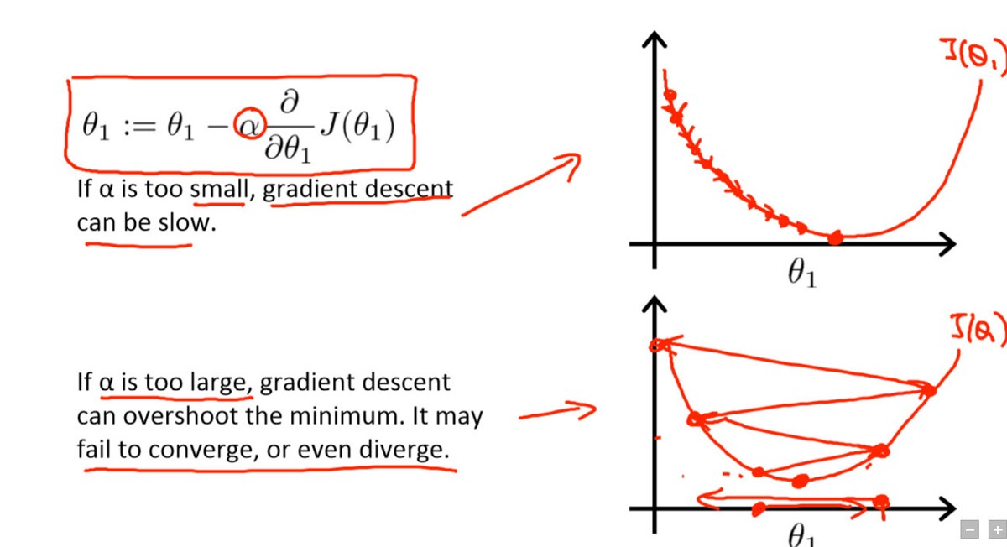
Source: Andrew Ng’s course on Coursera

Slide 15
So getting the right learning rate to start with plays a significant role
Fast.ai has implemented a custom function that finds a right learning rate for a given model.
Jeremy says to plot the loss function across learning rate to find the best starting point for lr.
We need to select a point on the graph with the fastest descent in the loss.
Choosing directly the lowest point might not help as it is very large and starting training with it might not even converge.
I have implemented my own custom lr_finder() that gives best learning rate to start with
I have run the training with increasing the learning rate by multiplying it by a small constant after each epoch.
Stop the procedure when the loss gets a lot higher than the previously observed best value (e.g., when current loss > least loss * 2).

Slide 16
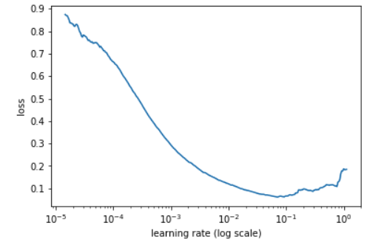
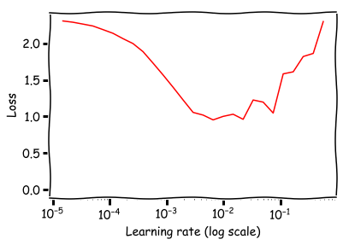
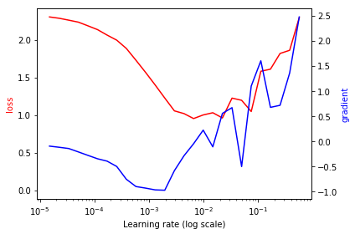

Slide 17
Approaches to obtain decent learning rate - Snapshot
The idea of reducing the learning rate as you train is called “Learning rate Annealing”
Most common is “Stepwise Annealing”
Better approach is one half of cosine curve which maintains high learning rate for a while and then drop quickly when we get closer – called as “Cosine Annealing”
Way forward is the “Stochastic Gradient Descent with Restarts (SGDR)”
Discussed in a paper published in 2015 called as “Cyclic LR schedule”

Slide 18
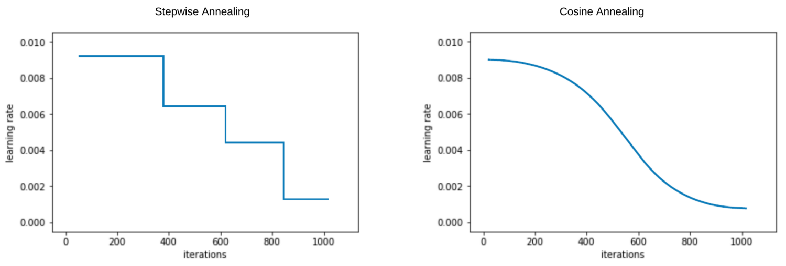
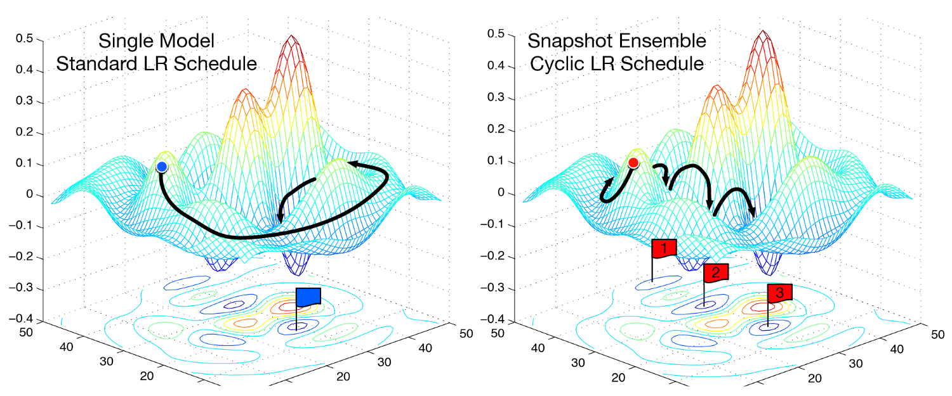

Slide 19
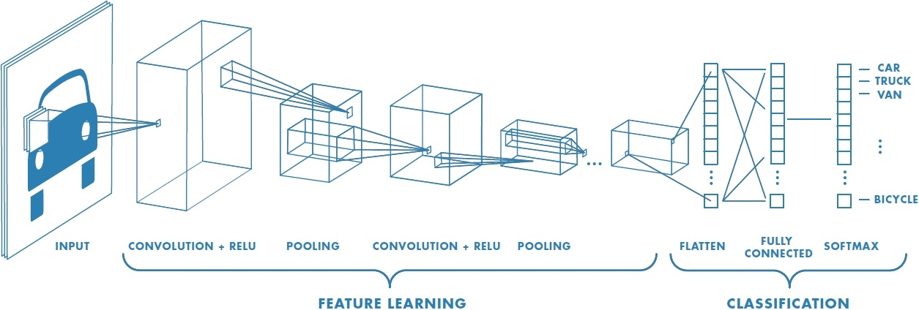
Image Classification Using Custom Network

Slide 20
Dataset: Flowers of 10 different classes organized into train, validation and test folders.
Images have been pulled from plants database
ImageFolder and DataLoader:
ImageFolder is a generic data loader where the images are arranged in the following way
main_dir/
0/
img1.jpg
…
1/
img7.jpg
…
…
…
where 0, 1, … need to be the class labels

Slide 21
DataLoader:
Combines a dataset and a sampler, and provides single or multi-process iterators over the dataset.
DataLoader can load multiple samples parallelly using torch.multiprocessing workers
num_workers is the attribute
Defined a Custom function to load different phases of data like train, validation and test

Slide 22
Image Augmentation
Deep networks need large amount of data to achieve good performance.
To build powerful image classifier using very little training data, image augmentation is generally required to boost the performance of deep networks.
Image augmentation artificially creates training images through different ways of processing or combination of multiple processing, such as random rotation, shifts, shear and flips, etc.
‘Transforms’ provide common image augmentation techniques in pytorch
They are chained together using ‘Compose’

Slide 23
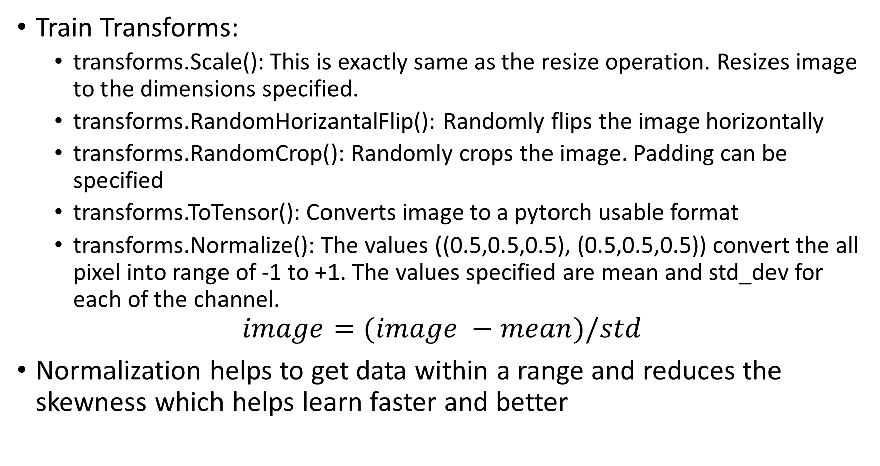
Train Transforms:
transforms.Scale(): This is exactly same as the resize operation. Resizes image to the dimensions specified.
transforms.RandomHorizantalFlip(): Randomly flips the image horizontally
transforms.RandomCrop(): Randomly crops the image. Padding can be specified
transforms.ToTensor(): Converts image to a pytorch usable format
transforms.Normalize(): The values ((0.5,0.5,0.5), (0.5,0.5,0.5)) convert the all pixel into range of -1 to +1. The values specified are mean and std_dev for each of the channel.
$$image=(image −mean)/std$$
Normalization helps to get data within a range and reduces the skewness which helps learn faster and better

Slide 24
ToTensor() and Normalize() must be last in the exact order as defined above.
The primary reason for this is that the other transformations are applied on the input which is a PIL image, however, this must be converted to a pytorch tensor before applying normalization.
Validation and Test Transforms can be same or different, however the input size of image to ToTensor() function must be same as train.

Slide 25
Defining the Model structure
Models are defined in PyTorch by custom classes that extend the Module class.
I am defining an atomic class consisting of basic components of CNN as listed below
convolution → Batch Normalization → ReLU
Convolution Layer
nn.Conv2d(in_channels=3, out_channels=16, kernel_size=3, stride=1)
Given our input (RGB) we specify input channels as 3

Slide 26
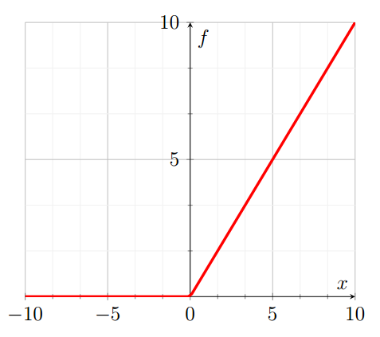
Batch Normalization
BatchNorm2D() essentially normalizes all inputs to have zero means and unit variance which greatly boosts the accuracy of CNN networks
ReLU – Activation Function
Thresholds all incoming features to be 0 or greater than zero i,e max(0,input)

Slide 27
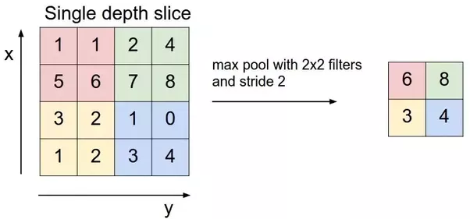
Other commonly used building blocks
MaxPool2d
Linear
The final layer of our network would almost always be the linear layer. It’s a standard, fully connected layer that computes the scores for each of our classes — in this case ten classes.

Slide 28
Training the Model
Step1: Create the optimizer and loss function
Step2: A Custom function that achieves stepwise annealing
Step3: Write functions to save and evaluate the model
Step4: Write the training function
Loop over training dataset
Clear all accumulated gradients
Pass predictions and actual labels to loss function
loss.backward() to propagate the gradients
optimizer.step() to modify our model parameters as per propagated gradients
Compute metrics

Slide 29
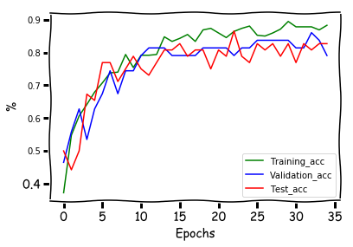
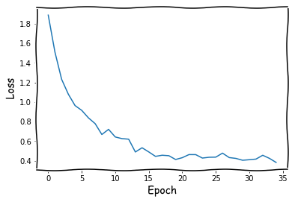
Best Training Accuracy: 89.46% at epoch 29
Best Validation Accuracy: 86.04% at epoch 32
Test Accuracy at epoch 32: 81%
Best Test Accuracy: 86.5% at epoch 22

Slide 30
Transfer Learning
In practice, it is very difficult to train entire CNN from scratch as it is rare to have dataset of sufficient size.
It is common to fetch a pretrained ConvNet on large dataset.
The two major Transfer Learning scenarios are as follows
ConvNet as fixed feature extractor: Take a ConvNet pretrained on ImageNet, remove the last fully-connected layer (this layer’s outputs are the 1000 class scores for a different task like ImageNet), then treat the rest of the ConvNet as a fixed feature extractor for the new dataset.
Fine-tuning the ConvNet: Fine tune the weights of the pretrained network by continuing the backpropagation. It is possible to fine tune whole network or keep some layers fixed and only fine tune some parts of network. However, this is out of scope for this exercise.

Slide 31
ConvNet Models
I have tried 5 different ConvNet Models
Resnet18
VGG16
AlexNet
SqueezeNet
Inception V3
All models have basic requirement of specific image input size and has 1000 classes as output classes under the Linear or Fully Connected component of the model
Inception V3 gave errors.

Slide 32
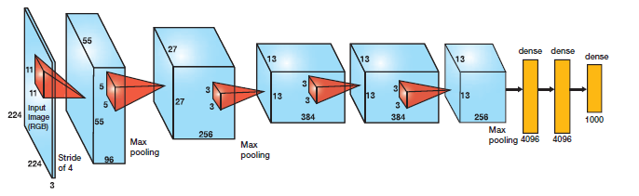
AlexNet
AlexNet is composed of 5 convolutional layers followed by 3 fully connected layers.
AlexNet user ReLU, instead of sigmoid or tanh, there by solving the vanishing gradient problem.
Another problem that this architecture solved was reducing the over-fitting by using a Dropout layer after every FC layer.

Slide 33
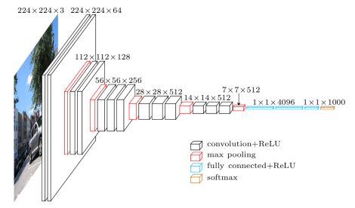
VGG16
The VGG convolutional layers are followed by 3 fully connected layers
The width of the network starts at a small value of 64 and increases by a factor of 2 after every sub-sampling/pooling layer
It achieves the top-5 accuracy of 92.3 % on ImageNet

Slide 34
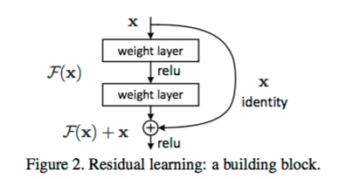
Residual Networks (ResNet)
Deeper networks like Alexnet and VGG suffer from vanishing gradient and high training error
Residual networks allow training of such deep networks by constructing the network through modules called residual models
The model just need to learn the features on top of already available input . Since it is learning only on residual, the module is called residual module.

Slide 35
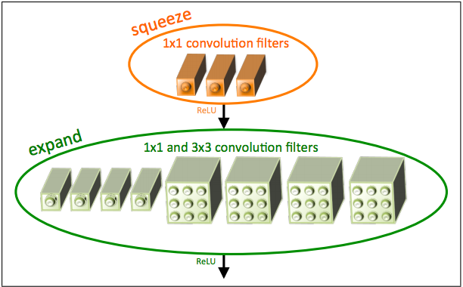
SqueezeNet
The building brick of SqueezeNet is called fire module, which contains two layers: a squeeze layer and an expand layer.
The squeeze layer and expand layer keep the same feature map size, while the former reduces the depth to a smaller number, the later increases it.

Slide 36
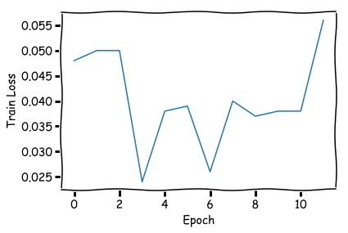
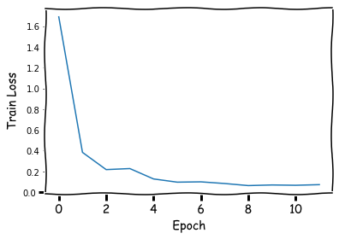
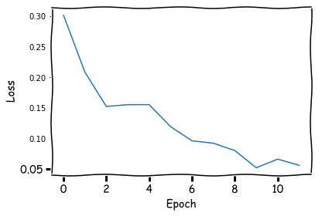
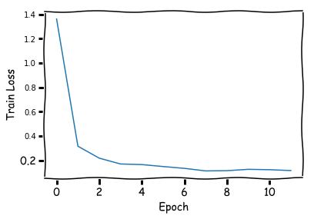
Comparison of different ConvNets – Train Loss
AlexNet
SqueezeNet
ResNet18
VGG16

Slide 37
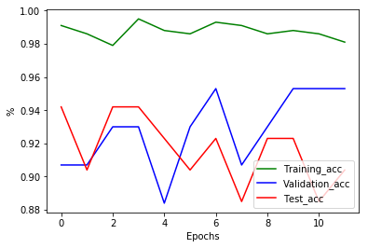
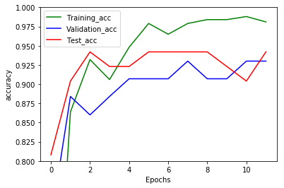
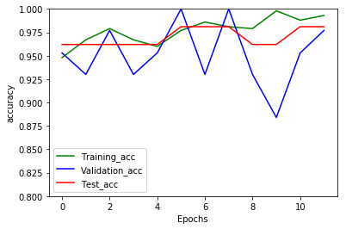
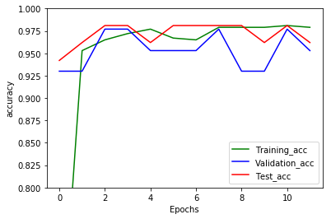
Comparison of different ConvNets – Accuracy
AlexNet
SqueezeNet
ResNet18
VGG16

Slide 38
ConvNet | Train Accuracy | Validation Accuracy | Test Accuracy
AlexNet | 98.8% | 95.3% | 92.3%
SqueezeNet | 98.8% | 93% | 90.4%
ResNet18 | 99.3% | 97.7% | 98.1%
VGG16 | 98.1% | 97.7% | 98.1%
* All accuracies mentioned are based on epoch for best validation accuracy

Slide 39
Comparison of PyTorch And TensorFlow
Difference #1: Dynamic Vs Static graph definition
Both frameworks operate on tensors and view any model as a directed acyclic graph (DAG), but they differ drastically on how you can define them
In TensorFlow, one has to define graph statically before a model can run. All communication with outer world is performed via tf.Session and tf.Placeholder
In PyTorch things are way more imperative and dynamic: you can define, change and execute nodes as you go

Slide 40
Until the forward function of a variable is called, there exists no node for the variable in the graph.
When you call backward(), as the gradients are computed, these buffers are essentially freed, and the graph is destroyed
This is in contrast to the Static Computation Graphs, used by TensorFlow where the graph is declared before running the program.
The dynamic graph paradigm allows you to make changes to your network architecture during runtime, as a graph is created only when a piece of code is run.
This means a graph may be redefined during the lifetime for a program.

Slide 41
Difference #2: Data Parallelism
TensorFlow allows fine tuning of every operation to be run on specific devices.
Nonetheless, achieving parallelism is more manual and requires thought.
PyTorch allows us to wrap any module using “torch.nn.Dataparallel” and it will parallelized. This is called Declarative Data Parallelism
This way we can leverage multiple GPU’s with no effort

Slide 42
Difference #3: Debugging
TensorFlow provides a special tool called “tfdbg” which allows to evaluate TensorFlow expressions at runtime in a specific session scope.
However, no tool is provided to debug the python code in TensorFlow.
As computation graph in PyTorch is defined at runtime you can use any of the python debugging tools like pdb, ipdb, PyCharm debugger either.

Slide 43
Difference #4: Visualization
TensorBoard is the visualization tool in TensorFlow which is very useful when it comes to comparison of different training runs
TensorBoard can display various summaries which are available at tf.Summary module.
PyTorch clearly lacks a comprehensive visualization tool.

Slide 44
Difference #5: Deployment
TensorFlow Serving is a framework to deploy your models on a specialized gRPC server.
When we switch back to PyTorch we may use Flask or another alternative to code up a REST API on top of the model.
PyTorch 1.0 is coming with C++ API, JIT compilation and production oriented capabilities from Caffe2, ONNX which would make production deployment much more simpler
Hybrid Front-End provides seamless transition to graph mode for speed, optimization and functionality in C++
Production scalability is sometimes a challenge given PyTorch tight coupling with python.

Slide 45
We need to translate training script into graph mode in Caffe2 to run at production scale.
Caffe2 is being extensively used at Facebook, delivering over 200 trillion predictions per day.
Migration from PyTorch to caffe2 used to be time intensive, error-prone.
Solved using ONNX.
Export models in the standard ONNX (Open Neural Network Exchange) format for direct access to ONNX-compatible platforms, runtimes, visualizers, and more.

Slide 46


Comparison Table
 | PyTorch | TensorFlow
Computation Graph
Data Parallelism
Debugging
Visualization
Deployment

Slide 47
Things Learnt
PyTorch
Understand the building blocks and define a network making use of them.
Understand backpropagation in the computation graphs
Steps involved in training a neural network
Bit of understanding the error stack trace
Learning Rate and it’s importance
Tweaking learning rate to reach best of many local minima inspired me.
Try and implement SGDR in future exercises
Little understanding of various ConvNets
OOPS concepts in python

Slide 48
Things to work on
Develop a custom python module incorporating different kind of annealing's in learning rate esp. Cyclical Learning Rate
Move the current implementation of lr_finder() into a package
Deploy a simple model on paperspace (cloud based GPU) to understand deployment and maintenance process of ML/Dl models
Code is available at https://github.com/chaituValKanO/ImageClassificationUsingTransferLearning

Slide 49
References
PyTorch official page: https://pytorch.org/
Learning Rate: http://www.fast.ai/
Spotting Differences: https://towardsdatascience.com/pytorch-vs-tensorflow-spotting-the-difference-25c75777377b
Backward Propagation: https://towardsdatascience.com/getting-started-with-pytorch-part-1-understanding-how-automatic-differentiation-works-5008282073ec
https://towardsdatascience.com/understanding-learning-rates-and-how-it-improves-performance-in-deep-learning-d0d4059c1c10
PyTorch1.0: https://developers.facebook.com/blog/post/2018/05/02/announcing-pytorch-1.0-for-research-production/

Slide 50
Q & A

Slide 51
Thank You

