Slide 1
Predicting Maintenance Opportunity of Machines
PHD - Batch 42
Chaitanya Kanth Vadlapudi

Slide 2

For the cerebellum of the brain

Slide 3
Problem Description
Predictive Maintenance is a major problem faced by the asset-heavy industry as there are significant costs and safety concerns that are associated with delays.
The business problem is about predicting problems caused by component failures such that “What is the probability that a machine will fail in near future due to failure of certain component?” can be answered.
The problem is formatted as a multi-class classification problem.
Machine learning algorithms are used to create predictive model that learns from historical data collected from machines.

Slide 4
Objective
We are expected to create an analytical and modelling framework to predict the future events based on past events for each machine.
The possible major ActionPoints are “ComponentRepair”, “ComponentReplacement” and “NoIssue” in next one month for each machine.
Also derive some top 10 actionable data insights that would help business work hassle free.

Slide 5
Data sources
The data for this problem comes from five different sources.
The datasets provided for the analysis are
Machine Details: This file contains MachineID, model and service period
ComplaintsLog: This file consists of details of minor errors that took place with each machine at various timestamps.
ComplaintsServiceLog: This file provides information about type of service provided and components attended
ComponentsReplacementLog: This file provides information on which components in each machine got replaced
OperatingConditionsData: This file provides information about timestamped readings of different sensors on different machines

Slide 6
Approach
Consolidated or aggregated dataset for training and testing.
Derive useful insights from the historical data by creating new features.
Mine new features from each dataset provided.
My thought process was mainly focused on frequency of complaints/errors being reported.
“What are the chances given a component is replaced/repaired being attended will error in near future?”

Slide 7
I have created datetime objects in all of the data sources making use of Year, Month, Date and time that has been provided.
Chronology of the events is the heart for this dataset, hence ordered all records based on the newly created timestamp objects.
Timeseries nature ?
We have to arrive at an consolidated data for each machine making use of provided data
The main idea here is to mine some patterns between errors, between service type, between components attended for each machine.
Also emphasizing the most recent service logs.

Slide 8
Machine Details data source
Machine details data file has 3 columns
It provides information about MachineID, type of model it is and service period duration in days
Service period is most likely in days considering the values it takes.
Observation:
Each machine has exactly one entry implying that each machine is either of one of the four different models

Slide 9
Complaints Log data source
Order the data on datetime object created
Once the data has been ordered, grouping on each machine would provide chronological history of the machine, which would provide great insights.
I am calculating two important numerical features here
Number of days between consecutive errors (might be different error types either) a.k.a Comp_Timelapse_diff_errors
Number of days between same error occurring for a machine a.k.a Comp_Timelapse_same_errors

Slide 10
Complaints Log data cont…
The previously mentioned features provides information about the question “How frequent?” and “Any relation between errors occurring?”
Now that we have time lapse between the errors and across the errors, we need to address the recency issue either
I have extracted two important categorical features that would help us in addressing recency issue
Most recent error a machine a.k.a RecentError
Frequent error a.k.a MostOccuredError

Slide 11
Component Service Log Data source
I have considered only service type “ComponentRepair” from this data source.
The other service type “ScheduledService” is very sparsely distributed and doesn’t have information for most of the machines.
I have calculated two numerical features
Number of days between same component getting repaired a.k.a Comp_Timelapse_same_repair
Number of days between different components getting repaired a.k.a Comp_Timelapse_diff_repair

Slide 12
Component Service Log cont…
I have also created two categorical attributes
Recent repaired component a.k.a RecentRepaired
Frequent repaired component a.k.a MostRepairedComponent
All the features are created for each machine in the dataset
Future scope:
Make use of the left out service type “ScheduledService” and tie it up with any of the above created components.

Slide 13
Déjà vu
Remember the image with footsteps on beach shown earlier?
A similar image from my personal collection has led to this thought process.
The distance between the footsteps and location of the last foot step would help us in predicting the location of next foot step.

Slide 14
Component Replacement Log data source
Only one type of service in the data source – “Component Replacement”
So I have repeated my approach for this dataset either and has created four columns for each machine
Time lapse between same component getting replaced a.k.a Comp_Timelapse_same_replace
Time lapse between different component getting replaced a.k.a Comp_Timelapse_diff_replace
Recent replaced component a.k.a RecentReplacedComp
Frequently replaced component a.k.a MostReplacedComp

Slide 15
Operations Conditions Details Data Source
This data source provides hourly data of 4 sensor reading for each machine for duration of an year.
For each machine I have found the min, max and average value of sensors reading.
Scope for improvement
This dataset offers good insights into the performance of the machine.
Plan to calculate z-score for each of the sensor reading across datetime

Slide 16
Operations Conditions Details cont…
Once we have z-scores we can overlay this data and match the timestamps across other datasets and find out the Component replaced, repaired and error history
The above approach would make complete use of the dataset.

Slide 17
Merging of the datasets
Finally we have 5 files with each row providing insights into a particular machine.
I have merged all these files into single file and had separated out train and test rows.
Master Dataset: 1150 rows with 37 columns in master dataset
Train Dataset: Matrix of (674x37)
Test Dataset: Matrix of (326x37)

Slide 18
Visualizing the Data
I have conceptualized some visualizations on train data as well as the new master dataset created
Made use of Matplotlib and Seaborn libraries
Copy of the entire visualizations is already submitted
Some important visualizations will be showcased

Slide 19
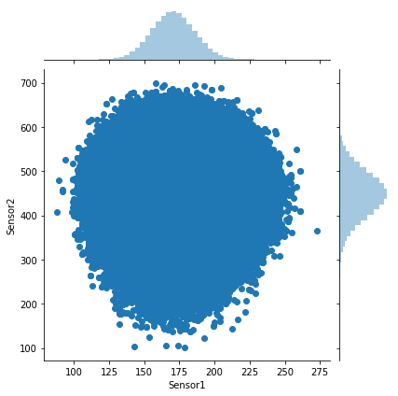
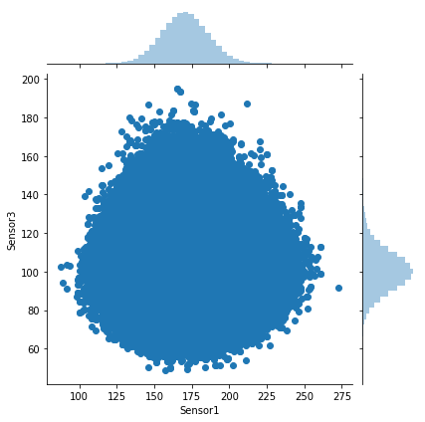
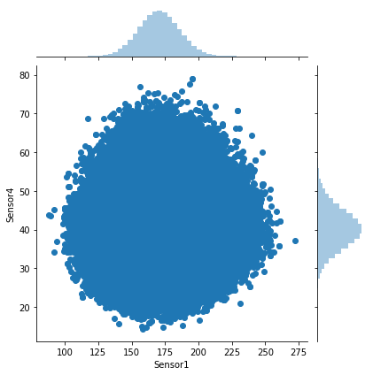
Sensor Data

Slide 20
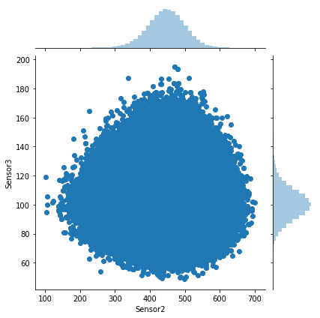
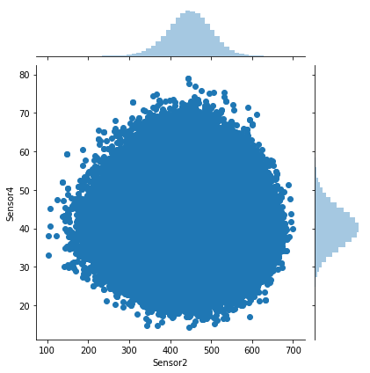
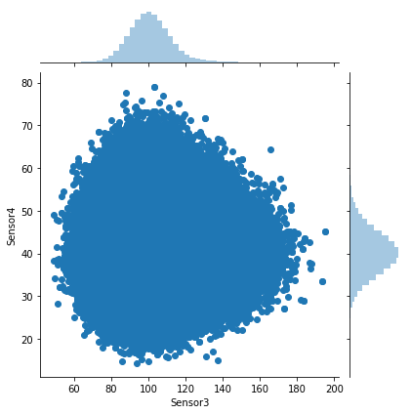

Slide 21
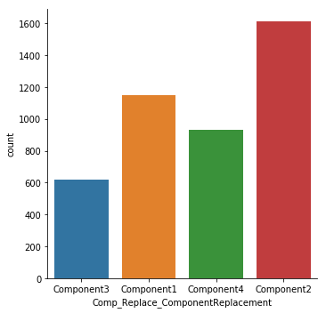
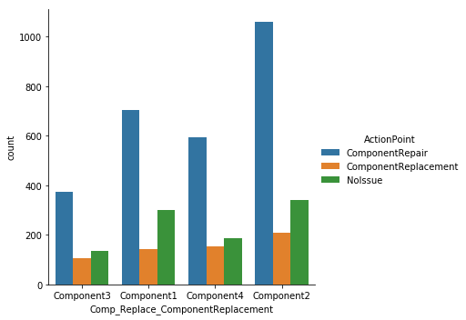
Visualizations - Component Replacement data

Slide 22
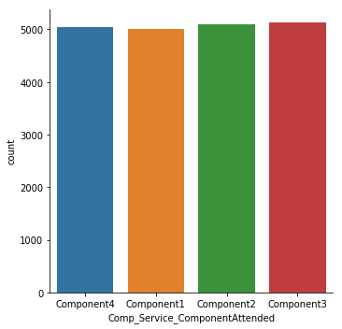
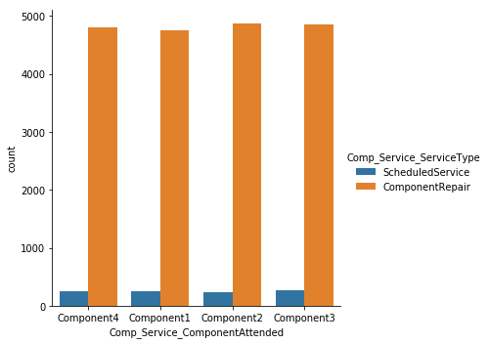
Visualizations - Component Service data

Slide 23
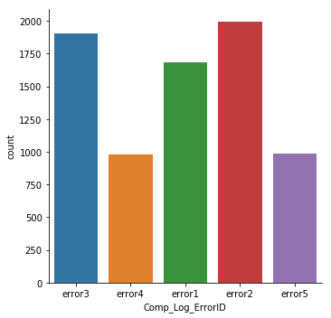
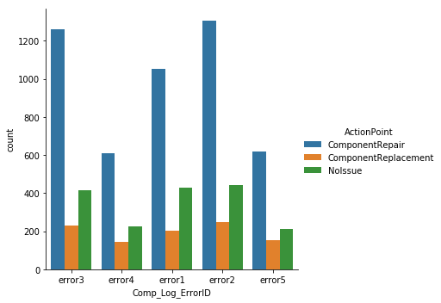
Visualizations – Complaints Log data

Slide 24
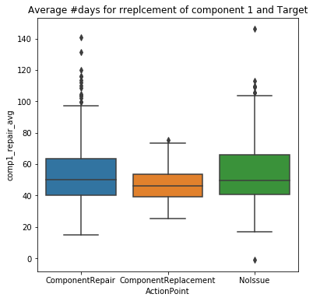
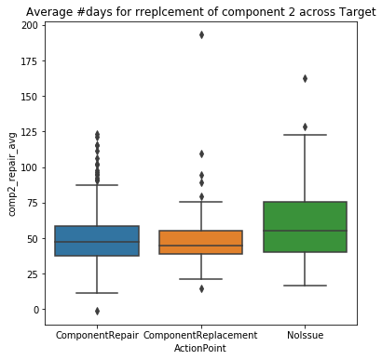
Avg days for a component to be repaired

Slide 25
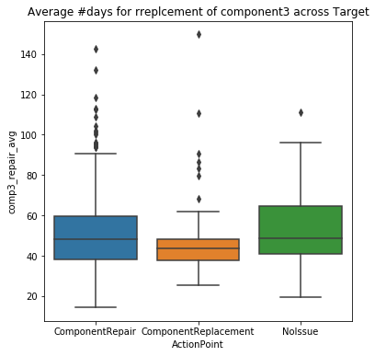
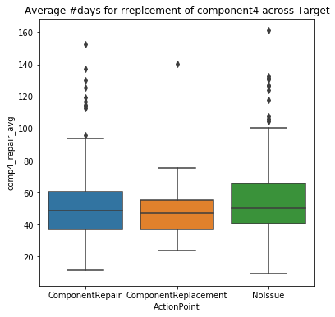

Slide 26
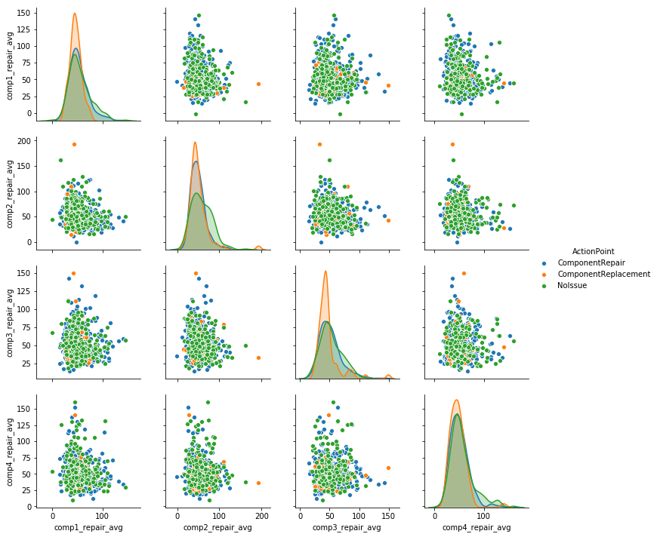
Component Service Data

Slide 27
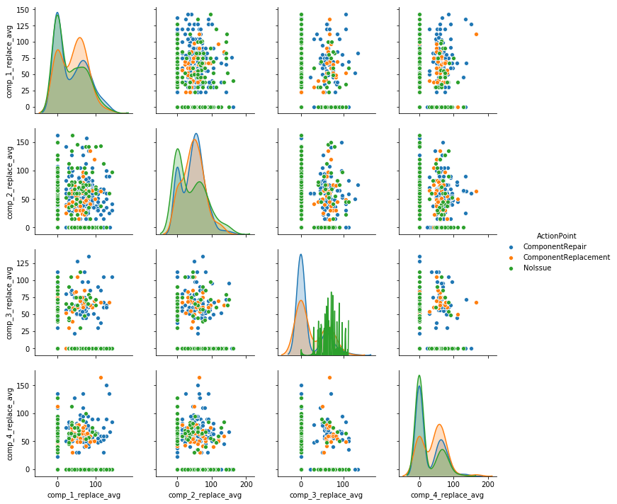
Component Replacement Data

Slide 28
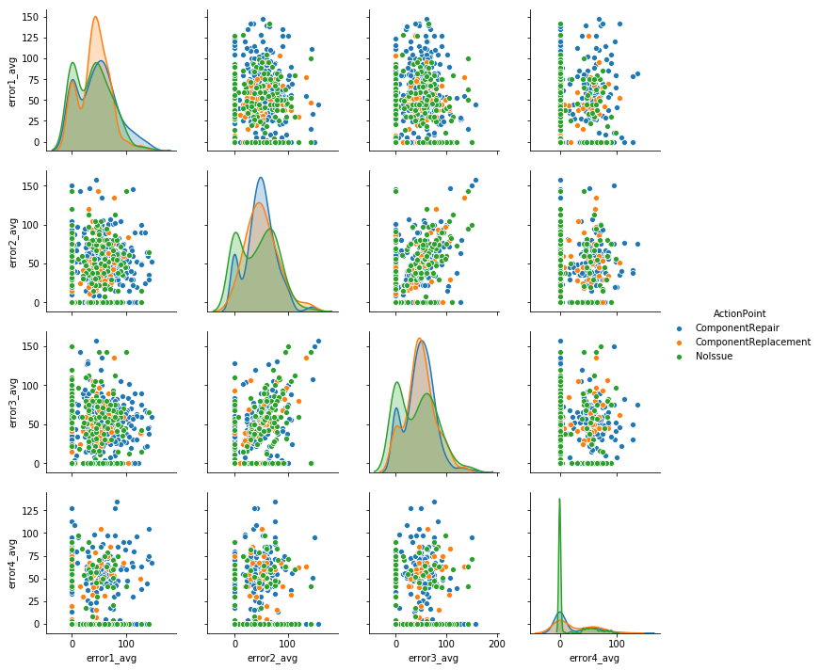
Complaints Log Data

Slide 29
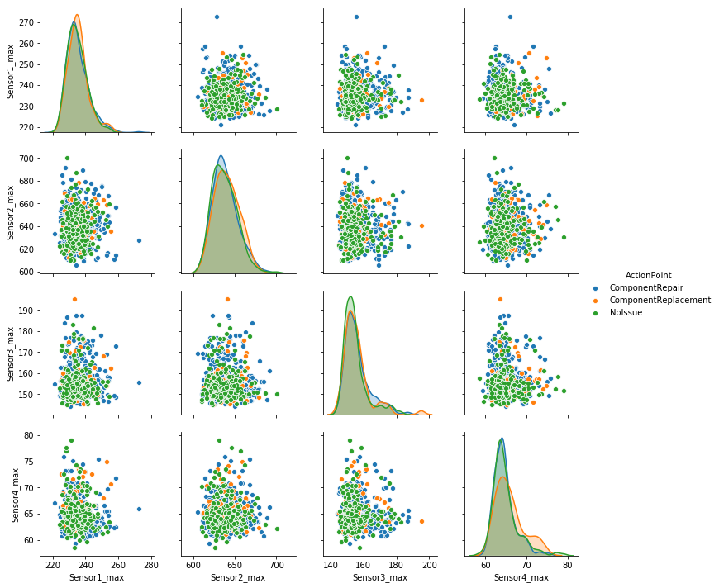
Sensor Data

Slide 30
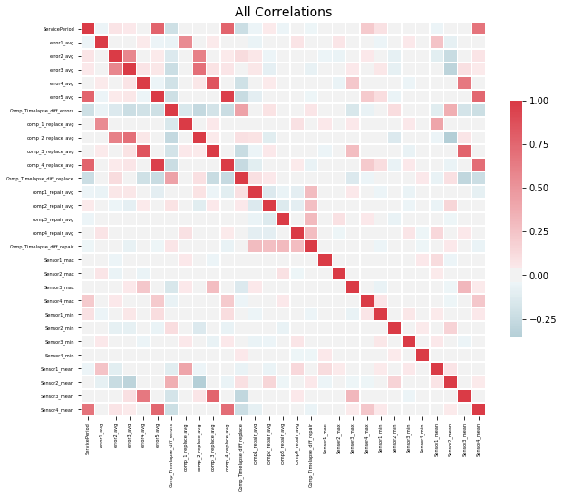
Correlations

Slide 31
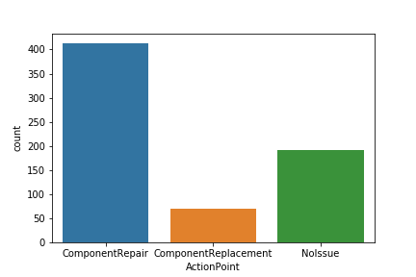
Class Imbalance

Slide 32
Modelling - Thoughts
From the previous graph, we know it is clearly a multi-class imbalance problem.
And the metric for evaluation is F1 score of the lowest represented class “Class Replacement”.
We need to make sure that model is not biased towards Majority class.
Several methods/models that handle class imbalance data under scikit-learn module in python

Slide 33
Modelling – Thoughts cont…
From my learning, I need two kind of models
Heavily penalize models for wrong predictions – Strong Regularization
Ways to emphasize under represented class – Clustering (discussed later in slides)

Slide 34
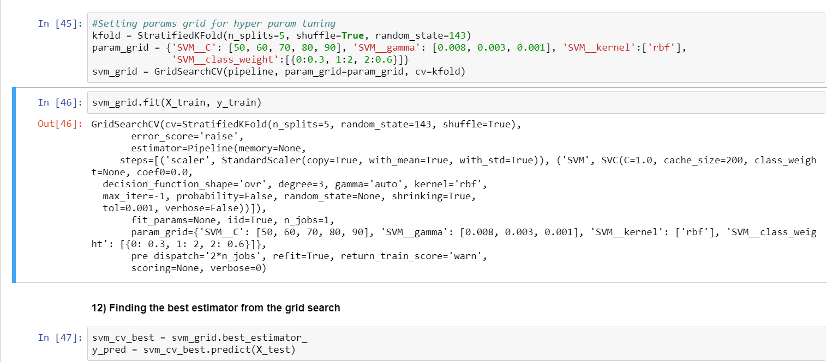
Strong Regularized Models
I have emphasized on models providing strong regularization.
Linear SVM, SVC, StochasticGradient Classifier

Slide 35
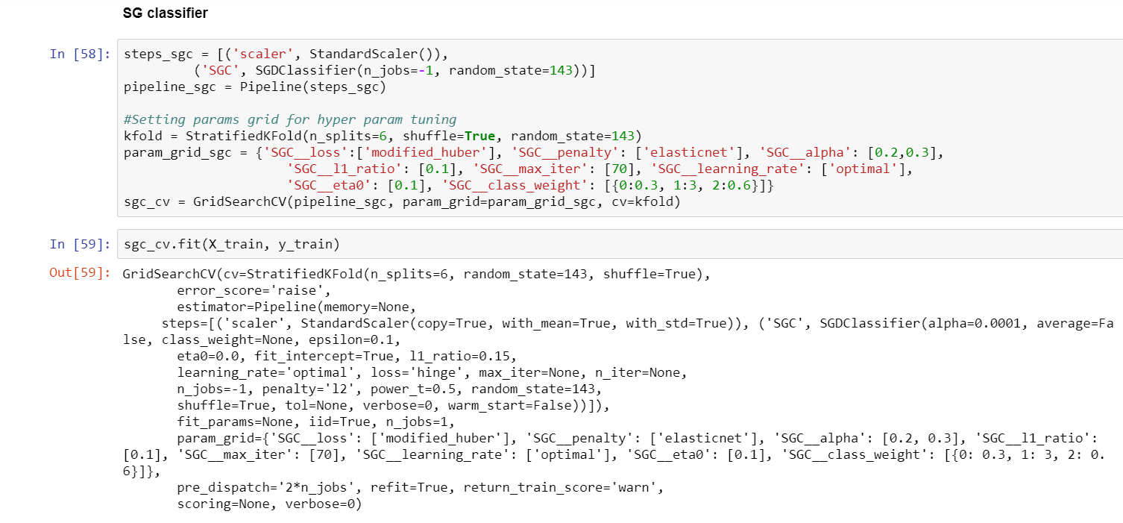
Good hands experience on Pipelines and Hyper Parameter Tuning using GridSearch CV and RandomSearch CV

Slide 36
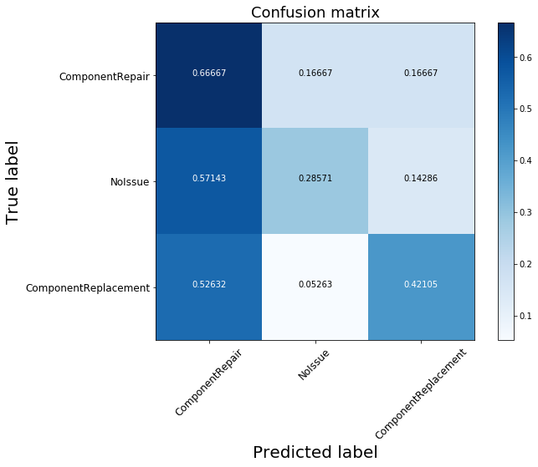
Confusion matrix of SG Classifier

Slide 37
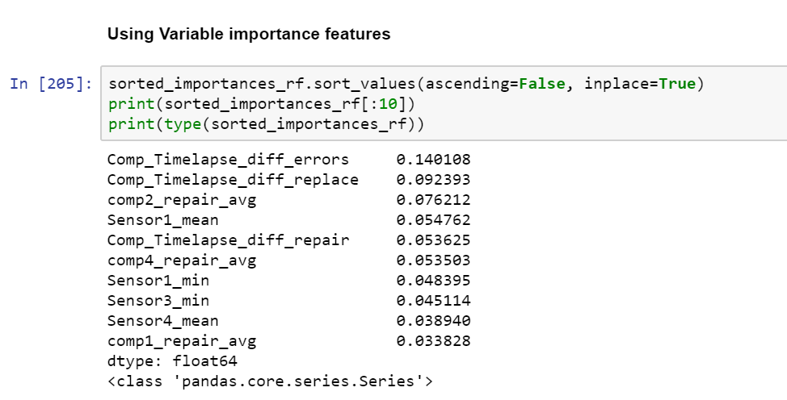
Bagging and Boosting Techniques
Have implemented DecisionTrees and Random Forest
Random Forest with top 12 variables gave the best local F1 score of 44% for Component Replacement class. But scored only 7% on grader
Altering max-depth and class weights have strong repercussions on the F1 score.

Slide 38
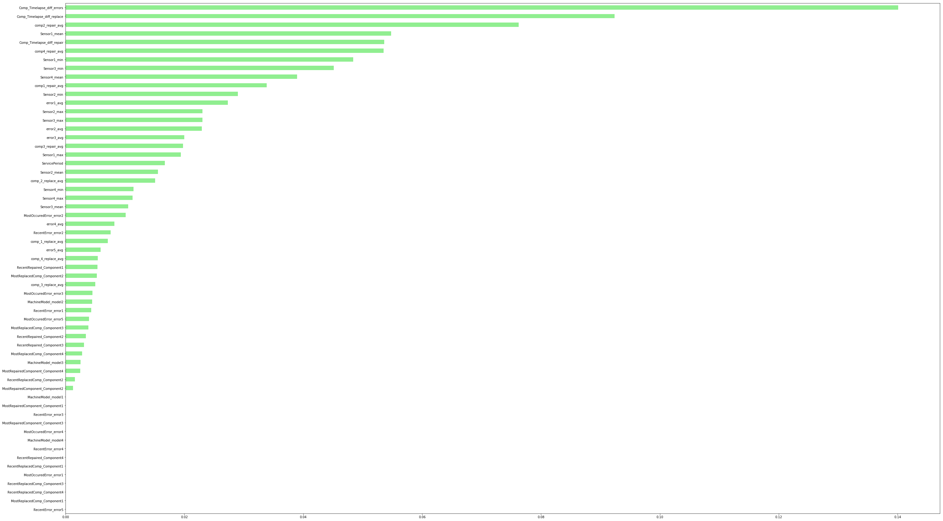
Random Forest – Important Variables Plot

Slide 39
Boosting Techniques
I have implemented AdaBoost and GradientBoosting Models.
Adaboost gave a decent local F1 score of 33%, but gave around 9% on grader.
GradientBoosting with hyper parameter tuning didn’t yield any good results either.

Slide 40
Other models trained
I have built Logistic Regression, Linear SVM, Kernel SVC, Naïve bayes classifier
Have tried OneVsRest and OneVsOne classifier wrappers around linear classifiers
Have built decision trees and Random Forest
Have built boosting techniques like AdaBoost and GradientBoost

Slide 41
Model Approach 2: Emphasize Under represented class
Divide the more abundant class into L distinct clusters.
Then train L predictors, where each predictor is trained on only one of the distinct clusters, but on all of the data from the rare class. to be clear, the data from the rare class is used in the training of all L predictors.
Finally, use model averaging or mode of three predictions as your final predictor.
This turns the multi-class classification into binary class classification

Slide 42
I have separated the abundant class (including NoIssue and Component Repair class) as one class (encoder value 0)
Divided the abundant data into 3 clusters
Attached minority class (Encoder value 1) rows to all the three clusters
This way we are tuning models to learn patterns about the minority class.
Ran Linear SVM, SG classifier and SVC (rbf) on each of the clusters and stored each of the model predictions on test data.
Merged MachineID and three rows of predictions as one dataframe and derived the result class as mode of three predictor values

Slide 43
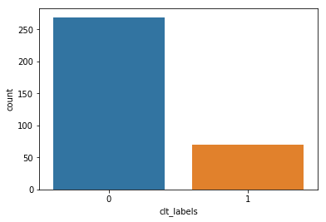
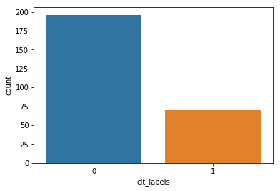
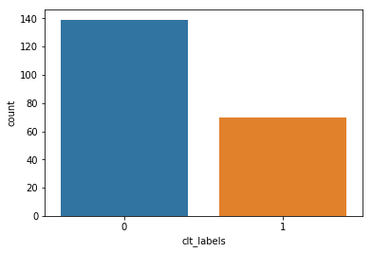

Slide 44
Models And Corresponding F1 scores
Model Name | F1 score (Validation data) | F1 score (Test data – Grader)
Logistic regression | 11% | 12.09%
Linear SVM | 18% | 5%
SVM (RBF) | 15% | 11%
SG classifier | 24% | 20%
Random Forest (var imp) | 42% | 9%
Adaboost | 33% | 9%
Naïve Bayes - Multinomial | 10% | NA
Clustering and Stacking | NA | 15%

Slide 45
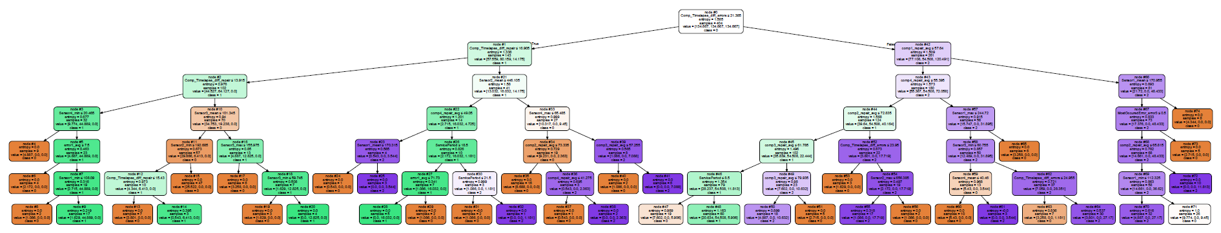
Patterns and Suggestions to the client
Some useful Patterns have been mined from the decision trees that would help business forecast errors upfront.

Slide 46
Way Forward
Re-feature engineer
Derive patterns from timestamp related data across tables
Make use of Service period in more effective way and take time difference between errors and last serviced

Slide 47
My Journey
I personally started Data science journey on 26th January 2018.
I was preparing myself for the next batch at Insofe.
I have started reading Linear Algebra, Statistics and Probability from various online courses.
It has been a wonderful journey with Insofe.
Learnt from some of the great minds, interacted with peers, built a network and made new friends
This is just the beginning of my journey towards data science and I always believe in continued reading and reinventing ourselves.

Slide 48
Q & A

