Slide 1

Presented by:
Santosh Mohan
Anudeep Pandiri
Chaitanaya Sai Manne
Karthik Ponnuru

Slide 2

MOBILE APPLICATION TESTING:
Mobile application testing is a process by which application software developed for hand held mobile devices is tested for its functionality, usability and consistency.

Slide 3
Related Work in Mobile Application Testing:
Black-box testing :
Black-box testing is a method of software testing that examines the functionality of an application without peering into its internal structures or workings.
White-box testing :
White-box testing is a method of testing software that tests internal structures or workings of an application, as opposed to its functionality (i.e. black-box testing).

Slide 4
Related Work in Mobile Application Testing:
Usability testing: Usability testing is a technique used in user-centered interaction design to evaluate a product by testing it on users. This can be seen as an irreplaceable usability practice, since it gives direct input on how real users use the system.
Quality-of-service testing:
Quality-of-service(QoS) mechanism controls the performance, reliability and usability of a telecommunications service. Mobile cellular service providers may offer mobile QoS to customers just as the fixed line PSTNservices providers and Internet service providers may offer QoS.

Slide 5
Related Work in Mobile Application Testing:
Wireless connectivity testing :
Connectivity changes with network and location, but you can't mimic those fluctuating conditions in a lab.
Mobile test automation frameworks :
By automating your testing, you can run a suite of tests that would take a manual tester hours to complete in minutes or seconds.
Eg: Selenium, Circleci, Robotium

Slide 6
Testing Approaches
Emulation-based Testing
Uses a virtual machine version of a mobile device for study on a computer.
Often included with a mobile platform’s software development kit(Ex., Android SDK).
Relatively inexpensive because no testing labs or no physical devices are needed while testing.
Support very limited gestures and device-specific functions.
Impossible to deal with multiple platforms/browsers as emulators are based on a specific platform.

Slide 7
Testing Approaches
2. Device-based Testing
Requires a real testing laboratory and purchasing real mobile devices.
Comparatively costlier but can test device-based functions, QoS parameters.
Major challenge is to cope up with the updates in the mobile devices and its platforms.
Another challenge is related to QoS because large-scale tests require many mobile devices which leads to more cost which is impossible for enterprises.

Slide 8
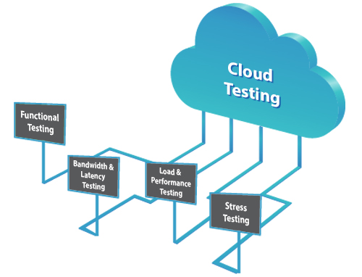
Testing Approaches
3. Cloud Testing
Basic idea is to build a mobile device cloud that can support testing services on a large scale.
Uses pay-as-you-go business model, hence cost effective than device-based testing.
Multiple platforms/browsers are supported for testing.

Slide 9
Testing Approaches
Crowd-based Testing
Uses freelance or contract based testing engineers or a group of end users along with a crowd-based infrastructure and a service management server.
Most of the mobile test operations are managed in an ad hoc way with limited testing tools.
Need not invest in a lab or purchase devices.
Risk of low testing quality.
A very uncertain validation schedule is followed.

Slide 10
Native vs Web Application
There are two types of mobile application testing
Native
Web
Native apps are deployed and executed on mobile devices, where as web apps are executes on web browsers

Slide 11
Primary testing objectives
Native apps
Web apps
Aims to validate the quality of mobile apps downloaded and executed on distinct mobile devices on selected platforms.
Testing focuses on functionality and behavior, QoS requirements, usability, security and privacy.
Aims to validate the quality of mobile web apps on different browsers on diverse mobile devices.
In addition, to the native apps, mobile Web app testing focuses on connectivity and interoperability.

Slide 12
Native apps vs Web apps
Native apps
Web apps
Testing environment
It underlies on multiple mobile platforms.
User Interface
It considers mobile clients, rich media content and graphics, and gesture features.
Technologies
Programming languages such as Java (Android), Objective-C (iOS), and Visual C++ (Windows)
Testing environment
The underlying Web browser is the testing environment.
User Interface
It considers web-based thin mobile clients, downloadable mobile clients, and browser-based rich media and graphics support.
Technologies
HTML5, CSS3, and JavaScript. The app developer might also use server-side languages or frameworks such as PHP, Rails, and Python.

Slide 13
Native apps vs Web apps (cont..)
Native apps
Web apps
Mobile Connectivity Testing
Online content synchronization during testing as well as download, deployment, and customization issues
Usability Testing
It involves testing mobile device-based gestures, content, interfaces, and the general user experience
Mobility Testing
It involves testing the device’s location-based functions, features etc.
Mobile Connectivity Testing
it is important to test with Internet connectivity and diverse wireless air protocols in mind, as well as the mobile connections between clients and servers.
Usability Testing
It focuses on Web-based GUI content, interfaces, and user operation flows.
Mobility Testing
Focuses on testing the quality of location-based system functions, data, and behaviors.

Slide 14
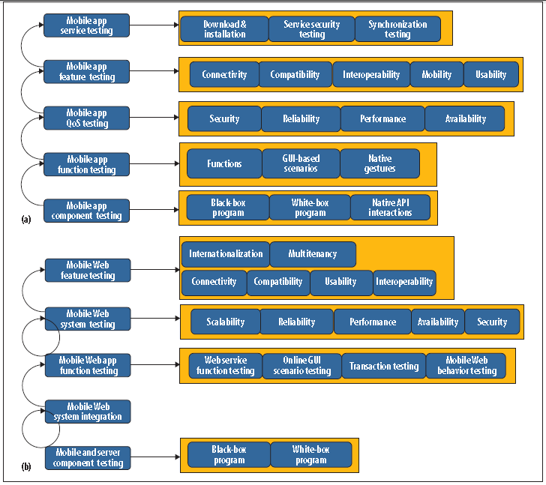
Test Process

Slide 15
Test process for Native apps
Component testing, includes both black- and white-box testing as well as native API interactions.
Function testing, focuses on validating functions, GUI-based scenarios, and native behaviors, such as gesture testing on mobile clients.
QoS testing, checks QoS attributes, including performance, reliability, availability, and security.
Feature testing, validates network connectivity, compatibility, interoperability, mobility, and usability
Service testing, looks at mobile app services, including download, installation, deployment, service security, and synchronization.

Slide 16
Test process for Web apps
Component testing, validates the quality of software components in mobile Web clients and the related server components using black- and white-box testing methods.
System integration, focuses on component integration with the system (mobile client and server).
Function testing, targets mobile Web service function quality, end-to-end business transactions, Web GUI scenarios, and Web-based mobile behaviors and gestures.
System testing, considers QoS requirements, including end-to-end system performance, load, reliability, availability, security, and scalability.
Feature testing, targets quality, such as mobile connectivity, compatibility, usability, interoperability, security, and internationalization.

Slide 17
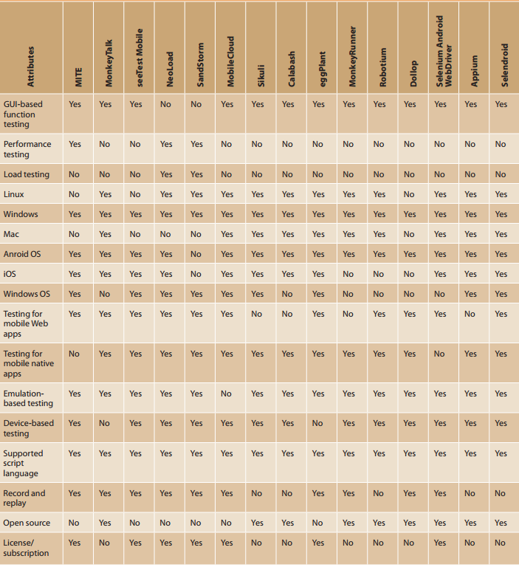

Slide 18
Issues, Challenges & Needs
Test environments:
Involves high costs and levels of complexity
Setting up a mobile test environment for multiple apps on each mobile platform for a range of devices is tedious, time-consuming, and expensive, and frequent upgrades in both device and platform spaces only exacerbate this challenge.
What to do?
a reusable and systematic approach
unified connectivity to different mobile platforms on mobile devices
a configuration capability that supports the systematic deployment, installation, and execution of a given app on different platforms for specific mobile devices.
diverse mobile network configuration options.

Slide 19
Issues, Challenges & Needs
Standards, modeling, and coverage criteria
Existing test models and coverage criteria can help address mobile program structures, dynamic behaviors, and GUI operation flows, but we still need to address the distinct requirements of mobile app testing.
Also a model is needed to address test coverage, taking into account underlying operational contexts that include a variety of mobile devices, platforms, browsers, and native APIs

Slide 20
Issues, Challenges & Needs
Test automation:
Lack of standardization in mobile test infrastructure, scripting languages, and connectivity protocols between mobile test tools and platforms
Need an elastic infrastructure to support large-scale test automation
What to do?
device-based mobile test clouds equipped with connected, diverse, and replaceable mobile devices
scalable emulation clouds that can enable the creation, deployment, and control of largescale mobile emulation testing
unified test control and execution solution that supports concurrent and largescale test automation

Slide 21
Thank you

