Slide 1


Semantic Search
- Movie plots
Presented by
Chaitanya Sai Manne
Karthik Reddy Vundela
Sri Chaitanya Patluri
Sai Venkatesh Gatiganti

Slide 2
Motivation
There is an existing Semantic search engine to find the details about the movies. We can find the details by giving a key word about the movie like movie name, cast etc. We are building an application to find the details based on the plot.
We can search by giving an plot of a movie and find the movies similar to that plot.

Slide 3
Objective
To design a application, Semantic Search Engine that provides search results based on the plot given by the user on movies which are obtained from Dbpedia and Wikipedia.

Slide 4
Datasets
Dbpedia
Wikipedia
CMU Movie Summary Corpus

Slide 5
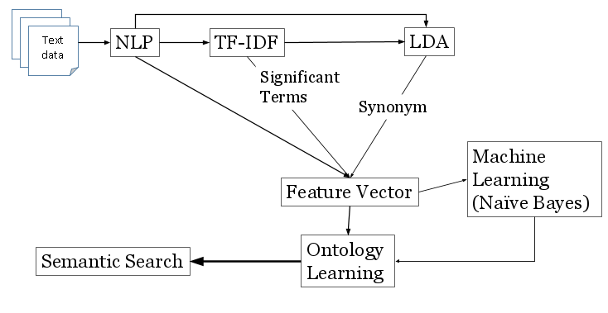
Approach

Slide 6
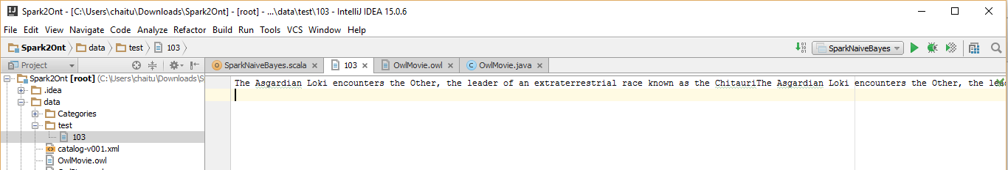
Input

Slide 7
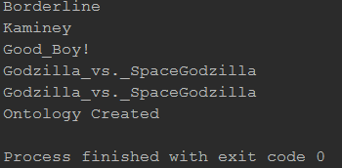
Results
Movie names

Slide 8
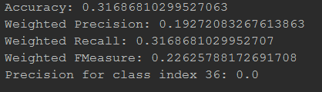
Results
Evaluation

Slide 9
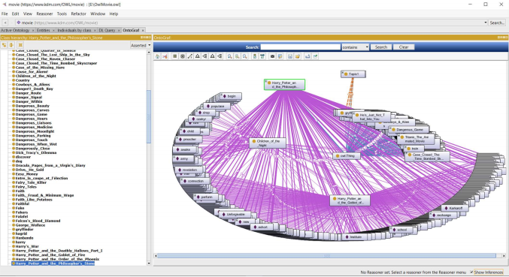
Ontology

Slide 10
Future work
Future work includes various domains for the semantic search engine like books.
Full fledge web application to show the results dynamically.

Slide 11
Bibliography
http://jmcauley.ucsd.edu/data/amazon/links.html
http://nlp.stanford.edu/nlp/
https://en.wikipedia.org/
http://wiki.dbpedia.org/

Slide 12
Thank you

