Slide 1

Team anything is fine
SIMPLE GENERATIVE AI MODEL
Guided by: Peter Sigurdson
Prepared by: Chaitanya kumar (C0830850) | Nividhaba Jadeja (C0851340) | Sakshi Gor (C0851346) | Saleem Chitrachedu (c0830509)

Slide 2
Introduction
An artificial intelligence (AI) system called the Generative AI Text Generation Model aims to produce new material that closely mimics the input data. It creates new material that is stylistically and grammatically comparable to the original data by using machine learning algorithms to analyse and comprehend the patterns and features of a corpus of text or other given set of data. These algorithms can produce everything from little phrases to lengthy books and articles as text.
Text generation models create new text using a range of methods, such as rule-based models, language models, and neural networks. Language models utilise statistical techniques to create text based on the likelihood of specific word sequences, as opposed to rule-based models, which use sets of predetermined rules. On the other hand, neural networks are a form of machine learning algorithm that can learn to produce text by analysing huge text databases.

Slide 3
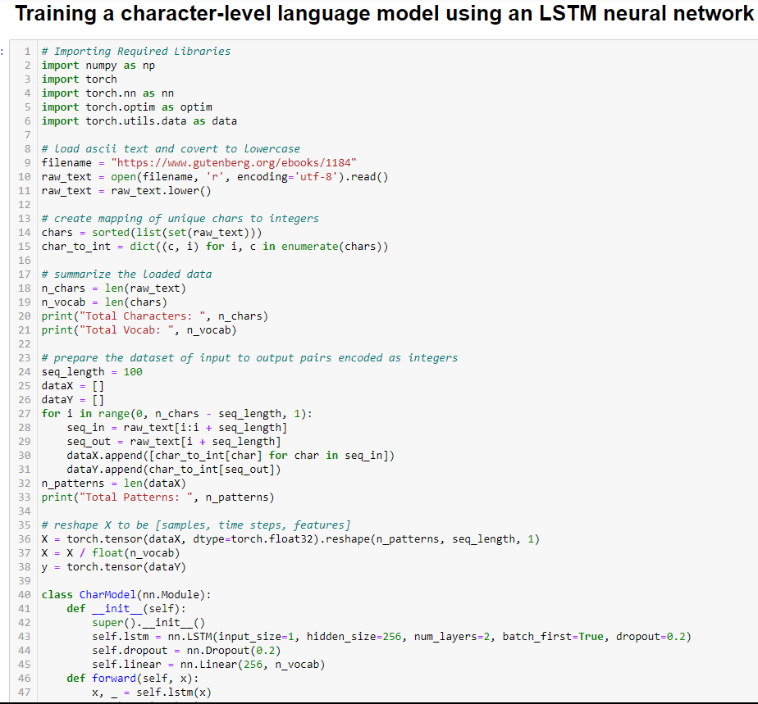
Code Explanation - 1
The first section of the code loads a book named "The Count of Monte Cristo" from the project Gutenberg and lowercases every character. The text is subsequently encoded using a mapping of distinct characters to numbers. The following step is to prepare the data as input-output pairs of sequences, with each input sequence having length seq_length and each output output being the subsequent character in the text. Following the data's division into training and validation sets, a PyTorch DataLoader is used to load it.
The two-layer LSTM neural network that is utilised for training is described as having an output dropout layer and a fully connected linear layer. The anticipated probability distribution over all potential characters at the next timestep is the output of the LSTM, which receives input sequences of one character at a time. In order to reduce the cross-entropy loss between the anticipated and actual characters, the model is trained over a predetermined number of epochs.

Slide 4
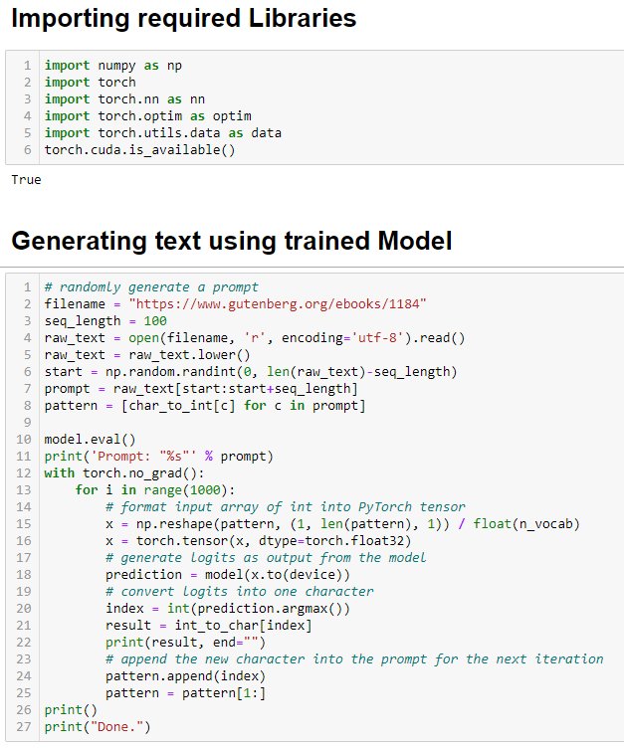
Code Explanation - 2
The second section of the code uses the trained model to create new text based on a prompt that is randomly generated from the text in the first section. A random segment of length seq_length from the text serves as the prompt. The predicted character is then added to the prompt for the following prediction after the model has been used to predict the previous character based on the prompt. To create a new text sequence, this operation is repeated a certain number of times. The generated text that was based on the initial prompt is the final output.

Slide 5
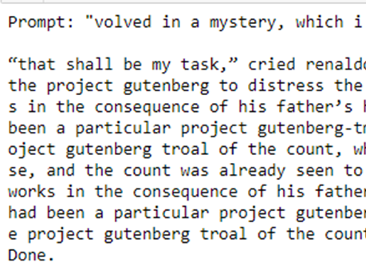
The output
Project Link:
https://github.com/chaitur19/simple-generative-ai-model
Finally it shows the output based on the given prompt:

Slide 6
references
Adrian Tam (2023, March 13), Text Generation with LSTM in PyTorch, Machine Learning Mastery, https://machinelearningmastery.com/text-generation-with-lstm-in-pytorch/
Karpathy, A. (2015). The unreasonable effectiveness of recurrent neural networks. Andrej Karpathy Blog. Retrieved from http://karpathy.github.io/2015/05/21/rnn-effectiveness/
Peter Sigurdson (2023, April 11), Open Source ChatGPT - What you need to know TODAY to stay ahead of Tomorrow, LinkedIn, https://www.linkedin.com/pulse/open-source-chatgpt-what-you-need-know-today-stay-ahead-sigurdson/?trackingId=BFhGq6WkI5CjyXAbuPHILA%3D%3D
Peter Sigurdson (2023, April 18), Project Document: AML 3304 W23 Course Project: Writing Python to construct a Simple Generative Al Language Model, coda.io, https://coda.io/@peter-sigurdson/lab-workbook-building-a-simple-generative-ai-language-model
Prompt Engineering (2023, April 8), Open Assistant: Open Source ChatGPT is Here!!! [live Demo], YouTube, https://www.youtube.com/watch?v=VFPrwxPBBVU&t=365s
Radford, A., Wu, J., Child, R., Luan, D.., Amodei, D., & Sutskever, I. (2019). Language Models are Unsupervised Multitask Learners. OpenAI Blog. https://openai.com/blog/better-language-models/

Slide 7
Thank You

