Slide 1
Calculating Body Mass Index
Sai Chaitanya Mallampati

Slide 2
Project Goal
The goal of this project is to come up with the body mass index of a person
Inputs
Height
Weight
Outputs
Body Mass Index
Under-weight
Normal weight
Over-weight
Obese

Slide 3
Body Mass Index Calculation
Body Mass Index is a measure of body fat based on height and weight that applies to adult men and women.
BMI = m / h^2
BMI : body mass index
m : mass in kg
h : height in meters

Slide 4
BMI Classification
Regarding the BMI measure, the World Health Organization proposes the following classification
BMI < 18.5 : Underweight
BMI [18.5-24.9] : Normal weight
BMI [25-29.9] : Overweight
BMI >= 30 : Obesity

Slide 5
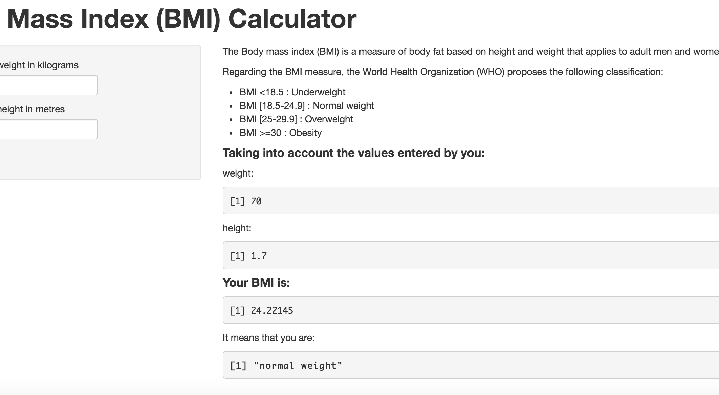
BMI Application UI

