Slide 1

Digital Music Store Analysis

Slide 2

Objective
This project will help us to understand how to analyze the music playlist database. we can examine the dataset with SQL and help the store to understand Business Growth by answering simple questions.

Slide 3
SQL PROJECT- MUSIC STORE DATA ANALYSIS
Question Set 1
1. Who is the senior most employee based on job title?
2. Which countries have the most Invoices?
3. What are top 3 values of total invoice?
4. Which city has the best customers? We would like to throw a promotional Music Festival in the city we made the most money. Write a query that returns one city that has the highest sum of invoice totals. Return both the city name & sum of all invoice totals
5. Who is the best customer? The customer who has spent the most money will be declared the best customer. Write a query that returns the person who has spent the most money

Slide 4
Question Set 2
Write query to return the email, first name, last name, & Genre of all Rock Music listeners. Return your list ordered alphabetically by email starting with A
Let's invite the artists who have written the most rock music in our dataset. Write a query that returns the Artist name and total track count of the top 10 rock bands
3. Return all the track names that have a song length longer than the average song length. Return the Name and Milliseconds for each track. Order by the song length with the longest songs listed first

Slide 5
Question Set 3
Find how much amount spent by each customer on artists? Write a query to return customer name, artist name and total spent
We want to find out the most popular music Genre for each country. We determine the most popular genre as the genre with the highest amount of purchases. Write a query that returns each country along with the top Genre. For countries where the maximum number of purchases is shared return all Genres

Slide 6
Solutions set 1
--Q1: who is the senior most employee based on job title?--
select top 1 * from emp
order by levels desc

Slide 7
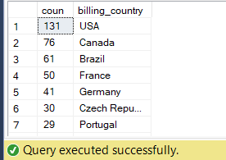
--Q2:which country have more invoices--
select * from invoice
select count(*) as coun,billing_country
from invoice
group by billing_country
order by coun desc

Slide 8
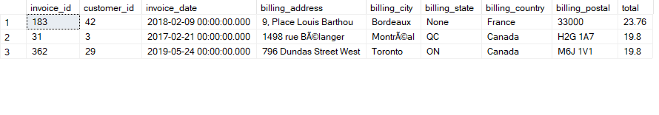
-- Q3: what are the top 3 values of total invoice--
select top 3 * from invoice
order by total desc

Slide 9
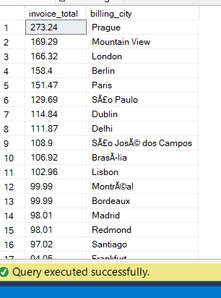
/*Q4: Which city has the best customers? We would like to throw a promotional Music Festival in the city
we made the most money. Write a query that returns one city that has the highest sum of invoice totals.
Return both the city name & sum of all invoice totals*/
select sum(total) as invoice_total,billing_city
from invoice
group by billing_city
order by invoice_total desc

Slide 10
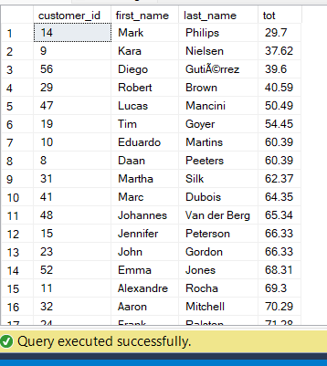
/*Q5: Who is the best customer? The customer who has spent the most money will be declared the best customer.
Write a query that returns the person who has spent the most money.*/
-- here we join two tables(customer table and Invoice table) to obtain the result
--
select customer.customer_id,customer.first_name,customer.last_name,SUM( invoice.total) as tot
from customer
join invoice on customer.customer_id=invoice.customer_id
group by customer.customer_id,customer.first_name,customer.last_name
order by tot

Slide 11
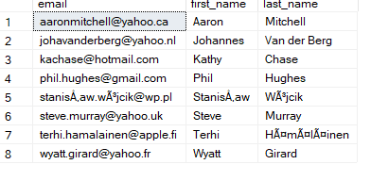
Set-2
Q1: Write query to return the email, first name, last name, & Genre of all Rock Music listeners.
Return your list ordered alphabetically by email starting with A */
select distinct email,first_name,last_name
from customer
join invoice on invoice.customer_id=customer.customer_id
join invoice_line on invoice_line.invoice_id=invoice.invoice_id
join track on track.track_id=invoice_line.track_id
join genre on genre.genre_id=track.track_id
where genre.name like 'rock'
order by email

Slide 12
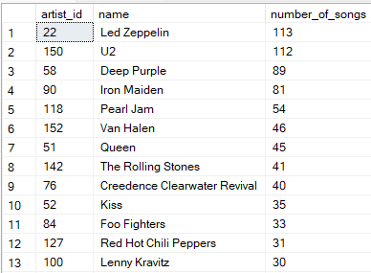
/*Q2: Let's invite the artists who have written the most rock music in our dataset. Write a
query that returns the Artist name and total track count of the top 10 rock bands */
select artist.artist_id,artist.name,count(artist.artist_id) as number_of_songs
from track
join album on album.album_id=track.album_id
join artist on artist.artist_id=album.artist_id
join genre on genre.genre_id=track.genre_id
where genre.name like'rock'
group by artist.artist_id,artist.name
order by number_of_songs desc

Slide 13
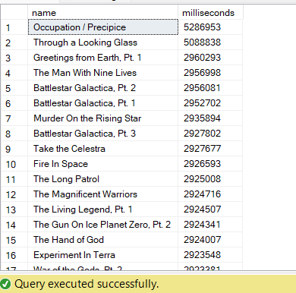
/* Q3: Return all the track names that have a song length longer than the average song length.
Return the Name and Milliseconds for each track. Order by the song length with the
longest songs listed first*/
select name,milliseconds
from track
where milliseconds >(select avg(milliseconds) as avg_track_length from track)
order by milliseconds desc

Slide 14
/*Q1: We want to find out the most popular music Genre for each country.
We determine the most popular genre as the genre with the highest amount of purchases.
Write a query that returns each country along with the top Genre.
For countries where the maximum number of purchases is shared return all Genres.
Steps to Solve: There are two parts in question- first most popular music genre and second need data at country level.*/
SELECT
COUNT(invoice_line.quantity) AS purchases,
customer.country,
genre.name,
genre.genre_id,
ROW_NUMBER() OVER(PARTITION BY customer.country ORDER BY COUNT(invoice_line.quantity) DESC) AS rowno
FROM
invoice_line
JOIN
invoice ON invoice.invoice_id = invoice_line.invoice_id
JOIN
customer ON customer.customer_id = invoice.customer_id
JOIN
track ON track.track_id = invoice_line.track_id
JOIN
genre ON genre.genre_id = track.genre_id
GROUP BY
customer.country, genre.name, genre.genre_id
ORDER BY
customer.country ASC, purchases DESC
)

Slide 15
/* Q2. Find how much amount spent by each customer on artists? Write a query to return
customer name, artist name and total spent*/
with best_selling_artist as (
select artist.artist_id as artist_id, artist.name as artist_name,
sum(invoice_line.unit_price*invoice_line.quantity) as total_sales
from invoice_line
join track on track.track_id=invoice_line.track_id
join album on album.album_id= track.album_id
join artist on artist.artist_id= album.artist_id
group by artist.artist_id,artist.name
order by total_sales desc
)
select c.customer_id,c.first_name,c.last_name,bsa.artist_name ,
sum(il.unit_price*il.quantity) as amount_spent
from invoice i
join customer c on c.customer_id=i.customer_id
join invoice_line il on il.invoice_id=i.invoice_id
join track t on t.track_id=il.track_id
join album alb on alb.album_id=t.album_id
join best_selling_artist bsa on bsa.artist_id=alb.artist_id
group by c.customer_id,c.first_name,c.last_name,bsa.artist_name
order by amount_spent ;

