Slide 1
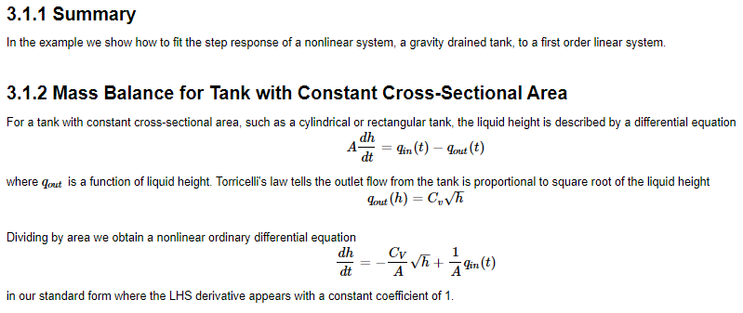
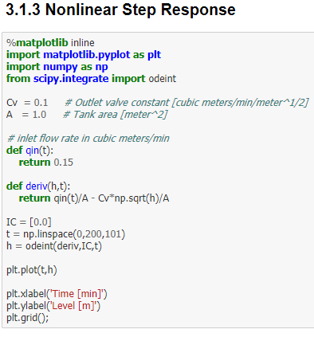
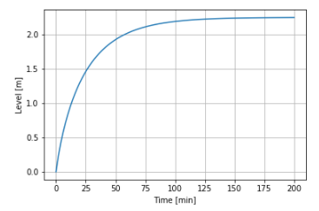
Process Modeling Step Response of a Gravity Drained Tank

Slide 2
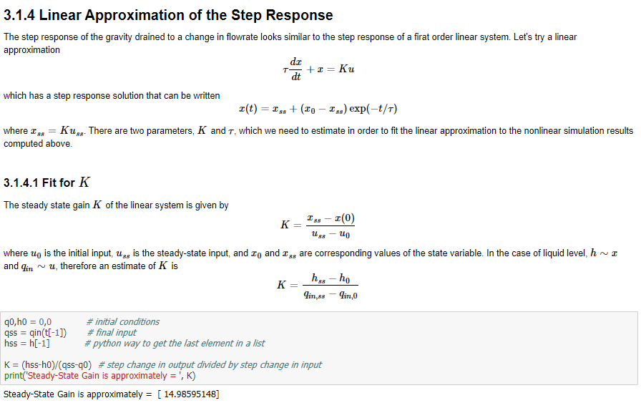
Process Modeling Step Response of a Gravity Drained Tank

Slide 3
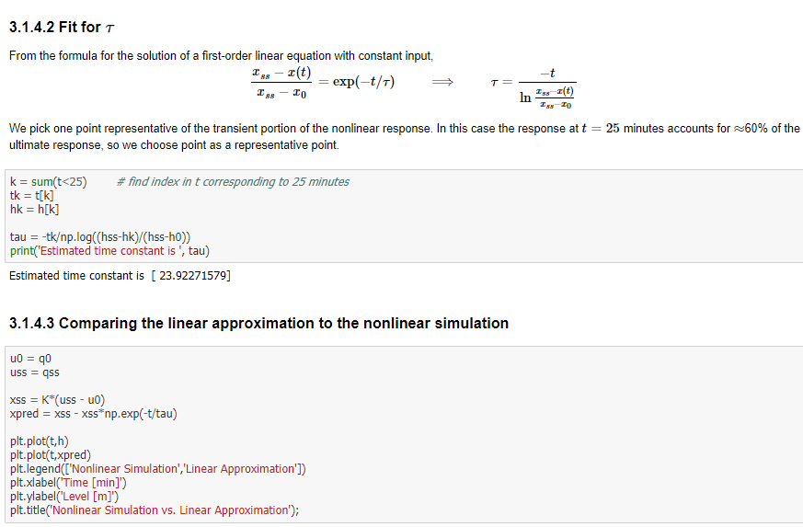
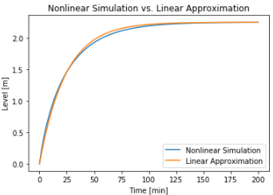
Process Modeling Step Response of a Gravity Drained Tank

Slide 4
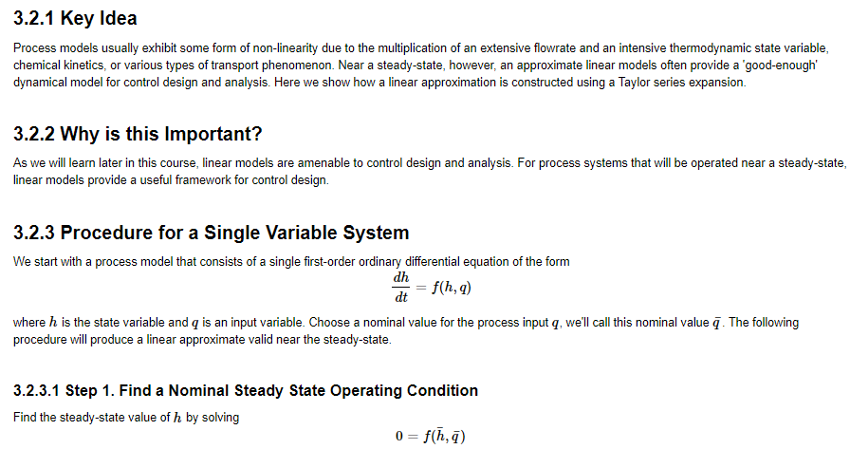
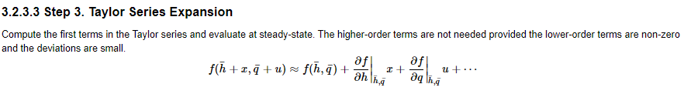

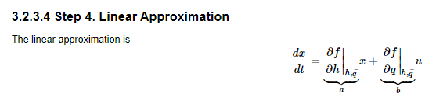
Process Modeling Linear Approximation of a Multivariable Model

Slide 5
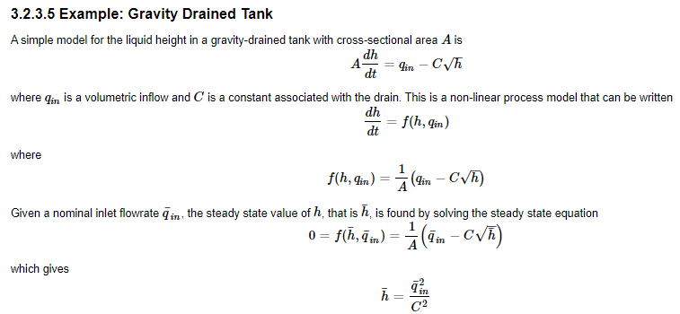
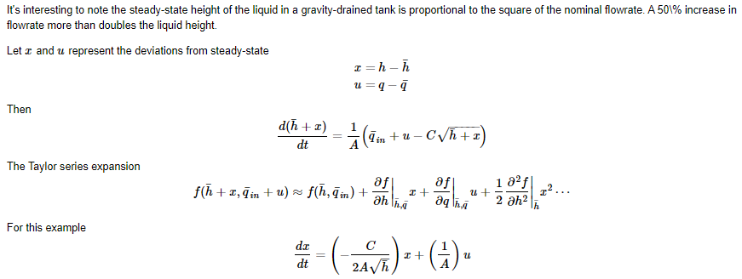
Process Modeling Linear Approximation of a Process Model

Slide 6
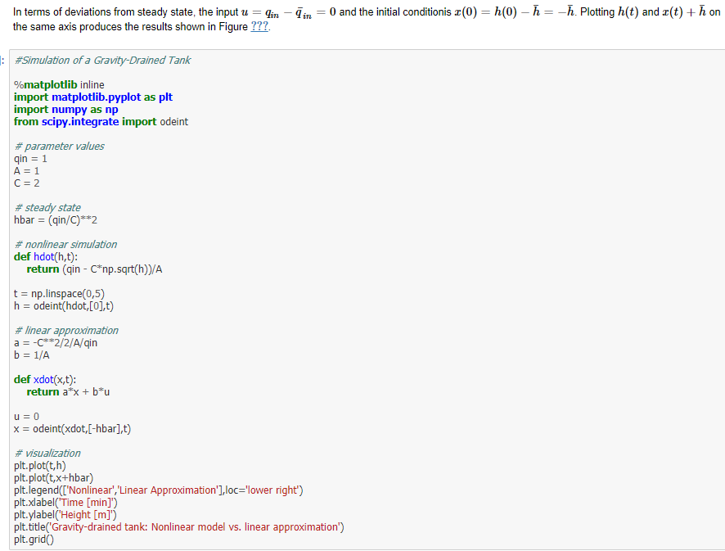
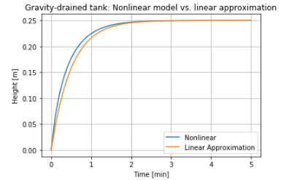
Process Modeling Linear Approximation of a Process Model

Slide 7
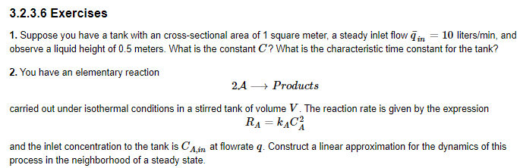
Process Modeling Linear Approximation of a Process Model

Slide 8
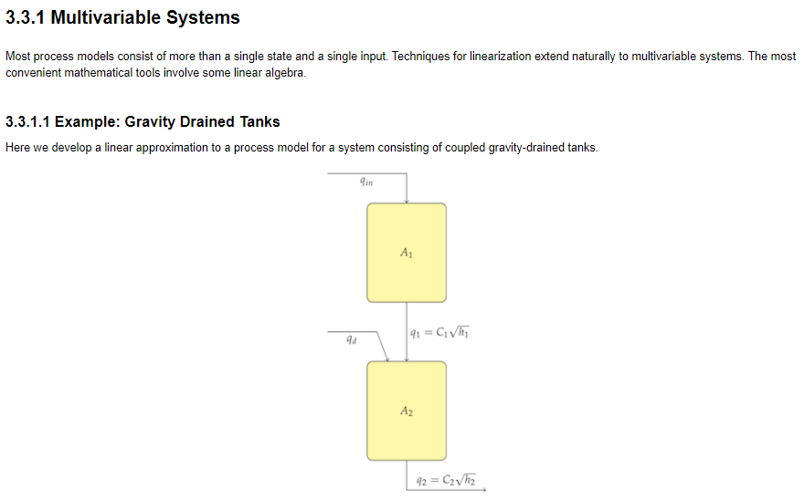
Process Modeling Linear Approximation of a Process Model

Slide 9
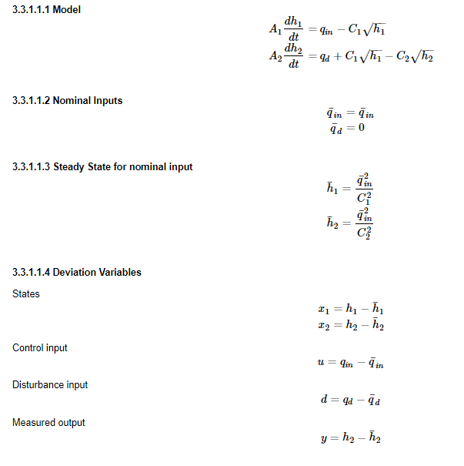
Process Modeling Linear Approximation of a Process Model

Slide 10
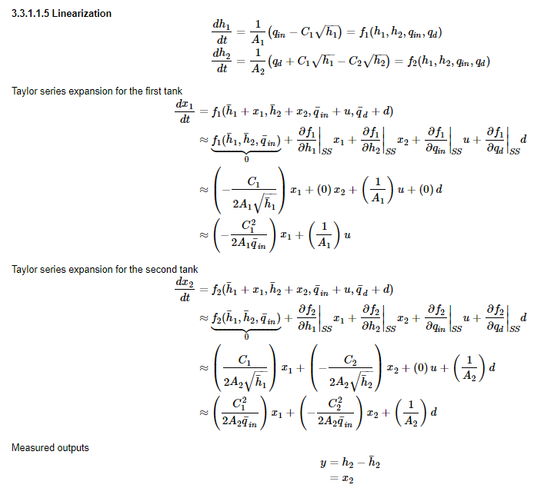
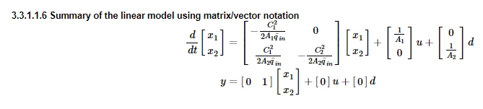
Process Modeling Linear Approximation of a Process Model

Slide 11
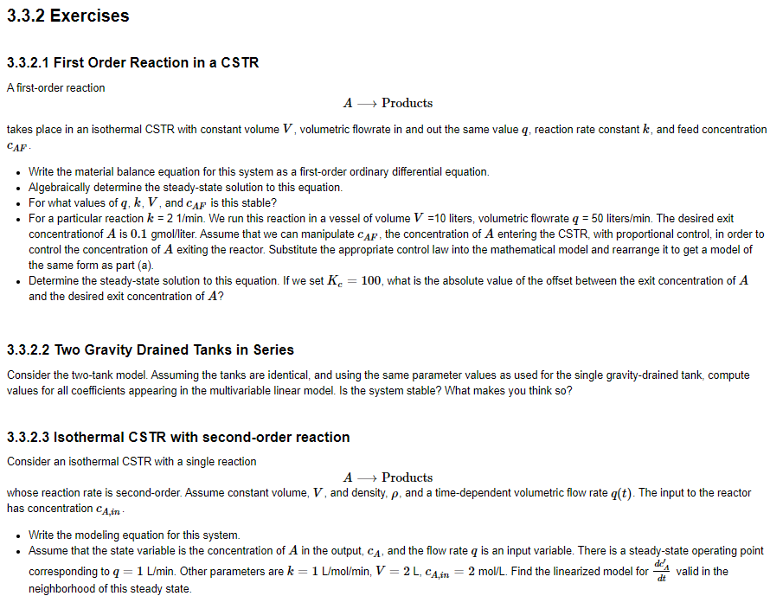
Process Modeling Linear Approximation of a Process Model

Slide 12
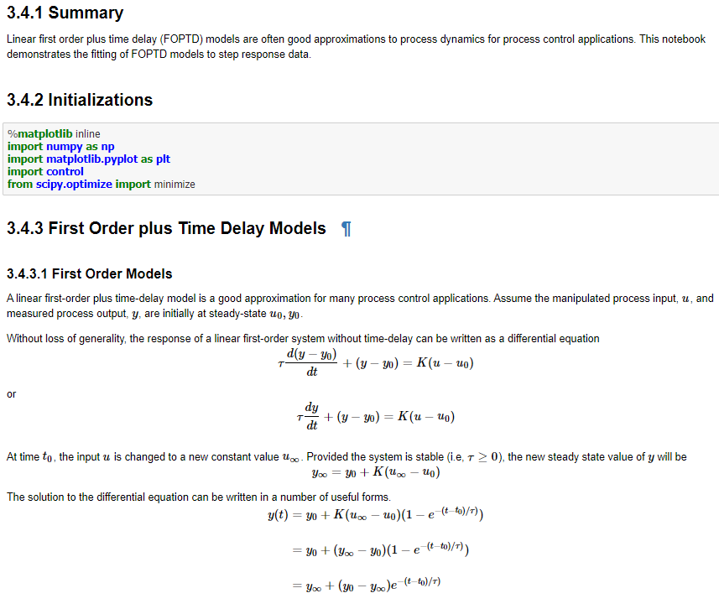
Process Modeling : Fitting First Order plus Time Delay to Step Response

Slide 13
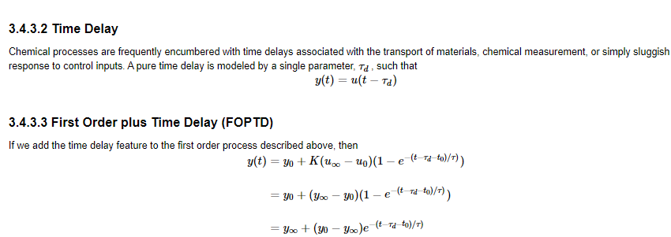
Process Modeling : Fitting First Order plus Time Delay to Step Response

Slide 14
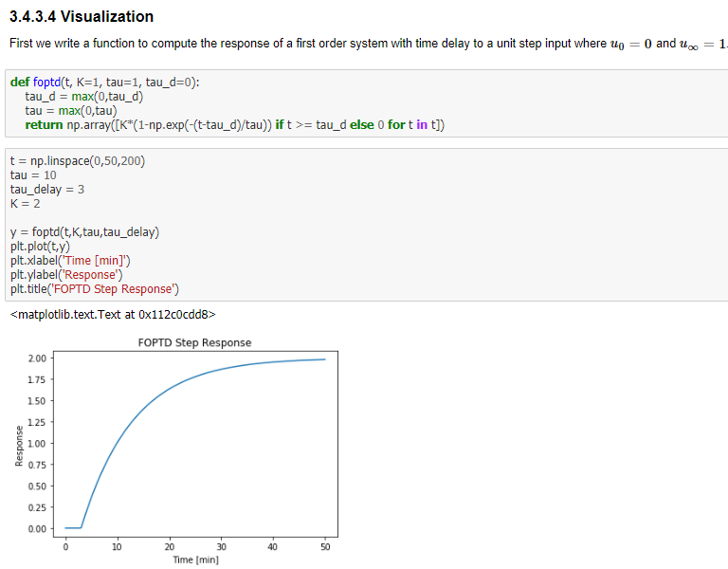
Process Modeling : Fitting First Order plus Time Delay to Step Response

Slide 15
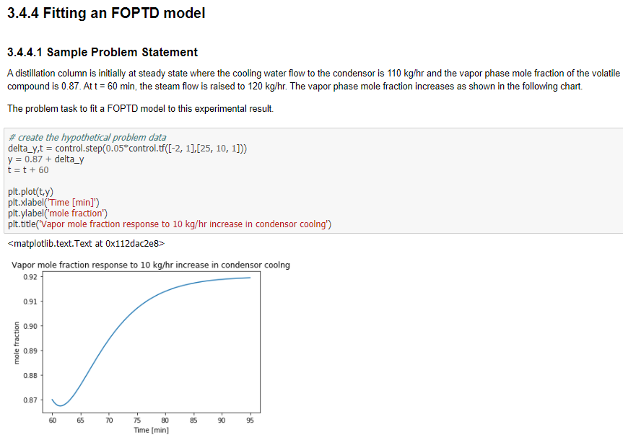
Process Modeling : Fitting First Order plus Time Delay to Step Response

Slide 16
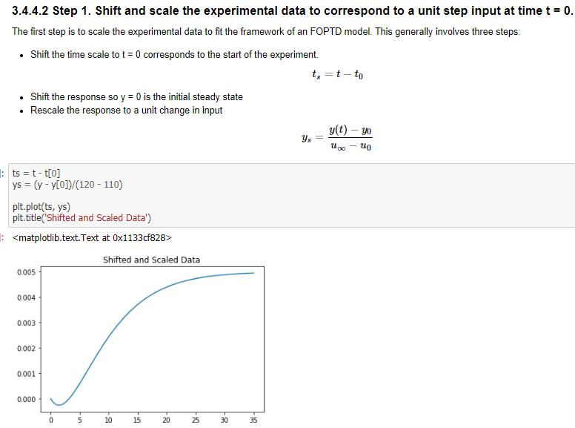
Process Modeling : Fitting First Order plus Time Delay to Step Response

Slide 17
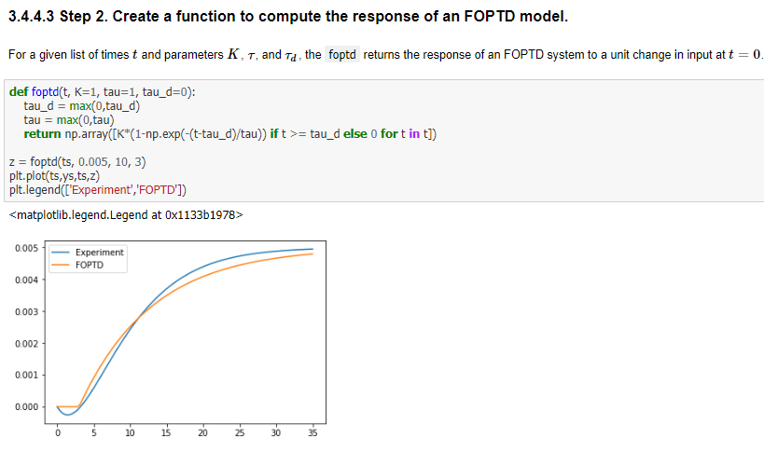
Process Modeling : Fitting First Order plus Time Delay to Step Response

Slide 18
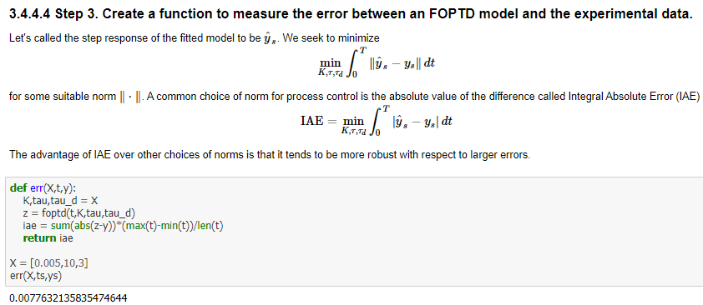
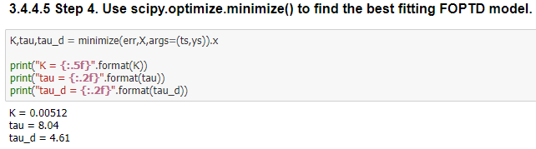
Process Modeling : Fitting First Order plus Time Delay to Step Response

Slide 19
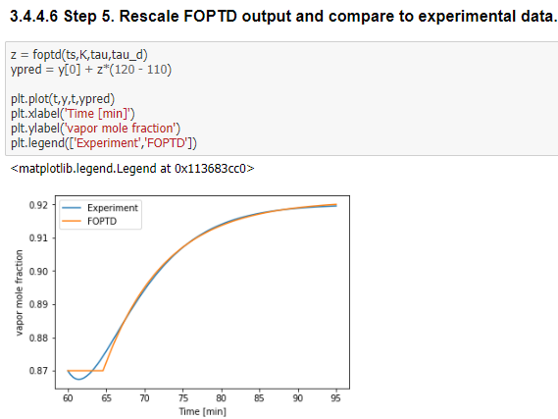
Process Modeling : Fitting First Order plus Time Delay to Step Response

Slide 20
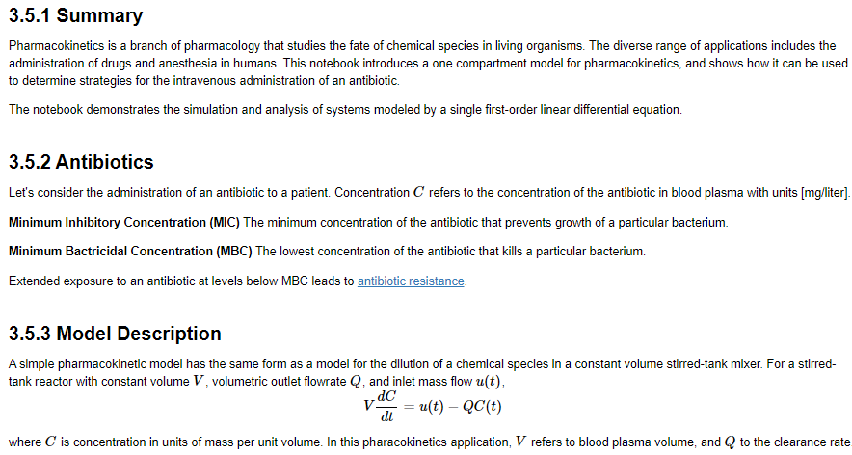
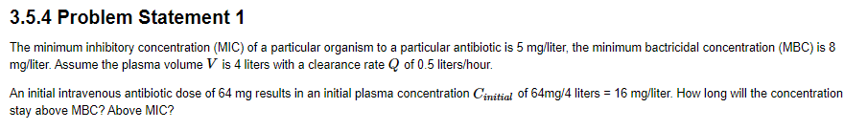
Process Modeling : One Compartment Pharmacokinetics

Slide 21
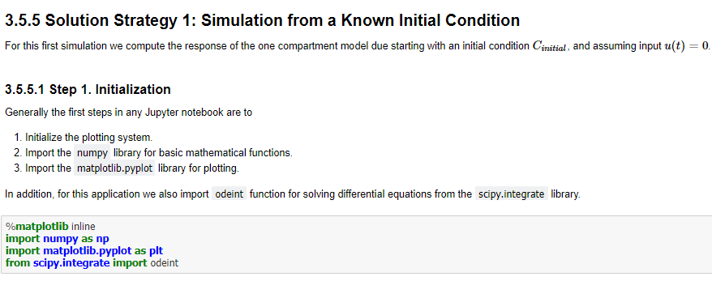
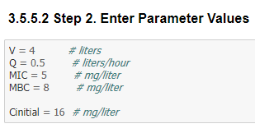
Process Modeling : One Compartment Pharmacokinetics

Slide 22
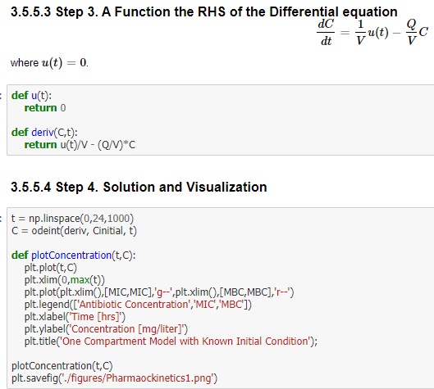
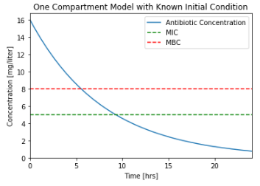
Process Modeling : One Compartment Pharmacokinetics

Slide 23
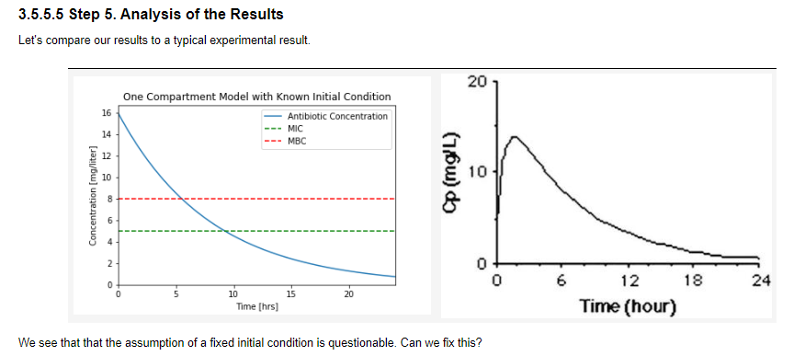
Process Modeling : One Compartment Pharmacokinetics

Slide 24
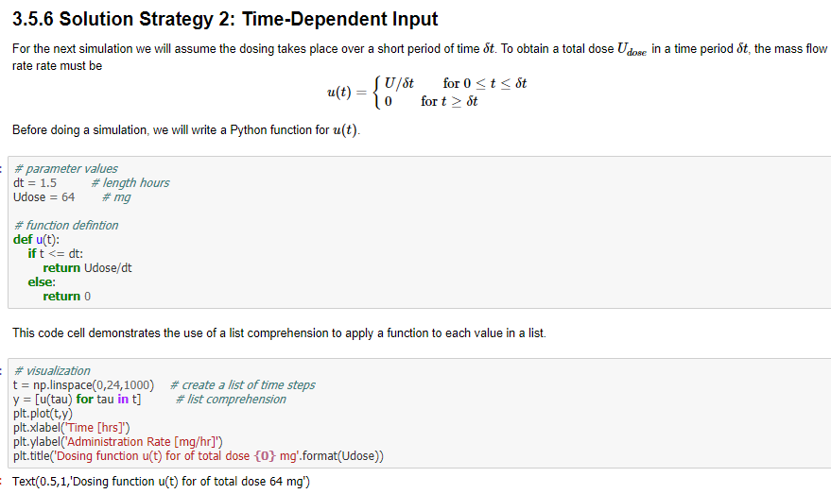
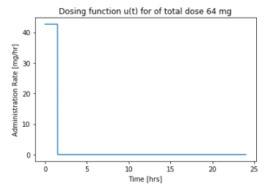
Process Modeling : One Compartment Pharmacokinetics

Slide 25
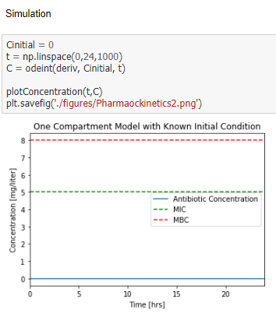
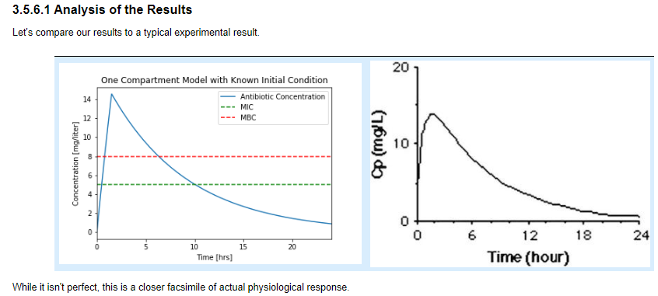
Process Modeling : One Compartment Pharmacokinetics

Slide 26
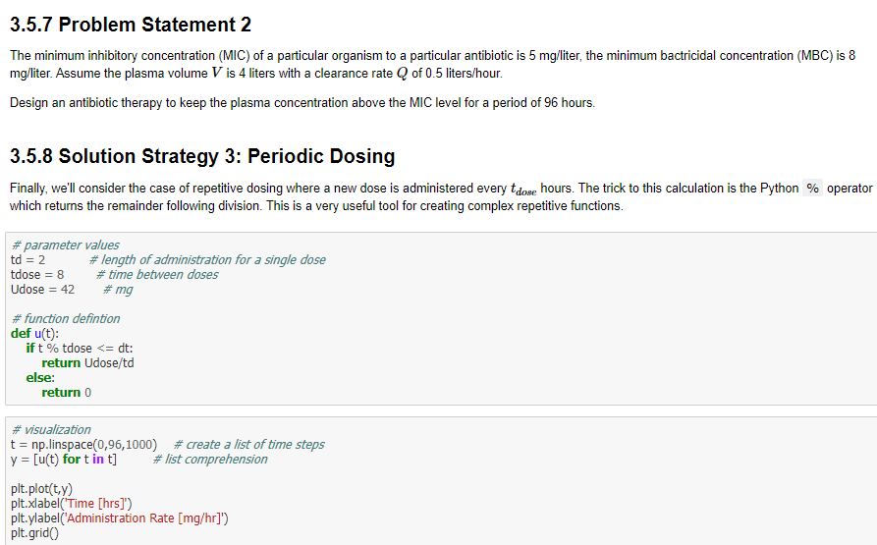
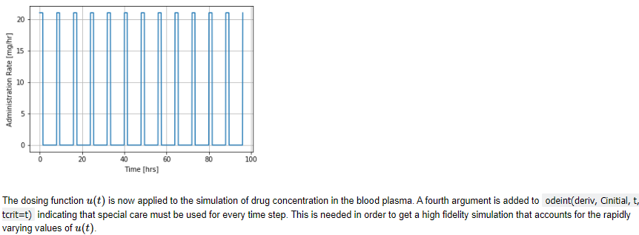
Process Modeling : One Compartment Pharmacokinetics

Slide 27
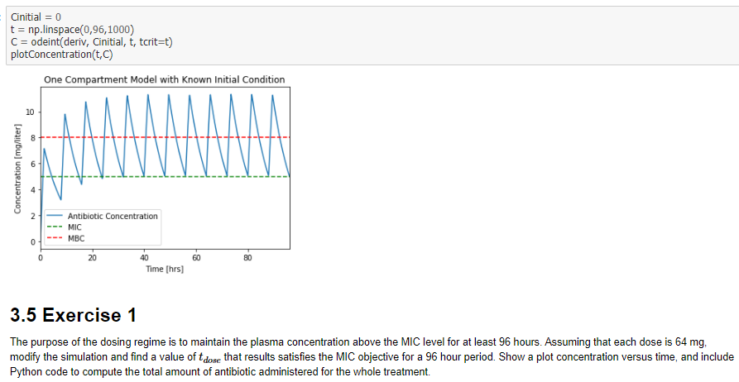
Process Modeling : One Compartment Pharmacokinetics

Slide 28
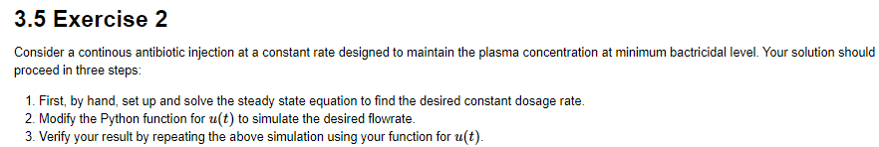
Process Modeling : One Compartment Pharmacokinetics

Slide 29
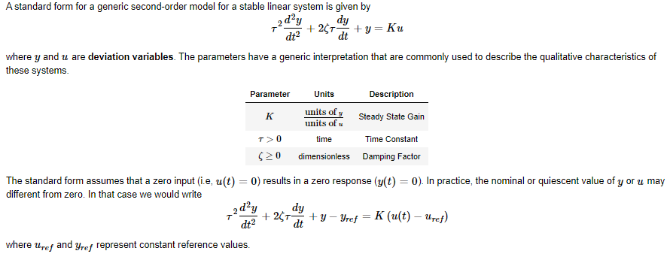
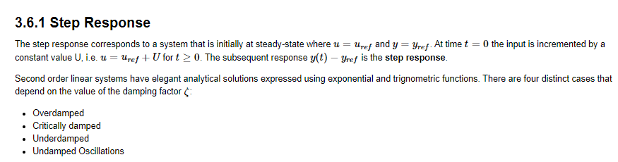
Process Modeling : Second Order Models

Slide 30
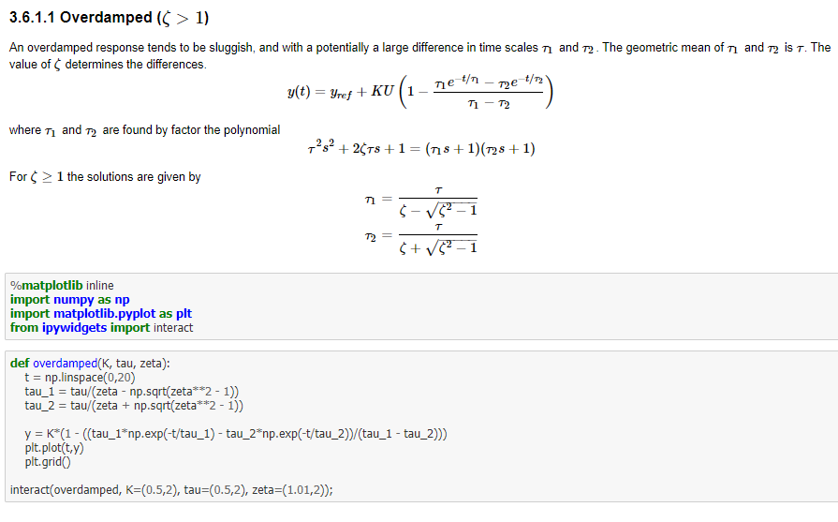
Process Modeling : Second Order Models

Slide 31
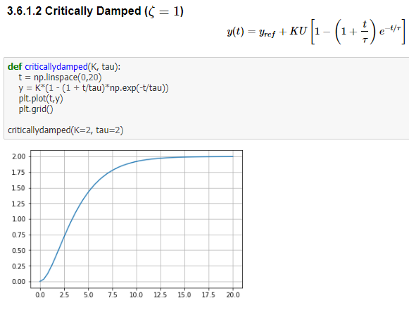
Process Modeling : Second Order Models

Slide 32
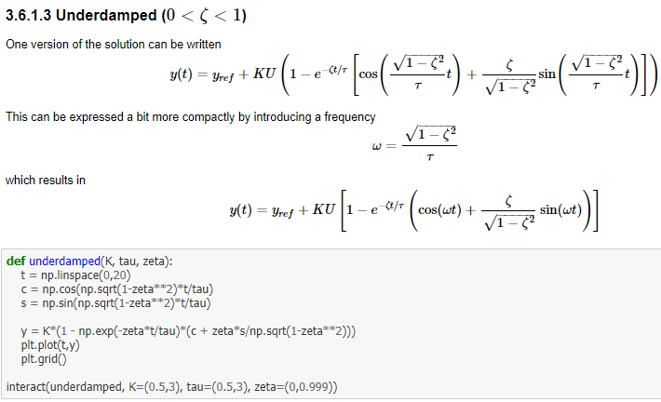
Process Modeling : Second Order Models

Slide 33
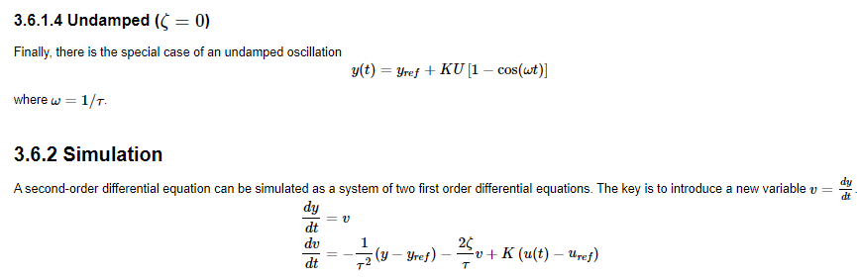

Process Modeling : Second Order Models

Slide 34
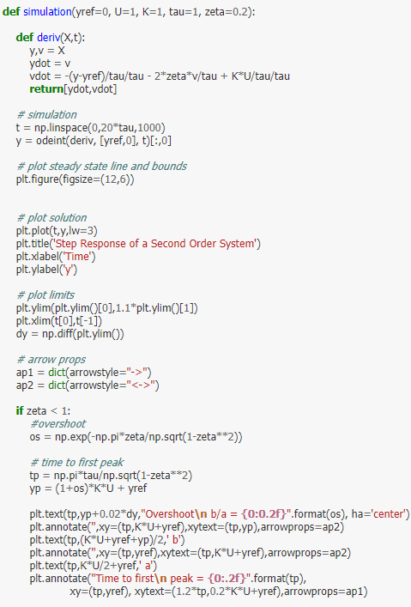
Process Modeling : Second Order Models

Slide 35

Process Modeling : Second Order Models

Slide 36

Process Modeling : Second Order Models

Slide 37



Process Modeling : Second Order Models

Slide 38


Process Modeling : Interacting Tanks

Slide 39


Process Modeling : Interacting Tanks

Slide 40


Process Modeling : Manometer Models and Dynamics

Slide 41

Process Modeling : Manometer Models and Dynamics

Slide 42

Process Modeling : Manometer Models and Dynamics

Slide 43

Process Modeling : Manometer Models and Dynamics

Slide 44


Process Modeling : Manometer Models and Dynamics

Slide 45

Process Modeling : Manometer Models and Dynamics

Slide 46

Process Modeling : Manometer Models and Dynamics

Slide 47

Process Modeling : Manometer Models and Dynamics

Slide 48

Process Modeling : Manometer Models and Dynamics

Slide 49

Process Modeling : Manometer Models and Dynamics

Slide 50

Process Modeling : Manometer Models and Dynamics

Slide 51

Process Modeling : Manometer Models and Dynamics

Slide 52

Process Modeling : Manometer Models and Dynamics

Slide 53

Process Modeling : Manometer Models and Dynamics

Slide 54
Process Modeling : Manometer Models and Dynamics

