Slide 1
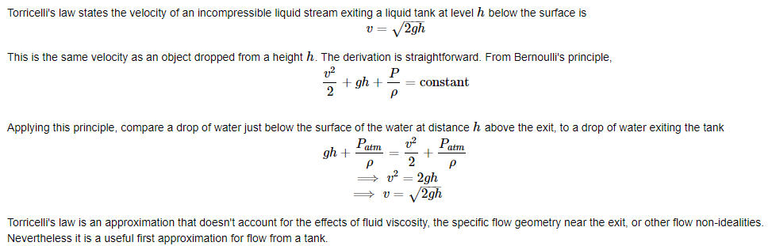
Process Modeling : Gravity Drained Tank
1.Summary
In the example we study the problem of constructing nonlinear process model for the liquid level in a gravity drained tank.
2. Torricelli's law

Slide 2
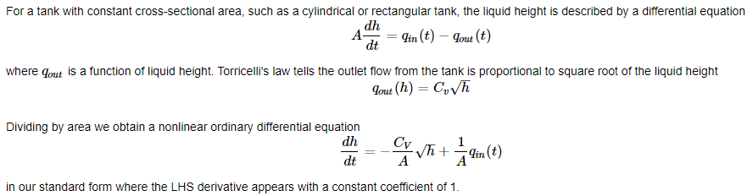
Process Modeling : Gravity Drained Tank
3. Mass Balance for Tank with Constant Cross-Sectional Area
4 Step-by-Step Approach to Nonlinear Simulation
Step 1. Initialize Jupyter and Python
Step 4. Choose an Initial Condition, a Time Grid, and Integrate the Differential Equation
Step 2. Define parameters
Step 5. Visualize and Analyze Results
Step 3. Write Functions for the RHS of the Differential Equations
Step 6. Adjust and Repeat as Needed

Slide 3
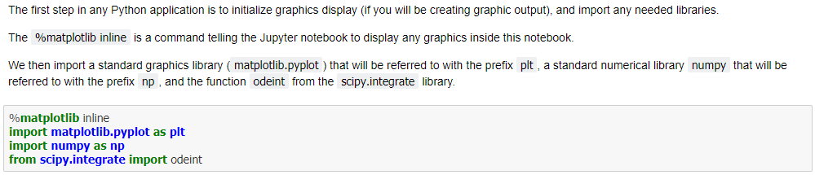
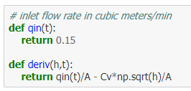
Process Modeling : Gravity Drained Tank
4. Step-by-Step Approach to Nonlinear Simulation
Step 1. Initialize Jupyter and Python
Step 2. Define parameters
Step 3. Write Functions for the RHS of the Differential Equations

Slide 4

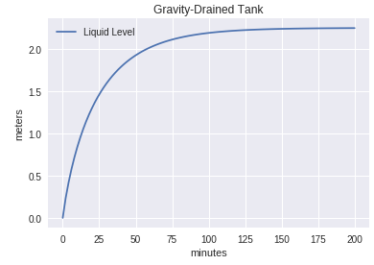
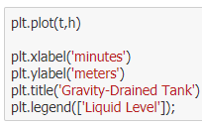
Process Modeling : Gravity Drained Tank
4. Step-by-Step Approach to Nonlinear Simulation
Step 4. Choose an Initial Condition, a Time Grid, and Integrate the Differential Equation
Step 5. Visualize and Analyze Results
Step 6. Adjust and Repeat as Needed

Slide 5
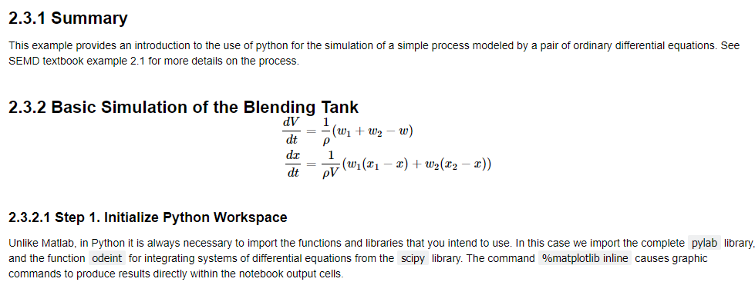
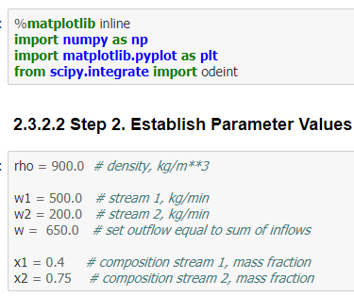
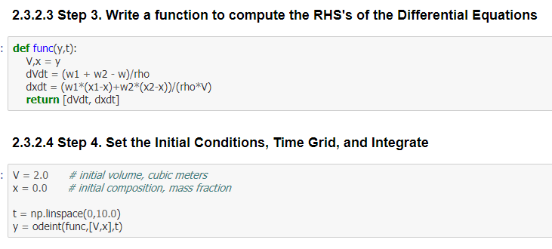
Process Modeling : Blending Tank Simulation

Slide 6
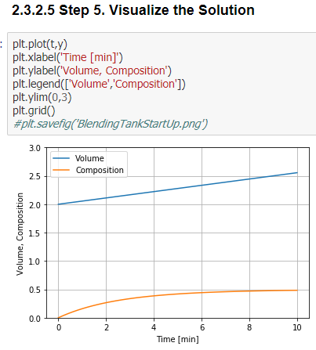
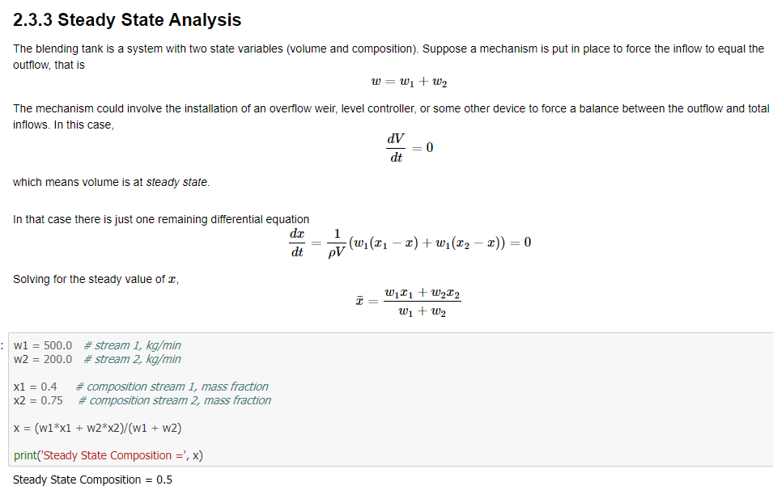
Process Modeling : Blending Tank Simulation

Slide 7
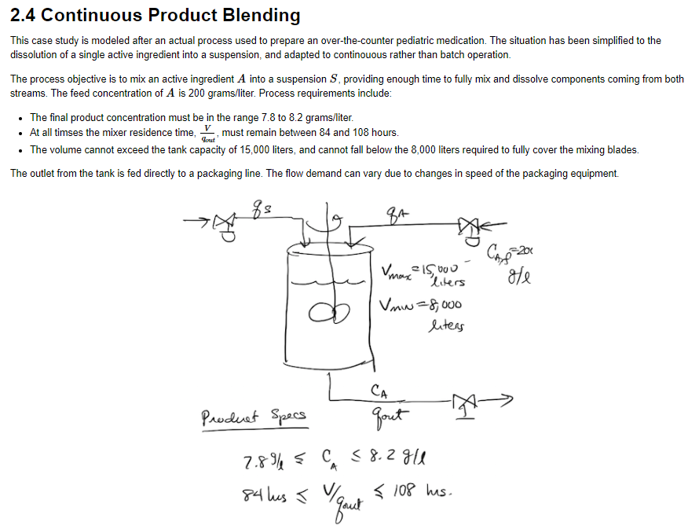
Process Modeling : Continuous Product Blending

Slide 8
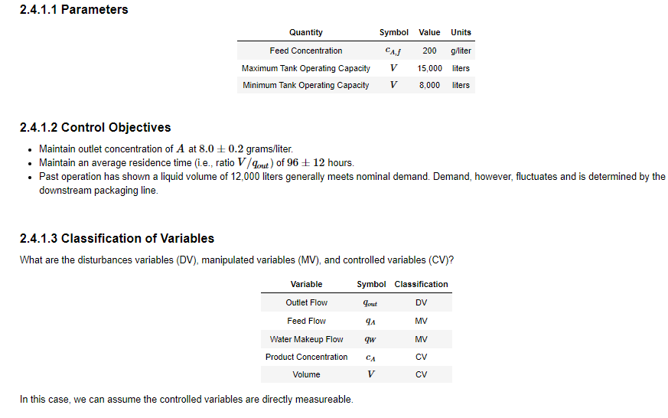
Process Modeling : Continuous Product Blending

Slide 9
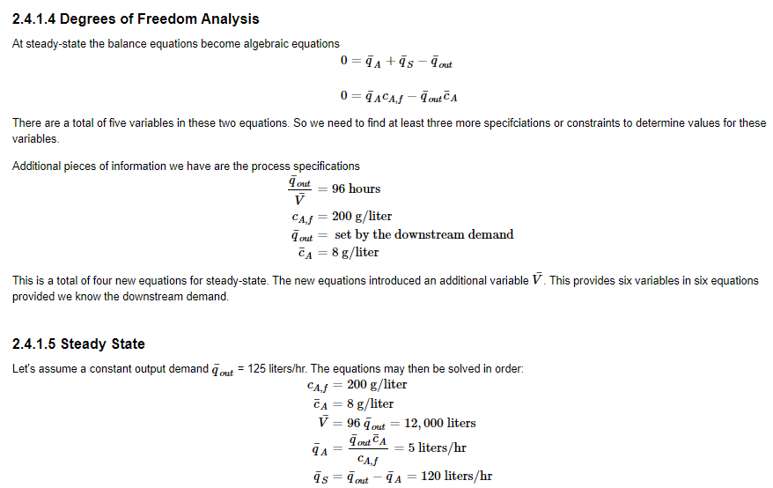
Process Modeling : Continuous Product Blending

Slide 10
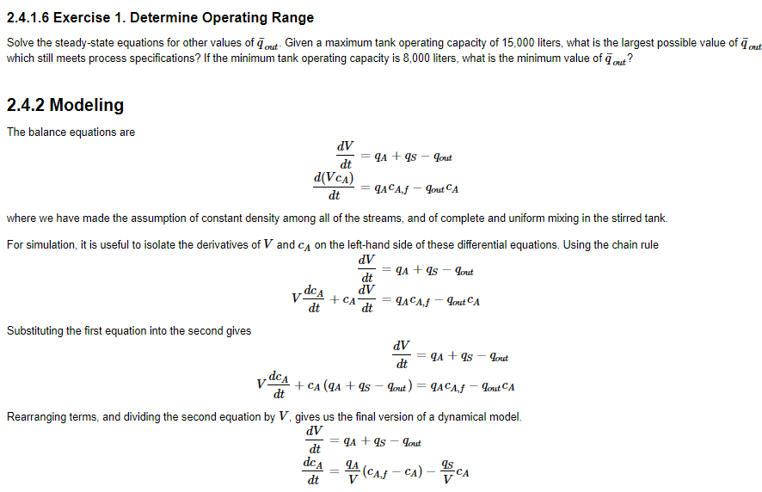
Process Modeling : Continuous Product Blending

Slide 11
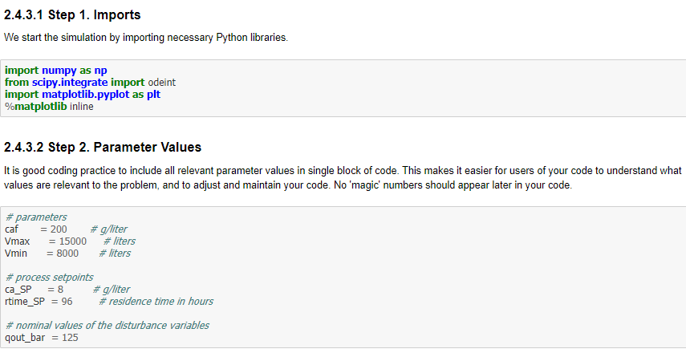
Process Modeling : Continuous Product Blending

Slide 12
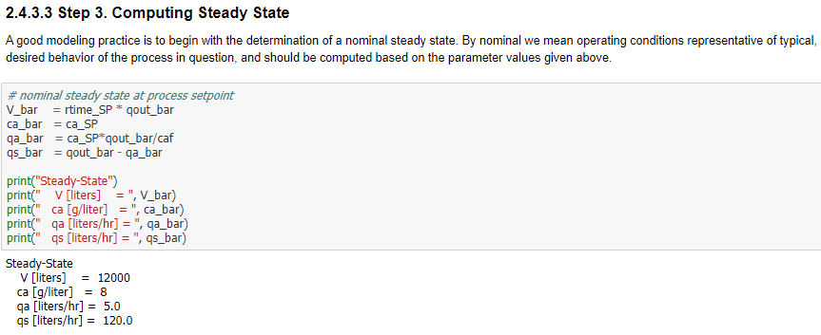
Process Modeling : Continuous Product Blending

Slide 13
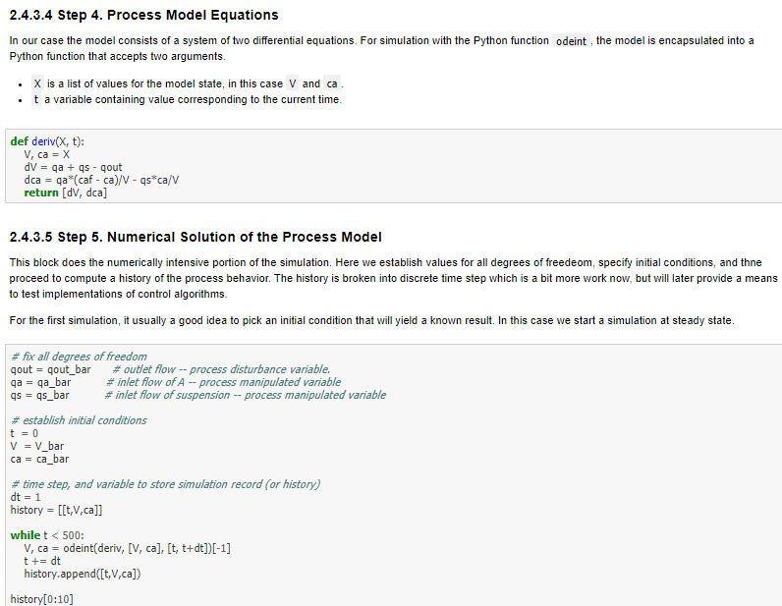
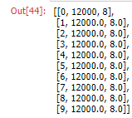
Process Modeling : Continuous Product Blending

Slide 14
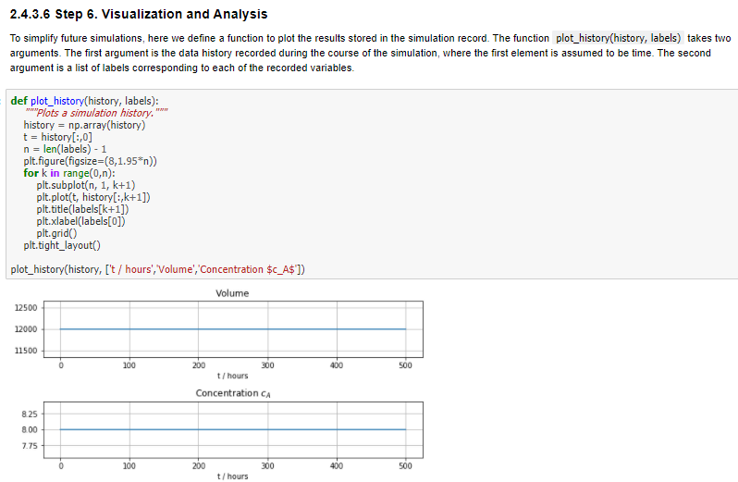
Process Modeling : Continuous Product Blending

Slide 15
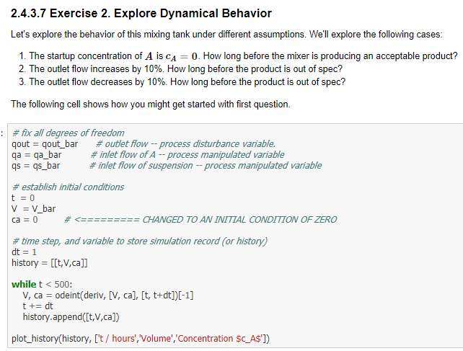
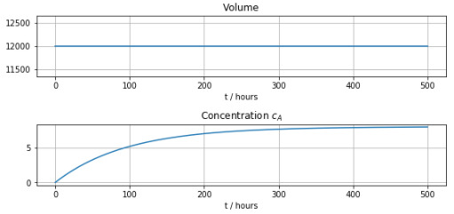
Process Modeling : Continuous Product Blending

Slide 16
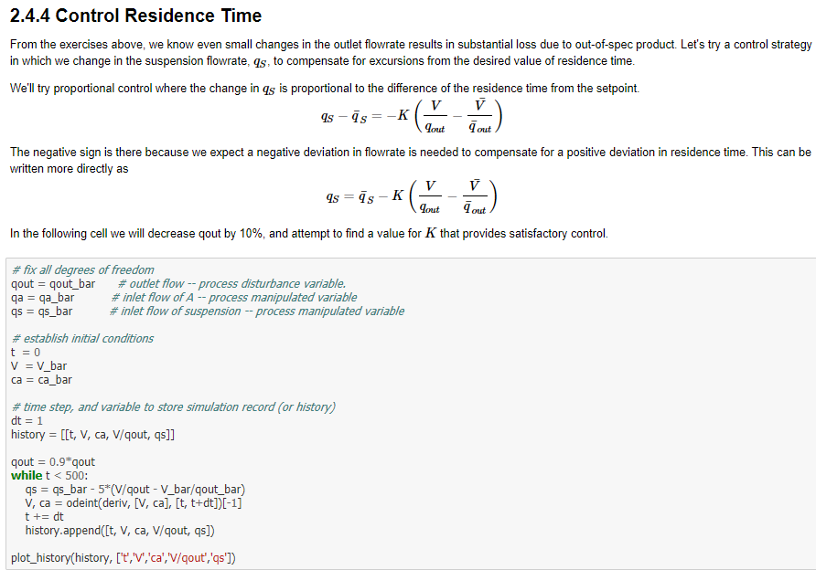
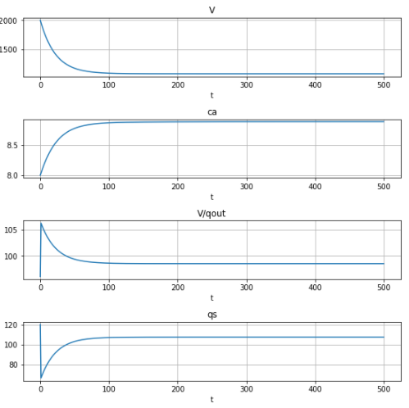
Process Modeling : Continuous Product Blending

Slide 17
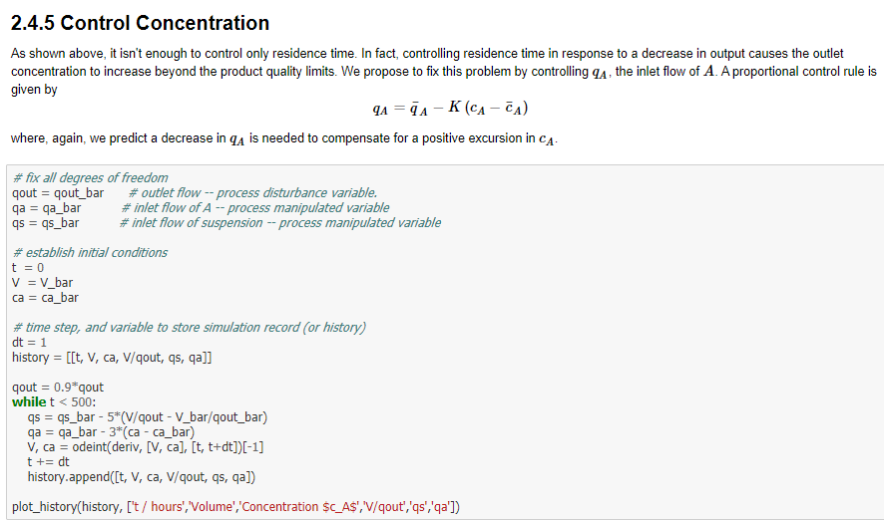
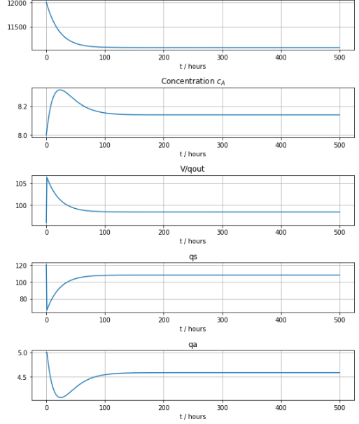
Process Modeling : Continuous Product Blending

Slide 18
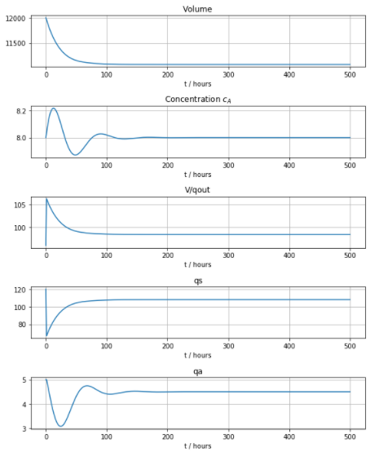
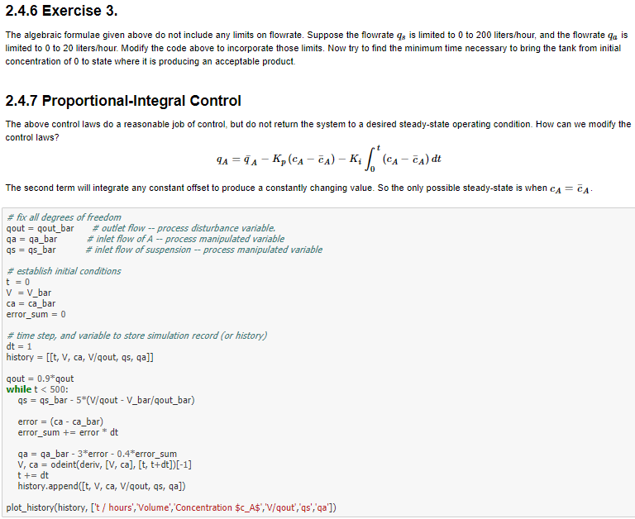
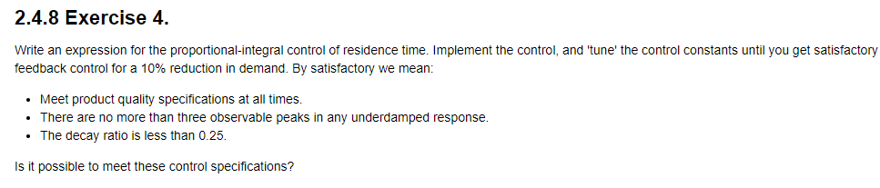
Process Modeling : Continuous Product Blending

Slide 19
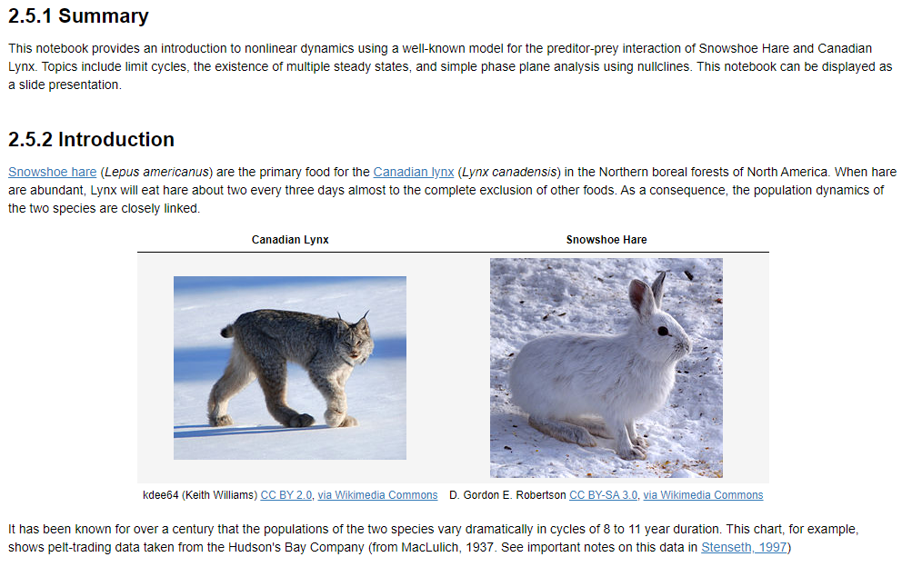
Process Modeling : Hare and Lynx Population Dynamics

Slide 20
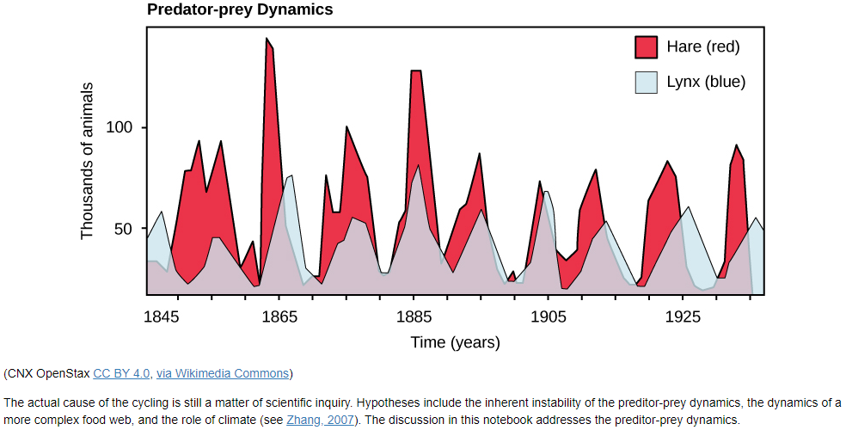
Process Modeling : Hare and Lynx Population Dynamics

Slide 21
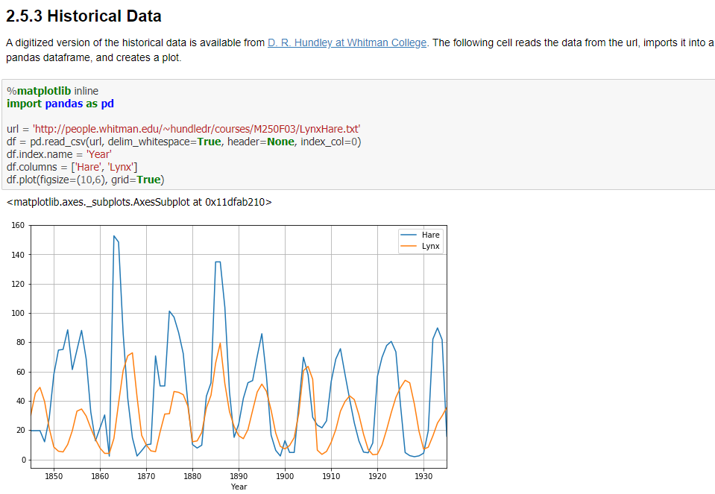
Process Modeling : Hare and Lynx Population Dynamics

Slide 22
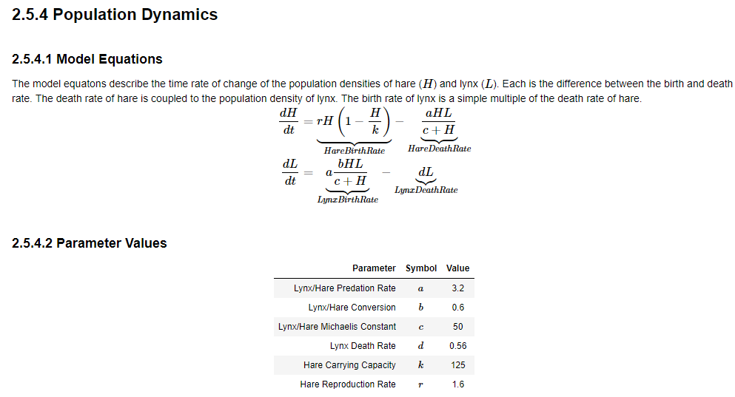
Process Modeling : Hare and Lynx Population Dynamics

Slide 23
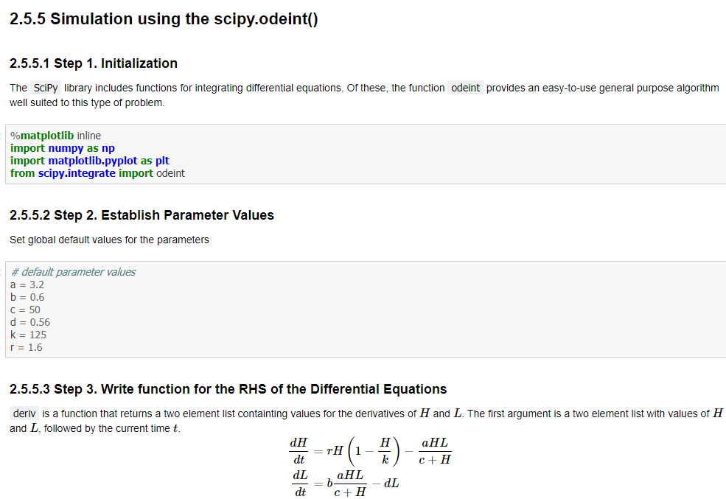
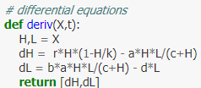
Process Modeling : Hare and Lynx Population Dynamics

Slide 24
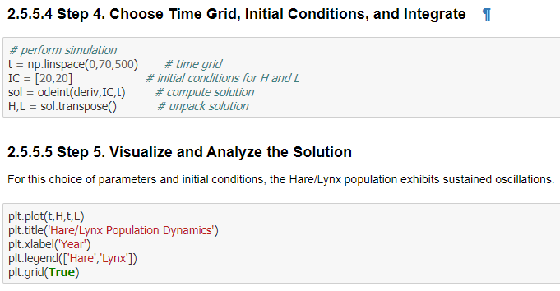
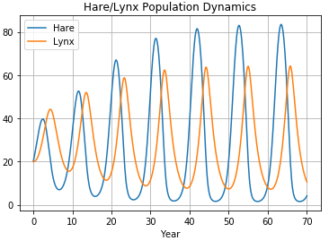
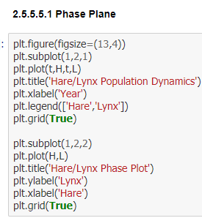
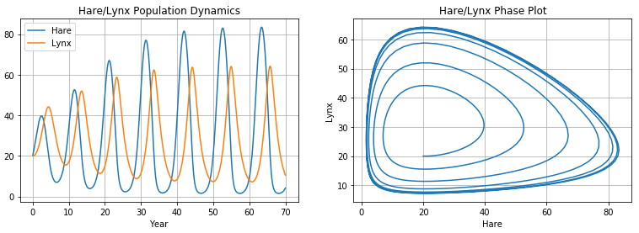
Process Modeling : Hare and Lynx Population Dynamics

Slide 25
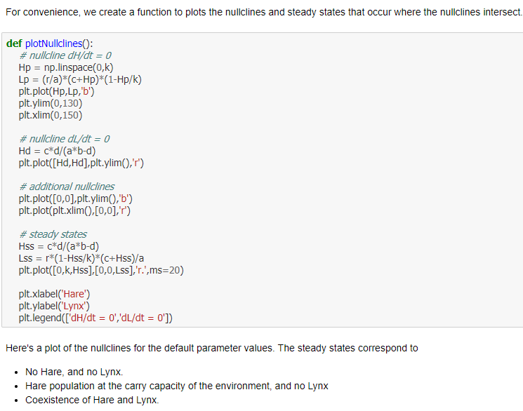
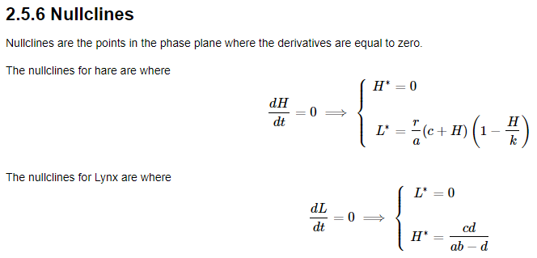
Process Modeling : Hare and Lynx Population Dynamics

Slide 26
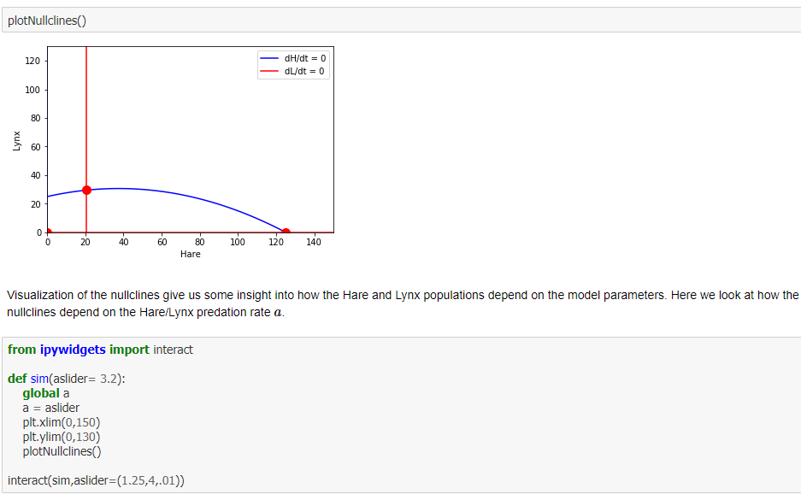
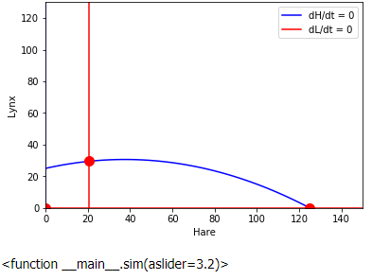
Process Modeling : Hare and Lynx Population Dynamics

Slide 27
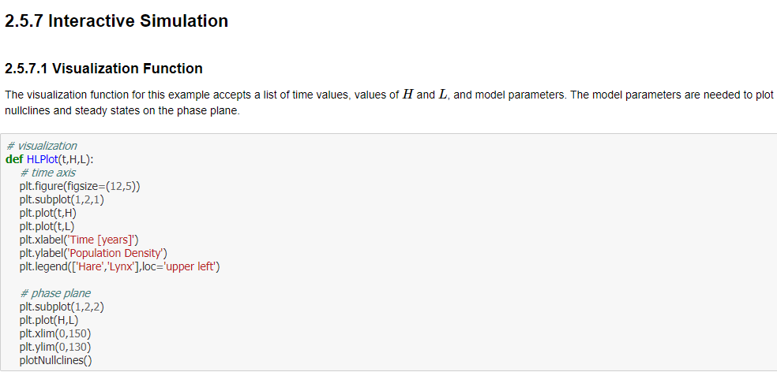
Process Modeling : Hare and Lynx Population Dynamics

Slide 28
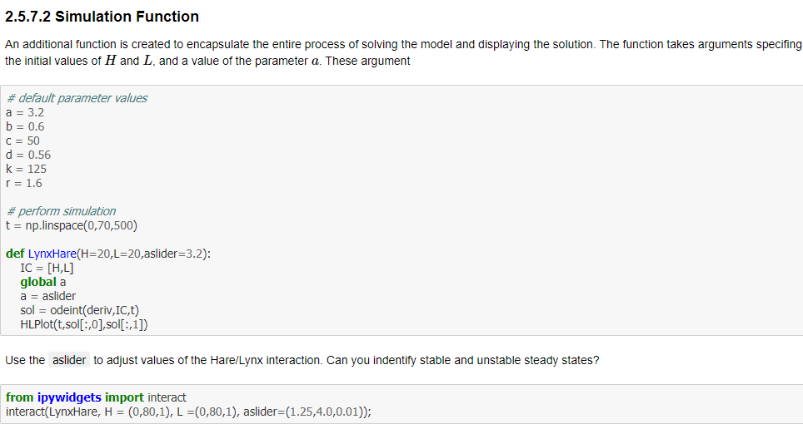
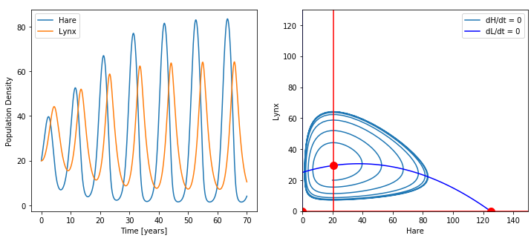
Process Modeling : Hare and Lynx Population Dynamics

Slide 29
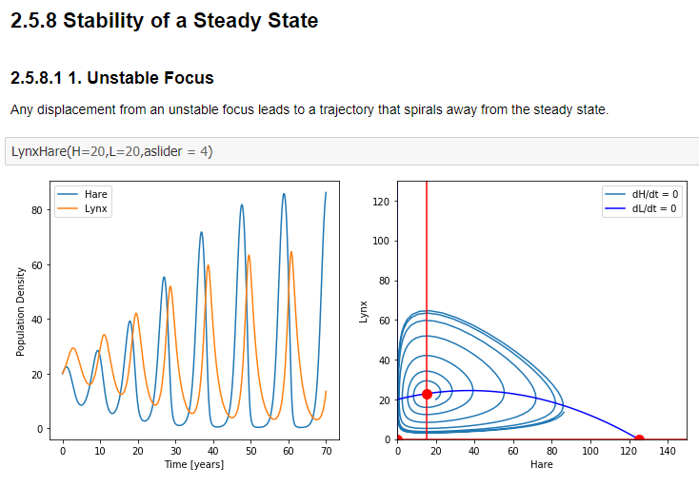
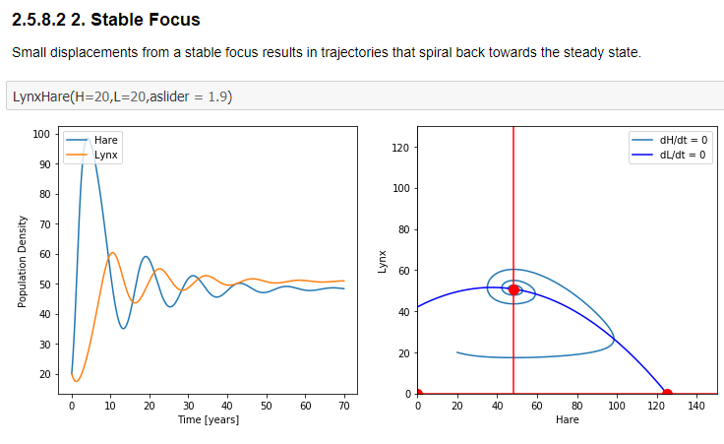
Process Modeling : Hare and Lynx Population Dynamics

Slide 30
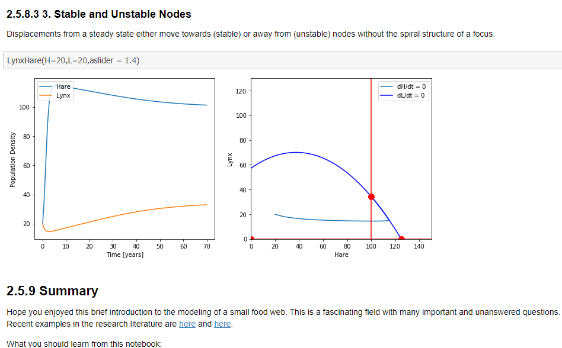
Process Modeling : Hare and Lynx Population Dynamics

Slide 31
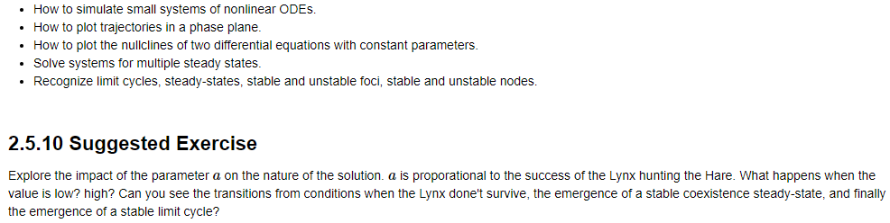
Process Modeling : Hare and Lynx Population Dynamics

Slide 32

Process Modeling : Exothermic Continuous Stirred Tank Reactor

Slide 33


Process Modeling : Exothermic Continuous Stirred Tank Reactor

Slide 34

Process Modeling : Exothermic Continuous Stirred Tank Reactor

Slide 35


Process Modeling : Exothermic Continuous Stirred Tank Reactor

Slide 36



Process Modeling : Exothermic Continuous Stirred Tank Reactor

Slide 37

Process Modeling : Exothermic Continuous Stirred Tank Reactor

Slide 38


Process Modeling : Exothermic Continuous Stirred Tank Reactor

Slide 39


Process Modeling : Exothermic Continuous Stirred Tank Reactor

Slide 40

Process Modeling : Fed-Batch Bioreactor

Slide 41

Process Modeling : Fed-Batch Bioreactor

Slide 42


Process Modeling : Fed-Batch Bioreactor

