Slide 1
Git branch oriented feature toggling
GOFT

Slide 2
Why feature toggling
Pros
Decouple development from release
Runtime configurable feature toggling
a/b testing
…

Slide 3
What is a feature?
Only specifc to the feature toggling context
Has a life span
Not the feature branch we normally talke about
From now on, it is better to differentiate the name:
Feature branch
Story branch
Bug branch
…

Slide 4
Feature toggles life cycle
formalize
In progress
Off
On
deprecate

Slide 5
Cons: tech debts
2 (even 3) manual versions of the same feature:
Old + new feature
New feature
Old feature (in case we switch back)
What about testing?
https://launchdarkly.com/guide/cleanup.html
… a short-lived feature branch off of master(call it pk/awesome-xyz)…
…create a second branch, off of the first (call it cleanup/awesome-xyz) …

Slide 6
How to solve the cons?

Slide 7
Part1: git strategy & hook

Slide 8
master
conflict_detect
feature1
feature2
Push hook
Push early, push often

Slide 9
Push webhook
Get the branch name, committer name and email, SHA
If (branchName.substring(0, 7)===`feature_` || branchName.substring(0, 5)===`master`){
// merging: https://developer.github.com/v3/repos/merging/
Call github to merge the branch into conflict_detect branch
If (success) then
return;// all good
Else
// Update a Reference: https://developer.github.com/v3/git/refs/
call github to rollback the merge (ie. git reset --merge)
call github to create a new unfinished comment
contact the committer with SHA
}
Note: For requests using Basic Authentication or OAuth, you can make up to 5000 requests per hour.

Slide 10
Sanity check
Run full merge from scratch N times/day

Slide 11
Until now, we are confident that there are no conflicts, then we can merge whatever features combination with master by our wish

Slide 12
Part2: elastic CI/CD pipeline

Slide 13
Naming convention
Feature branch name: feature_???
Others branchs: story_???, bug-???
Comment in commit:
Not finished: ??? / Not finished
Finished: finished_???

Slide 14
How many features got finished?
Const branches= Call github to get branches // GET /repos/:owner/:repo/branches
Const featureBranches= branches.filter(branch=>branch.name.substring(0, 7)===`feature);
Const finishedFeatureBranches=[];
featureBranches.forEach(
branchInfo= Call github to get branch info //
If (branchInfo.commit.commit.message .substring(0, 8)===`finished_` )
finishedFeatureBranches.push(branchInfo) // GET /repos/:owner/:repo/branches/:branch
)
return finishedFeatureBranches;

Slide 15
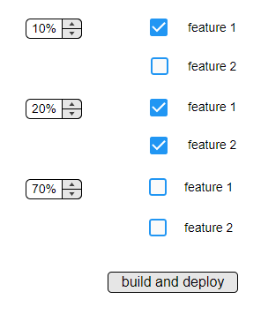
I want
10% user get feature1
20% user get feature1+feature2
70% user without features

Slide 16
Mix and match
master
feature1
feature2
dyna
dyna_feature1
dyna_ feature1_feature2

Slide 17
Groups.forEach(group=>{
const concatName=`dyna_`+ group.selectedFeatureBranches.join(`_`);
// GET /repos/:owner/:repo/branches/:branch
if (exist(concatName)){
// DELETE /repos/:owner/:repo/git/refs/:ref
delete the branch;
}
// POST /repos/:owner/:repo/git/refs
create the branch from master;
group. selectedFeatureBranches.forEach(
// merging: https://developer.github.com/v3/repos/merging/
Call github to merge the selectedFeatureBranche into concatName branch
If (conflict) then {
// Update a Reference: https://developer.github.com/v3/git/refs/
call github to rollback the merge
return;
}
)
Run build// got a artifact with name like dyna_feature1_feature2
}
)
Github api
Bamboo api (https://docs.atlassian.com/bamboo/REST/5.5.0/)
Octopus api
Azure api

Slide 18
Part3: adaptive webpack

Slide 19
git-rev-sync
Const git = require('git-rev-sync');
Const currentBranchName = git.branch();
// feature1

Slide 20
Webpack + multi-compiler
var config = {
// TODO: Add common Configuration
module: {},
};
var indexConfig = {...config, ...{
name: "index",
entry: "./src/index.js",
output: {
path: "./dist",
filename: "index-[hash].js"
},
}};
var appConfig = {...config, ...{
name: "app",
entry: "./src/App.jsx",
output: {
path: `./dist/dyna_${currentBranchName}`,
filename: `app-[hash].js
},
}};
// Return Array of Configurations
module.exports = [
fooConfig, barConfig,
];

Slide 21
Part4: dynamic runtime

Slide 22
Option 1 multi-instances (not bad, but not ideal)
we get 3 artifacts: dyna, dyna_feature1, dyna_ feature1_feature2
Azure instances
Dyna:
Index-hash.js
dyna_feature1:
Index-hash1.js
dyna_ feature1_feature2:
Index-hash12.js
Load balancer?
https://docs.microsoft.com/en-us/azure/load-balancer/load-balancer-distribution-mode
https://blogs.msdn.microsoft.com/benjaminperkins/2016/06/03/setting-application-request-routing-arr-affinity-for-your-azure-app-service/

Slide 23
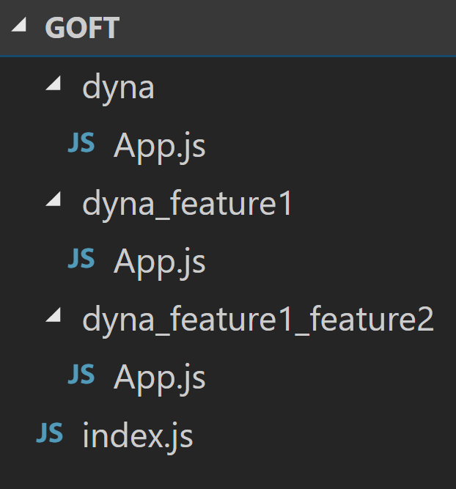
Option2: Dynamic import ( TC39 stage 3) babel-plugin-syntax-dynamic-import, babel-plugin-dynamic-import-webpack, react-loadable https://developers.google.com/web/updates/2017/11/dynamic-import
From build to 1 artifact (mix and match again)
dyna:
Index-hash.js
Dyna/app.js
dyna_feature1:
Index-hash.js
Dyna_feature1/app.js
dyna_ feature1_feature2:
Index-hash.js
Dyna_feature1_feature2/app.js

Slide 24
Index.js
import LoadableVisibility from 'react-loadable-visibility/react-loadable';
const App= LoadableVisibility({
loader: () => import(`./dyna_${features.join(‘_’)}/app`),
// get dyna_feature1_feature2/App.js
loading() {
return <div>Loading...</div>;
}
});
render(
<Provider store={store}>
< App />
</Provider>,
document.getElementById(`root`)
);

Slide 25
Summary
Git strategy & hook
elastic CI/CD pipeline
adaptive webpack
Dynamic runtime
Apparently only happy path considered
Configure is not runtime, but click-build-deploy, still acceptable (for admin)?
Actually feature toggling is runtime (for users)
Advanced: feature dependency, feature before(uncertainty)/after(certainty) login, etc
What about backend?

Slide 26

devops

