Slide 1
Git branch oriented feature toggling
GOFT

Slide 2
Why feature toggling
Pros
Decouple development from release
Runtime configurable feature toggling
a/b testing
…

Slide 3
What is a feature?
Only specifc to the feature toggling context
Has a life span
Not the feature branch we normally talke about
From now on, it is better to differentiate the name:
Feature branch
Story branch
Bug branch
…

Slide 4
Feature toggles life cycle
formalize
In progress
Off
On
deprecate

Slide 5
Cons: tech debts
2 (even 3) manual versions of the same feature:
Old + new feature
New feature
Old feature (in case we switch back)
What about testing?
https://launchdarkly.com/guide/cleanup.html
… a short-lived feature branch off of master(call it pk/awesome-xyz)…
…create a second branch, off of the first (call it cleanup/awesome-xyz) …

Slide 6
How to solve the cons?

Slide 7
Part1: git strategy & hook

Slide 8
master
conflict_detect
feature1
feature2
Push hook
Push early, push often

Slide 9
Push webhook
Get the branch name, committer name and email, SHA
If (branchName.substring(0, 7)===`feature_` || branchName.substring(0, 5)===`master`){
// merging: https://developer.github.com/v3/repos/merging/
Call github to merge the branch into conflict_detect branch
If (success) then
return;// all good
Else
// Update a Reference: https://developer.github.com/v3/git/refs/
call github to rollback the merge (ie. git reset --merge)
call github to create a new unfinished comment
contact the committer with SHA
}
Note: For requests using Basic Authentication or OAuth, you can make up to 5000 requests per hour.

Slide 10
Sanity check
Run full merge from scratch N times/day, unit test, e2e test, build

Slide 11
Until now, we are confident that there are no conflicts, then we can merge whatever features combination with master by our wish

Slide 12
Part2: elastic CI/CD pipeline

Slide 13
Naming convention
Feature branch name: feature_???
Others branchs: story_???, bug-???
Comment in commit:
Not finished: ??? / Not finished
Finished: finished_???

Slide 14
How many features got finished?
Const branches= Call github to get branches // GET /repos/:owner/:repo/branches
Const featureBranches= branches.filter(branch=>branch.name.substring(0, 7)===`feature);
Const finishedFeatureBranches=[];
featureBranches.forEach(
branchInfo= Call github to get branch info //
If (branchInfo.commit.commit.message .substring(0, 8)===`finished_` )
finishedFeatureBranches.push(branchInfo) // GET /repos/:owner/:repo/branches/:branch
)
return finishedFeatureBranches;

Slide 15
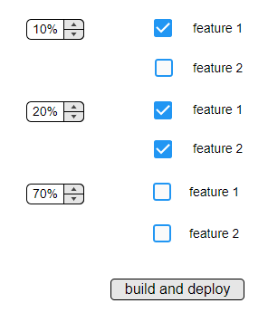
I want
10% user get feature1
20% user get feature1+feature2
70% user without features

Slide 16
Mix and match
master
feature1
feature2
dyna
dyna_feature1
dyna_ feature1_feature2

Slide 17
Groups.forEach(group=>{
const concatName=`dyna_`+ group.selectedFeatureBranches.join(`_`);
// GET /repos/:owner/:repo/branches/:branch
if (exist(concatName)){
// DELETE /repos/:owner/:repo/git/refs/:ref
delete the branch;
}
// POST /repos/:owner/:repo/git/refs
create the branch from master;
group. selectedFeatureBranches.forEach(
// merging: https://developer.github.com/v3/repos/merging/
Call github to merge the selectedFeatureBranche into concatName branch
If (conflict) then {
// Update a Reference: https://developer.github.com/v3/git/refs/
call github to rollback the merge
return;
}
)
Run build// got a artifact with name like dyna_feature1_feature2
}
)
Github api
Bamboo api (https://docs.atlassian.com/bamboo/REST/5.5.0/)
Octopus api
Azure api

Slide 18
Part3: adaptive webpack

Slide 19
git-rev-sync
Const git = require('git-rev-sync');
Const currentBranchName = git.branch();
// feature1

Slide 20
Webpack + multi-compiler
var config = {
// TODO: Add common Configuration
module: {},
};
var indexConfig = {...config, ...{
name: "index",
entry: "./src/index.js",
output: {
path: "./dist",
filename: "index-[hash].js"
},
}};
var appConfig = {...config, ...{
name: "app",
entry: "./src/App.jsx",
output: {
path: `./dist/dyna_${currentBranchName}`,
filename: `app-[hash].js
},
}};
// Return Array of Configurations
module.exports = [
fooConfig, barConfig,
];

Slide 21
Part4: dynamic runtime

Slide 22
Option 1 multi-instances (not bad, but not ideal)
we get 3 artifacts: dyna, dyna_feature1, dyna_ feature1_feature2
Azure instances
Dyna:
Index-hash.js
dyna_feature1:
Index-hash1.js
dyna_ feature1_feature2:
Index-hash12.js
Load balancer?
https://docs.microsoft.com/en-us/azure/load-balancer/load-balancer-distribution-mode
https://blogs.msdn.microsoft.com/benjaminperkins/2016/06/03/setting-application-request-routing-arr-affinity-for-your-azure-app-service/

Slide 23
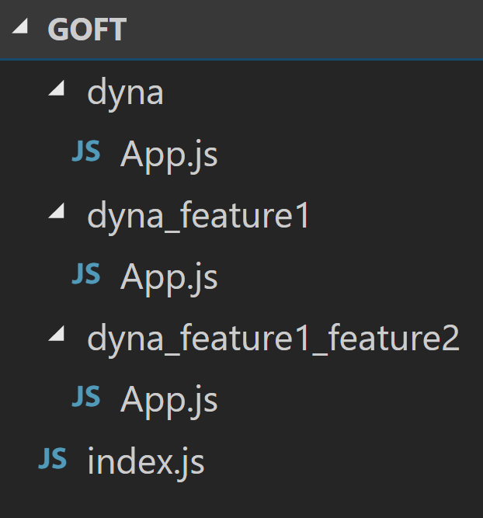
Option2: Dynamic import ( TC39 stage 3) babel-plugin-syntax-dynamic-import, babel-plugin-dynamic-import-webpack, react-loadable https://developers.google.com/web/updates/2017/11/dynamic-import
From build to 1 artifact (mix and match again)
dyna:
Index-hash.js
Dyna/app.js
dyna_feature1:
Index-hash.js
Dyna_feature1/app.js
dyna_ feature1_feature2:
Index-hash.js
Dyna_feature1_feature2/app.js

Slide 24
Index.js
import LoadableVisibility from 'react-loadable-visibility/react-loadable';
const App= LoadableVisibility({
loader: () => import(`./dyna_${features.join(‘_’)}/app`),
// get dyna_feature1_feature2/App.js
loading() {
return <div>Loading...</div>;
}
});
render(
<Provider store={store}>
< App />
</Provider>,
document.getElementById(`root`)
);

Slide 25
Summary
Git strategy & hook
elastic CI/CD pipeline
adaptive webpack
Dynamic runtime
Apparently only happy path considered
Configure is not runtime, but click-build-deploy, still acceptable (for admin)?
Actually feature toggling is runtime (for users)
Advanced: feature dependency, feature before(uncertainty)/after(certainty) login, etc
What about backend?

Slide 26

devops

